Slide 1
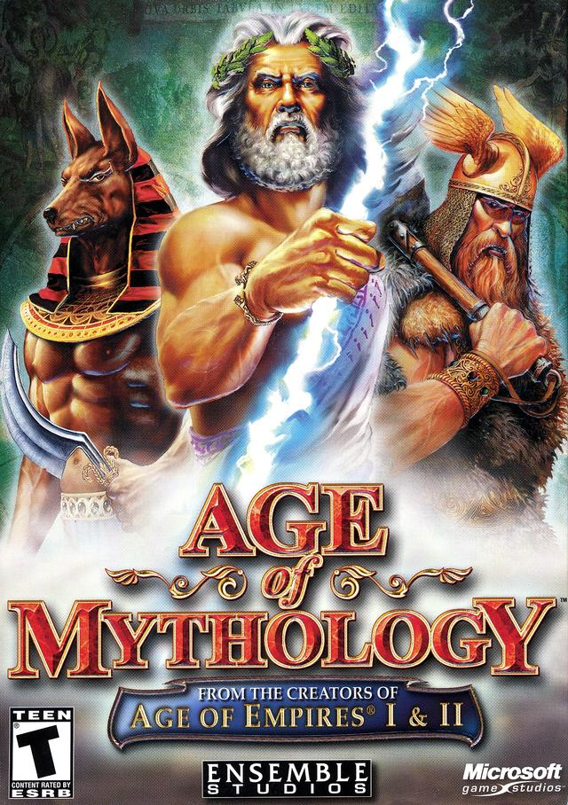
AGE OF MYTHOLOGY
DEVELOPER: ENSEMBLE STUDIOS
PUBLISHER: MICROSOFT GAME STUDIOS
TYPE OF GAME: REAL TIME STRATEGY
PRICE: $29.99

Slide 2
HARDWARE REQUIREMENTS MINIMUM RECOMMENDED
OS: Windows 7, 8.1+
Processor: 2.6 Ghz
Memory: 4 GB RAM
Graphics: Direct X 11+
DirectX: Version 11
Storage: 5 GB available space
Additional Notes: GeForce 9800GTX, Radeon 4850+
OS: Windows 7, 8.1+
Processor: 1.6 Ghz
Memory: 1 GB RAM
Graphics: Direct X 10+ Capable GPU
DirectX: Version 10
Storage: 3 GB available space
Sound Card: Direct X Compatible Sound Card
Additional Notes: GPU at least (Integrated HD 3000, 8600GT, etc.)

Slide 3
GAME SUMMARY
Age of Mythology is a RTS that incorporates Greek, Egyptian, and Norse mythology
Campaign follows Arkantos, an Atlantean general, who hunts the cyclops Gargarensis. Follows him through each of the game’s mythological backgrounds
The player takes control of units and structures of their own color, and work at taking objectives or killing the enemies

Slide 4
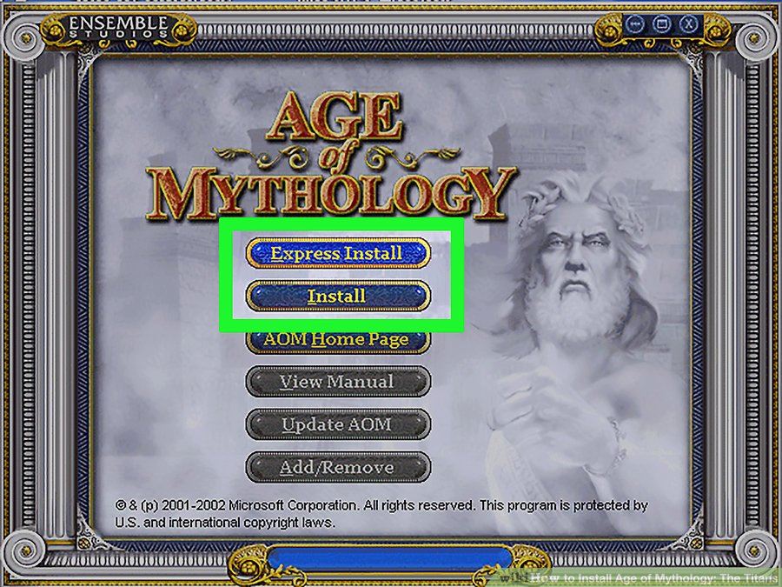
INSTALLATION AND USER INTERFACE
Archaic, Classical, Heroic, Mythic

Slide 5
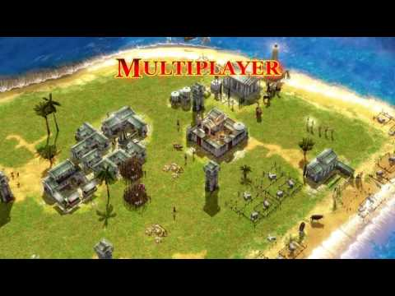
GAMEPLAY

Slide 6
SCORING

Slide 7
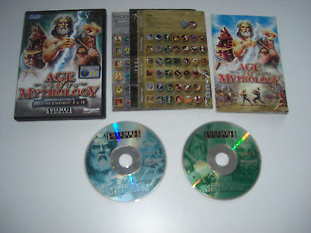
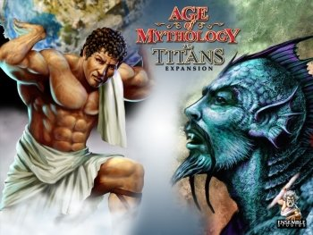
ARTWORK, SOUND, MUSIC, AND MANUAL ARTIST: LANCE HOKE COMPOSERS: STEPHEN RIPPY, KEVIN MCMULLAN

Slide 8
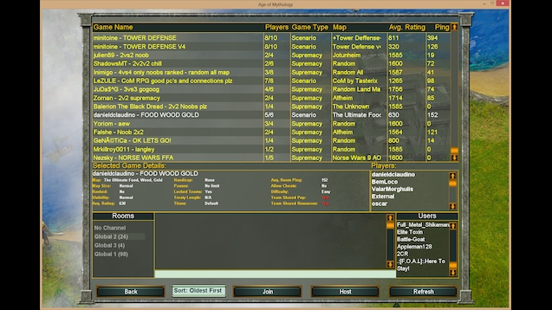
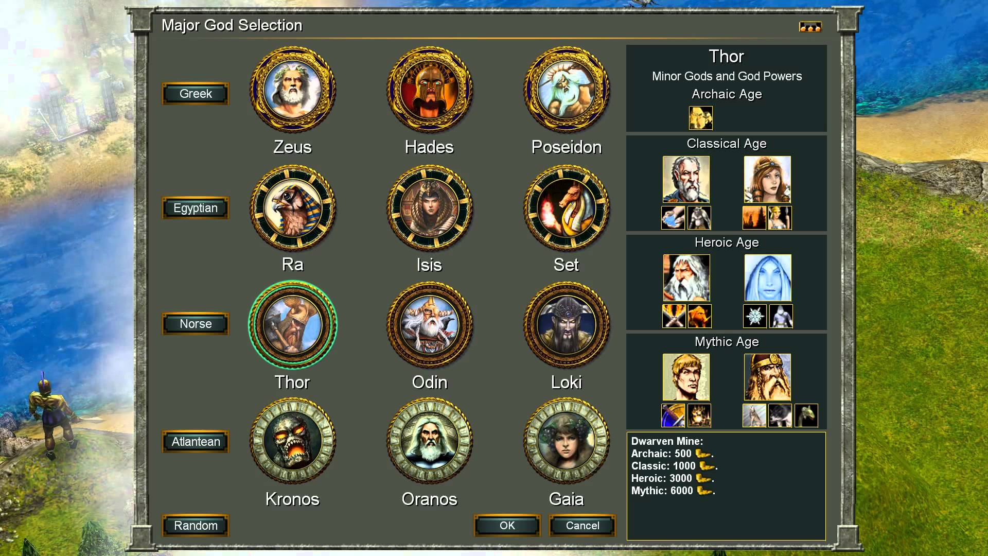
WHAT IS FUN ABOUT THE GAME?
Has one of the best RTS campaigns (immersive, good story telling/gameplay)
Unique level design
Introduction of lesser gods
New type of resource
Custom games
Level Creator

Slide 9
WHAT IS BAD ABOUT THE GAME?
Poor optimization
Lack of updates/balancing
Shrinking community size
Small amount of bugs

Slide 10
HOW DOES IT COMPARE TO SIMILAR GAMES IN THE SAME GENRE/WHY IS IT BETTER OR WORSE THAN SIMILAR GAMES?
Similar games: Age of Empires, Rise of Nations, Starcraft, Halo Wars, Total Rome
Old game, graphics don’t hold up to newer RTS’s
Compared to non “Age of” games, gameplay is simpler and easier to start playing
Similar to other RTS’s due to how hard it is to master

Slide 11
WHAT IS THE APPROPRIATE AUDIENCE FOR THIS GAME?
Appropriate audience is 16+
Average player age is around 25

Slide 12
ARE ANY DESIGN MISTAKES PRESENT?
Level creator isn’t bug tested
New DLC “Tale of the Dragon” wasn’t bug tested, seemed like a money grab

Slide 13
OVERALL STRENGTHS WEAKNESSES
Strengths: Easy to start playing, phenomenal storytelling/story depth, level creator/custom games, and satisfying gameplay
Weaknesses: Lack of updates, unpatched bugs, unpolished DLC

Slide 14
IS GAME WORTH PURCHASING/ HOW COULD IT BE IMPROVED?
Game is worth full price, getting on sale is much better though
Continuation of updates would incredibly improve the game
Another graphics update might make it more appealing

