Slide 1
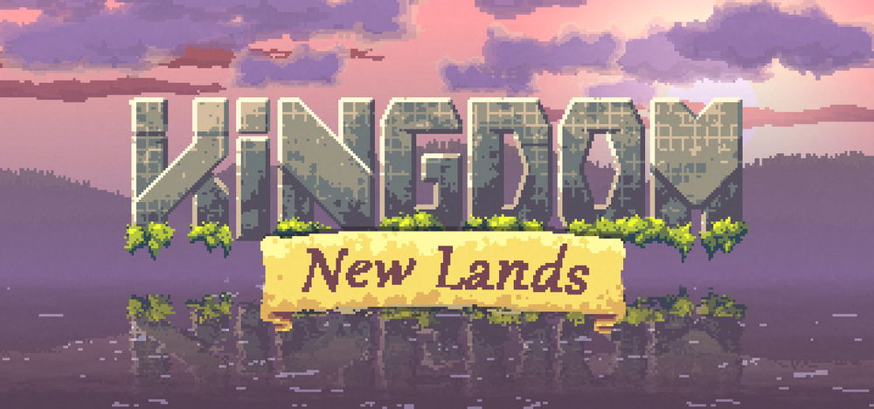

Slide 3
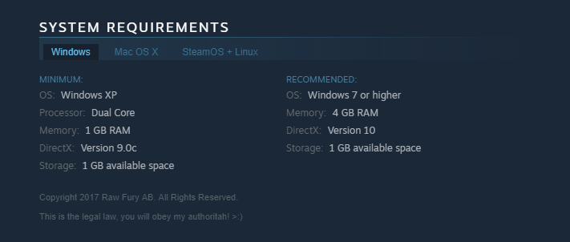
Game Trailer:https://youtu.be/YCkhhwvKz2sl
Price:
App store: $9.99
Steam: $14.99
Occasionally on sale

Slide 4
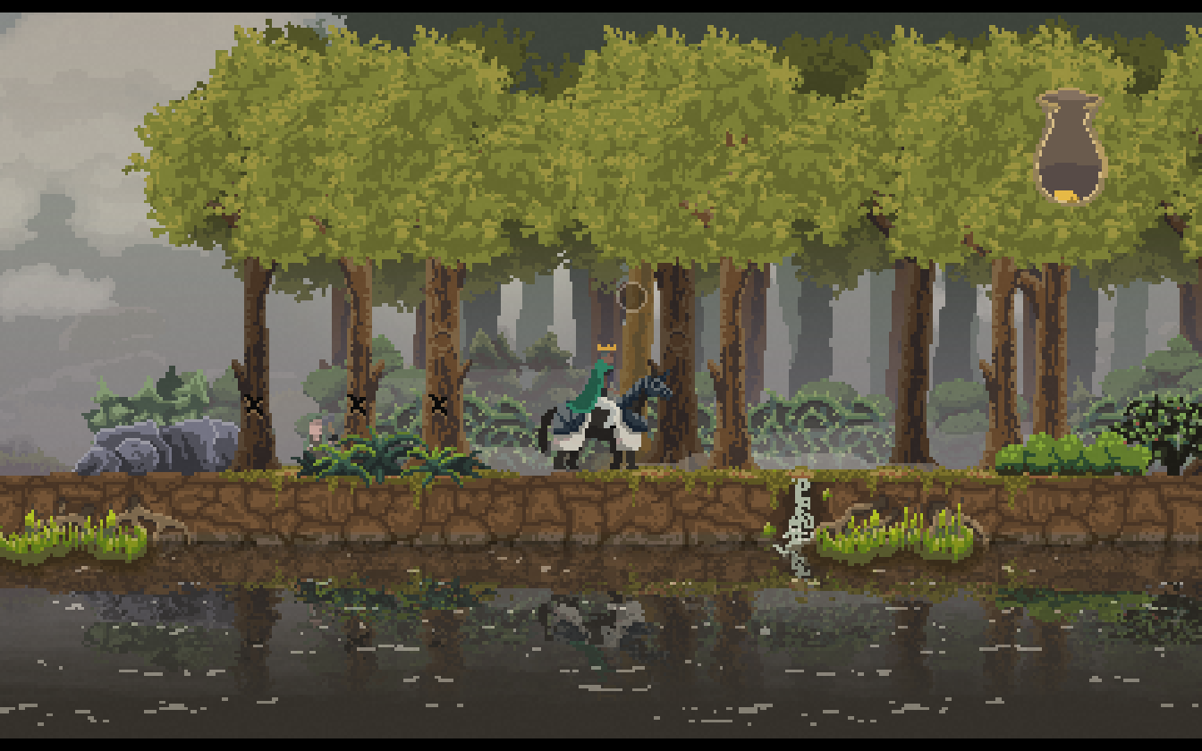
Overview:
Everything about this game is simple.
The player: King/Queen of the realm, decide where to spend coins. Don’t get hit by greedlings!
Coins: AI villagers work for coin, but also generate coins with their jobs.
The controls: left, right, down, enter.
No real score, just survive.

Slide 5
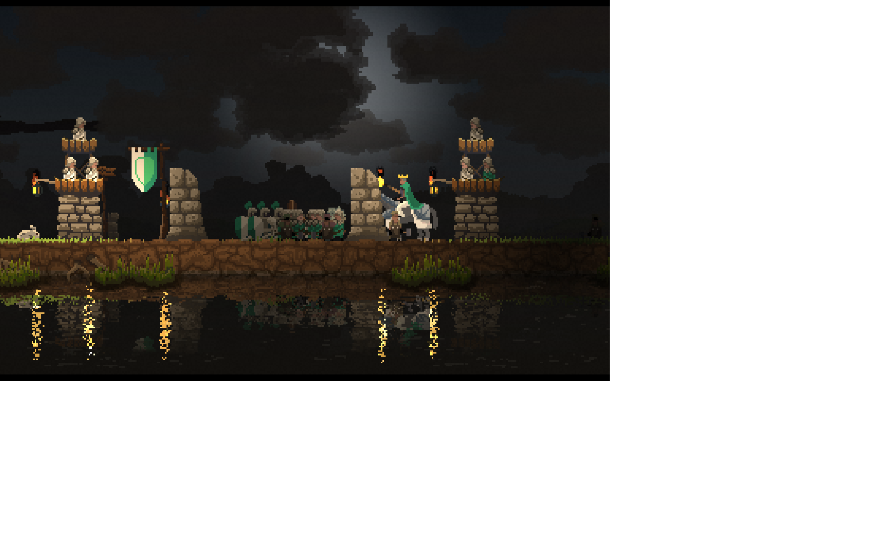
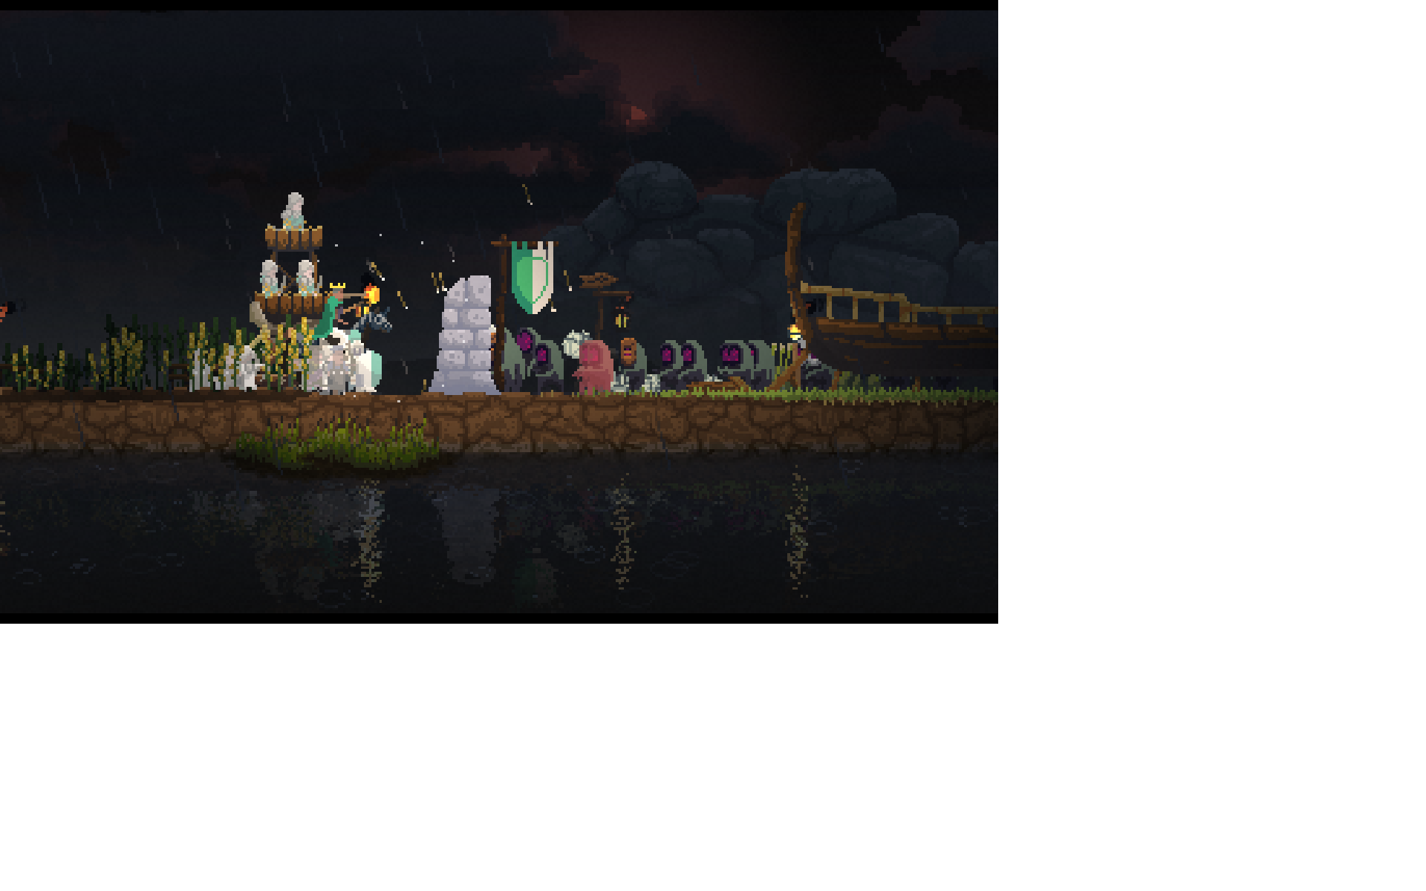
The Review:
This game does a lot of things right; over 90% positive feedback on steam.
With very little direction you come across different objects in the game and wonder how to implement them, or what they are, this makes the exploration fun.
The "greedlings", your opponent, are sufficiently creepy, and dangerous.
Each island presents its own challenges, and they are not identical between each play through.
There is no loading, a single state game, so when you die you restart from the beginning. A great or horrible mechanic.

Slide 6
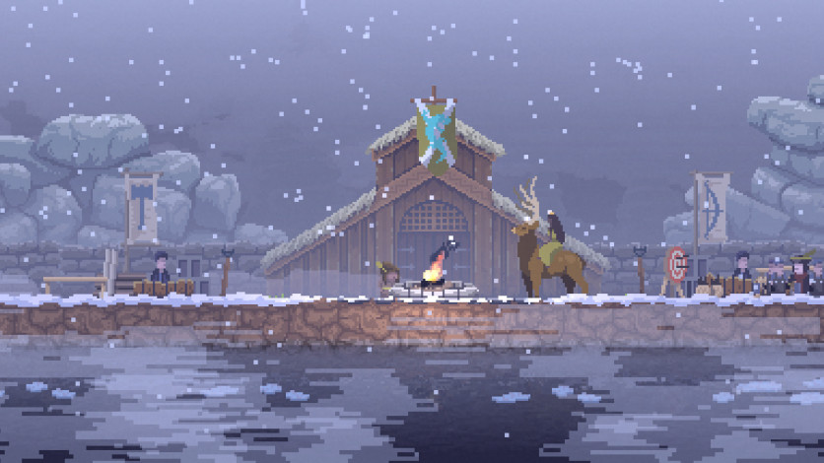
The Review:
There is no loading, a single state game, so when you die you restart from the beginning. A great or horrible mechanic.
I am not aware of other games that are the same as this, so this game does a good job of differentiation and sticking to its vision.
Its hard to say the small amount of information given about the elements of the game is a bad thing, but I did end up looking at the wiki for more information.
As recommended I feel this is a good game for ages 9+
I have not noticed any "mistakes" in the game

Slide 7
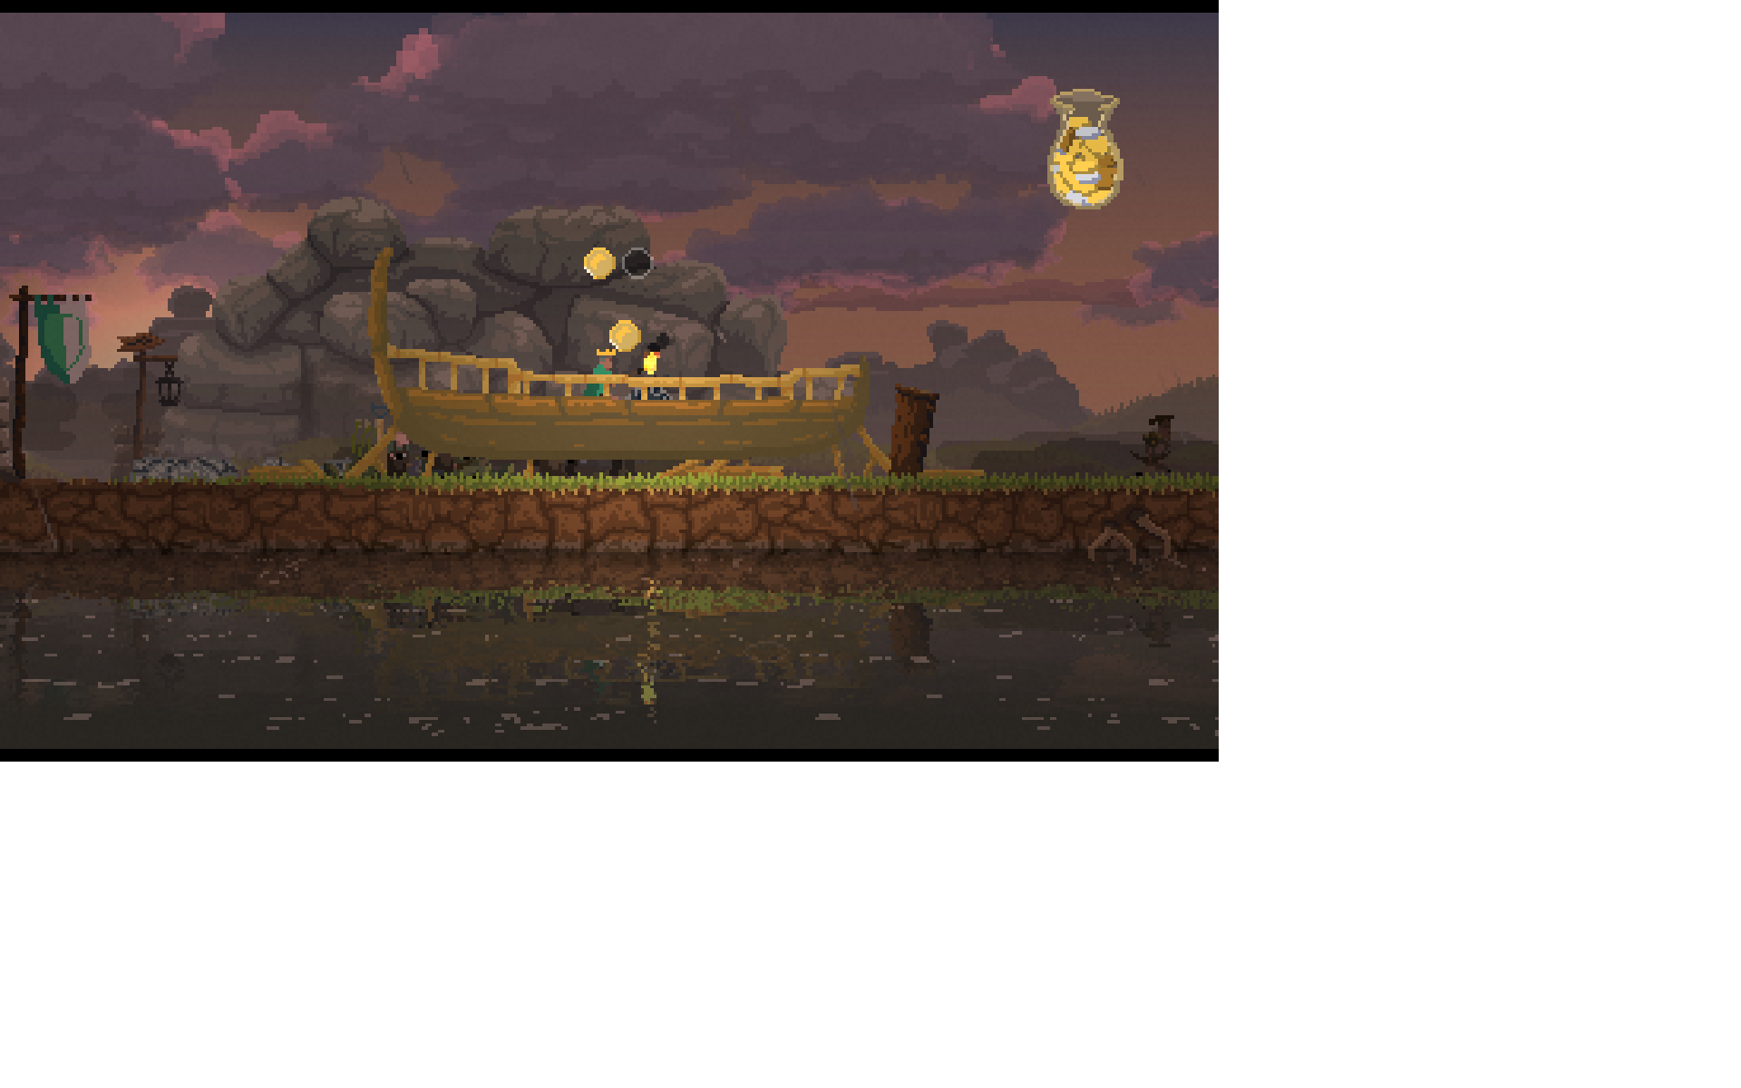
How could it be improved?
This game has a high level of achievement, and so any "improvement" might be a deviation from the idea. However, between gaming sessions you might lose track of what is on the island you are currently working on, a map might help.
Other ideas: In trying to reach all islands I kind of lost track of the overall goal... or if there is one. At this point I have not beaten the game.

Slide 8
In the end, I would say this game is worth buying and playing, especially when it goes on special for 75% off.

