Slide 1
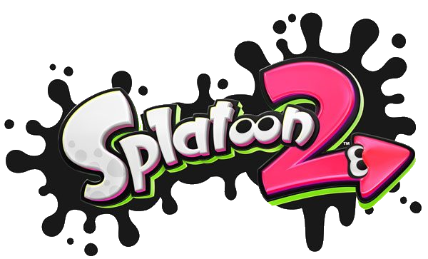
Splatoon 2: A Game Review
Christopher Thompson
CIS 487
18 September 2017

Slide 2
Basic Info
Title: Splatoon 2
Author/Company: Nintendo
Game Type: Third Person Shooter
Price: $59.99 USD
Minimum Requirements: N/A
Hardware Required:
Nintendo Switch
Splatoon 2 Game (Digital/Physical Cartridge)
Joy-Con Controllers (pair) or
Nintendo Switch Pro Controller
Wi-Fi/LAN Internet Connection

Slide 3
Overview
Third Person Shooter based around “inking turf”
Characters are called “Inklings,” a squid-human hybrid
Consists of several game modes
Single Player campaign
Multiplayer 4v4 battles (online)
Salmon Run (online)
Local Multiplayer
Victory varies with each mode
Installation is simple:
Purchase physical cartridge and insert into system
Download digital title from Nintendo eShop
No visible bugs, and no manual present

Slide 4
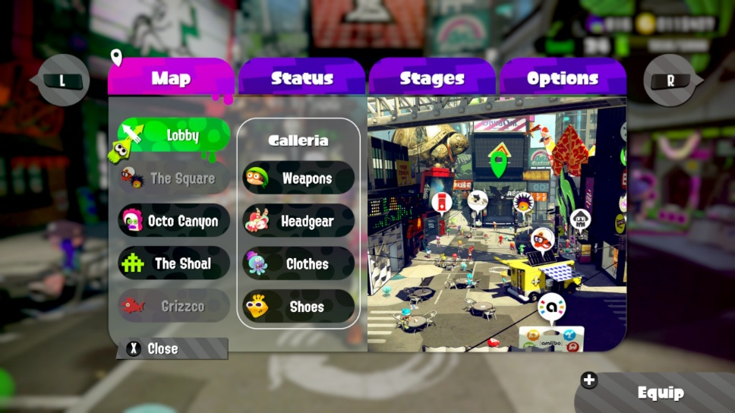
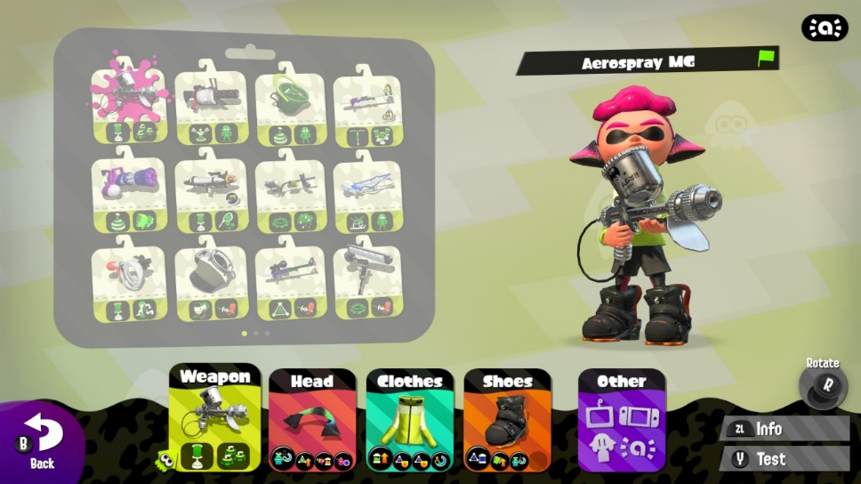
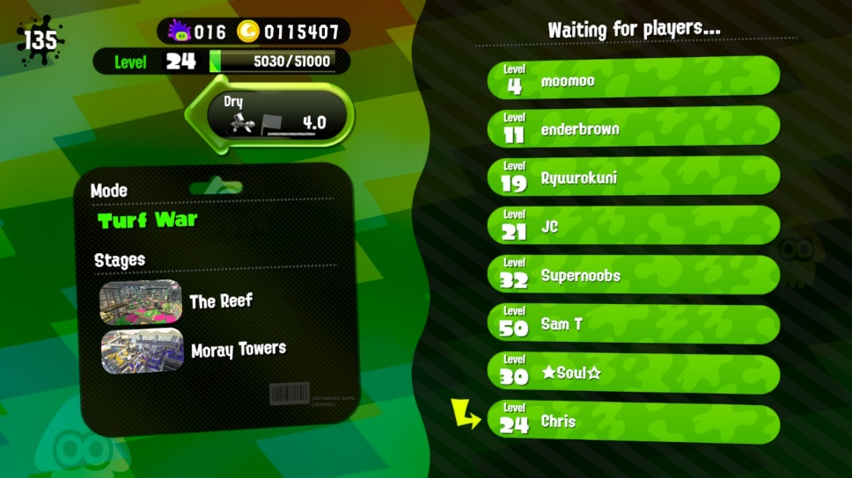
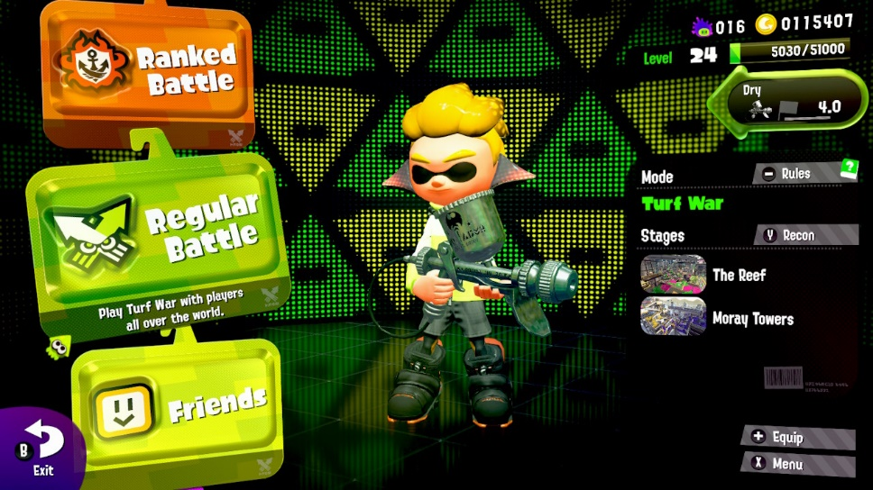
User Interface – A Visual Guide

Slide 5
Story Line
Found in Single Player Campaign
Once again, the evil Octolings have stolen the Great Zapfish
You are “Agent 4,” tasked with stopping them
Single Player campaign has 32 levels
Five are bosses
Each level has a smaller Zapfish to collect

Slide 6
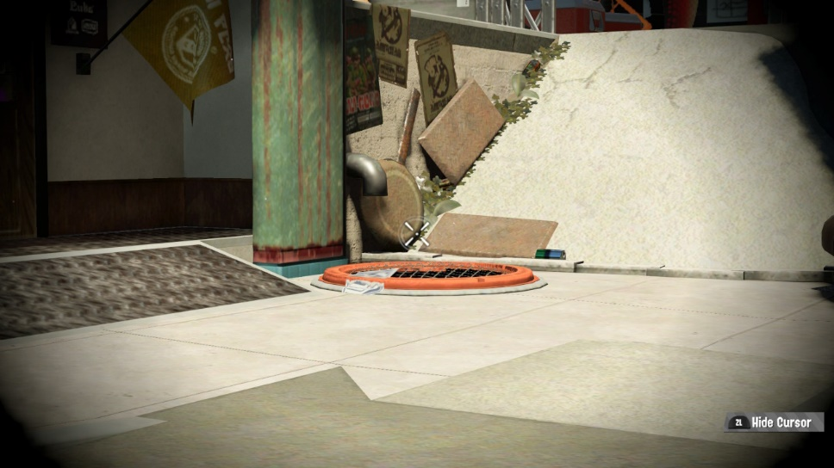
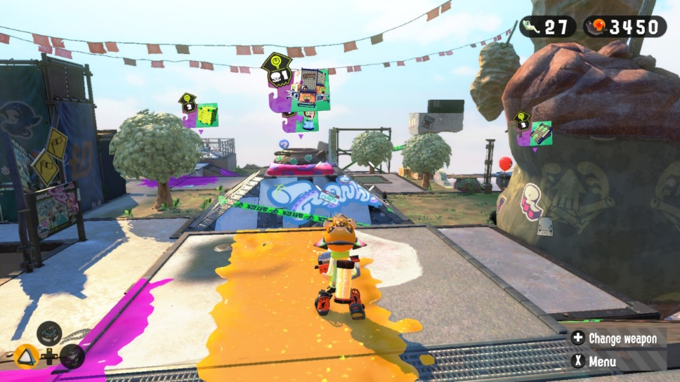
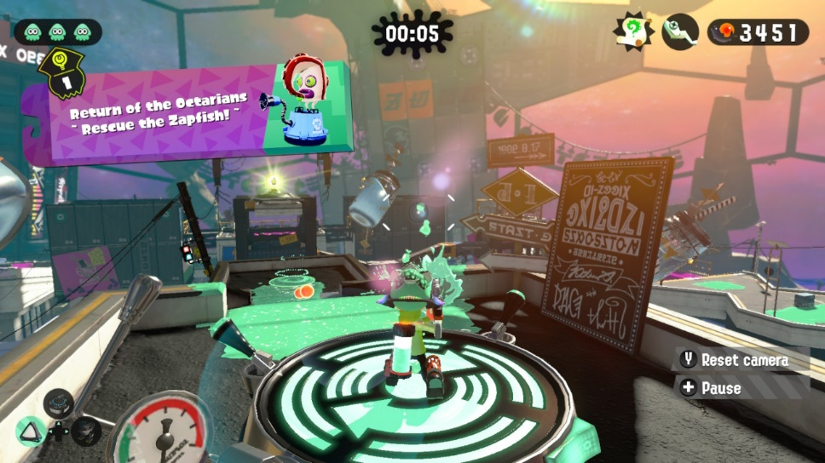
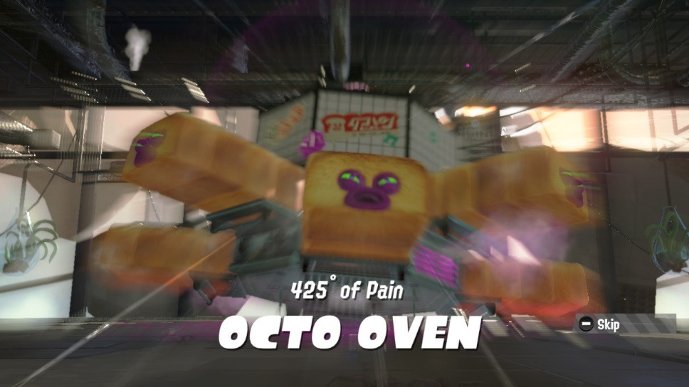
Gallery: Single Player

Slide 7
Online and Local Play: Multiplayer
Regular Battles
Turf War
Ink as much turf as possible
“Splat” opposing players to send them back to their spawn
Winner declared after 3 minutes of play
The team with the most turf inked wins
Ranked/League Battles
Splat Zones
Like Turf War, but with specific areas of battle
Teams compete for control, ticking down their timer
The team with the longest period of control wins
If either team depletes their timer completely, they win
Rainmaker and Tower Control
Move a special weapon or tower to opposing territory
Each mode has different rules
Tower stops at “checkpoints” on the way to the goal
Rainmaker carrier can be splatted
Closest team after 5 minutes wins
If either team reaches the goal before time expires, they win

Slide 8
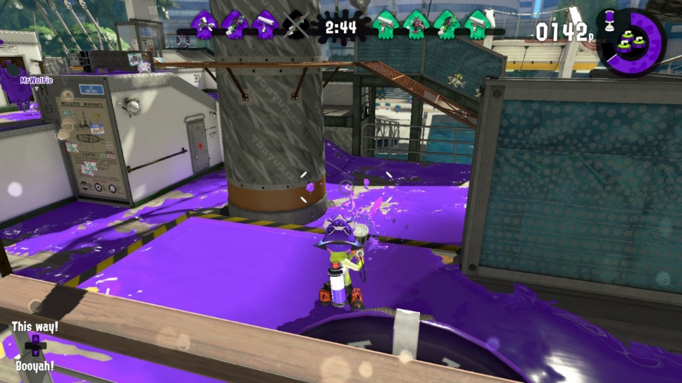
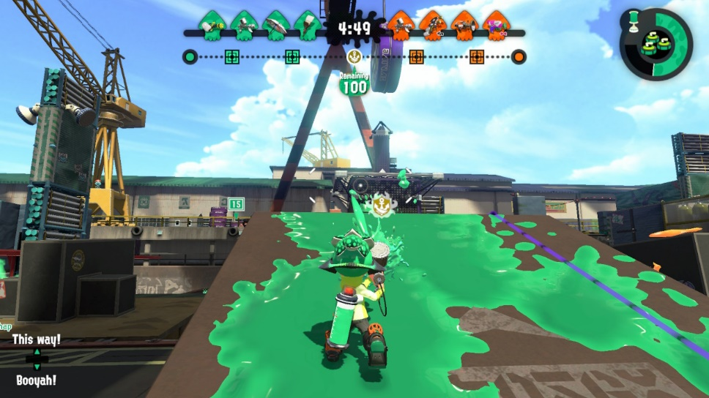
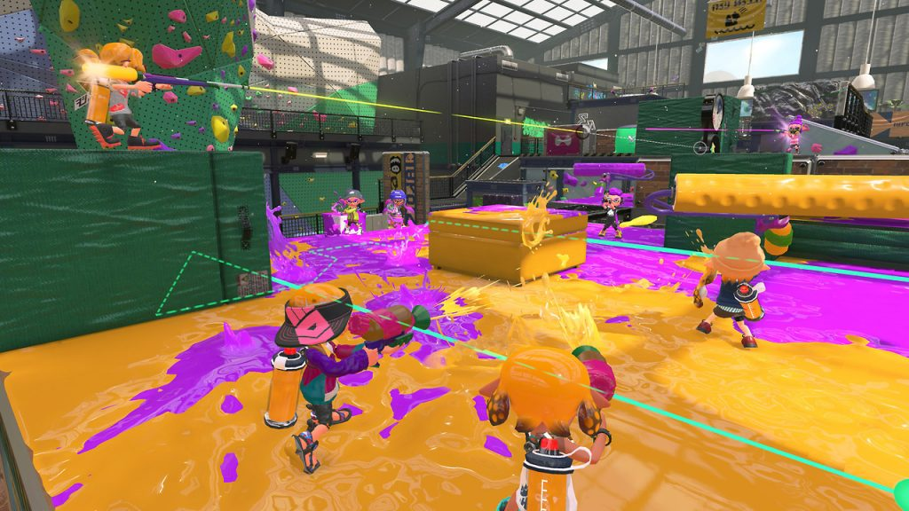
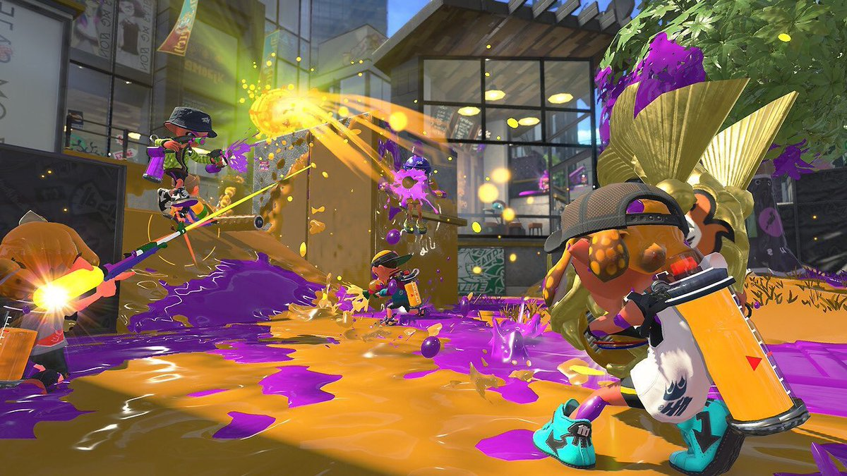
Gallery: Multiplayer

Slide 9
Online and Local Play: Salmon Run
Zombies-style gameplay
Squads of 4 players cooperate to get the most “Salmon Eggs”
Quotas are set by a mysterious character known only as Mr. Grizz
Waves of enemies attack characters
Each has varying difficulty
Small, easily defeated “Warriors”
Larger, heavy Warriors
Huge, strong bosses with different ways of defeat

Slide 10
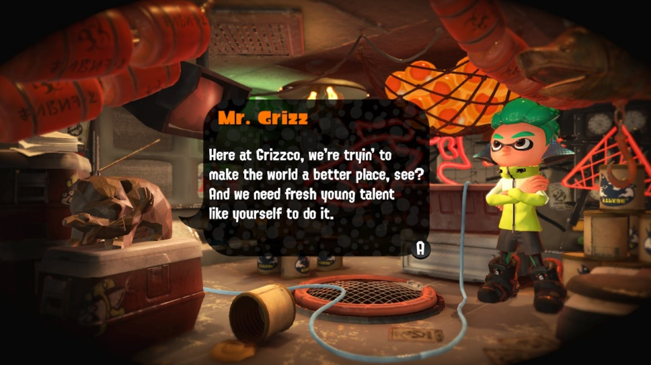
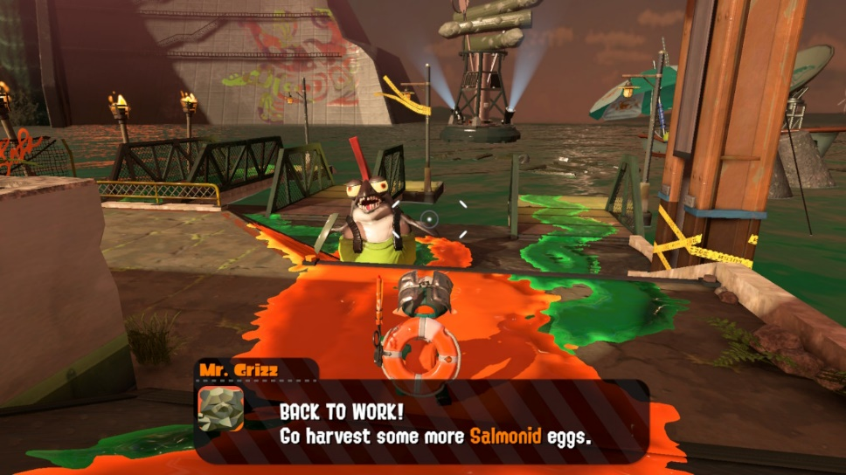
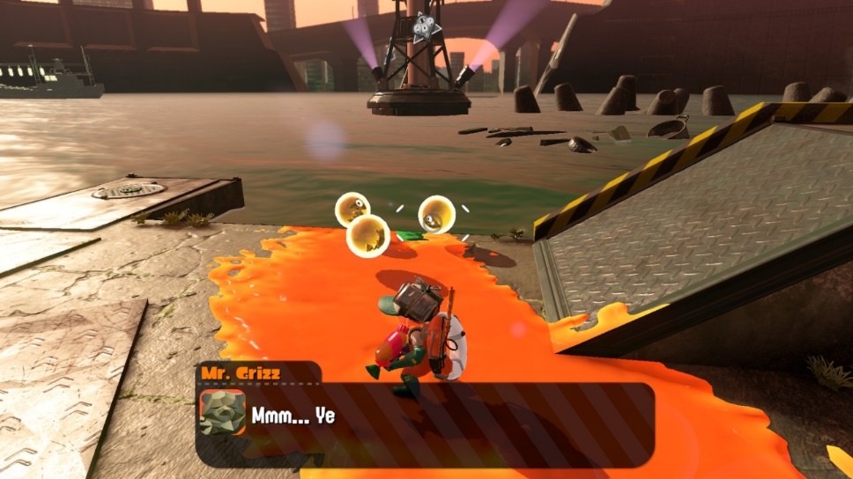
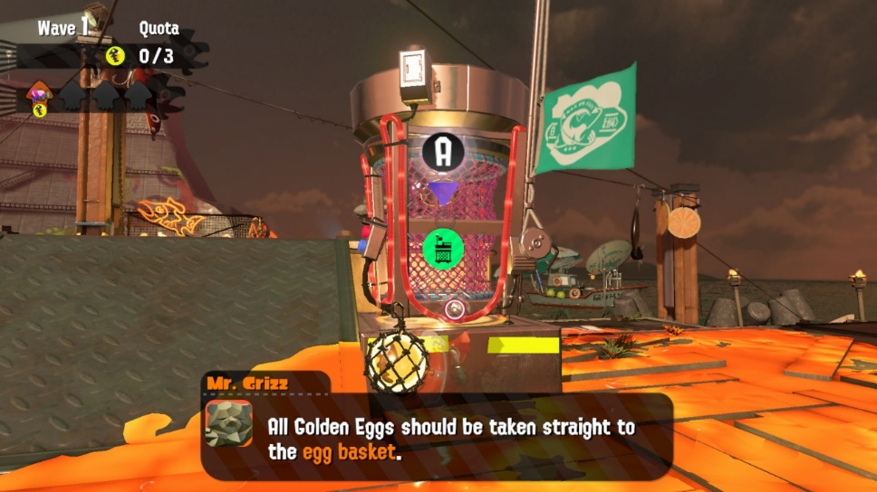
Gallery: Salmon Run

Slide 11
Artwork, Sound, and Music
Vibrant, poppy colors
Characters have their own unique flair
Artwork has a nautical-meets-municipal feel
Sound is well directed
A unique language is used (These are Squids, after all)
All sound is believable and makes sense
Music
Energetic, pop-inspired tunes that permeate every portion of the game
Music gives proper feel to different areas

Slide 12
Special Features
Character customization
Hundreds of combinations of clothes, each with its own special abilities
Hairstyle, eye color customizable
“Boosts” in Hub World
Food truck in main area offers dishes to boost certain aspects, like extra cash or EXP
Splatfests
“Parties” in-game that revolve around two sides (cake vs. ice cream, ketchup vs. mayo, flight vs. invisibility)
Special design of hub world, and battles are all Turf Wars
Nintendo Switch Online
Splatnet 2

Slide 13
What’s Fun?
Games are fast paced, unique
Main goal is not killing opponents, but rather besting them in a strategy
Loss is still rewarded in the form of exp and money, though not as lavishly
Each mode does not feel repetitive
No noticeable design mistakes present

Slide 14
What’s Not Fun?
Poor server management
Cannot Switch weapons between matches (single-player online only)
Matchmaking could be handled better
Tower Control, Rainmaker, and Splat Zones are chosen at random; player has to wait for their preferred game mode

Slide 15
Comparisons?
Mechanically similar to other Third Person Shooters (TPS)
Familiar to pick up for those who are used to other shooters
Tactics are different than other TPS
Fresh take on a tried-and-true formula
More unique than others, puts it above others in genre

Slide 16
Appropriate Audience
The target audience for this game are kids to young adults
Age group: approximately 8 – 25
Treatment of death (Splats rather than kills)
Tactics (Ink turf with your weapons)
Not exclusive, but the target

Slide 17
Summary and Conclusions
Strengths
Fun
Fast paced
Easy to pick up and play
Weaknesses
Matchmaking isn’t the best
Disconnects are a problem
Ranked/League matches not user-selectable
Worth it?
Despite weaknesses, yes
Lots of content, good game for playing online with friends
Improvement
Try new matchmaking algorithms
Address disconnect issues
Add weapon changes between matches
Allow mode selection for Ranked or League Matches

Slide 18
Works Cited
Cryer, Hirun. “Splatoon 2 Splat Zones.” Splatoon 2 Ranked Battles Guide - Rainmaker, Splat Zones, Tower Control Modes Tips and Tricks. US Gamer, 22 August 2017. http://www.usgamer.net/articles/22-08-2017-splatoon-2-guide/ranked-battle-guide-splat-zones-tower-control. Accessed 18 September 2017.
---. “Splats 2 Rainmaker.” Splatoon 2 Ranked Battles Guide - Rainmaker, Splat Zones, Tower Control Modes Tips and Tricks. US Gamer, 22 August 2017. http://www.usgamer.net/articles/22-08-2017-splatoon-2-guide/ranked-battle-guide-splat-zones-tower-control. Accessed 18 September 2017.
murdermushrooms. “Splatoon 2 Logo.” The Logos of Splatoon. Reddit, 27 July 2017, https://www.reddit.com/r/splatoon/comments/6pyn78/the_logos_of_splatoon/. Accessed 18 September 2017.
Thompson, Christopher. Boss. 2017.
---. Equip UI. 2017.
---. Level. 2017.
---. Menu Inkopolis. 2017.
---. Multiplayer Lobby UI. 2017.
---. Multiplayer UI. 2017.
---. Overworld. 2017.
---. Salmon Run Collection. 2017.
---. Salmon Run Enemy. 2017.
---. Salmon Run Golden Eggs. 2017.
---. Salmon Run Intro. 2017.
---. Single Player Entrance. 2017.
---. Tower Control. 2017.
---. Turf War. 2017.

