Slide 1
Assignment 1: Game Review
Yuichi Taya

Slide 2
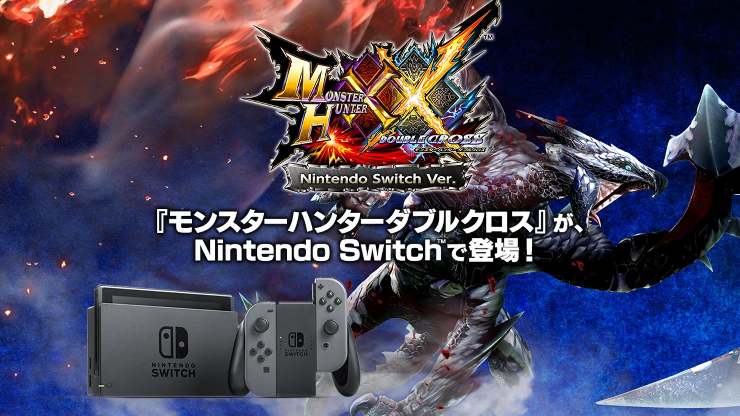

Slide 3
Basic Information
Title: Monster Hunter Double Cross
Company/Author: Capcom
Type of Game: Action Role Playing Game (ARPG)
Price:
Physical copy: 5,800 yen + tax (~$51.94 + tax)
Digital download: 5,546 yen + tax (~$49.66 + tax)
Hardware requirements:
Nintendo Switch

Slide 4
Game Summary
Installation
Insert game cartridge into console (if physical copy), or download the game (if digital copy).
Quick overview
You’re a hunter set to protect villages by taking on quests.
Storyline
Villagers lives are at risk by existence of large and dangerous monsters, so hunters must use their knowledge to slay or capture them to defend their daily life.
Player’s role
Hunt monsters and gather materials for villagers.

Slide 5
Game Summary Part 2
User interface
Time limit via clock, HP/stamina bar, and player name/status
Map and item wheel
Hunter arts
Scoring
Money (zenny) rewarded based on performance in mission
Size of monster encountered
Art work
3D with nice details for different types of environments (Desert, Forest, Island, Swamps, Volcano, Plain, Snowy mountains, Icy plains, etc)
Sound/Music
Each location has its unique ambient sound or music.
In presence of a large monster, they have their own unique “boss fight” music.

Slide 6
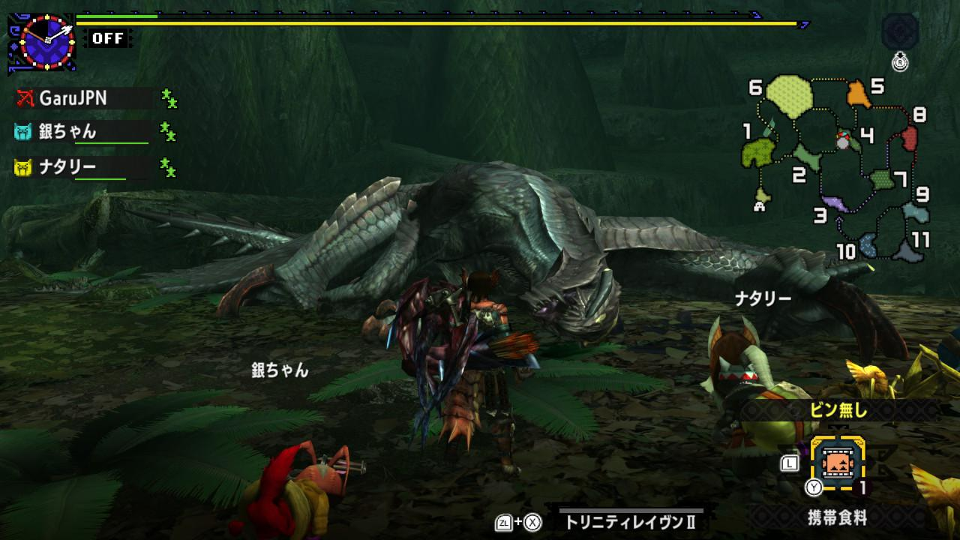

Slide 7
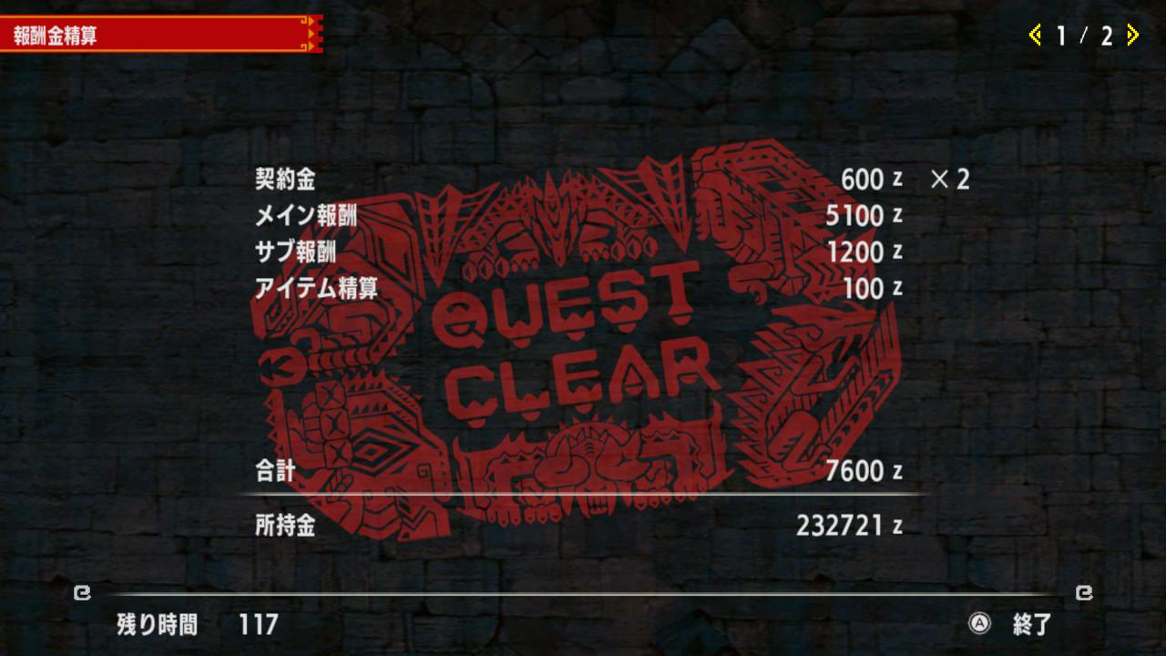

Slide 8
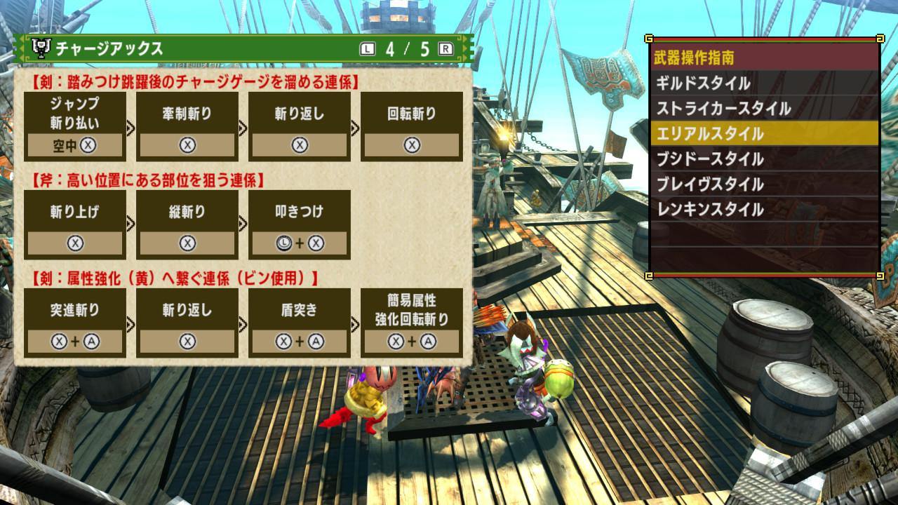
Game Summary Part 3
Special Features
Downloadable contents: Event quests, supplies, etc
Bugs
Using power shot 2 on bow with rapid shot type in brave or adept style causes the last arrow to not register, leading to loss of damage.
Manual
Hunter notes section of the menu
Includes basic controls and some simple combo
Online http://game.capcom.com/manual/MHXX/

Slide 9
Gameplay
Choose 1 of 14 weapons (11 blademaster, 3 gunner) and 1 of 6 hunting styles for many unique gameplays.
3rd person action
Mission based
Gathering quest: Gather required materials for the mission.
Hunting quest: Slay monster(s).
Capture quest: Capture a monster.
Certain missions (key quests) completed will unlock higher level quests, as well as have access to certain type of materials necessary to craft new equipments and items.

Slide 10
Game Review
What is good/fun about the game and why
Large monsters with unique designs, action packed, feeling of self-improvement as you play.
What is bad/not fun about the game and why
Extremely information reliant: Monsters physical/elemental weaknesses are not mentioned in game, so online resources are almost a must.
Comparison to similar game in genre
Dark Souls, Dauntless, God Eater, Dragon’s Dogma

Slide 11
Game Review Part 2
Why is it better or worse than similar games
Better because of the many unique gameplay styles along with many kinds of monster designs which makes using different weapons make the game “new.”
Worse because of “clunky” controls and can be quite grindy due to requiring many materials for crafting.
What is appropriate audience for this game
Teen and older due to difficulty of the game as well as humors used in game.
Any design mistakes?
Allowed to kill monsters outside of playfield making the player unable to carve monsters for materials, especially for gunners.

Slide 12
Summary
Great game with lots of replay value due to having so many weapons to choose from as well as styles. Game can be frustrating due to lack of information in game.
Worth purchasing for those who like games that requires good coordination and precise gameplays.
Game could be improved with bug fixes which directly affect gameplay i.e. loss of damage via bow attack or not being able to carve monster because they are out of playfield.

Slide 13
Enjoy a quick demo :)
Credit to CantaPerMe
Gore Magala https://youtu.be/q56E0vNgJz0?t=7s
Valphalk https://youtu.be/BFa8VGvn6_8?t=1m

