Slide 1
Game Evaluation The Legend of Zelda: Breath of the Wild
Masayuki Tanaka
CIS487/587
2017 Fall

Slide 2
Basic Information
Game Title | The Legend of Zelda: Breath of the Wild
Company & Author | Nintendo
Development Period | Approximately 5 years
Published | March 3, 2017
Type of game | Open-world Action RPG
Price | $59.99
Hardware | Wii U / Nintendo Switch
Age (rating) | 10 years old+ (US - ESRB) 12 years old+ (Japan - CERO)
# 5 years is a quite long time

Slide 3
Game Summary

Slide 4
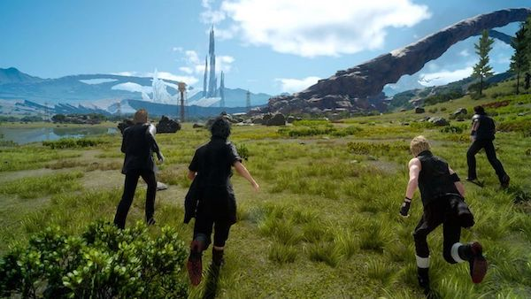
Quick overview
The Legend of Zelda: Breath of the Wild (BotW) is made to mix Zelda series and open-world RPG.
Video game companies in Japan have to reply on sales from overseas because of unbalanced population between generations.
Previous Zelda series:
https://en.wikipedia.org/wiki/List_of_The_Legend_of_Zelda_media
# Successful open-world RPG titles:
- Skyrim
- Fallout 4
- Witcher 3
Final Fantasy XV (2016, SQUARE ENIX)
# Open-world Japanese games
- Final Fantasy XV (2016)
- Monster Hunter World (2018)

Slide 5
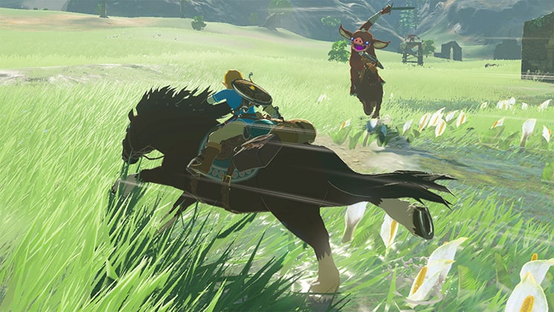
Story
Link, the protagonist, and his team lost with the villain "Ganon" 100 years ago. With the late heroes' support, Link finally wakes up and recollects his ability and memory to beat Ganon again.
Image from: http://www.nintendo.com/games/detail/the-legend-of-zelda-breath-of-the-wild-switch

Slide 6
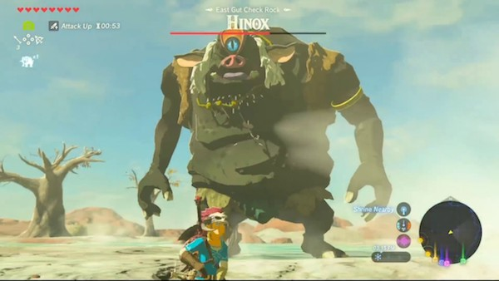
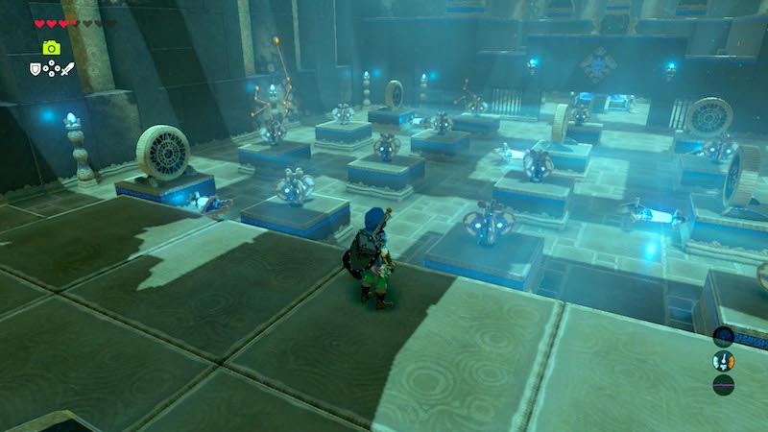
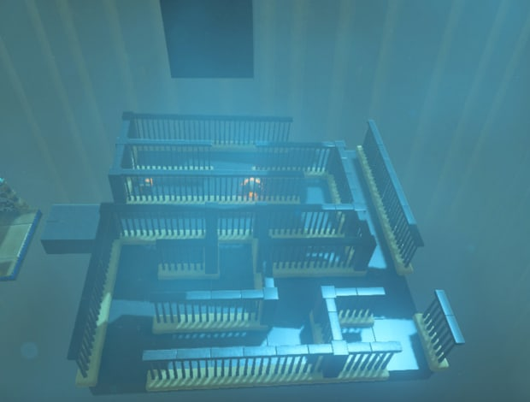
Game Play – 3D Action RPG
Action against enemies
3D puzzle against the field

Slide 7
Game Play - Non-linearlity
No level or exp: if you have skills, you can directly go to the final boss.
any order
Water Beast
Fire Beast
Start
Tutorial
(Great Plateau)
Ganon
End
Thunder Beast
Wind Beast
# The world record is less than 40 minutes
https://www.youtube.com/watch?v=ripapSXElg8
skip

Slide 8
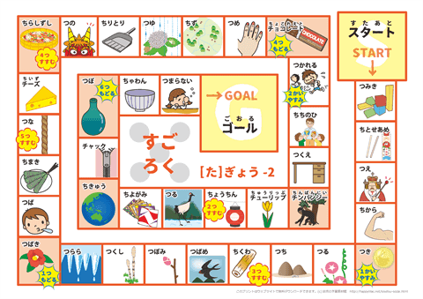
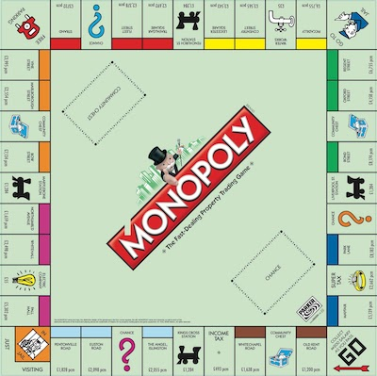
Game Play - Non-linearlity
Non-linearlity is implemented to reach out Western players while Asian culture prefers predictability.
Sugoroku is a traditional Japanese boardgame (linear).
Monopoly has only a loop with lots of events combination (Non-linear) .
Sugoroku - Linear
Monopoly – Non-linear

Slide 9
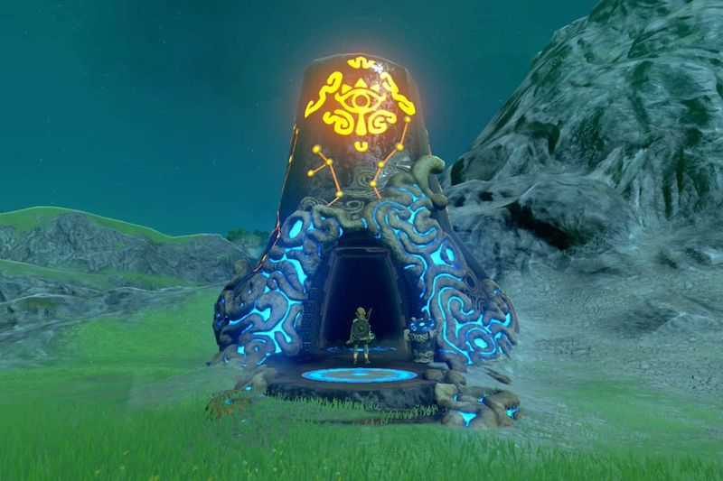
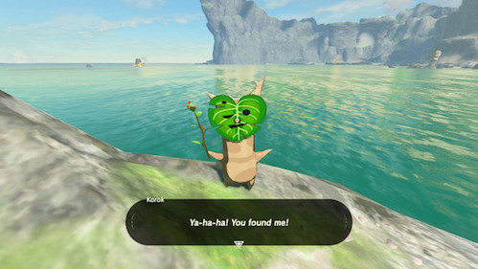
Special features
120 Shrines: Motivate players to adventure
Korok seeds: Reward of visiting all places
Trial of the Sword: Battle skill
The Master Trials DLC: "Difficult" mode

Slide 10
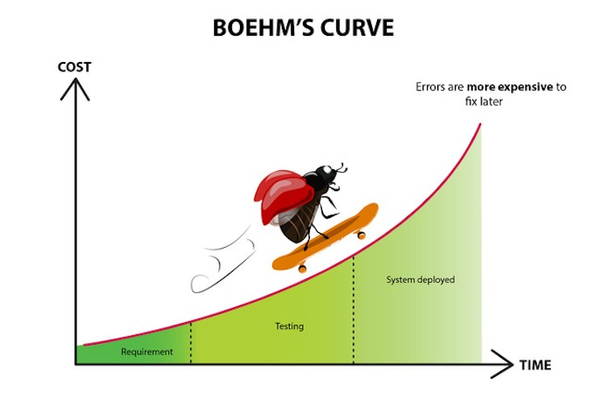
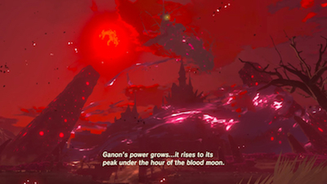
Bugs
Not many
Once the game crashed when I was doing fasttravel.
This is not uncommon for open-world RPG. I experienced hang up when I was playing Witcher 3 on PS4.
# Actions to reduce bugs
1) Bugfix in the early stage of development
IGN Japan, Presentation at CEDEC 2017
http://jp.ign.com/cedec-2017/16963/news/botw
(Japanese)
2) "Red moon" system
- Initialize game objects: Cut tree, beaten monsters
- Justified by the game stroy
http://reqtest.com/general/a-bug-goes-skateboarding-on-boehms-curve/

Slide 11
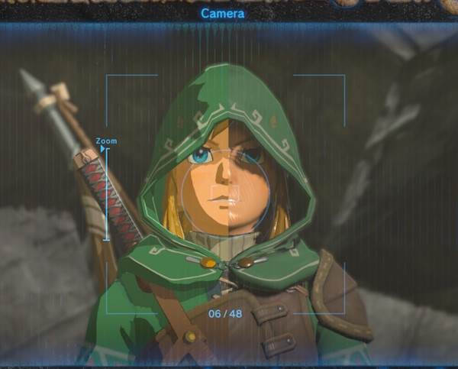
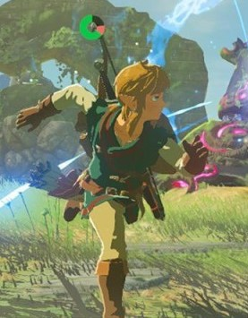
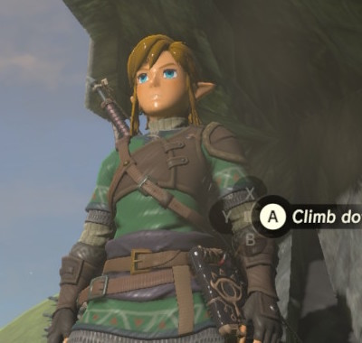
Artwork
Anime-textured 3D model
You can see the difference using a glitch:
https://www.reddit.com/r/Breath_of_the_Wild/comments/6n68gq/odd_graphical_glitch_found_at_lake_hylia/
3D model before rendering
Rendered anime model

Slide 12
Sound and Music
Supporting music
https://www.youtube.com/watch?v=-_eh0yHXZd0&t=0m55s
Calm, not melodious
Compare: FFVII (1997, SQUARE ENIX)
https://www.youtube.com/watch?v=e-n_sjtmTOI&index=20&t=28m17s
Game synchronization
https://www.youtube.com/watch?v=RKD4Ooi4cIc&t=3m55s
The same technique used FFXV
https://www.youtube.com/watch?v=OfOiiF0fK3A&t=16m5s
Explained GDC 2017 (See at 38m 23s)
https://www.gdcvault.com/play/1023971/Epic-AND-Interactive-Music-in

Slide 13
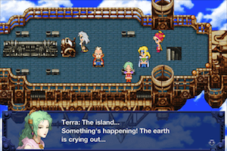
Supporting music vs Leading(melodious) music
Being not melodious isn’t a bad thing.
Harry Potter presents melodious music in the early sequel.
https://www.youtube.com/watch?v=T_-qsf-NcCo&t=3m23s
In the later sequel, the music becomes less melodious but more sophisticated with its orchestration
https://www.youtube.com/watch?v=Ue-yhbbU12o&t=1m36s
# Games with the best music (Reviewer’s choice)
1) Final Fantasy VI: Music is leading the game world
https://www.youtube.com/watch?v=juw_KwcZ47U&t=3m24s
2) Witcher 3: Impressive music as core game mechanics
https://www.youtube.com/watch?v=2bSk-8C76dc
3) Life is strange: High quality as TV series or movies
https://www.youtube.com/watch?v=htpG3W7aTyw&t=9m51s

Slide 14
Game Review

Slide 15
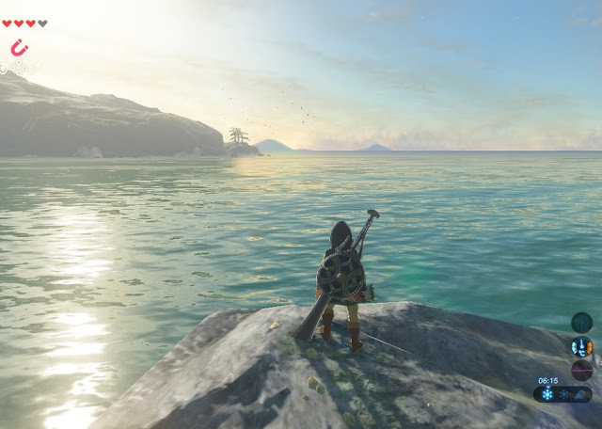
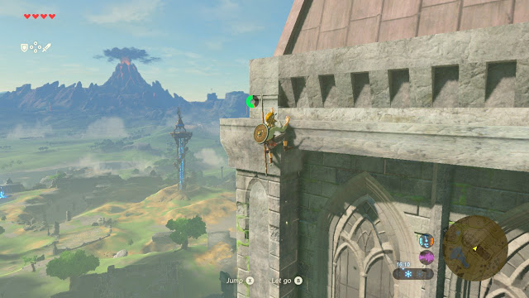
What is good (fun) about the game? Why?
Game mechanics work for both casual and heavy player.
I am a casual player and gave up playing Bloodborne because it's too difficult for me.
Settings: Players can experience with Link who lost his memory. (Link doesn't talk much in order to reflect player's persona. )
Stunning open-world graphics.
http://www.digitallydownloaded.net/2017/03/review-legend-of-zelda-breath-of-wild.html

Slide 16
What is the appropriate audience for this game?
Kids. Nintendo is a good job because it is important for kids to play console games who are future consumers for game industries. If someone doesn't play game in childhood, they probably don't play the game for their lifetime.
However, game play might be too difficult for kids.

Slide 17
What is bad (not fun) about the game? Why?
Story.
The purposes of story (Textbook) are
Evoking emotion
Motivation and justification
Progresssion and reward
Story also matters because it's the thing people remember after finishing it. Also, story cost millions of dollars for scripting, voice acting, localization, etc.
The story of BotW is not as good as its system because of the following reasons.
1) Cultural cliché
Collaboration with 4 heroes is "Spirit Bomb" cliché
https://www.youtube.com/watch?v=3VA1qMDklS0
There are too many of “collaboration with others” in literatures, anime, game, etc.
2) Impersonality
Mechanic Link: Why are you doing this?
Resulting with vague objective, weak justification.
Ganon: Why are you doing this?
Boring because it feels as if they are fighting against disease.

Slide 18
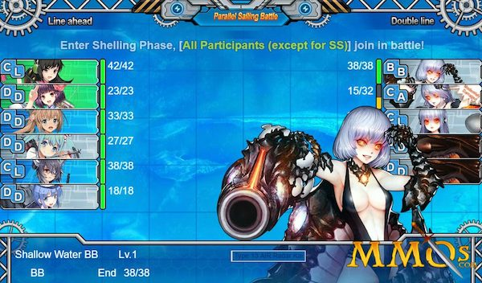
What is bad (not fun) about the game? Why?
3) Sexism
Princess Zelda is described as an incompetent shaman. I conclude the scenario writer of this game wants to satisfy men who want to enhance their self-esteem by helping a "incapable" woman. (Although Zelda princess finally overcame her problem and got world-saving ability.)
Cultural examples of preferences over looking down on someone
AKB48: Many single men pay to be a "patron”
Kancolle: Have girls work for the player
Gender gap ranking
http://reports.weforum.org/global-gender-gap-report-2016/rankings/
United States: 45th
Japan: 111th
Other things players hate
Fragile weapon – your weapons break after using it
Rain – suddenly you cannot climb
“Kancolle” is a game with girls fighting for the player.
But sometimes obstacles/inconvenience is necessary because it enhances comfortability when it is overcome. Just because people (and me) hate doesn't mean it's a bad system.

Slide 19
How does it compare to similar games in the same genre?
Game to compare: Witcher 3
1) Easier to play
Fast travel from anywhere
2) Vertical movement
Ascending: Climbing
Descending: Paragliding
Witcher 3: Almost every fall is prohibited to reduce software test cases (equivalently development cost). Poor vertical movement might result (a) being stuck (b) infinite routing (c) complex test case over the field
3) Non-sexual, less violent (targeted for kids). Story is a bit Kindergarten-ish.
# Game experience with vertical movement
- Fighting with dragon in the sky
https://www.youtube.com/watch?v=bQ2uEdqRcfQ
- Climb up the tower
https://www.youtube.com/watch?v=-_eh0yHXZd0&t=33m51s

Slide 20
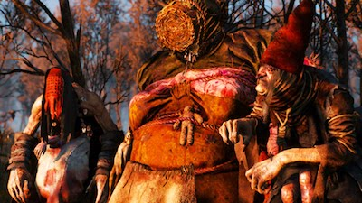
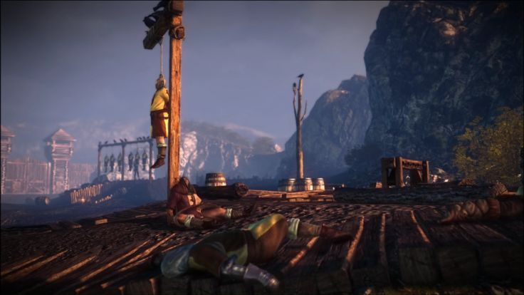
Are any design mistakes present?
Strategic mismach
Targeted for kids but a bit difficult for kids.
Too much cultural cliché for global players.
Too much Anime-style for global players. (But I think this is the right direction. )
Witcher 3 is an amazing game but absolutely for ONLY adults

Slide 21
Summary

Slide 22
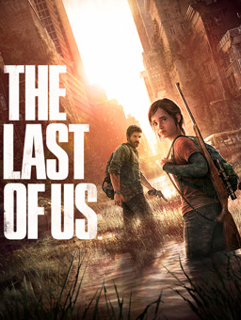
Overall strengths and weaknesses.
Strength
Mechanics
Graphics
Weakness
Story
# Games with the best story (Reviewer’s choice)
1) Dragon Quest V: Dramatic life - 10 years as a slave (for monster), choosing a bride, relationship between father and son
2) Last of US: Joel and Ellie protecting each other
3) Shadow of colossus: Minimal explanations with deep settings

Slide 23
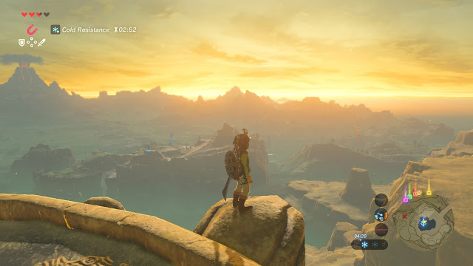
Is the game worth purchasing?
It's a must. It might affect games in the future in terms of:
Excellent game system
Vertical movement as open-world RPG
Playing portablly (Nintendo Switch)
http://www.digitallydownloaded.net/2017/03/review-legend-of-zelda-breath-of-wild.html

Slide 24
How could it be improved?
Since the system is almost perfect, maybe exact same system with a few more different games for older audience will be welcome.

Slide 25
End of the slide

