Slide 1
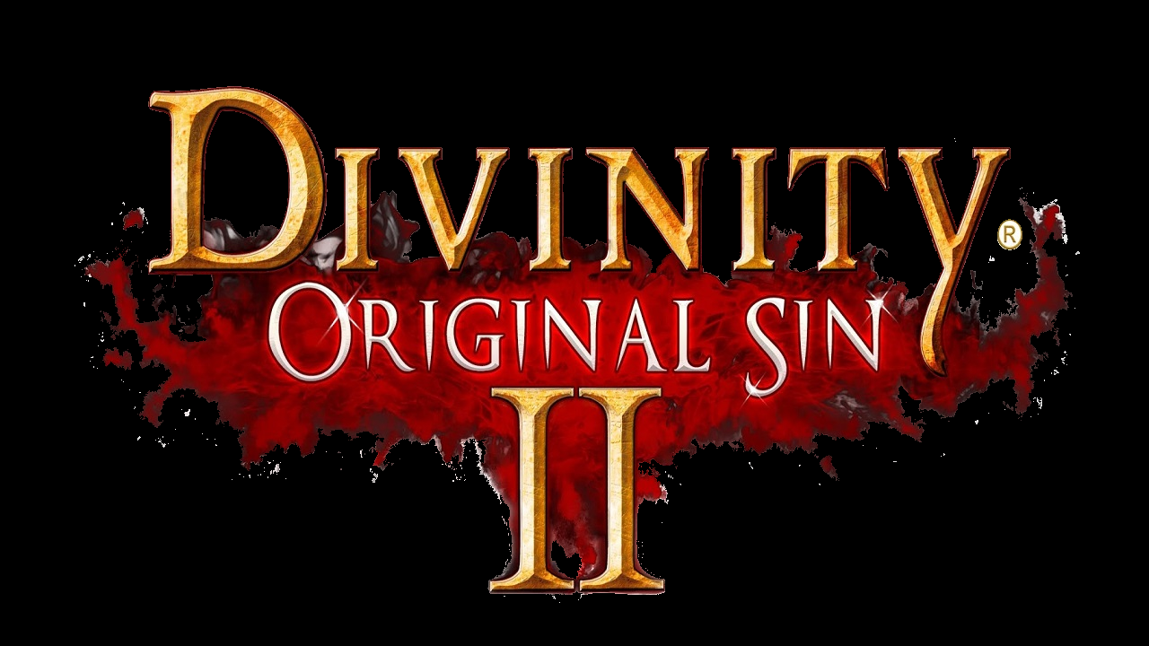
Game Review:
Divinity: Original Sin 2
Kenneth Rogale
Notes:
This is my game review for the game Divinity: Original Sin 2. This game is a recently released sequel to Divinity: Original Sin. However, the game has been in early access on steam for some time now.

Slide 2
Information
Title - Divinity: Original Sin 2
Company: Larian Studios
Price: $44.99
Minimum System Requirements:
OS: Windows 7 SP1 64-bit or Windows 8.1 64-bit or Windows 10 64-bit
Processor: Intel Core i5 or equivalent
Memory: 4 GB RAM
Graphics: NVIDIA® GeForce® GTX 550 or ATI™ Radeon™ HD 6XXX or higher
DirectX: Version 11
Storage: 35 GB available space
Recommended System Requirements:
OS: Windows 7 SP1 64-bit or Windows 8.1 64-bit or Windows 10 64-bit
Processor: Intel Core i7 or equivalent
Memory: 8 GB RAM
Graphics: NVIDIA GeForce GTX 770 or AMD R9 280
DirectX: Version 11
Storage: 35 GB available space
Notes:
The game is developed by Larian Studios out of Belgium, and they are selling it via steam on PC for $44.99. The minimum requirements are not very high, but to play the game smoothly at high frame rate you will need at least the recommended level of hardware. Compared to the previous game, this release is much more optimized and smooth. Note that the size of the game on HDD is rather large, this is mostly due to the entire game having full voice acting.

Slide 3
Summary
Genre: Turn Based Combat RPG
Setting: Medieval-like time period with typical high fantasy races (Dwarves, Elves, etc.) Magic exists and is called source.
Story: You play as a “Sourcerer” trapped on a prison barge set for a prison Island along with other prisoners. After you arrive on the island one way or another, your immediate goal is to escape your imprisonment with the help of up to 3 other characters or players.
Installation: The game is hosted and sold through Steam, making installation very easy and fast
Notes:
The game focuses heavily on the turn based rpg combat with an emphasis on strategy. The game takes place in a medieval-like time period with swords and armor like many of the genre. The game also features magic which it calls “source” and contains typical high fantasy races such as Elves, Dwarves, Undead, and Reptile People. To buy and install the game you only have to go to the steam store and select the buy option making this really easy to set up and play.

Slide 4
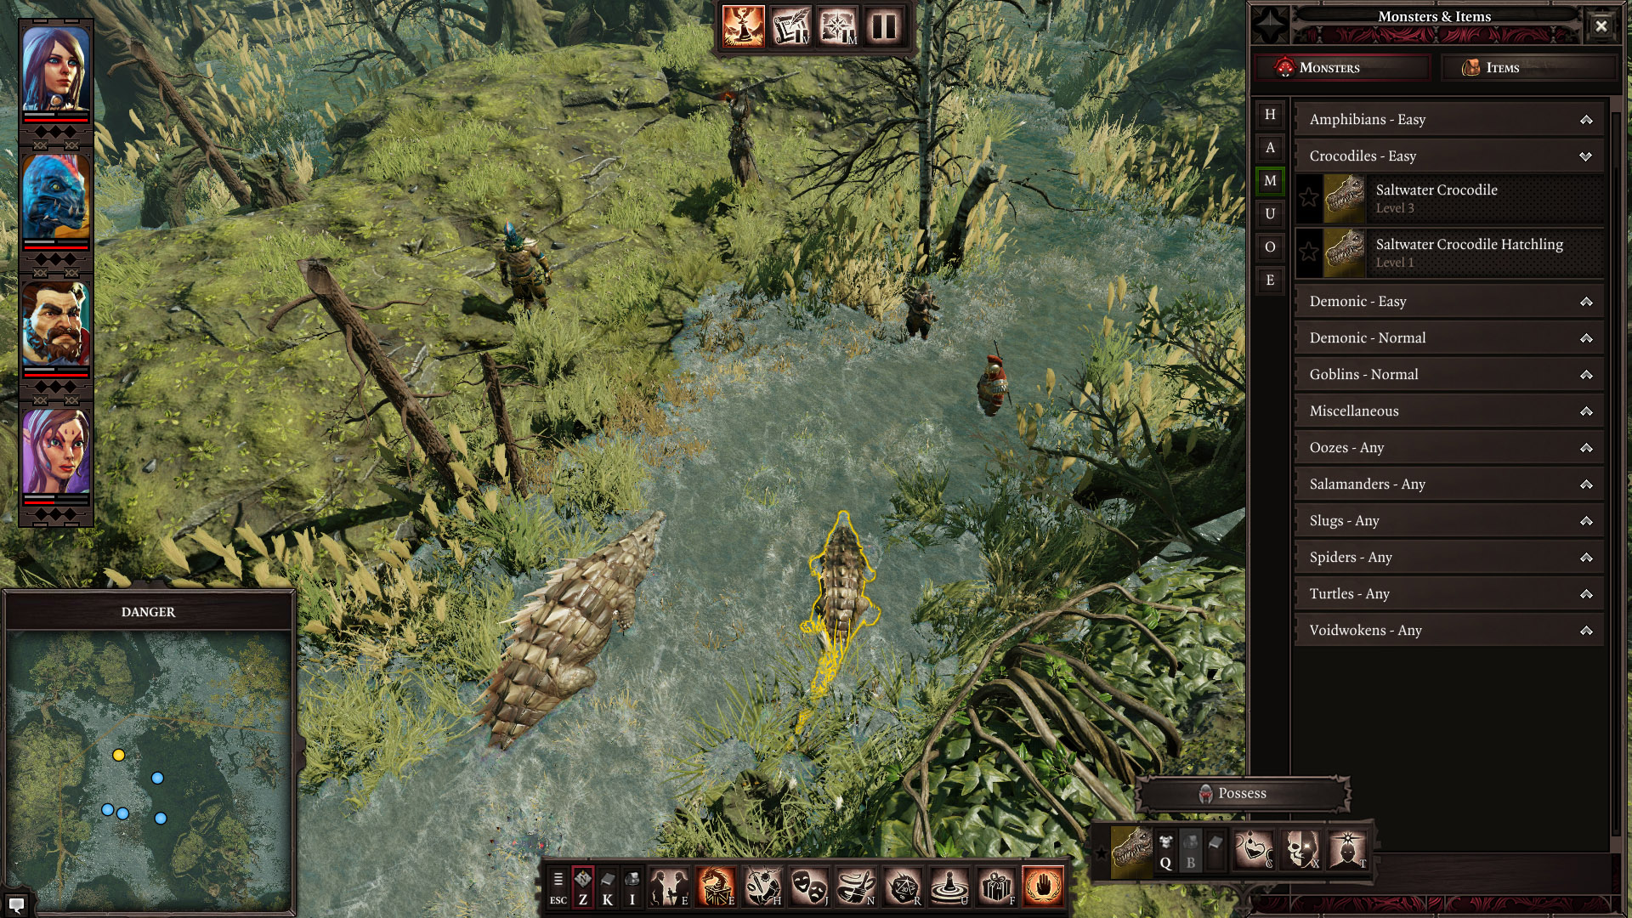
Summary (cont.)
User Interface: Typical RPG style UI: (Picture from Polygon’s article on the game)
Notes:
Here is a screenshot of the UI. This particular schot is of the Game Master mode which allows players to create content for others to play. The combat UI is very similar and also features a number of windows feeding information to the player. One of my favorite things about this UI is that you can re-arrange many of the elements to your liking.

Slide 5
Summary (cont.)
Game Play: During combat the game is turn based top-down, outside of combat is real time top-down
Scoring: As expected there is no real “scoring” mechanism in the game, but progress can be tracked through levels and quests completed.
Artwork: Fantasy style 3D artwork with some darker tones mixed in.
Sound and Music: Medieval sounding music where each character has a different theme based on who is currently taking a turn
Notes:
During exploration and dialogue the game plays like an RTS game with point and click movement and WASD camera controls. During combat the game turns into a turn based game where each turn you can choose to use an ability, move, or both using action points. As far as scoring goes, as expected there is no classic score for the player. The closest thing is the amount of experience the player has which is given to them for completing tasks, defeating enemies, and solving puzzles. The artwork is a typical fantasy style with some rather dark themes. Which reminds me, the game is meant for a mature audience due to the graphic nature of the fights in the game. Sound and music are dynamic and flow from one theme to another depending on if the player is doing well or poorly.

Slide 6
Summary (cont.)
Bugs:
There have been some reported connectivity issues with multiplayer, but are said to be minor
The huge number of ways to solve each problem leave some exploits throughout the game allowing the player so skip certain encounters.
Notes:
Some people in the forums have reported having issues maintaining stable connection with other players. I have only played an hour or two of the multiplayer but I have not encountered this problem at the time of writing this. Also due to the many different mechanics in the game some unforeseen interactions exist, allowing the player to skip tough enemies or kill them very easily. One such problem is with a boss in the first act. Normally she is very difficult to fight but a player with the teleport ability can line up 3 party members in a narrow hallway while the player with teleport will put the boss on the other side of the “player wall.” this way the party only needs to fight the boss and not the additional 6 or 7 enemies she summons in the boss room.

Slide 7
Review
Pros:
Huge variety of items and abilities
Story that adapts with every choice made by the player.
Full voice acting allows more immersion
Free-form problem solving (always several ways to do anything)
Huge number of small details and interaction allow for high replayability.
Notes:
Some of the major buying points for the game are: an extremely large selection of items and gear along with a very detailed crafting mechanic. The story features dozens upon dozens of choices for the player each with different results in the short term and the long term, making the game fun even on the third time around. The addition of full voice acting near the end of development largely helps the game immerse the player and does not require you to read large walls of text to know what is going on. The free form approach to problem solving in this game makes it very interactive and fun; if there is an obstacle that is difficult to overcome try looking around and most times there are better and easier ways to solve the problem. Somewhat related to the above point is the attention to detail that the game features. For example, most NPCs will allow different actions and dialogue options depending on who in the party is talking to them based on background, sex, race, and moral standing.

Slide 8
Review
Cons:
Very easy to miss things and get stuck on problems
Hard to tell when content is meant for higher level players until it’s too late to back up
Some information on abilities is very vague.
Loading times are rather slow even on high end PCs
Notes:
One of my biggest problems with the game is that the huge number of interactions makes it very easy to miss a key item or person that can pretty much be required to progress without outright killing the obstacle. A related problem is that sometimes it can be hard to tell when there is a secret to beating a certain enemy or if you are just not supposed to be fighting them yet. This can lead to frustration for the player after a few attempts at the same fight. Another problem is that the descriptions for some items and abilities is vague, or leaves out some important characteristics. Lastly, with how often the player is expected to save and load over and over again, the loading time begins to become an issue even for higher-end PCs

Slide 9
Review
Compared to other top-down RPGs Divinity:OS2 tends to be more replayable thanks to the large number of important decisions made by the player. Also, it appears much more polished and carefully created than many other comparable games.
However, Divinity lacks direction compared to other games, some view the sandbox style as good but others view it as bad.
Notes:
Compared to similar games, DivinityOS2 can be praised for its great replayability. This is thanks to the multiple endings and paths for the player to take with each playthrough along with the fact that there is no way that the player did not miss something in their first playthrough. Other than the potential mechanic exploits, the game is very well polished and fleshed out compared to other similar games. However, much more time is required exploring looking over and over again for the next objective you are supposed to be working on while many similar games will give you hints and point you in the right direction.

Slide 10
Review
Audience: Divinity appeals to a player that is patient with a slower paced game and those that play games for the story, but players looking for a PVP experience or a fast paced game may not enjoy this game.
Design Mistakes: There are no glaring design mistakes present largely thanks to the year and a half early access to part of the game for testing.
Notes:
The audience that would enjoy the game is the player that is willing to spend time exploring and looking for secrets. Also this game will appeal to players looking for a story-rich strategy game where every choice can make a huge change. Luckily there are not any glaring mistakes with the game, but I think that is largely thanks to this not being their first game in the genre and also the long time spent in early access allowing for large scale testing.

Slide 11
Conclusion
Pros:
Fun with friends
Very customizable characters
Variety of things to do
Replayable
Large attention to detail
Cons:
Slow paced at times
Lacking direction for the player
Vague information
Notes:
This game is great with up to 3 other friends, there is a large degree of freedom when it comes to character gear and playstyle, there is ALWAYS something that you can be working on in the game to either level up or progress, there is a good opportunity for replayability with each playthrough being quite different from the last, and there is a great attention to detail in the world. The negatives of the game are that it can be rather slow paced at times, related is the lack of direction much of the time for players, and the vague information on abilities and game mechanics can make it frustrating at times.

Slide 12
Worth Getting?
If you are a person that is looking for a slower paced game with a lot of strategy or if you are looking for a story rich experience the game is well worth the money.
But generally speaking, YES I would recommend this game.
Notes:
Is the game worth getting? As long as you enjoy a story driven game and don’t mind strategy elements I believe this game would be worth getting.

Slide 13
Improvements?
Possible ways to improve:
Optimize loading times if possible
Drop hints to the player for the next objective
Make exploring more optional than mandatory
Notes:
Some ways that would improve the game are as follows: If at all possible, optimize and shorten the loading times, drop hints to the player telling them where to go to progress in the story, and making exploration more of an option for better loot and gear rather than making it mandatory for the player to hunt for one particular object to progress. Despite these, I think that this game is one of the better games released this year on PC or in past few years for the genre. Thank you

