Slide 1
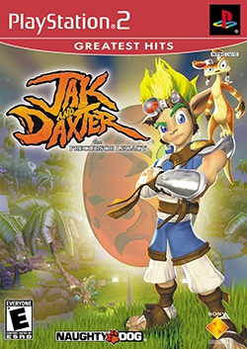
Game Evaluation Jak and Daxter: the Precursor Legacy
By: Matthew Pownall

Slide 2
Basic Info
Made by: Sony computer entertainment + Naughty Dog
In 2001
Adventure, Puzzle, Platformer
Amazon Current Price : $15
Specs: 691kb memory card space
Hardware: Playstation 2

Slide 3
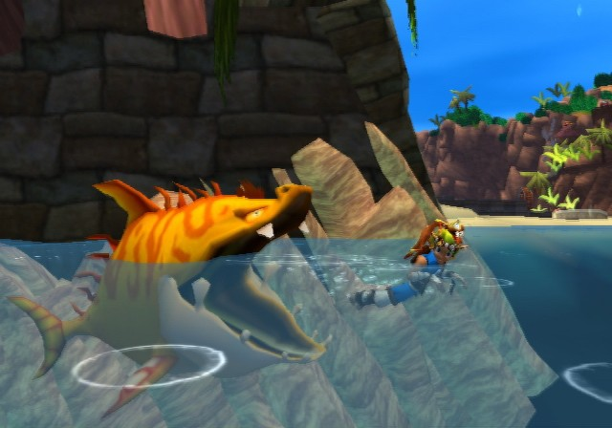
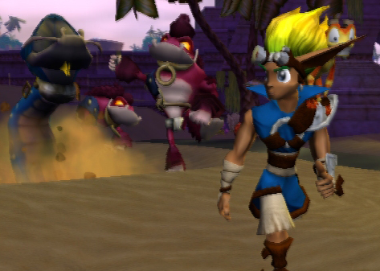
Game Summary
Quick story line
+ player role
The players characters (Jak’s) friend, Daxter, becomes a little fury creature.
With some help from their friends they travel to get help for him
Along the way the quest changes to stopping what the lurkers, the main enemy type, and what their masters, the “Help” for Daxter, have planed.
Overview
Collect power cells to power special machinery to let you travel further towards your ultimate destination
Power cells are found in the wild, given for doing jobs for NPC’s, and traded for precursor orbs.
Platform and puzzle solve through many side areas while avoiding enemies, deep water, and other hazards.

Slide 4
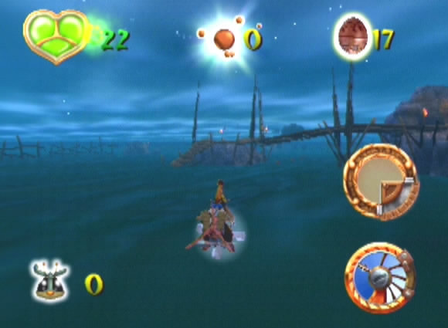
Game Summary
Installation – put game disk in console
User Interface – collectable counters, health guage, eco timer.
(on zoomer) speed and temp. guages
Game Play – jump, fight, solve, collect, explore, channel, and drive.

Slide 5
Game Summary
Scoring – there are no points except the total counter for power cells
Artwork – cartoon fantasy
Sound and Music – atmospheric background music, adds an extra to the world design. notable sound effects include drum noise when walking upon precursor stuff, eco power-up noises, and heartbeat noises.

Slide 6
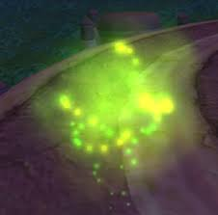
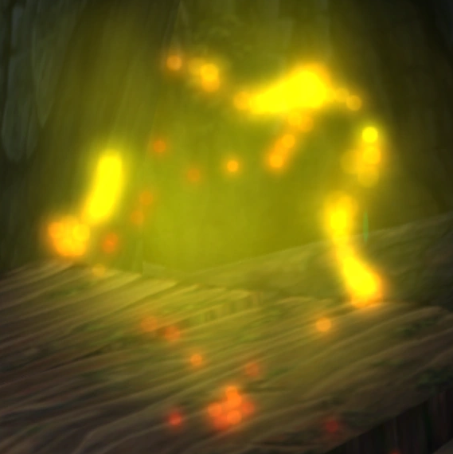
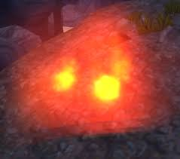
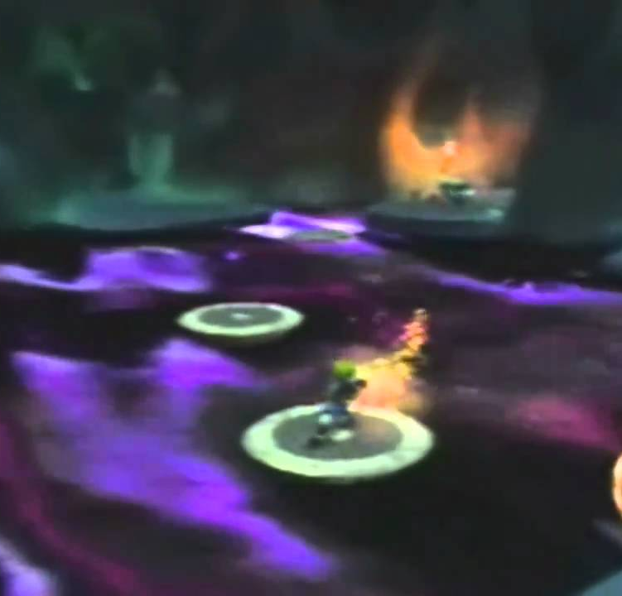
Game Summary
Special features
Collectables
Precursor orbs
Power cells
Eco
Green – grants health and life
Blue - increases movement speed and
can activate precursor stuff
Red – increases attack damage and range
Yellow – allows Jak to throw strong fireballs (KI Blasts)
Dark – used as a plot device and a hazard
Mounts
A Gram Zoomer – main method of travel through power cell checks and used in specific side areas for special sections
Flap Flap Bird – increases speed, jump distance, and control in the air. Used in specific side areas for special sections

Slide 7
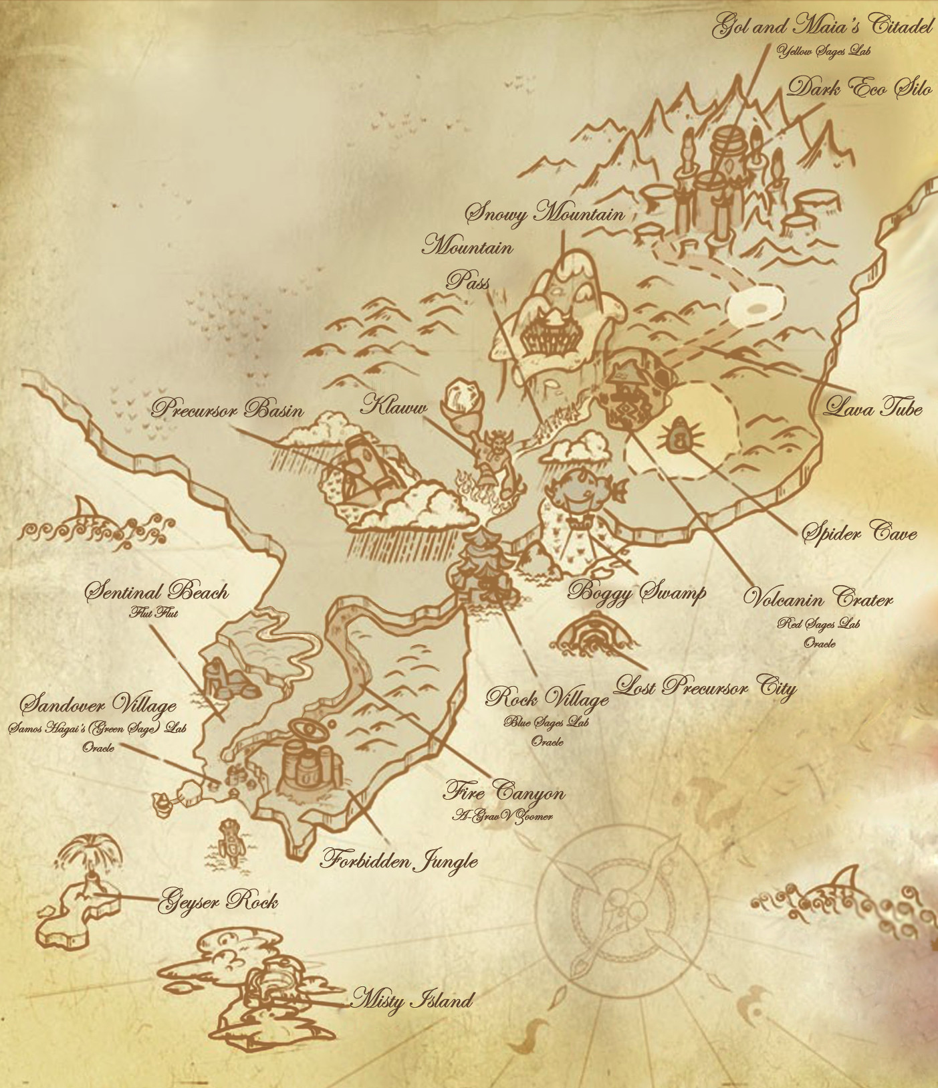
Game Summary
Manual (if any)
comes with a small paper manual with controls, story, and character info in the box
Also comes with an artistic rendering of the full map
Bugs
there are things used in speed running that help players skip entire power cell checks.

Slide 8
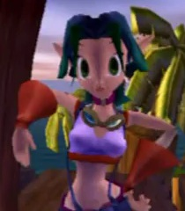
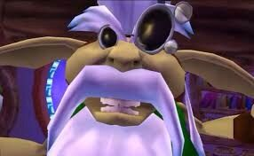
Game review
What is good (fun) about the game? Why?
Daxter’s whimsical nature – makes the difficult and potentially frustrating points of the game easier and more fun (death quips)
Moving through the world – has a satisfying fluidity to the movement.
Collecting orbs and power cells – the collection sound of the orbs and the cinematic celebration of the power cells are wonderful and fun
Using the eco powerups, mounts, and platforming skills to solve puzzles – because each adds a new twist to how jack moves or normally does things
The colorful and diverse locations – make the world feel big, cheerful and care free, or dangerous and mysterious, based upon where you are.

Slide 9
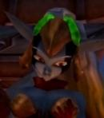
Game review
What is bad (not fun) about the game? Why?
Due to age, the graphics could use updating and polishing (it doesn’t look repulsive though, just old)
Main antagonists a little too absent from story – makes them feel like minor characters.
The climax gets a little confusing with introduction of light eco at the last second.
Collecting all power cells leads to a satisfying door opening but not showing what is behind the door.

Slide 10
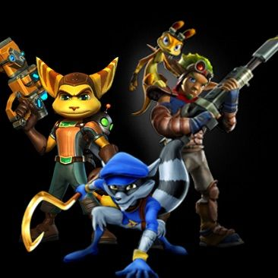
Game review
How does it compare to similar games in the same genre?
It competes to be one of the defining mascots of the PlayStation 2
It is a beloved classic that is still played today
Why is it better or worse than similar games?
Little to no punishment for deaths
Mascot character and world are fun and interesting
Levels are geographically connected and can be traveled to with out load screens
The sequels go in a different direction, more story/mission driven, leaving this one in a class all it’s own
My sister compared this game to sly cooper

Slide 11
Game review
What is the appropriate audience for this game?
A younger audience, mainly younger than 13
Still an enjoyable experience for those who want a “fast” fun game.
Are any design mistakes present?
No fast travel out of an area when at it’s end.
Can’t freely move camera up and down.
Lack of description of maneuvers in game. High jump, long jump, uppercut, roll, spin in air for extra height + hang time.

Slide 12
Summary
Overall strengths and weaknesses.
Fun, bright, colorful with great variety within world and puzzles
Lacks more modern stuff, it is a little bit out of era.
Worth purchasing?
Yes, recently brought back on ps4 via the marketplace
Improvements?
Free the camera movement + more control descriptions
talk about the “myth” or something of light eco before the finale.
Show more of the main antagonists doing stuff in the game.
Polish it up, keep same art and animations, just make them higher resolution and less blurry

