Slide 1
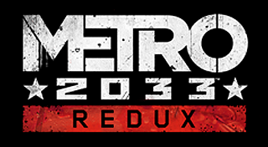
By Nick Ponikiewski

Slide 2
Basic Information
Company & Author: 4A Games
Type of game: First person shooter & Survival Horror
Price: Initial: $25 ($50 for Redux bundle). Current: $20 ($30 bundle).
Minimum Requirements
Processor: Dual Core (2.2+ GHz or better)
Memory: 2 GB
Graphics: DirectX 10, Shader Model 4 compliant graphics cards
Storage: 10 GB needed
Recommended Requirements
Processor: Any Quad Core or 3.0+ GHz Dual Core
Memory: 4 GB
Graphics: GTX 480 or above
Storage: 10 GB needed

Slide 3
Game Summary
Quick overview: A post-apocalyptic FPS with survival horror mechanics set in the Moscow metro.
Storyline: Set in 2033, twenty years after the nuclear apocalypse. The station of Exhibition is under attack by a new mutant, the Dark Ones. Artyom, the player, is persuaded to leave his home and seek help from the Spartan Order by Hunter, one of its members.
Player's role: The reluctant hero.
Installation: either off of a disc or an online retailer.
Gameplay: Engage in firefights with human or mutant enemies. Use stealth to evade enemies or kill them silently. Military grade ammo serves as the currency. The player can buy new weapons and weapon mods.

Slide 4
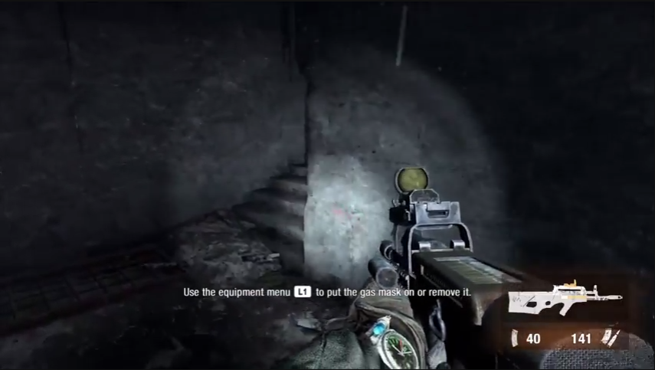
User Interface

Slide 5
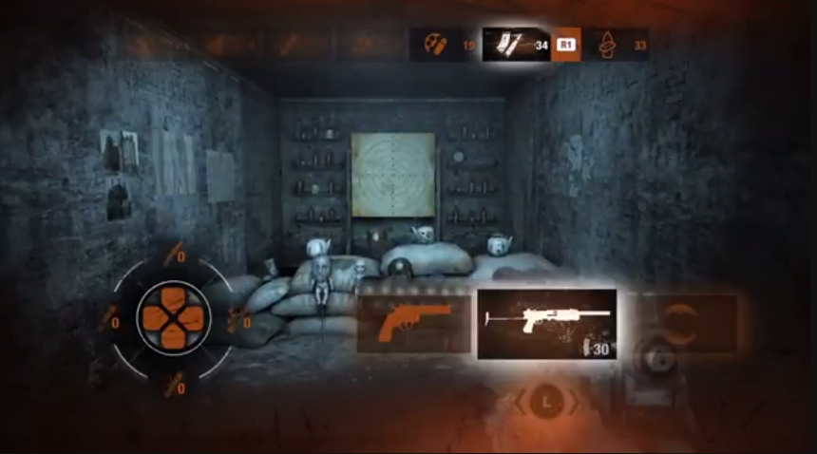
User Interface

Slide 6
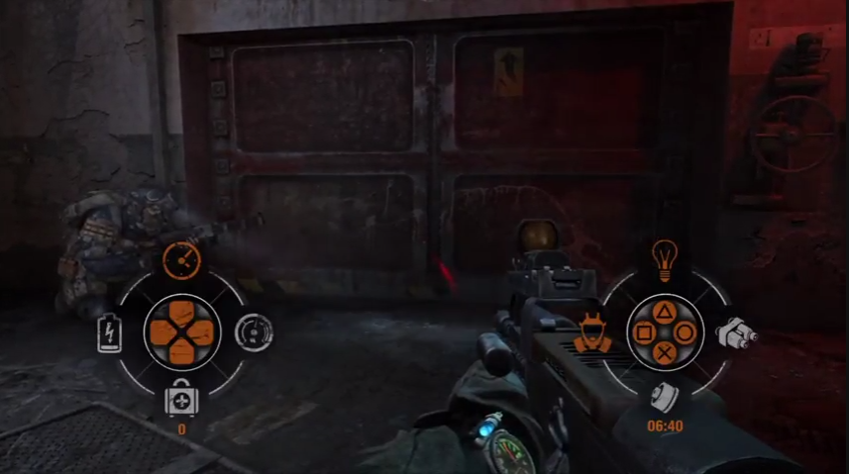
User Interface

Slide 7
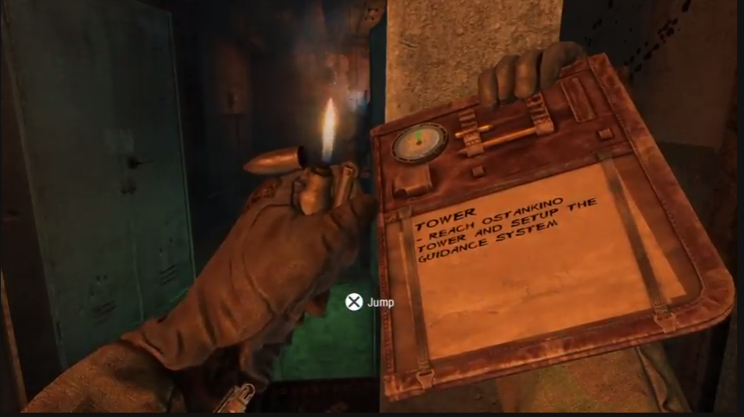
User Interface

Slide 8
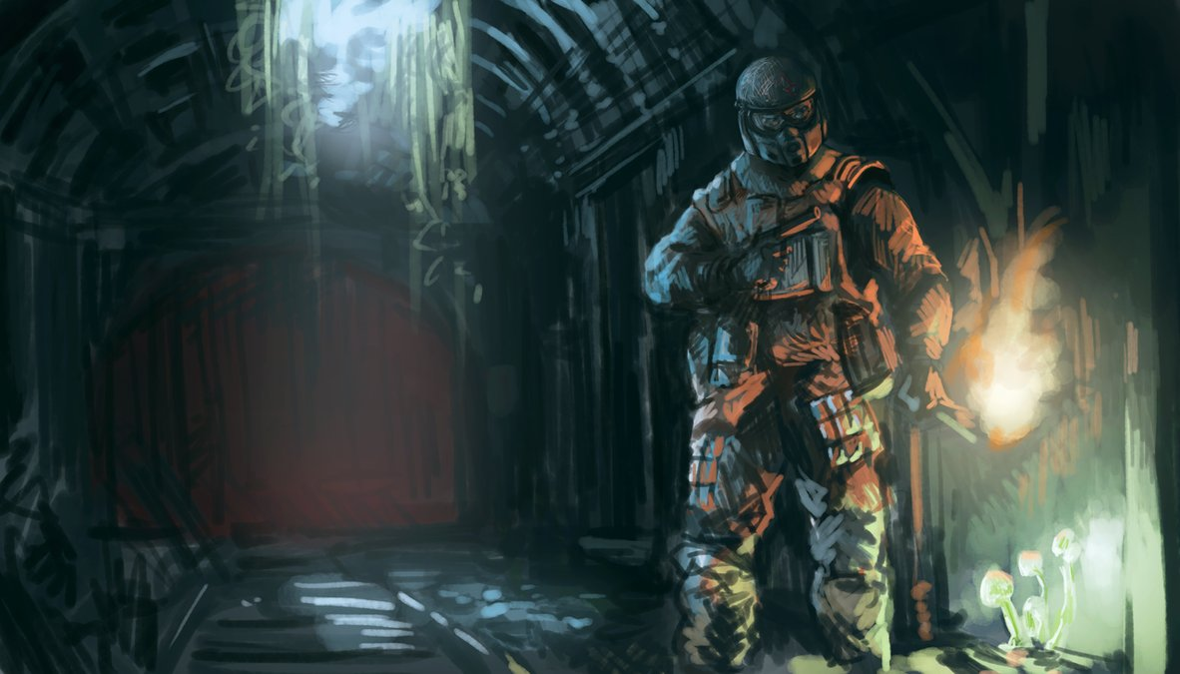
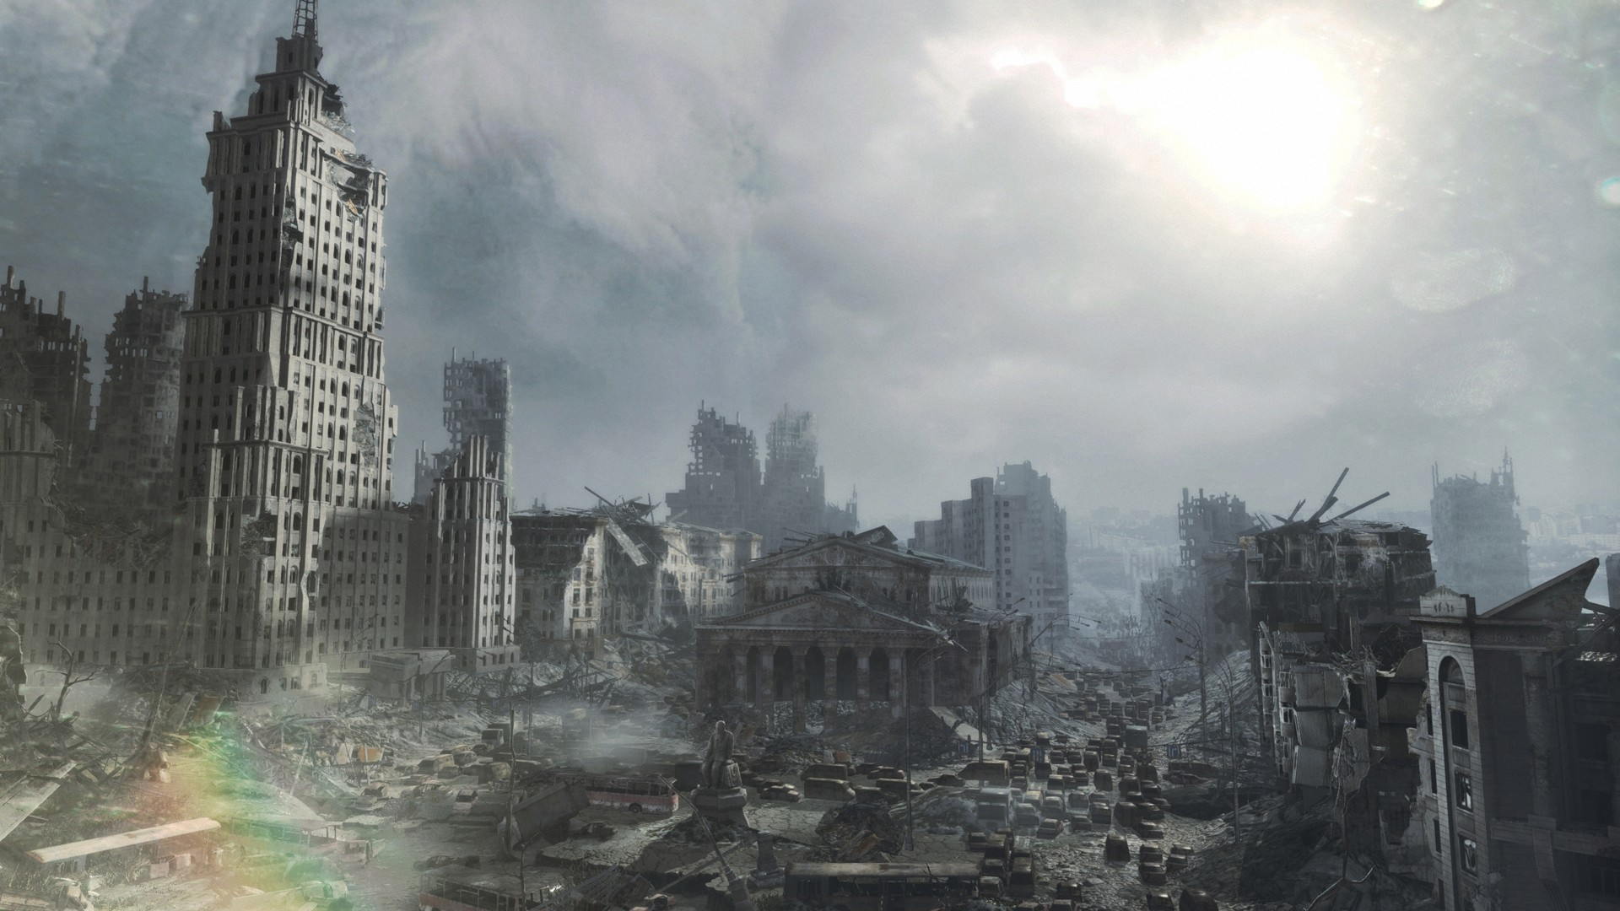
Artwork

Slide 9
Music and Scoring

Slide 10
Game Summary
Special features
Play Style
Survival: Ammo and filters are in short supply, deadlier combat and more challenging stealth, survival offers players the original survival horror oriented experience of metro 2033, with an emphasis on resource management and tense combat.
Spartan: For players who enjoy faster paced, more action-oriented gameplay. Ammo, filters and other resource are also more plentiful.
Ranger Mode
Ranger: Disables most HUD and UI elements, damage is increased, and resources are scarcer.
Ranger Hardcore: Disables all HUD and UI elements, ‘realistic’ damage, and resources are even scarcer.
Bugs
Some Jittery animations

Slide 11
Game Review
What is good (fun) about the game? Why?
Tense stealth and combat
Varying difficulties
Resource management
What is bad (not fun) about the game? Why?
Enemies don’t share the player's lack of supplies
Too linear, more exploration
Forced combat/turret section
How does it compare to similar games in the same genre?
Fallout: A more stylistic world with metro being more bleak.
STALKER: The most similar to metro, through metro is much more narrative focused while STALKER is more of a pseudo open-world game.

Slide 12
Game Review
Why is it better or worse than similar games?
Metro is more polished than Fallout and STALKER.
Metro is a shorter game, taking about 12 hours while the others are much longer; stalker 30+ hours, Fallout NV 60+ hours.
What is the appropriate audience for this game?
Fans of the post-apocalyptic genre.
Fans of Survival / survival horror.
Fans of First person shooters.
Are any design mistakes present?
Unfair enemy supplies
Forced Combat

Slide 13
Summary
Overall strengths and weaknesses.
Strengths
Engaging story
Fun and intense gameplay
Varying difficulties
Weaknesses
unlimited supplies for enemies
forced combat
Is the game worth purchasing?
Yes
How could it be improved?
Remove forced combat sections for survival and ranger modes
Enemies have a reasonable amount of supplies
Less linear

Slide 14
References
http://metrovideogame.wikia.com/wiki/Difficulties
http://metrovideogame.wikia.com/wiki/Heads-Up_Display
https://psnprofiles.com/trophies/2824-metro-2033-redux
http://news.softpedia.com/news/Metro-2033-Redux-and-Metro-Last-Light-Redux-Finally-Arrive-on-Linux-Get-Major-Discount-467267.shtml
https://www.pinterest.com/pin/348466089888735726
https://howlongtobeat.com/game.php?id=20737
https://howlongtobeat.com/game.php?id=8038
https://howlongtobeat.com/game.php?id=3351
https://en.wikipedia.org/wiki/Metro_2033_(video_game)

