Slide 1
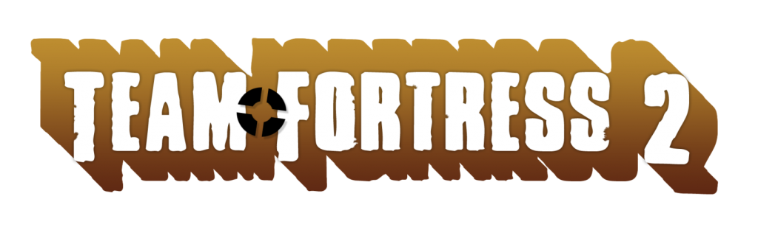
Created by Valve corporation
Slideshow by Bradley Moore

Slide 2

Price
Team Fortress 2 initially launched in 2007 for a price of 50$, being included with The Orange Box along with Portal and Half Life 2
  The standalone version of the game retailed for 20$ a year later
  In June 2011, the game went free to play

Slide 3

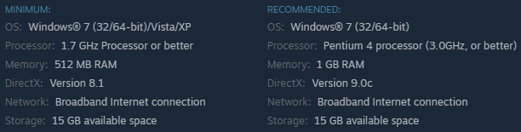
Hardware Requirements
The hardware requirements can easily be found on Steam, although they have not changed since 2007
The store does not even recommend a graphics card!

Slide 4
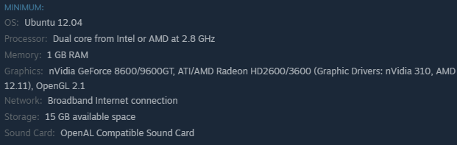
Hardware Requirements (cont.)
Because of the ludicrous amount of hats and weapons that were added to the game post-launch, the initial requirements are not accurate
Because the Linux port came about 7 years after the initial game’s release, it has a bit more accurate specifications

Slide 5
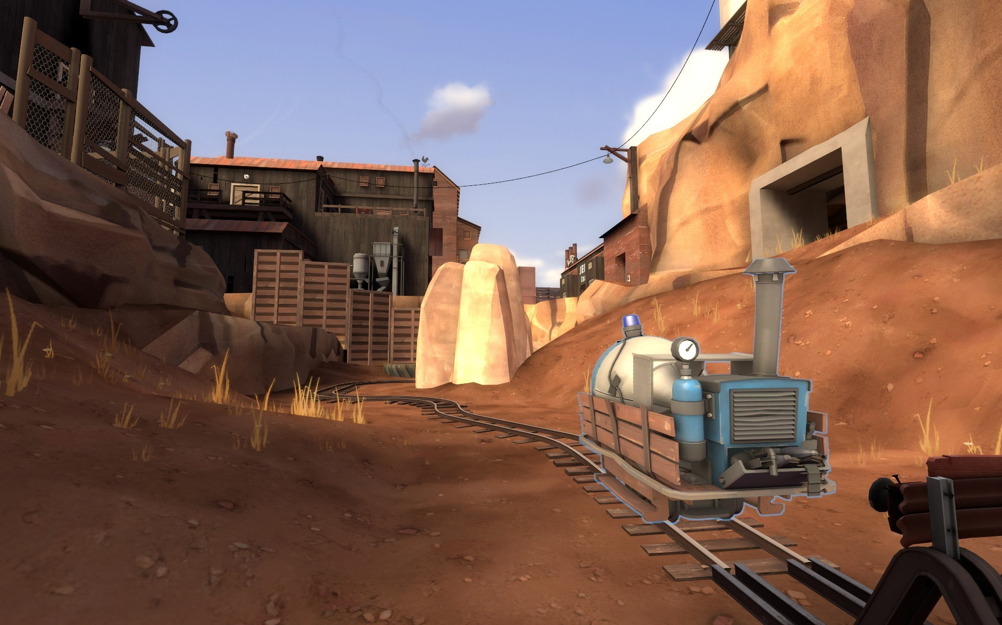
Game Type
Team Fortress was among the first in the online first person shooter genre to include distinctive classes, each with different abilities
Similar to most first person shooters, there are many game modes, all which revolve around using teamwork and strategy to push forward to the next point

Slide 6
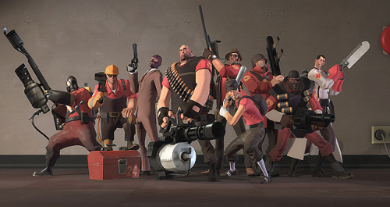
Overview
This game, being primarily online, includes no story mode, deciding to reveal the story in comic book styled shorts
The most important aspect of this game is it’s class structure, adding to the strategy and variability of team fights
These classes are split up into 3 groups; offensive, defensive, and support

Slide 7
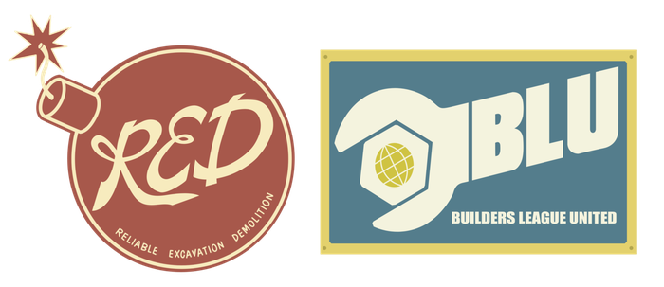
Story
The story comics for this game are released online, causing the story to only grow for the last ten years
It begins as a story of two bickering sons, Blutarch and Redmond, each receiving half of their fathers land in his will when he died in 1860, only to spend the rest of their lives fighting to take it for themselves
These two brothers both end up hiring a team of nine mercenaries to fight for their land, along with teams of scientists to artificially extend their lives
The war in the current game is occurring around 1970, with both Redmond and Blutarch being senile old men, each fighting for what is “rightfully theirs”

Slide 8
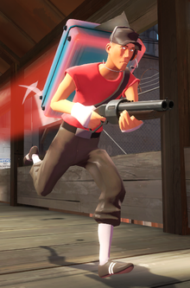
Player’s Role
Each player can choose one of the 9 mercenaries, each with their own strengths and weaknesses in each situation
The player’s job is to simply kill as many of the opposing team as possible while helping your team complete the objective
It is the players job to choose which character is best
suited for the situation, and attack or defend the objective

Slide 9

Installation
The installation for this game is all handled through the steam client, which means some DRM is required to play the game
Steam does make it fairly easy for people to install games however. Once it is found in the store, you only need to click the play button to install

Slide 10
Class overview
The first important part of gameplay is understanding the classes
  Scout – 125 hp
  Soldier – 200 hp
  Pyro – 175 hp
  Demoman – 175 hp
  Heavy – 300 hp
  Engineer – 125 hp
  Medic – 150 hp
  Sniper – 125 hp
  Spy – 125 hp

Slide 11
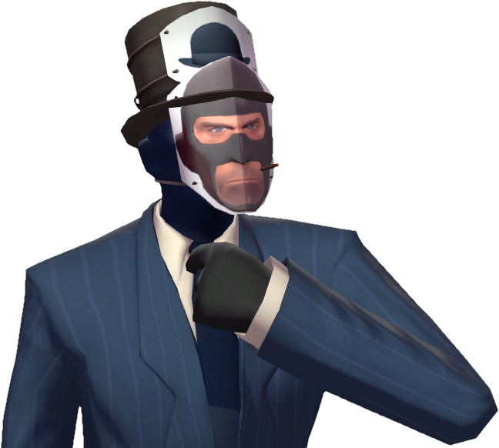
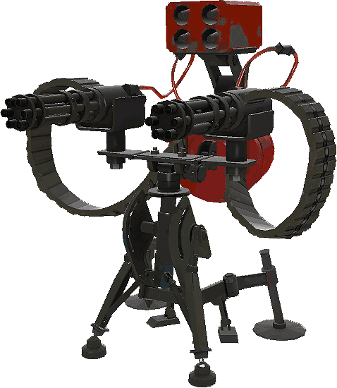
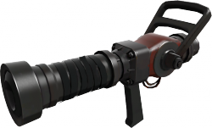
Gameplay
Because of the variety of classes, it can become a very hectic game
The majority of the classes have three damage-dealing weapons, a primary which goes along with their class, a secondary weapon, and a melee weapon
There are 3 exceptions to this, the spy, medic, and engineer

Slide 12
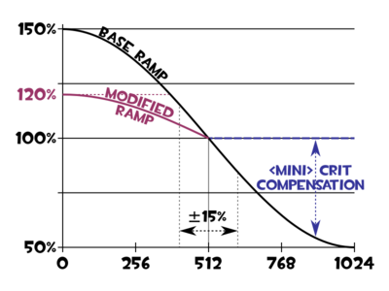
Mechanics
There are a variety of mechanics in this game which are not seen in similar games, including:
  Damage falloff- In most cases, the farther an enemy is from your attack, the less damage they will take. This increases the strategy and challenge as you must get close to get kills
  Critical hits – In casual mode there is a small percentage chance that any attack will become a critical, dealing three times the normal damage and having no damage falloff, effectively one-shotting most people

Slide 13
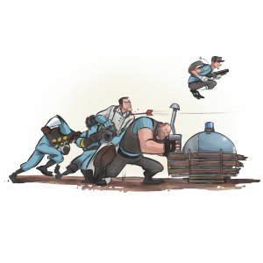
Game Modes
There are many different game modes in Team Fortress 2, with the most popular being:
  Payload – One team must push the cart to the other end, with new spawn locations at each checkpoint
  King of the Hill – One team must hold the point for three minutes total
  Capture Points – There are either 3 or 5 points on the map, and both teams try to push the other back to the final point to win
  Capture the Flag – A reboot on a classic game, the first to three captures wins

Slide 14

Scoring
In order to win a game of Team Fortress 2, you must win two out of the three rounds on the given map
In attack/defense game modes, the teams will switch after every round
In addition to winning, each person earns points on the scoreboard for kills and assists, defending, healing, and many other attributes

Slide 15
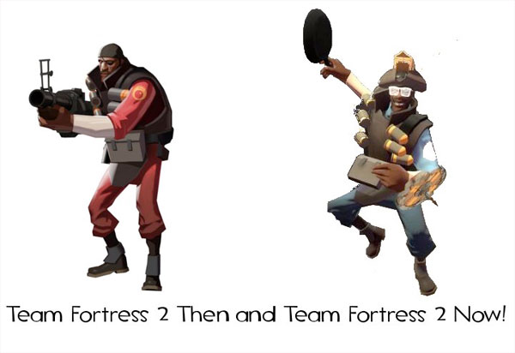
Artwork
The art style of Team Fortress 2 is very cartoony, with matte colors and a simple art style it is simple to see what is happening at a glance
The art direction has changed drastically since the game came out, largely due to the popularity of hats and other cosmetic items in the game
While the initial hat designs tried to still
keep the art style consistent, newer hats
like the “Dangeresque glasses” show
how far the style has come

Slide 16

Sound and Music
The soundtrack of this game goes along well with the era they are trying to replicate, and is also quite catchy
The music in the game only plays when in the main menu, or when you win/lose a game, meaning it does not overstay its welcome
It has heavy influences from both classic rock and jazz, including some which have an orchestral style

Slide 17
Why is it Fun?
The chaotic nature of the game
  With 24 players and 9 classes, things are always happening, keeping the action high
Easy to learn, hard to master
  Many classes have a fairly high skill cap, requiring more competitive players to learn difficult maneuvers
Good player base
  Enough people play this game to create many player-owned servers, meaning custom maps and modded servers are easily accessible

Slide 18
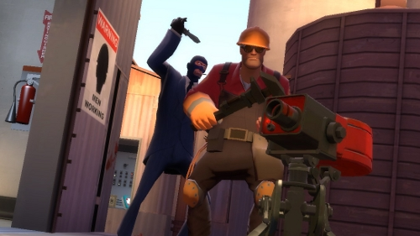
What is not Fun?
Insta-kills
  No one likes to be one shot, no matter the game. While a sniper’s accuracy must be amazing to land constant shots, the ease of a spy’s backstab can be annoying, and random criticals can feel completely unfair
Paranoia
  Continuing with the last point, any teammate around you could be a spy, so you must be fairly paranoid to avoid being backstabbed
Class Variety
  Counterintuitively, the variety of weapons each character can hold actually causes a bit too much variability in what a class can do.
  This can lead to some weapons which are unbalanced, as there are too many for each class to balance effectively
  Example: The spy can go invisible, however he can trade that ability in order to fake death occasionally on a cooldown. This causes people to expect an alive spy almost always, despite only about half of people using it

Slide 19
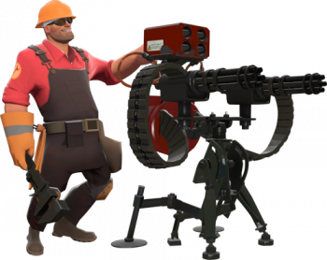
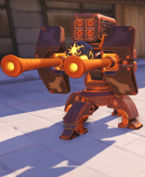
What are some similarities to Overwatch?
Overwatch, the newest and most popular game in the class centered first person shooter genre, has many similarities to Team Fortress 2
  There are at least four classes which have some mechanics borrowed and expanded upon from TF2:
    Soldier/Pharah, Demoman/Junkrat, Engineer/Torbjorn, Medic/Mercy, and Sniper/Widowmaker/Hanzo
  The game modes are also very similar to TF2, however the inclusion of hybrid maps is an interesting addition
    Some similar game modes include payload, capture point, and king of the hill

Slide 20
What are the differences?
Team Fortress 2 allows players to customize each class with different weapons for each slot in their loadout, causing the same class to potentially have very different abilities
  Overwatch makes this simpler by giving each class multiple abilities that can not change, unless there is a major update
Overwatch includes many more characters, 25 in total, but also allows only one of each character to be played on a team
  This allows there to be many different ways to approach a situation, similar to TF2’s classes
Overwatch also initially launched with a competitive mode already built in, along with golden weapons for each season’s performance

Slide 21
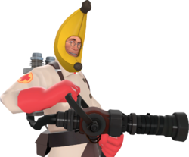
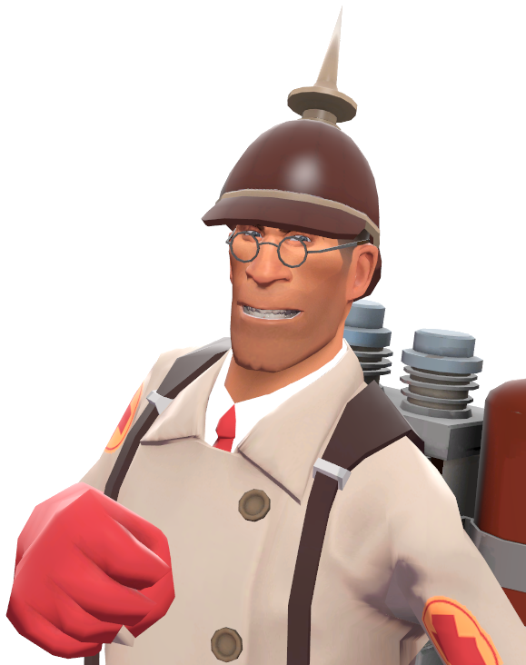
Which is better?
Overwatch and Team Fortress 2 are very similar games, however Overwatch does improve on TF2 in many aspects
  Having more classes instead of more weapons makes it possible to still adapt if your current strategy is not working, while keeping each classes core abilities the same
  The graphics in Overwatch have much more color and life to them, making the game more visually appealing
  The skins in Overwatch are all consistent with their characters design, while TF2 has a problem of ahving too many wacky or promotion items, causing the characters initial design to get lost
  Team Fortress 2 does not have a good competitive mode

Slide 22
Audience
The audience of this game are likely teens to young adults who enjoy first person shooters, but wanted a bit more variety and tactics
People who traditionally like more strategy focused gameplay may enjoy a class based shooter more than a generic FPS
People who enjoy a more casual atmosphere in a game, as competitive TF2 is not very active

Slide 23
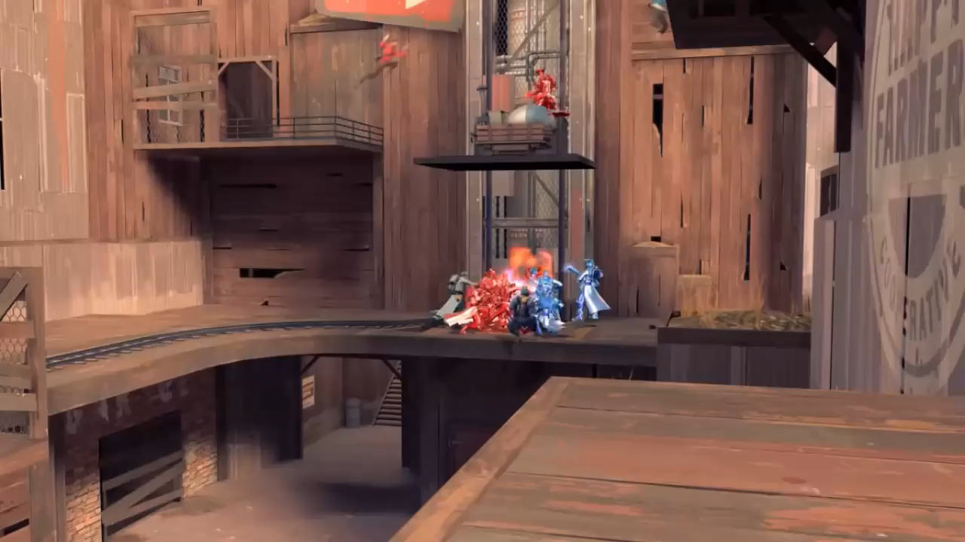
Summary
The greatest strengths of this game include fun yet difficult combat which feels rewarding, many game modes, including modded modes and maps, and a good community
Its biggest weakness is its high learning curve, as it turns away many new players while its player base is decreasing
This game is free to play, so I would highly recommend trying it for a very solid class shooter
The performance of the game could be greatly improved by removing about half of the hats from the game, as they have raised the games recommended specifications considerably

