Slide 2
Basic Information
Company: Developed by Intelligent Systems, Published by Nintendo
Creators: Directed by Ryota kawade, produced by Shigeru Miyamoto and Ryouichi Kitanishi, Written by Hironobu Suzuki and Misao Fukuda
Genre: RPG
Price: $50 (in 2004), nowadays anywhere from $40-130
Hardware: A Nintendo Gamecube and 1 controller

Slide 3
The Adventure Unfolds
The sequel to the critically acclaimed Paper mario on the nintendo 64, this turn-based RPG begins with Princess Peach inviting Mario on a treasure hunt for ancient artifacts. However, before Mario can meet up with the princess to begin their quest, it seems she’s run off without a trace. She’s left the treasure map behind, so it’s up to Mario and the colorful cast of companions that he meets along the way to continue the journey and discover what became of the headstrong royal.

Slide 4
The Quest for the Crystals
Upon arriving in the town of Rogueport and meeting the eager archeologist Goombella and her mentor Professor Frankly, mario heads down to the ruins below the city to investigate the so-called treasure. Upon reaching an ancient sealed door, the treasure map suddenly reacts, magically marking the location of a relic known as a Crystal Star. Setting off to find the artifact, Mario meets a new friend, a Koopa named Koops, and defeats the dragon Hooktail to lay claim to the Diamond Star. Thinking his quest finished, mario returns to the door -- only to find that the map marks another location. It seems the adventure is far from over.

Slide 5
Discovering what lies beyond the door
As mario and company continue to uncover the Crystal Stars, they butt heads with a mysterious orginazation known as the X-Nauts. It would seem that this nefarious group is bent on world domination, and they need the crystal stars to do it. Apparently, these villains are also the ones that kidnapped Princess Peach, and she seems to be essential to their plans as well; this information leads Mario and friends to hypothesize that the “treasure” behind the Thousand-Year Door is actually something much more sinister.

Slide 6
Basic gameplay
The player takes up the role of mario in this RPG. The game consists of exploring an expansive overworld through the use of Mario’s signature platforming abilities in order to solve various puzzles and proceed through the game. Along the way, Mario will meet new party members and gain new abilities to allow him to progress as well -- these abilities contribute to the game flow in ways like allowing him to reach new areas, deal more damage, or solve new puzzles.

Slide 7
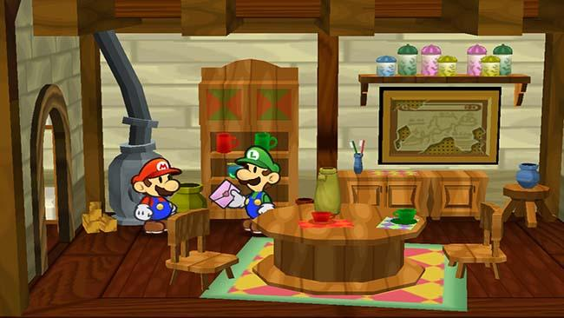
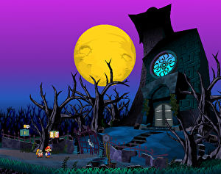
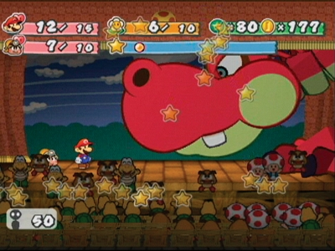
The Style and Sound of Paper Mario
The paper aesthetic of the game world is very charming, and the graphics hold up very well for a game made 13 years ago. The music is also quite high quality, featuring remixes of classic mario tracks and excellent original compositions as well.

Slide 8
This game has bugs?
For the most part, 99% of players won’t encounter any bugs playing through the game normally. However, speedrunners have found a great number of bugs and glitches that speed up the process of completing the game -- some are used to skip certain chapters of the game, acquire upgrades or partners earlier than intended, or activate event flags out of earlier. That being said, none of these bugs can really be encountered by accident, and the casual player will have no trouble completing the game without issue.

Slide 9
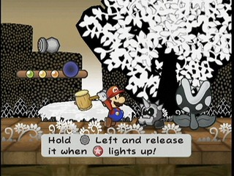
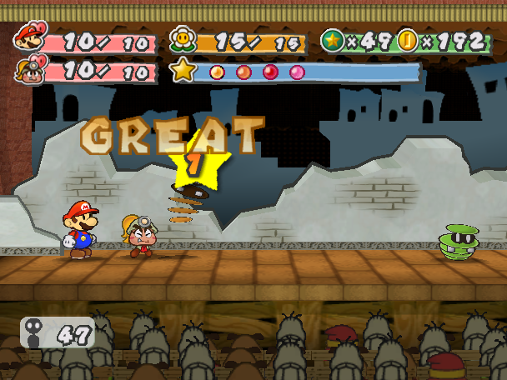
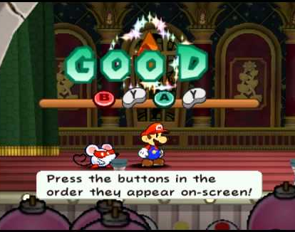
Why it’s good: The Combat
Forgoing the typical turn-based combat of other games of the genre, Paper mario puts the player in a much more active role -- every attack requires input from the player, and each attack has different button commands and timing, so combat is always active and interesting. The player is rewarded for good timing on defense as well, being able to reduce or completely negate incoming damage.

Slide 10
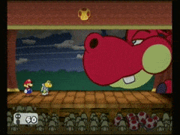
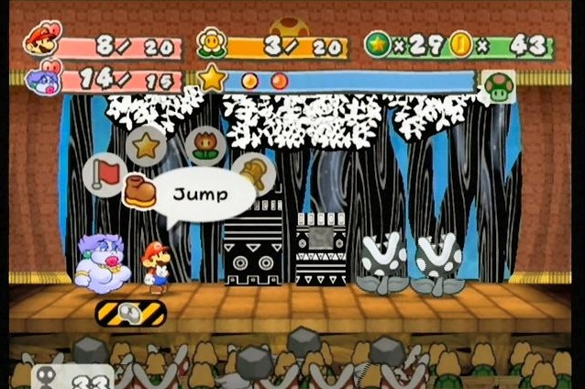
Why it’s good: The presentation
The world, thanks to its paper aesthetic, gives off the vibe of a pop-up storybook, and it’s very charming. The game is also split up into 8 chapters, which further reinforces the idea that you’re turning the pages of a thrilling tale the more you play. The game presents battles as mario and his enemies putting on a stage play, and the audience actually matters -- impressing them lets you use special moves, boring them can cause them to pelt you with rocks, and bosses and enemies can attack them as well!

Slide 11
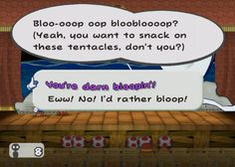
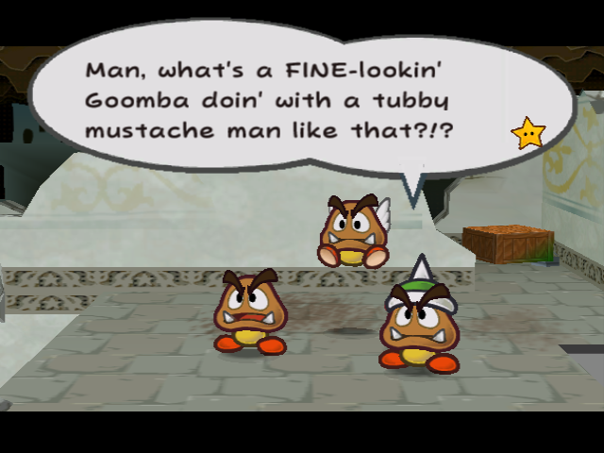
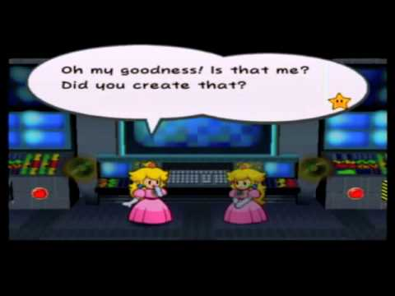
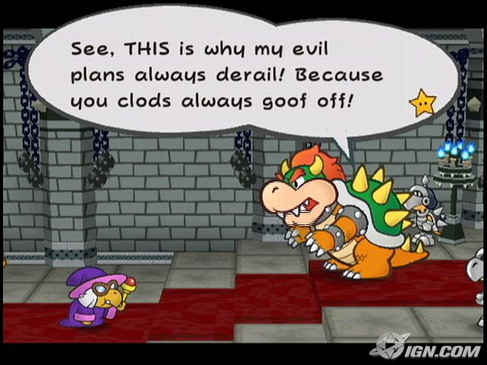
Why it’s good: The Story
One of the most compelling stories I’ve encountered in videogames is in this game. Very well-written, charming and hilarious, and at times epic in scale, Mario saving not just the princess, but the entire world, is a nice change of pace from “jump through this level.” Peach herself is a well-developed character with personality, Bowser is no longer a big bad turtle, but a lovable baddie with a sense of humor, and the main villain oozes evil.

Slide 12
So...What’s bad?
I have very little negative to say about this game, however, it isn’t perfect. Chapter 2 has an annoying mechanic where you have to keep track of these small creatures called punies, and they get lost and scared very easily. Chapter 4 has a lot of annoying backtracking, and enemies that can very easily kill you since you don’t have any of your partners with you. It’s basically just running back and forth through the same 5 screens with different information required to progress. The pacing of the story is a little slow in the first few chapters, as well.

Slide 13
How does it stack up to other RPG titles?
Personally, I find this game much more compelling than other traditional turn-based RPGs. The interactivity of the combat, coupled with the more light-hearted story that isn’t afraid to make fun of itself, make this an incredibly fun and enjoyable experience, even for people who aren’t the biggest fans of things like Final Fantasy or Dragon Quest. Add in a fantastic soundtrack, compelling side characters and lots of side quests, and there’s plenty of content to be found and enjoyed.

Slide 14
Who should play this game?
Everyone. You. Your parents. Your grandparents. Your children and your children’s children. This game is an experience that is very rewarding for people of all ages, and the perfect RPG for people who aren’t RPG fans.

Slide 15
Design Flaws
The game features an expansive collection of badges that can customize Mario’s stats, abilities, and buffs. A few of these badges up mario’s attack power when he is at 5 health or lower, which is known as the “Danger” state. There is also an NPC that can take stats from one category, such as HP, and add it to another category, like FP. Doing so puts Mario into danger permanently, allowing the player to take advantage of the power buff at all times -- and wearing more than one badge stacks the bonus. Not necessarily a bug, but it allows players to come up with pretty interesting strategies that were most likely not intended by the developers.

Slide 16
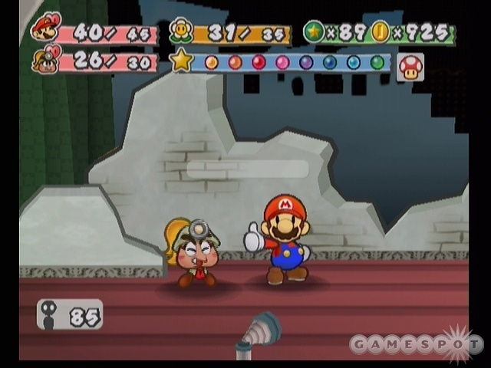
Summary
Paper Mario: The thousand, year door is an incredible, fulfilling game that is very well polished and designed, and a great example of making a game accessible to people who are not typically fans of the genre that the game belongs to. It is also an excellent example of maximizing the power and limitations of the hardware to create an optimized, seamless experience.

