Slide 1
Knights of the Old Republic
The Sith Lords A game review by: Zachary Kreklau

Slide 2
Game Specs
KOTOR2 uses the odyssey engine created by Bioware
Released December 6th 2004 on the xbox
Roleplaying game
Turn based combat
D20 based system
Basically D&D reskinned as star wars
Trailer: https://www.youtube.com/watch?v=Ka2a_xctbRw
Added Prestige classes

Slide 3
Combat
The game has real time combat but is pausible.
It is turn based so enemy and character will take an action each turn
If no action is selected a basic attack on the nearest enemy is executed
Force powers, and feats provide characters with actions
Can switch between you and your 2 party members and give them actions
Gameplay for combat: https://www.youtube.com/watch?v=DOdn9likqzc

Slide 4
Story
To be honest this game has one of the best plotlines that I’ve ever played.
Synopsis: you are trying to re-establish your connection to the force while being hunted by every evil entity in the galaxy as the last jedi. Everyone calls you the exile because you were exiled from the jedi order for war crimes and genocide.

Slide 5
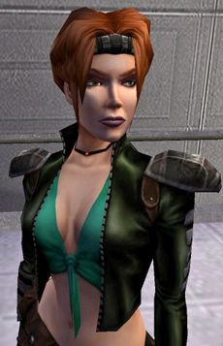
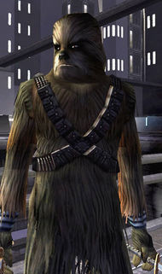
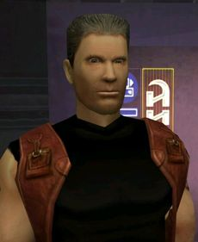
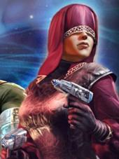
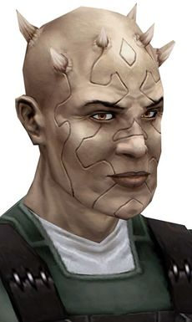
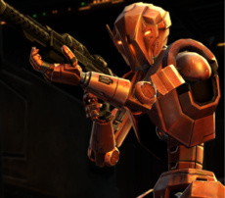
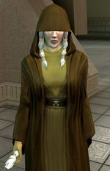
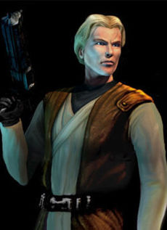
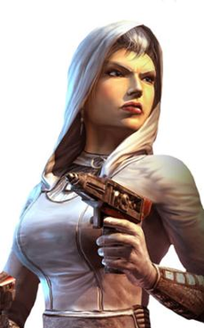
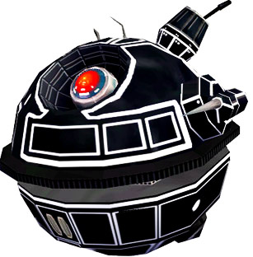
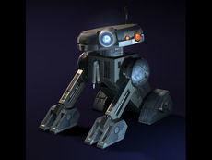
Party members
There are 12 total party members however you can only ever have 10 depending on your actions or gender

Slide 6
Party members expanded
J denotes if they are trainable into a jedi
Atton Rand – former sith assassin and mandolorian war veteran J
Mical – former jedi youngling who never became a full fledged jedi J
Visas-Marr – Darth nihilus’s apprentice and last of her kind J
Brianna – Echani handmaiden of atris J
Bao-Durr former general under you in the war and tech expert J
Mira – bounty hunter who was raised by mandolorians J
HK-47 – assassin droid who was built by revan (best character)
G0-T0 – droid who runs a bounty hunter and smuggling enterprise
Mandalore – canderous ordos leads the mandolorians
Kreia – former sith lord who is your mentor, you guys hold a bond
T3-M4 – astromech droid that aids you in your travels was revan’s droid

Slide 7
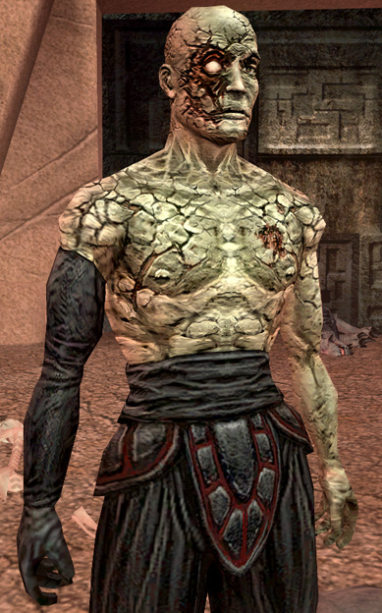
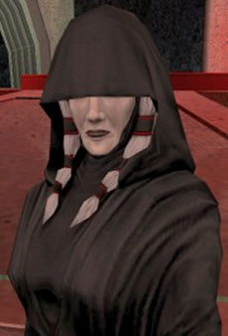
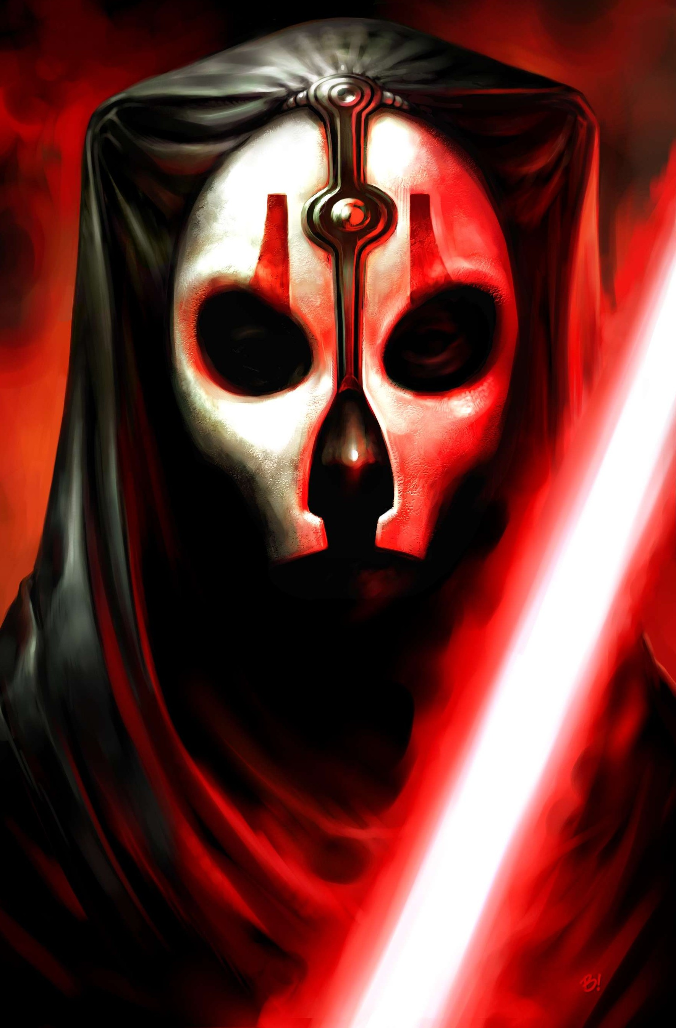
Bad Guys
You have to beat all 4 of the bosses at the end game sequence and each gets progressively harder You fight atris first(bottom left)
Then Darth Nihilus(bottom Right)
Then Darth Sion (top left) The final boss Darth Traya aka Kreia (top right) Darth Traya is kind of a story twist because of the irony as a player you know she was a sith lord and probably still is, but the character has no ideal that she is going to betray her, and has been acting against her the entire story. In the pregame knowledge she saved you from assassin droids and she was your mentor the entire game healing your connection to the force.

Slide 8
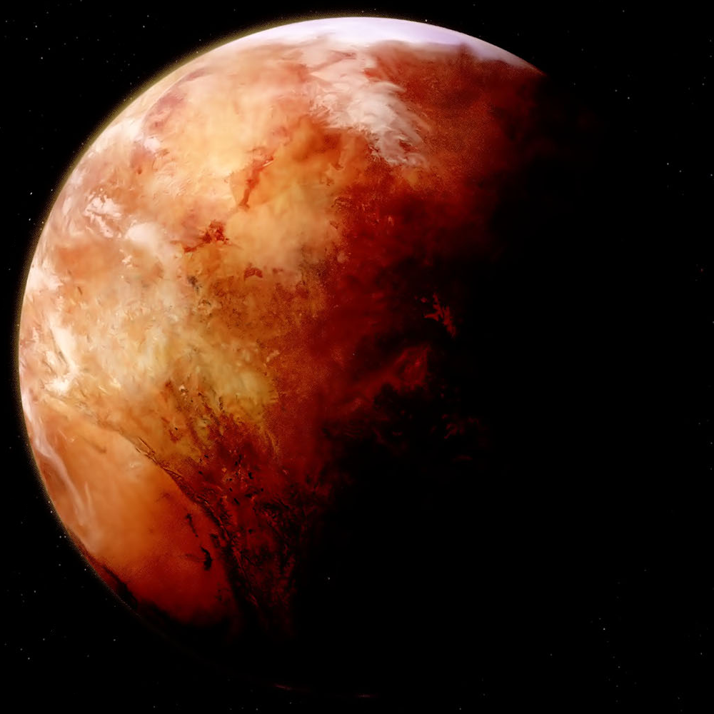
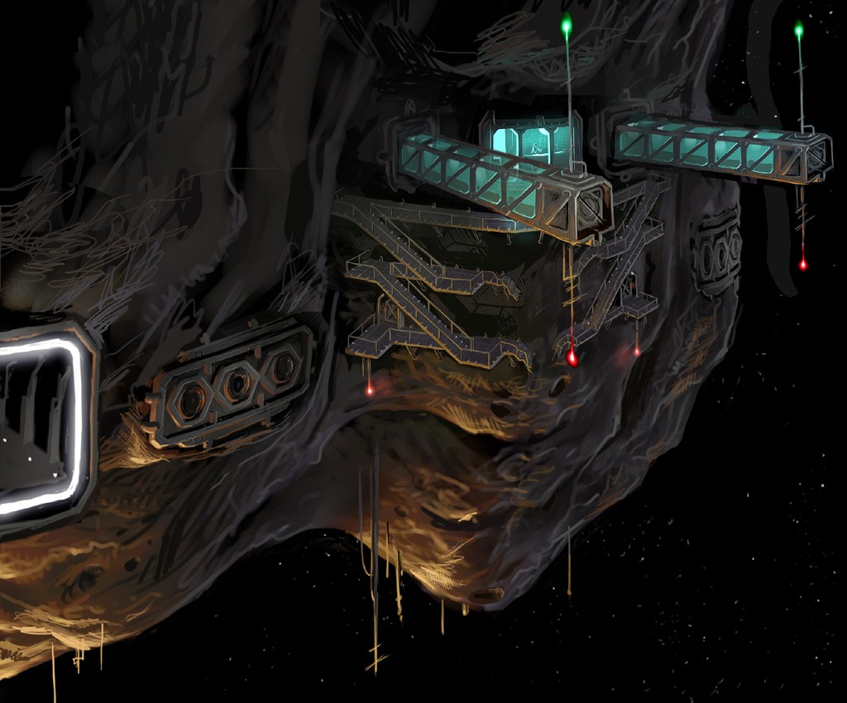
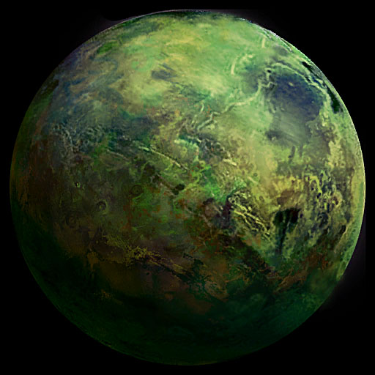
Planets
You start in the mining Facility which is kind of like a prologue You then head to Telos which has environment damage
Then you head to Nar Shaddaa which is a smuggler moon of bounty hunters
or you can go to korriban and see the old sith academy
Or Onderon for the civil war
Then Dxun for the mandolorian base then back to Onderon to finish the war
Back to Telos then to Malachor V

Slide 9
Mods and Bugs
A lot of the game content was cut due to lucas arts time constraints
8 years later a restoration game mod was created for the game
It restored a lot of cut content that the developers had to removed to meet time constraints however it didn’t added the planet the extra droid planet that was removed
There was some bugs that would crash the game like a giant monster that creates a gas cloud after it dies which would crash the game if the camera angle caught it

Slide 10
Compared to Similar Games
I’d say Kotor 2 is one of the best games ive played, the games that I’d say it worse than would be Mass Effect 1 because mass effect was quite profound to say the least with its story.
I would say that there isn’t much to make the game better maybe a party mix up like in Kotor 1 or the original cut content added back
The Story is what makes this game the easily in the top 3 RPG games I’ve played.
Hopefully they adapt it to a mobile application like they did with Kotor 1
The Audience I would say at least 10 it is preferable to be older so you can understand social situations better but I played it at 10 and loved it.

