Slide 1
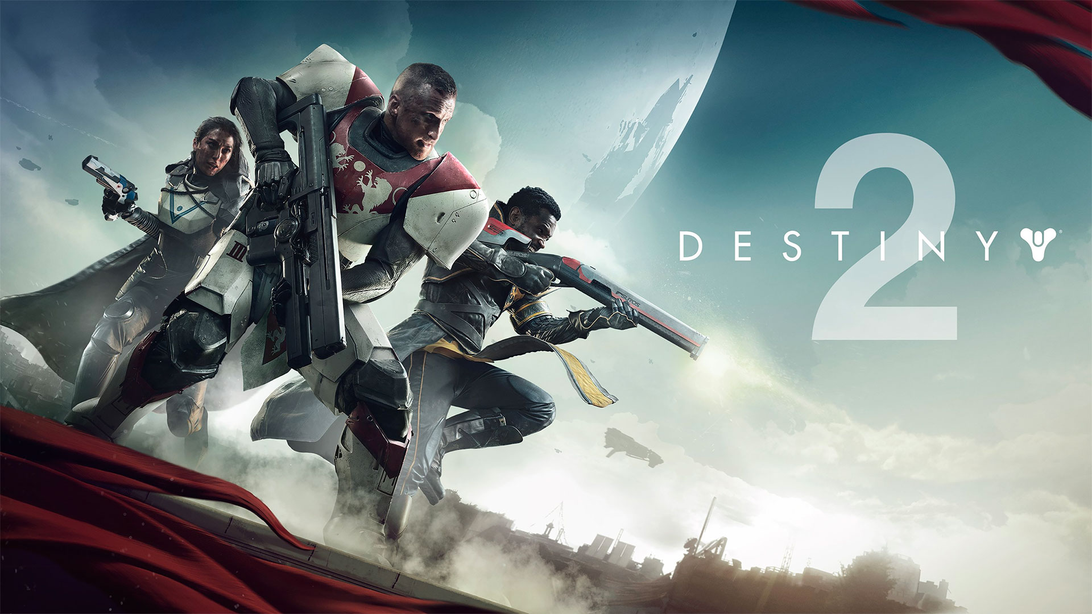
Reviewed by: Corey Knick
(PS4 Version)

Slide 2
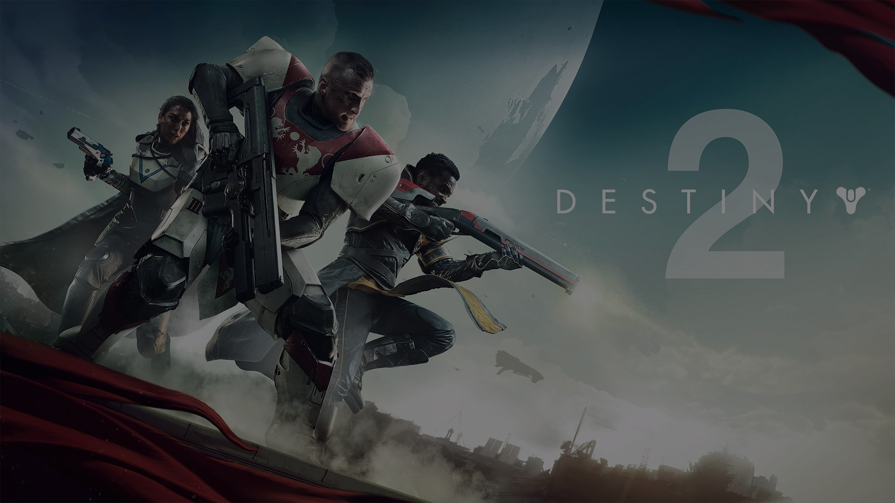
Basic Info
Developed by Bungie, Published by Activision
  Director – Luke Smith
Type of Game – Aspects of FPS, MMORPG
  “Shared World Shooter”
Audience Age: Teen
  Violence, Blood, Language
Price - $59.99

Slide 3
Hardware Requirements
30 GB download on PS4 / Xbox One, PC size unknown
Minimum Hardware requirements
  OS - Windows 7 / 8 / 10
  Processor - Intel Core i3 3250 or AMD FX-4350
  Graphics - NVIDIA GeForce GTX 6600 or ATI Radeon HD 7850
  Memory - 6 GB RAM
Recommended Hardware requirements
  OS – Windows 7 / 8 / 10
  Processor – Intel Core i5 2400 or AMD Ryzen R5 1600X or better
  Graphics - NVIDIA GeForce GTX 970 or AMD Radeon R9 390 or better
  Memory – 8 GB RAM

Slide 4
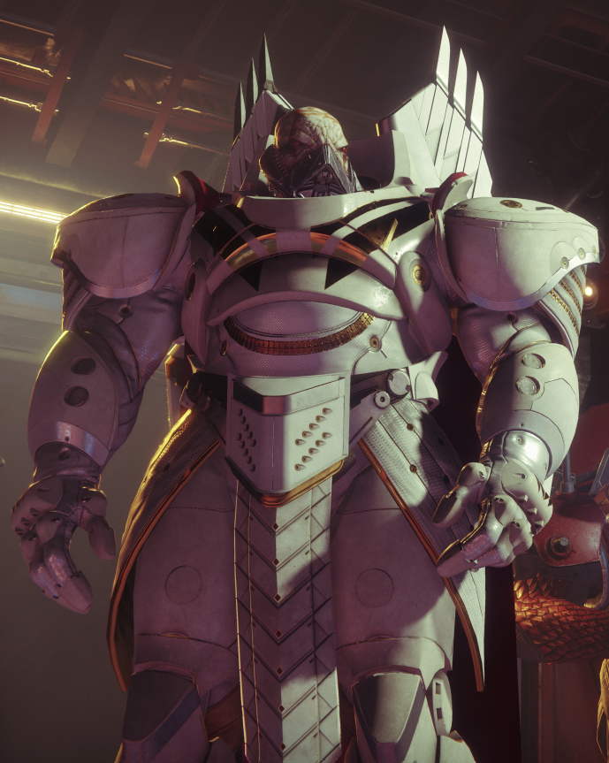
Game Overview
Background
  Set in the future, Humanity has prospered thanks to the “light”.
  The “light” was being hunted by the “darkness” and created Guardians to defend itself.
In Destiny 2
  The Guardians are attacked and their light is stolen.
  The player is chosen to slowly regain their light and must defeat Ghaul in order to restore light to the other Guardians.

Slide 5
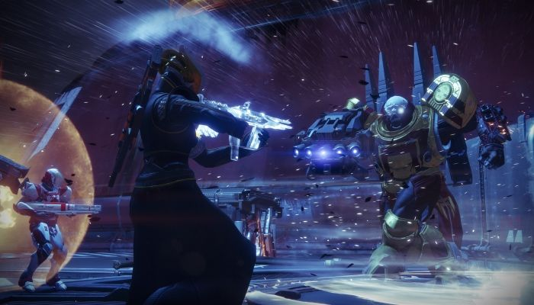
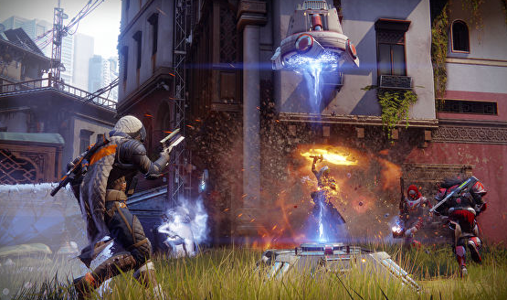
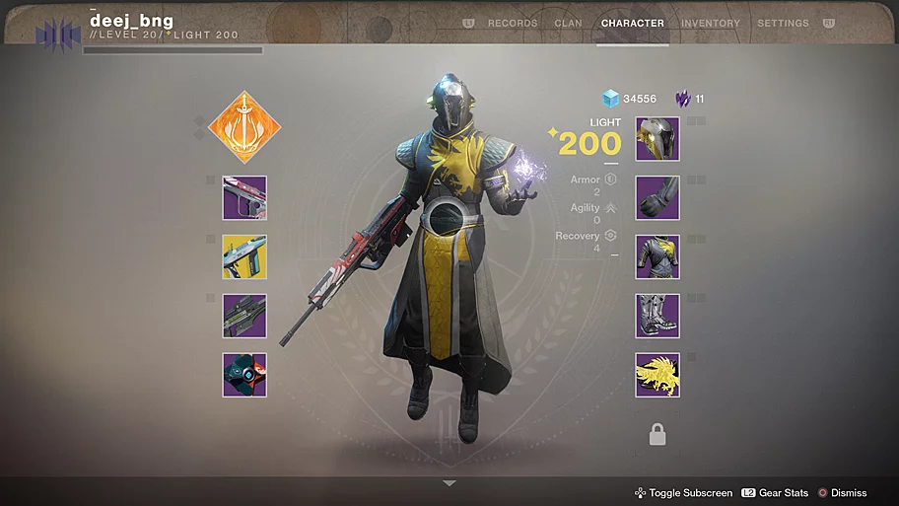
Game Summary – Gameplay and UI
Game Play and Scoring
  PvE
  PvP
  Weapon Choices
  Classes and Subclasses
User Interface
  Menu Screens – Given a cursor
  Director (Map)

Slide 6
Game Summary - Other
Sound and Music
  Unique sound effects for different guns and abilities
  Wide range of background music throughout the game
Bugs
  Visual glitches
  Quests not rewarding loot

Slide 7
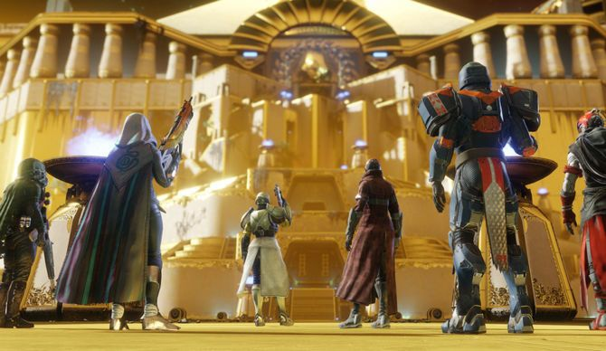
Game Review
What is good (fun)?
  Gunplay
  Social Aspect
  Raid
What is bad (not fun)?
  Lack of Selection in game modes
  Some activities seem pointless

Slide 8
Game Review - Similar Games
Borderlands Series
  Both games are “loot-shooters”, but Borderlands’ system feels more rewarding. It also has a better story.
  Destiny 2’s gunplay is superior and it has PvP.
  Edge: Borderlands
The Division
  Both games are shared world shooters with a PvE environment, but the Division’s PvP zone is more creative.
  Destiny 2 has a wider range of options for the player and has a higher replay value.
  Edge: Destiny 2

Slide 9
Game Review - Improvements
Design Mistakes
  Only one difficulty
  Crafting / Mods
How could it be improved
  Implement a form of in game lore
  Better Item management

Slide 10
Summary
Strengths
  Easy to play with others
  Outstanding gameplay
Weaknesses
  Lacking if a solo player
  Limited end-game activities
Is the game worth purchasing?
  If you enjoy either FPS or RPG games, yes
  If not, then probably pass

