Slide 1
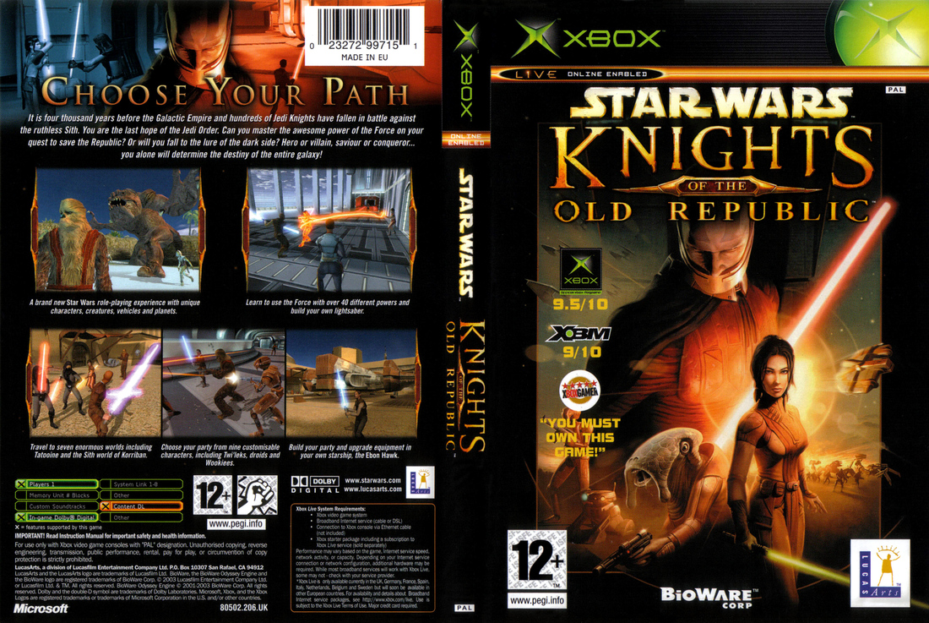
Star Wars: Knights of the Old Republic
Presented by Erik Johnson
CIS487 Fall 2017
Image: KOTOR EU Box Art

Slide 2
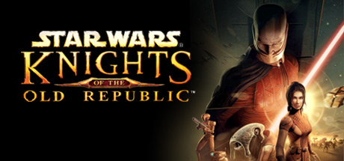
Basic Information
Image: KOTOR Store Page on Steam
Company: BioWare Edmonton
Writer: Drew Karpyshyn
Type of game: Role-playing
Price at Debut: $49.99
PC / Xbox / Android / iOS
Minimum HW Reqs (PC):
CPU: Pentium III or Athlon, 1 GHz
RAM: 256 MB
OS: Windows 98SE/ME/2000/XP
Video Card: 32 MB OpenGL 1.4 AGP w/ HW T&L
DirectX 9.0b
Sound Card
4X CD/DVD-ROM
Minimum Android Reqs:
OS: Android 4.1+
Minimum iOS Reqs:
OS: iOS 6.0+
Device iPhone / iPad / iPod Touch
Recommended HW Reqs (PC):
CPU: Pentium III or Athlon, 1.6 GHz
RAM: 512 MB
OS: Windows 2000/XP
64 MB OpenGL 1.4 AGP w/ HW T&L (GeForce4 Ti+ / Radeon 9200+)
DirectX 9.0b
Sound Card
16X CD/DVD-ROM
Notes:
Company: BioWare was formed in ‘95 by three doctors (MDs): Ray Muzyka, Augustine Yip, and Greg Zeschuk. They formed a joint venture with Pandemic Studios before eventually being bought by EA. The studio became known as BioWare Edmonton after being merged with Mythic Entertainment and adding other studios to its joint venture.
Price: Was not able to find an official source for the price, the price I found was based on my own memory and several sales sites that listed it new at 49.99.

Slide 3
Game Summary
Image: KOTOR Store Page on Steam
3d RPG with realtime exploration and pausable, tactical combat.
Heavily story-based
Star Wars!!!!!!!!!!!!!!!!!!!!!!!11eleven
Pre₁ + Pre₂ + Pre₃ + …. + Pre_{n} quel (3951 years BBY)
3rd person (for the most part)
Multiple minigames
Pazaak, Ebon Hawk space dogfighting, Puzzles
Stats-based (DnD)
Item-based
Open but not open world (point of no return events)
Alignment system (Light/Dark)
Class system (Soldier/Scout/Scoundrel, Jedi Guardian/Consular/Sentinel)

Slide 4
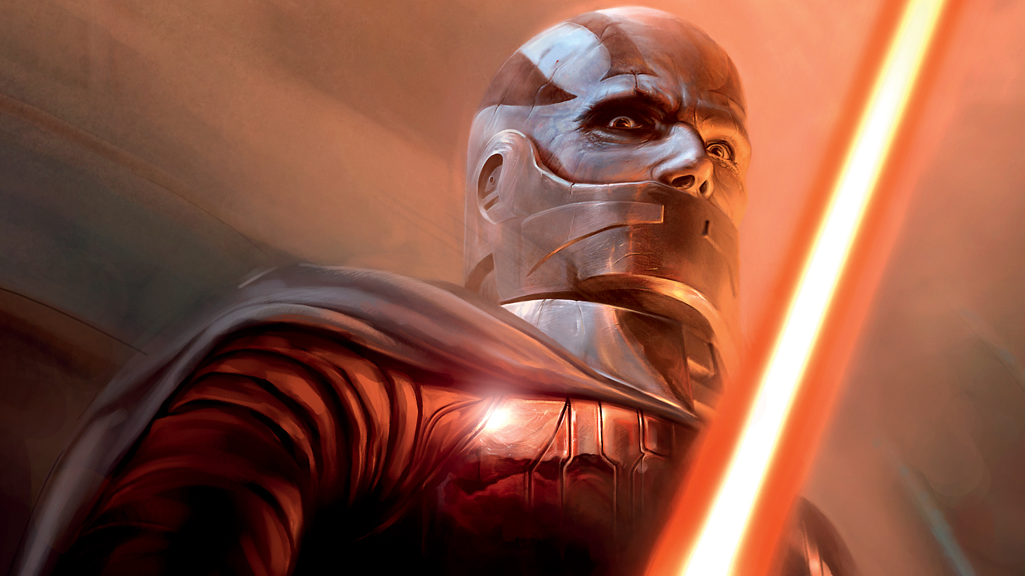
Game Summary
Image: KOTOR Store Page on Steam
Player’s Role
Story
Image: Darth Malak (Wookieepedia site)
Notes:
Player’s role starts out as a nobody and evolves into the greatest hero the galaxy has ever known (Hero’s Journey!)
There is WAY, WAY too much to fit in one small presentation, especially considering that certain parts of the story change DRAMATICALLY depending on player choice and alignment, but the 1 minute version for a strict Light Side playthrough is:
The player joins Carth Onasi (a Republic soldier) in escorting Bastila Shan to the Republic because she has a rare and critically important force power, battle meditation.
You fight against Darth Malak, the current Dark Lord of the Sith, who is searching for Bastila to either try to convert her to the dark side, or kill her.
You learn that Malak was formerly a Sith Apprentice to Darth Revan, an even more powerful Sith. Malak and Revan started as Jedi in the Republic, but fell to the Dark Side, turned against the Republic and attacked them. This attack occurred immediately after the Mandalorian Wars left the Republic weakened, allowing Malak and Revan to seize control of many Republic worlds and start a new war. Malak eventually betrayed Revan by ordering the ships in Revan and Malak's fleet to fire upon the ship Revan was on.
Through a serious of visions, story and dialogue you uncover more information about Revan and Malak... until...
SPOILER????
Malak reveals that YOU are Darth Revan. You were captured by the Republic and the Force was used to wipe your memory to see if you could be redeemed.
In a fight with Malak, Bastila is cut off from you and Carth, and disappears. You leave without her.
You learn more information about Malak's aims.
Malak seeks the power of the Star Forge, a highly advanced mass manufacturing engine created by an ancient race that would give his military nearly limitless capability for manufacturing starships.
In finding the home world of the ancient race that created the Star Forge, you also find Bastila... who has fallen to the dark side. She tries to persuade you to join her, but you refuse. She bails.
You head to the Star Forge, redeem Bastila, defeat Malak, destroy the Star Forge, and live happily ever after... OR DO YOU? (KOTOR2 & SWTOR)

Slide 5
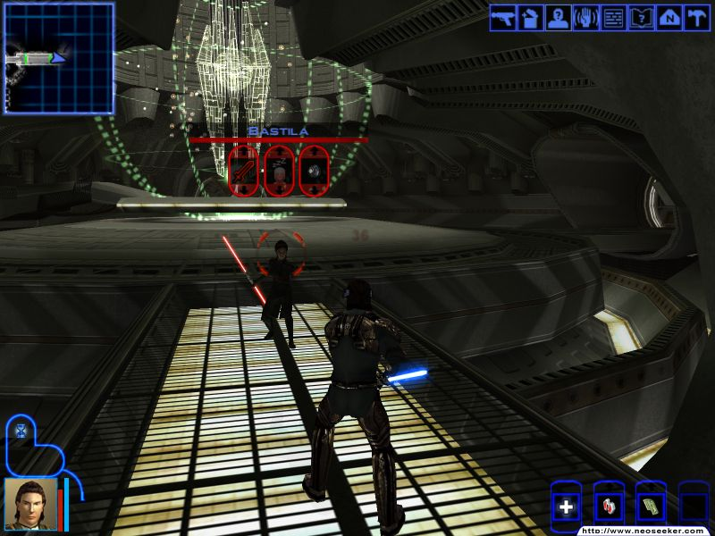
Game Summary
Image: Fight against Bastila (Screenshot from Neoseeker)
Image: KOTOR Store Page on Steam
Installation:
Xbox – None!
PC – Installed through Steam (Great UX, select, click Install, click Next a few times and you’re good)
Android – Installed via Google Play Store
iOS – Installed via App Store
User Interface

Slide 6
Game Summary
Image: KOTOR Store Page on Steam
Gameplay
Open area exploration in 3D
Several different worlds to travel to, using Ebon Hawk
Ebon Hawk itself
Character Progression
Experience, leveling up & stats increase based on “quest” outcomes and combat
Minigames
Ebon Hawk starship battles
Pazaak
Puzzles
Tower of Hanoi
Dialogue “scenes” that influence your stats and are in turn influenced by your stats
Base Stats (Str/Dex/Con/Wis/Int/Cha)
Non-combat Skills
Non-combat Force Powers
Round-based combat, pausable, multi-character (up to 3)
Combat Skills
Combat Force Powers
Auto Attack
2h Ranged Weapons / 1H & Dual Wield Ranged Weapons
2h Melee Weapons / 1h & Dual Wield Melee Weapons

Slide 7
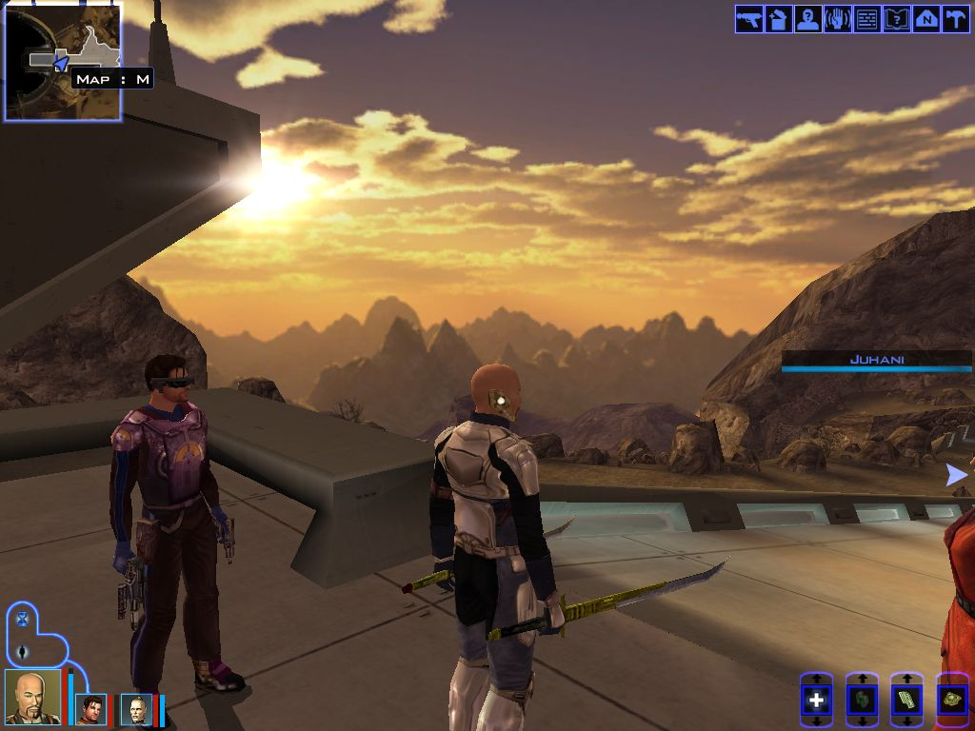
Game Summary
Image: Korriban (Sith Headquarters and Ancient Dark Side Haven)
Image: KOTOR Store Page on Steam
Artwork
3d models
2d textures
Particle effects

Slide 8
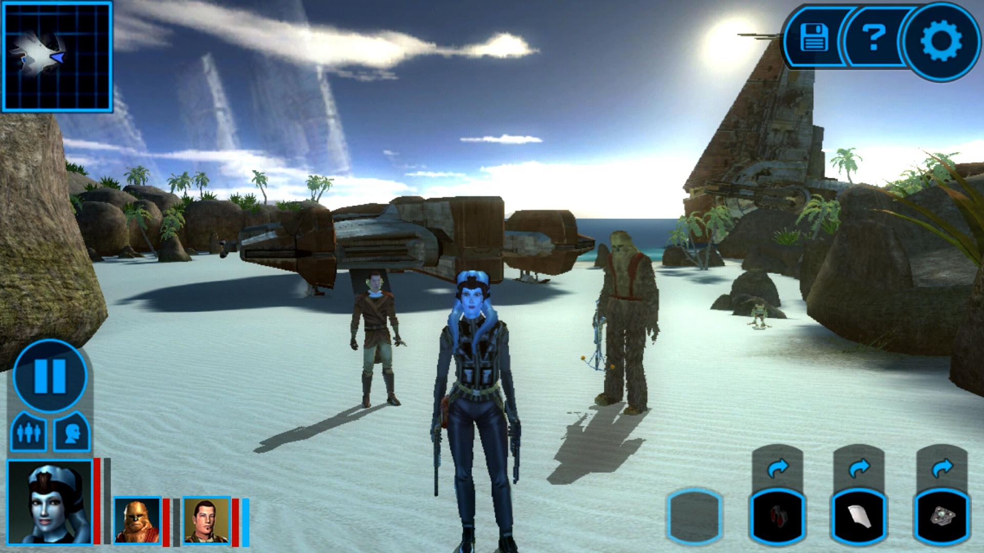
Game Summary
Image: Lehon (Home of the Rakata)
Image: KOTOR Store Page on Steam
Artwork
3d models
2d textures
Particle effects

Slide 9
Game Summary
Image: KOTOR Store Page on Steam
Sound
Many, many voiced characters
300, to be exact, with 15,000 lines of dialogue
Jennifer Hale (Mass Effect), Ed Asner, Ethan Phillips
Music
Scored by Jeremy Soule (Skyrim and others)
https://youtu.be/jSKvMyruPTA?list=PL43516D2ACB876976&t=18

Slide 10
Game Summary
Image: KOTOR Store Page on Steam
Special Features
Character portrait generated from 3d model of your character
Nearly all in-game items modify your character’s aesthetic
Story changes depending on your choices
Different endings, main characters can die
Lots of voice acting for its time
Per Voice Department Manager, all voice scripts took up 10 5-inch binders.
Player-controlled-and-inhabited ship, the Ebon Hawk
Visitable as a location in game, the ship is so large it needs its own map.

Slide 11
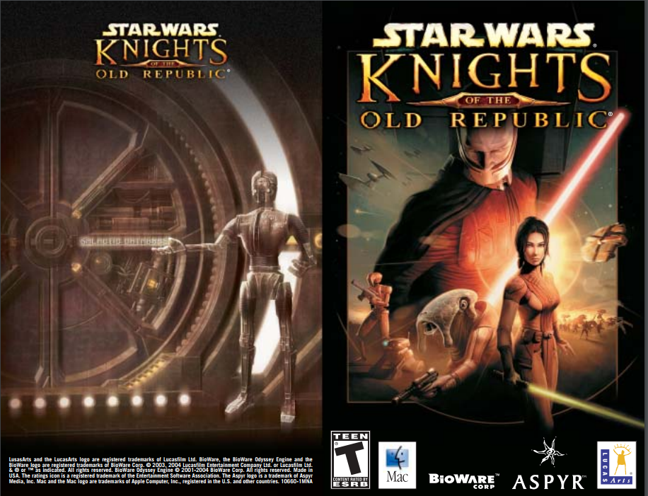
Game Summary
Image: PDF Manual (Aspyr Media Web Site)
Image: KOTOR Store Page on Steam
Manual
Full-color printed

Slide 12
Game Summary
Image: KOTOR Store Page on Steam
Bugs
On 16:10 resolution, textures appear a bit stretched out (tested on my 1680x1050 monitor)
Menu is VERY SMALL on modern resolutions
Worst bug:
There is a point where if you are cloaked when you finish a certain section, at a later point in the game, the game will get stuck during a certain dialogue scene, because the character that is supposed to be speaking will be invisible. The game will make an awareness check vs that character’s stealth rating, and if it fails, it will retry every 20 seconds. If your awareness is too low, you will have to reload a previous save as it will reroll forever. If it is close, you may have to reroll for hours. If it is high enough it will only take a few tries. The “rolling” is not communicated to the user in any way.
(Source: https://www.gamefaqs.com/xbox/556553-star-wars-knights-of-the-old-republic/faqs/24705):

Slide 13
Game Review
Image: KOTOR Store Page on Steam
What’s fun:
Story and intricacy of story & dialogue
Your stats influence the dialogue and events
Events and dialogue influence your stats
Combat
Combat is hectic but manageable thanks to being able to pause
This makes it easy to switch strategy / tactics mid-battle
Player Choice
Signature BioWare… The ability to change the story based on your actions and alignment
You can alienate potential NPCs that can join you so they refuse to join you
Main characters can die
Variety of Gameplay systems
Ship combat, card games, classic puzzles with a Star Wars spin, person vs. person combat with many foes, bombastic & huge boss fights with interesting mechanics
Quest/Mission Variety and Depth
Even the side quests are interesting
NPCs that join you have their own quests too
Great characters with high character depth
Each character has a fully fleshed out backstory & reason for doing what they are doing
One of my favorites is HK-47, a murderous assassin droid with a disdain for organic life and a slew of funny one liners "Translation: He requires proof of good faith. We must make a contribution to his people that shows we are not a threat. Shall I blast him now, master?"
―HK-47, during Revan's negotiations with the Sand People chieftain
Why it’s fun:
Story and intricacy of story & dialogue
Gives you an emotional connection to the game and increases immersion
Combat
The combat is fun because it is interspersed between other types of events, so you don’t get fatigued even though the combat is relatively simple.
Player Choice
Adds a high level of immersion and make suspension of disbelief easy
Adds to the feeling you are part of a world, a universe
Variety of Gameplay systems
As mentioned for Combat, this makes sure you will never get bored from just doing one thing, as the systems are interleaved very well throughout the game.
Quest/Mission Variety and Depth
For the same reason as above. Prevents fatigue from doing the same thing over and over, and increases the immersivity of the world
Great characters with high character depth
Makes it easy to relate to the characters to form an emotional connection

Slide 14
Game Review
Image: KOTOR Store Page on Steam
What’s not fun:
When the game first came out for Xbox, each time you traveled to a new system, you had to wait a while for the disc to load.
No fast travel system
Few “grey” options – very polarized
Why it’s not fun:
Disc wait & no fast travel – this meant that if you forgot to do something on one of the world you had to wait for it to load (minimum 30 seconds) and then run ALL THE WAY back (depending on zone might take you as long as 10 minutes). NOT FUN.
Having few “grey” options… choices where morality isn’t black or white… means that you are either playing the insane villain or the do-gooder knight stereotypes most of the time.

Slide 15
Game Review and Summary
Image: KOTOR Store Page on Steam
How does it compare to other games in the same genre, why is it better or worse, what is the appropriate audience, are any design mistakes present?
At the time, it was simply incomparable, there wasn’t anything that was even close.
In present day:
It is still a holistically good and really fun game, even compared to games like Skyrim and the Witcher.
When compared to other BioWare games such as Mass Effect (except Andromeda obviously) I’d say the Mass Effect games edge it out
It is slightly worse than similar games, simply because the aesthetic has changed and was subject to stronger limitations in play on the Xbox, and lacks improvements in UX/UI and game design that have become standard since its release.
The appropriate audience for the game is anyone that loves a good story, and has an attention span for dialogue and round-based tactical combat, and puzzles.
The lack of fast travel and “grey” options were its biggest mistakes, in my opinion. KOTOR2 remedied the latter.
Strengths
Intricate story
Variety of gameplay
Star Wars!
Player choice affects outcomes
High level of immersion
Relatable characters
Weaknesses
No fast travel
No grey choices
Requires mods on PC to increase menu size & fix some bugs
At the time, it was simply incomparable, there wasn’t anything that was even close.

Slide 16
Game Review and Summary
Image: KOTOR Store Page on Steam
Worth purchasing?
Absolutely. $10 on Steam, Android, iOS
Maybe a bit easier to stomach on mobile, feels a bit graphically weak for a PC game
How could it be improved?
Fast Travel
Grey choices

