Slide 1
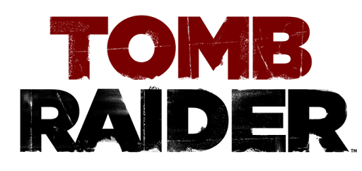
Review By: Ayah Hamad CIS 487 – 9/20/2017

Slide 2
General Information
Title: Tomb Raider
Release Date: 3/5/2013
Game Developer: Crystal Dynamics (PC), Feral Interactive (Mac & Linux)
Publisher: Square Enix (PC), Feral Interactive (Mac & Linux)
Genre: Action-Adventure, Puzzle, Third Person Shooter
Rating: Mature (17+)
Price:
Base Game: $59.99 on release, $19.99 currently
Definitive Edition (including all DLC): $29.99 on release, $19.99 currently

Slide 3
Hardware Requirements
MINIMUM:
OS: Windows XP Service Pack 3, Windows Vista,7,8 (32bit/64bit)
Processor: Dual core CPU: AMD Athlon64 X2 2.1 Ghz (4050+), Intel Core2 Duo 1.86 Ghz (E6300)
Memory: 1GB Memory (2GB on Vista)
Graphics: DirectX 9 graphics card with 512Mb Video RAM: AMD Radeon HD 2600 XT, nVidia 8600
DirectX®: 9.0c
Hard Drive: 12 GB HD space
Other Requirements: Broadband Internet connection
RECOMMENDED:
OS: Windows Vista, Windows 7, Windows 8
Processor: Quad core CPU: AMD Phenom II X4 955, Intel Core i5-750
Memory: 4 GB RAM
Graphics: DirectX 11 graphics card with 1GB Video RAM: AMD Radeon HD 5870, nVidia GTX 480
DirectX®: 11
Hard Drive: 12 GB HD space
Other Requirements: Broadband Internet connection

Slide 4
Quick Overview
Single player - Third Person Action-Adventure
Story driven, linear storyline with QTE interactive cutscenes, side quests and collectibles, allowing the player to progress at their own pace
Character Progresses as player advances in the game: unlocking new skills, gaining access to more equipment and weapon upgrades
Ability to travel between explored areas on the map using fast travel points called “campsites” that also function as save points, crafting and skill selection menus

Slide 5
Storyline & Player’s Role
Lara Croft, on her first archaeological adventure, is shipwrecked on the lost Japanese island of Yamatai. She must navigate the cursed land to find her missing friends and crewmates.
The player controls Lara and makes their way through the island, picking up collectibles and resources along the way that will help them upgrade her skills and equipment.
The player must fight off crazed cultists who want to kill Lara and her friends, while solving puzzles that will bring them closer to uncovering the mysteries of the island that will allow Lara and her friends to escape Yamatai and return home safely.

Slide 6
GamePlay & Interface
Experience-based character progression
Third Person, stealth-based combat, emphasis on terrain exploration and hunter/gatherer based crafting
Campsites: Skill & Gear Upgrades, Fast Travel and Save points
Skill Points: spent on gaining/upgrading Survivor, Hunter and Brawler skills
Salvage: necessary for gear upgrades
Survival Instinct: shows player objects of interest, such as collectibles, climbable surfaces, enemies, animals and waypoints.
Map/Scoreboard: player can access map, list of documents and relics in area, XP progression

Slide 7
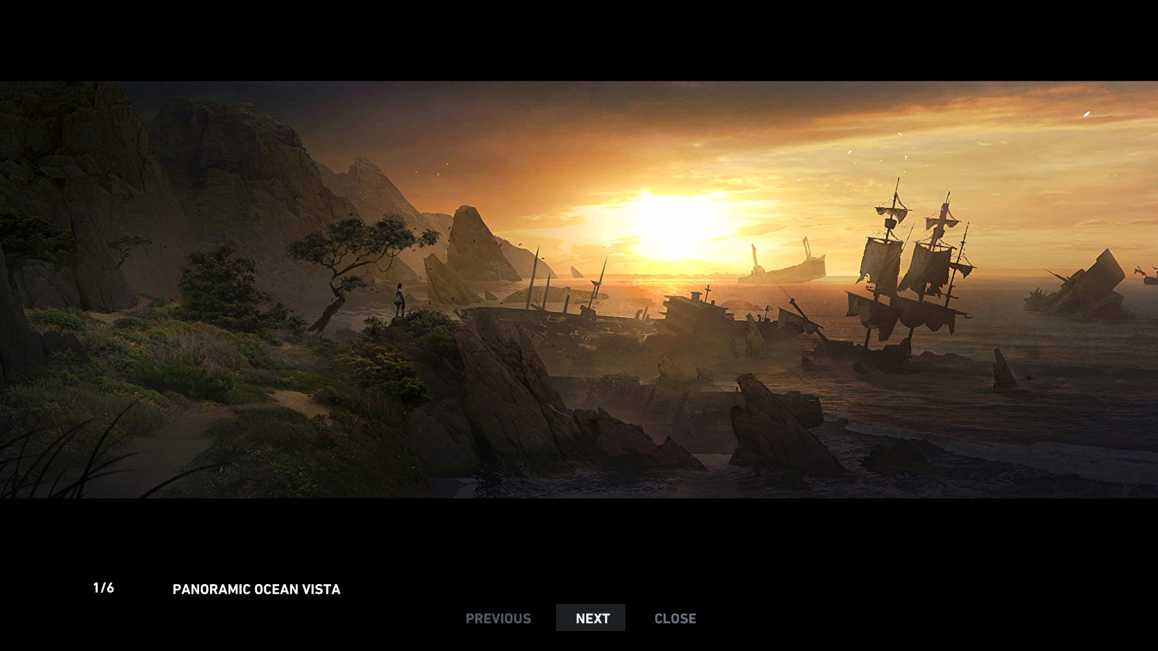
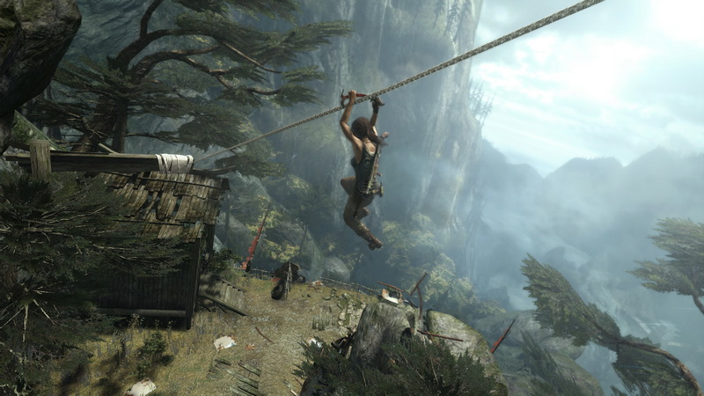
VisualS
Island’s environment is rich in dense forests, beaches, and mountains.
Various ruins and old buildings from different eras such as ancient Japanese, 1700s Japanese Military, German Axis, 1900s US Marines, and others that have inhabited and died on the island.
Cult Encampments are dark and gory, with sacrificial sites, dead bodies and blood drawings on the walls.
Day/Night cycles and weather are realistic when playing in the linear storyline, but randomized when travelling back to completed areas.

Slide 8
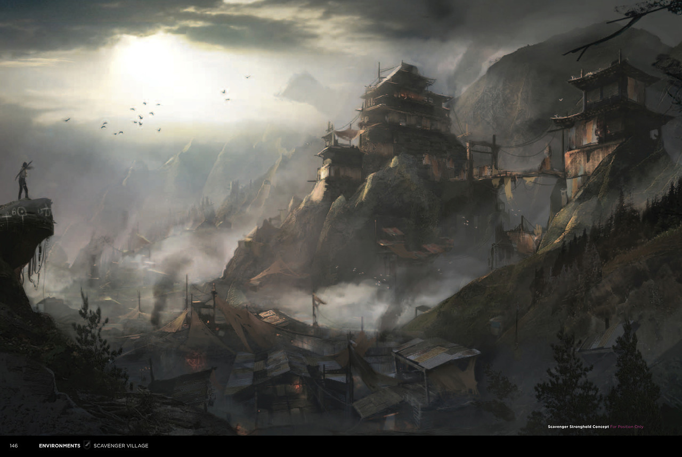
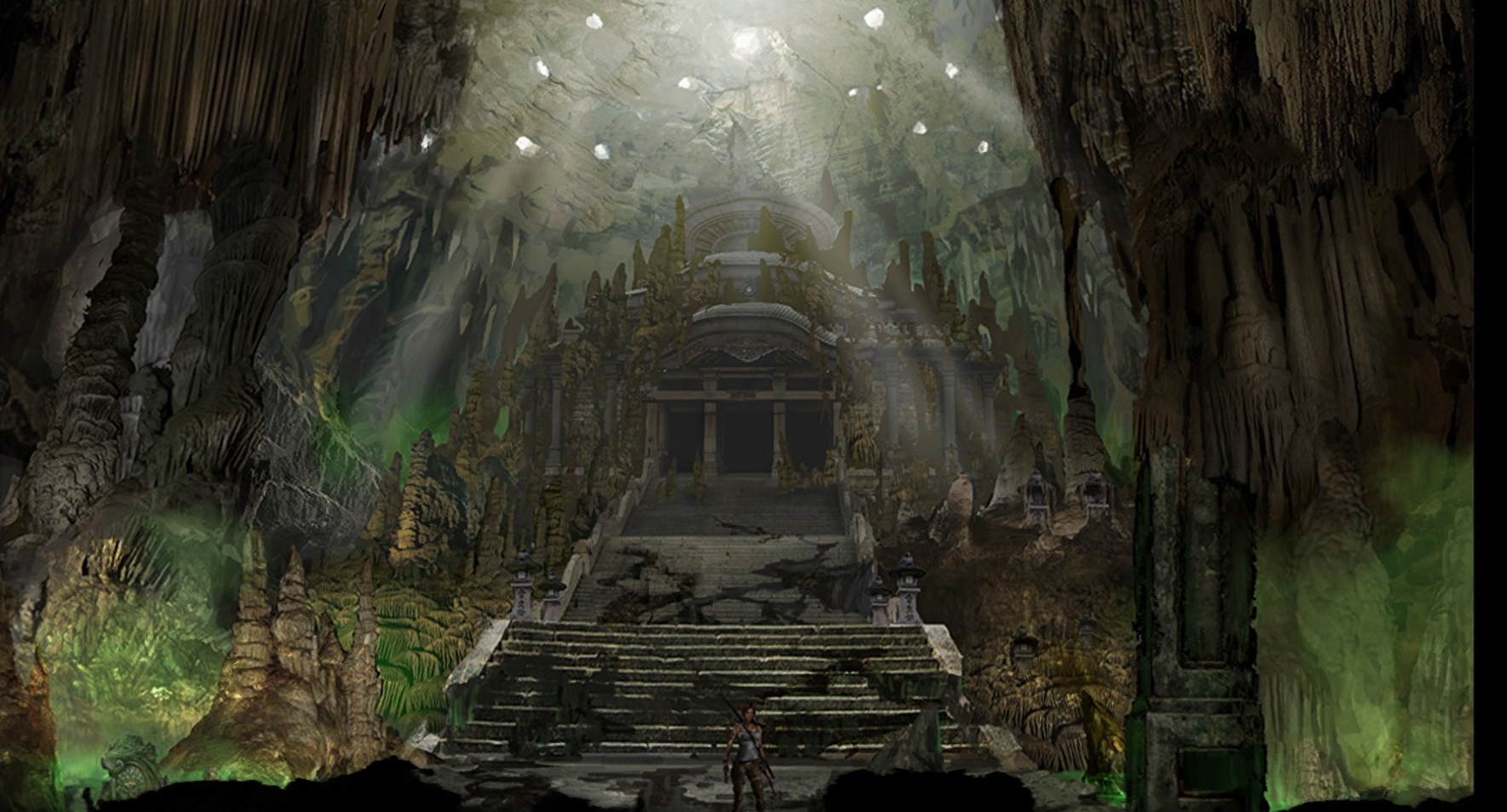
Scavenger Village
Ancient catacombs
Scavenger Den
Mountain Temple

Slide 9
Audio
Environment sounds are realistic and well thought-out, such as trees rustling in the wind, ocean waves splashing on the shore, or animal sounds that can be useful when hunting.
Music plays on player’s emotions, in direct relation with events: If Lara is in danger or around enemies, the music is tense and fast paced, but calms down when Lara is safe.
Soundtrack is scored by Jason Graves, a composer that specializes in video game music relating to thriller and action genres.
Some music themes from the game:
A Survivor is Born: https://www.youtube.com/watch?v=4YsLixfHh6M
Alone: https://www.youtube.com/watch?v=IcKXVo_fYd4
Reaching Roth: https://www.youtube.com/watch?v=8eKOZOT_t-k

Slide 10
Bugs and Glitches
Video demonstrating common glitches: https://www.youtube.com/watch?v=dDCNeAWEw84
graphics and gameplay bugs - various glitches throughout gameplay:
First demonstrated is a gameplay bug preventing death by fall
Next 4 demonstrations are of visual glitches where NPC held items remained floating in mid air
Environment glitches: animation failure of buildings and environment
- Most glitches have been patched and reworked soon after the game was released

Slide 11
Game Review
Things I liked about the game:
Engaging storyline with dimensional characters
Combat system is easy to learn, with various weapons and melee attacks available
Intuitive Learning curve, tutorials are short and to the point
Environment art and music provide immersive atmosphere for player
Capability to travel to earlier areas helps players achieve full completion and achievements.
Things I didn’t liked about the game:
Lacks in character or skill customization, which is more available in other games in the genre
Too many QTE sequences in the beginning
Not much replay value due to linear storyline
No co-op mode for storyline, limited to only online arena
Less Puzzles than expected for a Tomb Raider game

Slide 12
Comparisons to similar Games in the Genre
Batman: Arkham City
The games share several aspects, including being third person, The player can only play with the main character in a linear storyline, similar mechanics (both have use of ropes and ziplining, traps, and stealth in combat). Arkham City however has more emphasis on puzzles and exploration, but has an easier combat system since Batman is overpowered, and Lara Croft lacks brute strength
Uncharted
These two games are always compared as they share many story elements, with both main characters on a quest to find relics. The mechanics of both games are similar in terms of climbing and moving along cliffs, gun combat, and emphasis on puzzles. Tomb Raider is more non-linear, allowing players to travel back, which isn’t the case in uncharted. Uncharted also has a storyline co-op mode, allowing up to three players to assist each other with missions, unlike Tomb Raider which is strictly single-player in story mode. The biggest difference is that Uncharted is a PS exclusive, while Tomb Raider can be played on multiple platforms.

Slide 13
Intended Audience
With the reboot, Tomb Raider(2013) was able to engage a fresh new audience, as well as build on the success of the original games and draw in older fans of the franchise.
Due to the M17+ rating, the game limits its audience to those who are mature enough to handle the intense themes of gore, violence and adult language.

Slide 14
Success of the Tomb Raider Reboot
Tomb Raider sold 1 million copies in its first 48 Hours after release, and over 8.5 million copies within the first year. It has also been nominated and won many awards, and has provided enough success for two sequels: Rise of the Tomb Raider and a third unnamed game still in development.

Slide 15
Summary
Overall, Tomb Raider does an excellent job at building on people’s nostalgia for the original games, while also introducing a whole new experience. Though fans of the franchise will notice a lack of puzzles, The story’s reboot provides a fresh outlook on the origin of Lara Croft, giving the player a more relatable character who is still finding her strength and courage. The improved and modernized combat system, alongside the beautifully designed environment gives players an engaging and unique game that is worthy of competing in today’s market.
Rating: 8.5/10
This is a game I’d highly recommend, especially since the definitive edition is available with all the DLC for half the release price. The only improvements I’d suggest are adding a new game+ system that allows players to go through the storyline again with their acquired skills and gear, and adding a storyline co-op mode, as these changes would add more replay value to the game.

Slide 16
Extra
Common Tags: Third Person, Adventure, Action, Puzzle, Atmospheric, Story Rich, Character Progression, Thriller, Origin Story, Third Person Shooter, Stealth, Single Player, Female Protagonist, Exploration, Cinematic
Tomb Raider – Survivor Trailer: https://www.youtube.com/watch?v=XsWojNNqFTg

