Slide 1
Michael Gutterman

Slide 2
Basic Information about Cities: Skylines
Developer: Colossal Order
Publisher: Paradox Interactive
Genre: City building and management simulation
Price (As of Sep 10, 2017)
Standard Edition: $29.99
Deluxe Edition: $39.99
Total DLC: $86.90
This Photo by Unknown Author is licensed under CC BY-SA
This Photo by Unknown Author is licensed under CC BY-SA

Slide 3
Hardware Requirements (for PC Version)
Minimum
Recommended
4 GB storage space
4 GB RAM
Intel Core 2 Duo or AMD Athlon 64 X2 6400+ processor
Nvidia GeForce GTX 260 or ATI Radeon HD 5670 graphics card
4 GB storage space (does not include user-made content)
6 GB RAM
Intel Core i5-3470 or AMD FX-6300 processor
Nvidia GeForce GTX 660 or AMD Radeon HD 7870 graphics card

Slide 4
Game Summary
The player’s duty as mayor is to build a sustainable city that also tends to the needs of its citizens.
The storyline varies from scenario to scenario, but story is left to the player’s imagination for the most part.
Available on Windows Store, the PlayStation Store, and Steam. User-created content is available from the Steam Workshop.

Slide 5
User Interface
The UI for Cities Skylines can be modified by using mods from the Steam Workshop. The unmodified UI has the following features:
Top-middle: Chirpy, the mascot for the social network “Chirper”. Clicking will display a list of recently sent “chirps” from the player’s citizens.
Upper-right: a music control panel. Cities: Skylines has a number of radio stations so player can listen to various genres of music when they grow bored of the game’s soundtrack.
Left: various “Info Views”. Info Views allow the player to visualize different aspects of the city with color-coding (e.g., pollution, traffic, flammability, citizen happiness, etc.)
Bottom: the player’s toolbox. Most of the things that the player needs to make changes to the city are here.

Slide 6
Screenshot of UI Gameplay from (an Earlier Version of) Cities: Skylines
This Photo by Unknown Author is licensed under CC BY-NC-ND

Slide 7
Gameplay
The player needs to manage several aspects of the city.
Crime & punishment (with the After Dark DLC, jail cells at the police station are only meant to hold criminals until a van from a city prison arrives. In prison, they undergo correction (in theory)).
Zone demand (residential, commercial, and industrial)
Fire safety
Natural disaster preparation and recovery (Natural Disasters DLC)
Healthcare and deathcare
Mass transit and roads (greatly expanded upon in Mass Transit DLC)
Finance
Education
Utilities (electricity, water, and garbage collection, plus heating (Snowfall DLC)
Tourism and Leisure (greatly expanded upon in After Dark DLC)
Environment (garbage collection, commercialization/preservation of natural resources)
Air, water, ground, and noise pollution
Transport of resources and goods (Natural Resources → Industry → Goods → Commerce
Citizen happiness

Slide 8
Scoring and Artwork
There is no official “score” to measure a mayor’s performance
The game’s built-in missions have a variety of winning conditions. Examples:
Some require a certain amount of ridership on public transit
Others require that the player protect the city from disasters for a given period.
In free play mode, I usually consider city population and citizen happiness to be a gauge of my mayoral performance.
Cities: Skylines is made with the Unity Engine, and the developers left much of the game open for mods and other user-made content to be made. A couple examples:
Someone made a highly-detailed model of the city of Los Santos from GTA V.
Someone else submitted a model of One Detroit Center.

Slide 9
Music
The developers were able to gather a good variety of music to play from the game’s radio stations.
Gold FM: 60s music
Rock City Radio: all things rock and roll (DLC)
Cities Radio: music from other games by Paradox Interactive
The Classics: classical music
Relaxation Station: smooth synth music (DLC)
Even without these radio stations, the soundtrack for Cities: Skylines is distinct enough to remember, yet subtle enough to not bother the player (at least not for a while).

Slide 10
Sound Effects
Cities: Skylines has plenty of ambient noise that changes depending on where the player’s view goes (chatter and traffic noise in high density areas, dogs barking and kids laughing in low residential neighborhoods.)
The Chirper notification sound effect could be less shrill, but I really do think some people make a bigger deal out of Chirpy than I think is realistic.
The vehicle sound effects are also pleasant to listen to.

Slide 11
Special Features and Game Manual
Lots of user-created content in the Steam Workshop (as previously mentioned)
Regular new DLC to add new dimensions of gameplay
Game manual can be found at http://cdn.akamai.steamstatic.com/steam/apps/255710/manuals/CitiesSkylines-UserManual_EN.pdf?t=1504517820

Slide 12
Bugs
Graphical glitches may occur if the slope between a building on a small cliff and a road at the bottom is too steep.
Sounds stutter or lag (possibly due to asset counts and limited hardware specs)
Vehicles become stuck at an intersection, swerving back and forth until the driver’s destination is destroyed.
Lamp posts can glitch through the downslope part of a bridge if placed correctly.
Blimps from the Mass Transit DLC sometimes collide with each other, but other times clip through each other.

Slide 13
Review of Cities: Skylines
What is good?
What is bad?
Familiarity: It brings back childhood memories of playing SimCity at my grandparents’ house.
Extensibility: The addition of new DLC adds entirely new ways to play the game in addition to Workshop content.
Realism: The amount of detail is astounding (even without DLC).
Fluff: Some argue that Chirpy’s messages are annoying and/or not helpful enough.
Volatility: The addition of DLC may temporarily break an existing mod until the author updates it, assuming he/she didn’t abandon it.
Complexity: The many aspects to manage can make it time-consuming to build a city from nothing into a metropolis.

Slide 14
Cities: Skylines vs. SimCity: The Downfall of the King
What Cities: Skylines did that SimCity did not
What SimCity did that Cities: Skylines did not
It allowed the player to build large cities regardless of connection status.
It left much of the game open for modification by the Steam community.
It was built by a newer, smaller company with a small but dedicated fanbase.
It launched with server problems lasting for the first few weeks, blocking even single player
It limited the area of cities to a smaller size compared to prior titles.
It relied on hype from the already large SimCity fanbase, but failed to deliver.

Slide 15
Who is Cities: Skylines Meant For?
The game is rated E for Everyone (PEGI 3)
It is likely to be enjoyed by those who played any of the following as kids:
Other city simulators like SimCity 2000/3000/4 (Left 2013 out on purpose)
Business management simulator games like SimGolf, RollerCoaster Tycoon, Zoo Tycoon, and Railroad Tycoon
Cities: Skylines borrows a number of concepts from Paradox’s earlier hit game series, Cities in Motion.
Transportation and road network management are very similar
Fans of CiM will likely enjoy CS as well.

Slide 16
Design Mistakes
Because of the vast array of mods and user-created content in the Steam Workshop, most design mistakes can be corrected with either a patch or a workshop item. However, this comes at a price of performance.
Occasionally, a user-created mod is incorporated into the base game, keeping the mod’s functionality but improving the game’s performance.

Slide 17
Strengths and Weaknesses
Strengths
Weaknesses
The game is more realistic than most prior city management games.
The game can be customized and expanded upon.
The game has high replay factor.
The base game has a lot of content.
The game can have a steep learning curve
The game is somewhat resource intensive.
Save files can become corrupted if mods conflict.
The DLC costs more than the game itself.

Slide 18
Verdict: Is Cities: Skylines Worth Purchasing?
It depends on the player.
Those who enjoy sandbox, management, and simulation games, as well as those who grew up playing games like SimCity, will probably love this game.
Those who enjoy first-person shooters, RPG, or any multiplayer games might want to save their money.
Everyone else might want to ask for their friends’ opinions and/or to let you play their copy of the game.

Slide 19
How Can Cities: Skylines be Improved?
Not all the DLC is worth buying. Paradox could offer more to the player to purchase it.
Some add entirely new aspects to the game (e.g., nighttime, disasters, snow removal, heating, new modes of mass transportation, etc.).
Some only add “new” buildings that behave exactly like existing buildings with only cosmetic differences (i.e., Workshop content, except it costs money.)
Cars clip through each other. I know Paradox tried to prevent this in Cities in Motion 2, but it did not work very well.

Slide 20
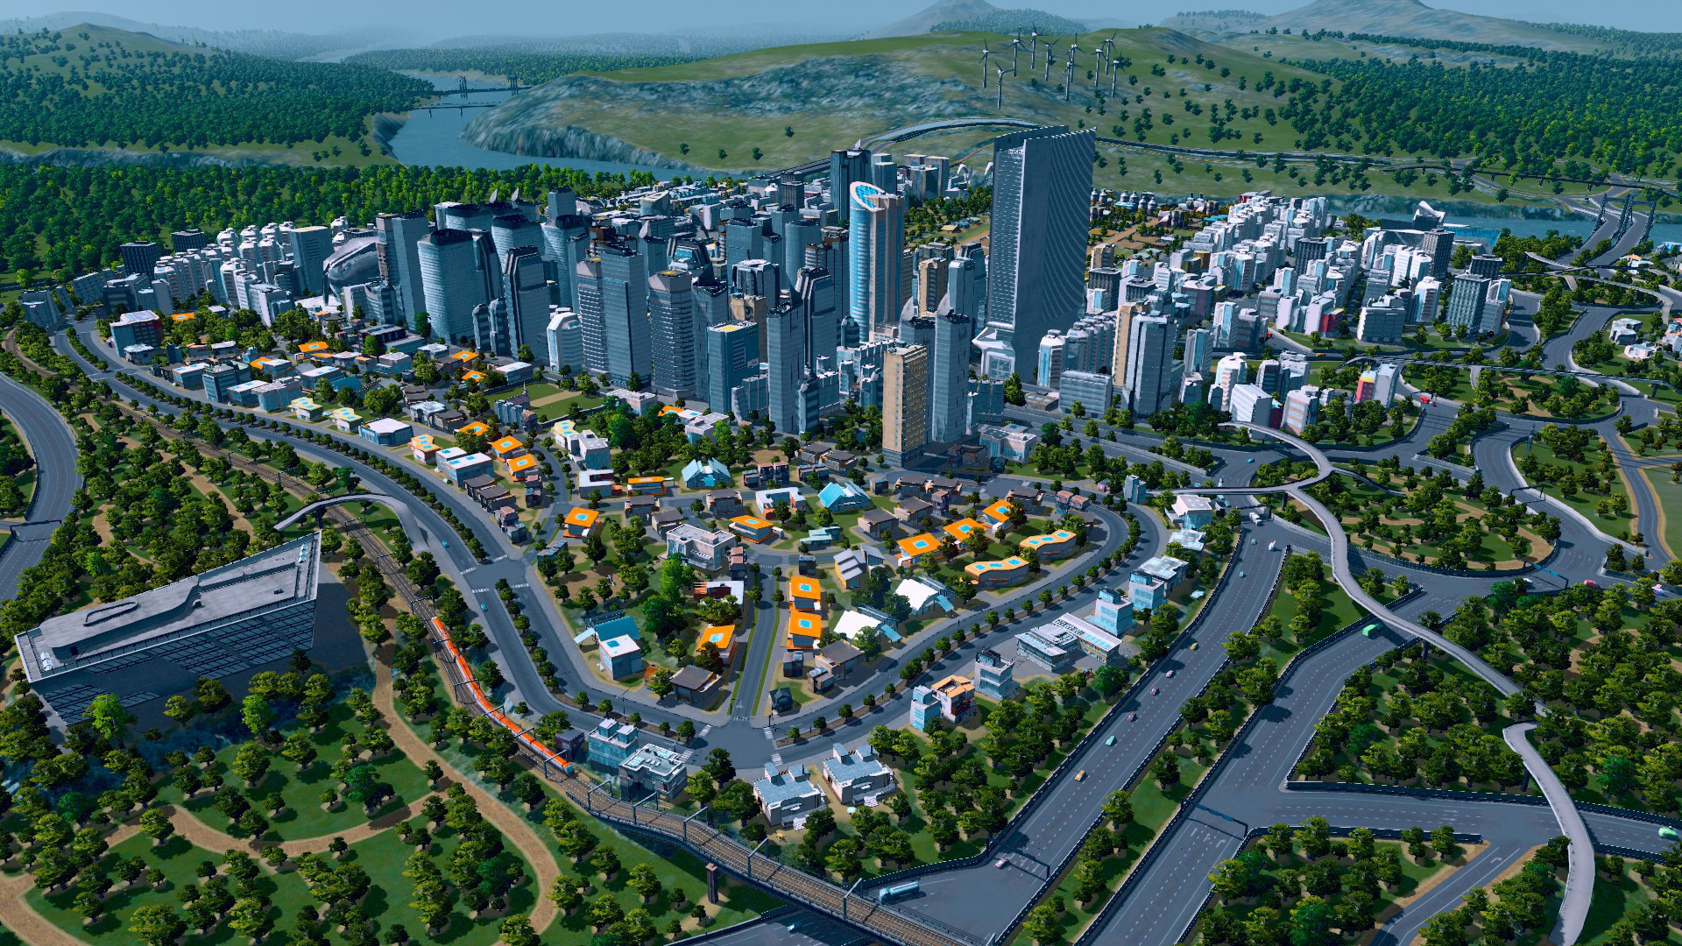
Any Questions?
Thanks for listening!
This Photo by Unknown Author is licensed under CC BY

