Slide 1
chrono Trigger
Austin Fell

Slide 2
Game summary

Slide 3
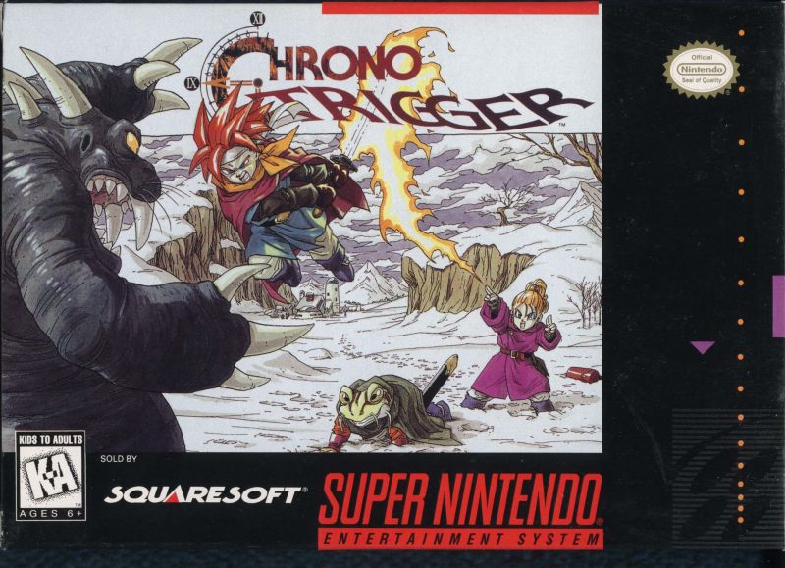
Basic Information
Company or Author: Square (Square Enix)
Game Type: RPG
Price
~$55 on Release (SNES)
~$25 used (NDS)
~$10 on Android App Store
Minimum Hardware Requirements Or Hardware Required
On consoles, only the console is needed to play the game
On Android, at least an Android 4 era device is required.

Slide 4
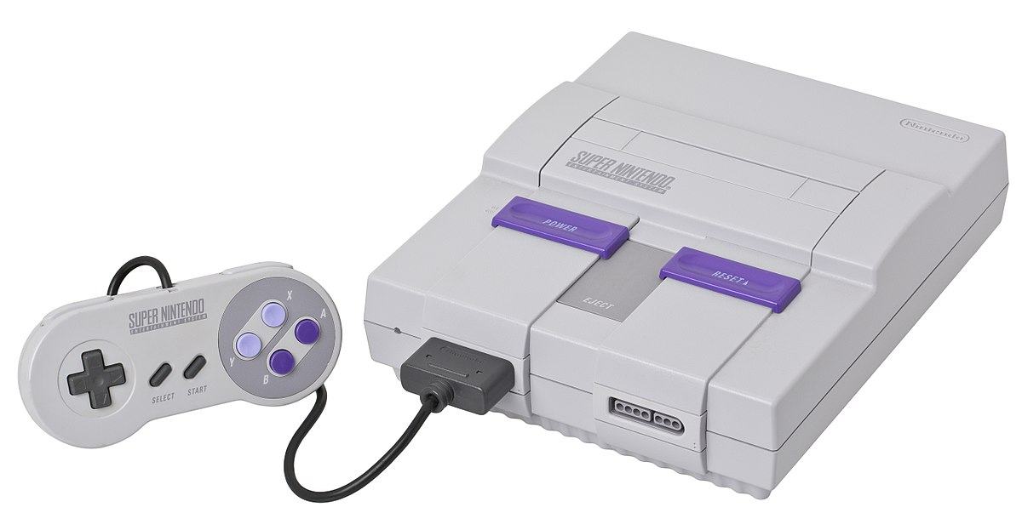
Overview
Top down RPG release on the Super Nintendo in 1995.
One of the many well know RPGs to appear on the SNES.
Similar To Final Fantasy And Others
Devil is in the details

Slide 5
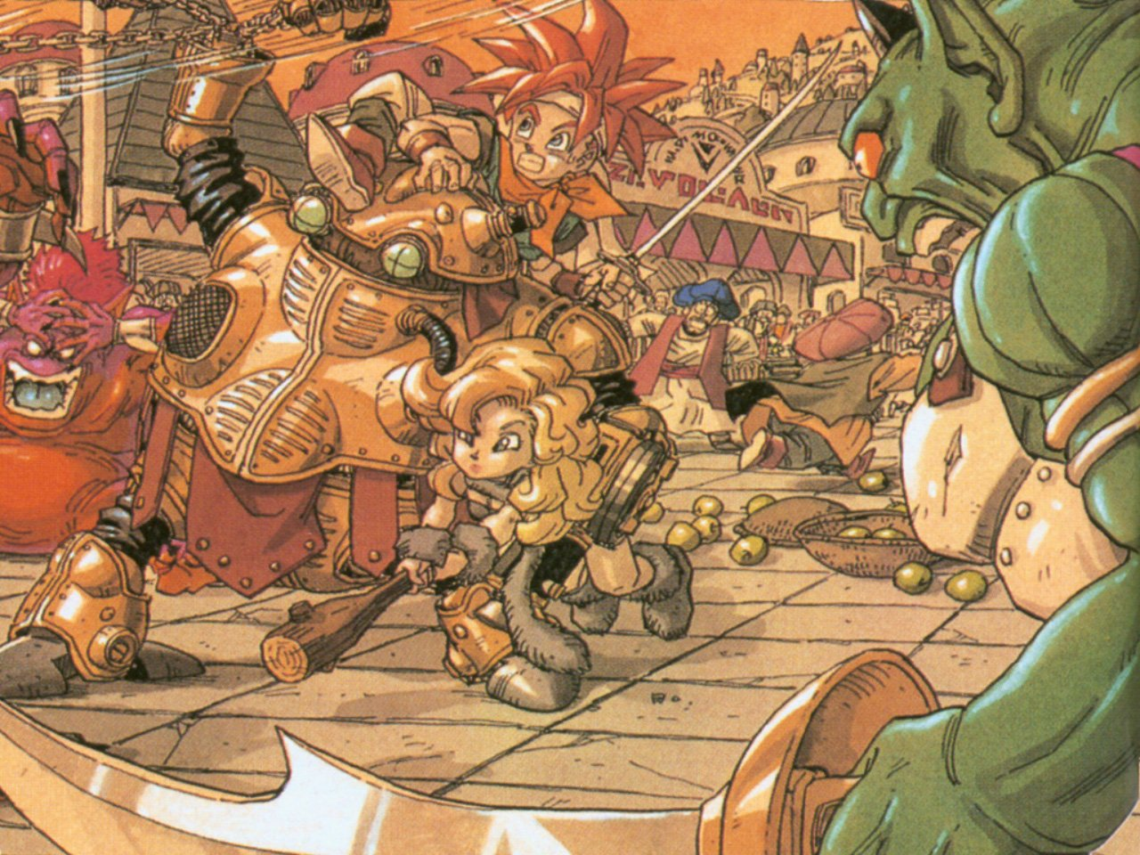
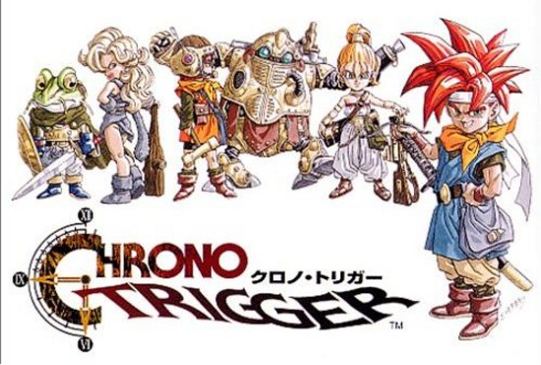
Storyline
Multiple Timelines
Many Periods
Starting Point

Slide 6
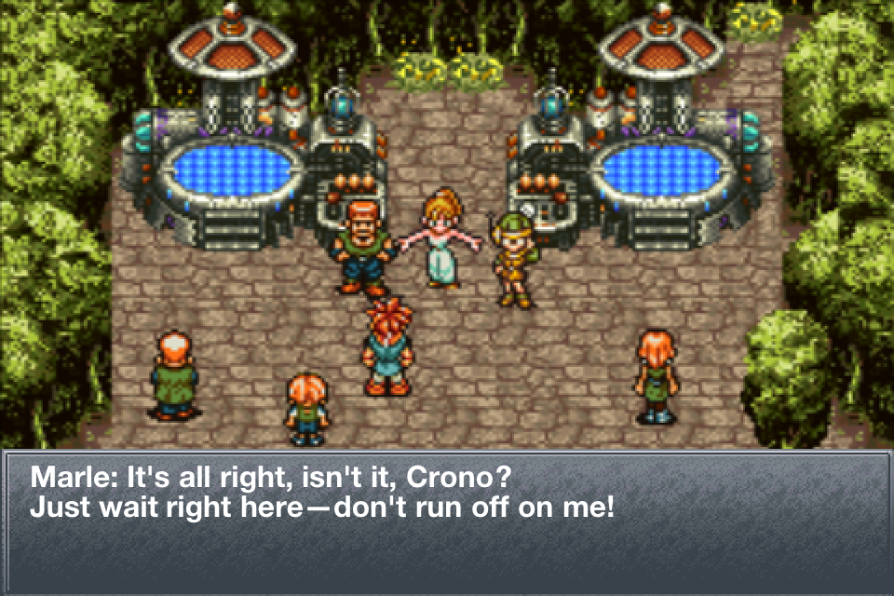
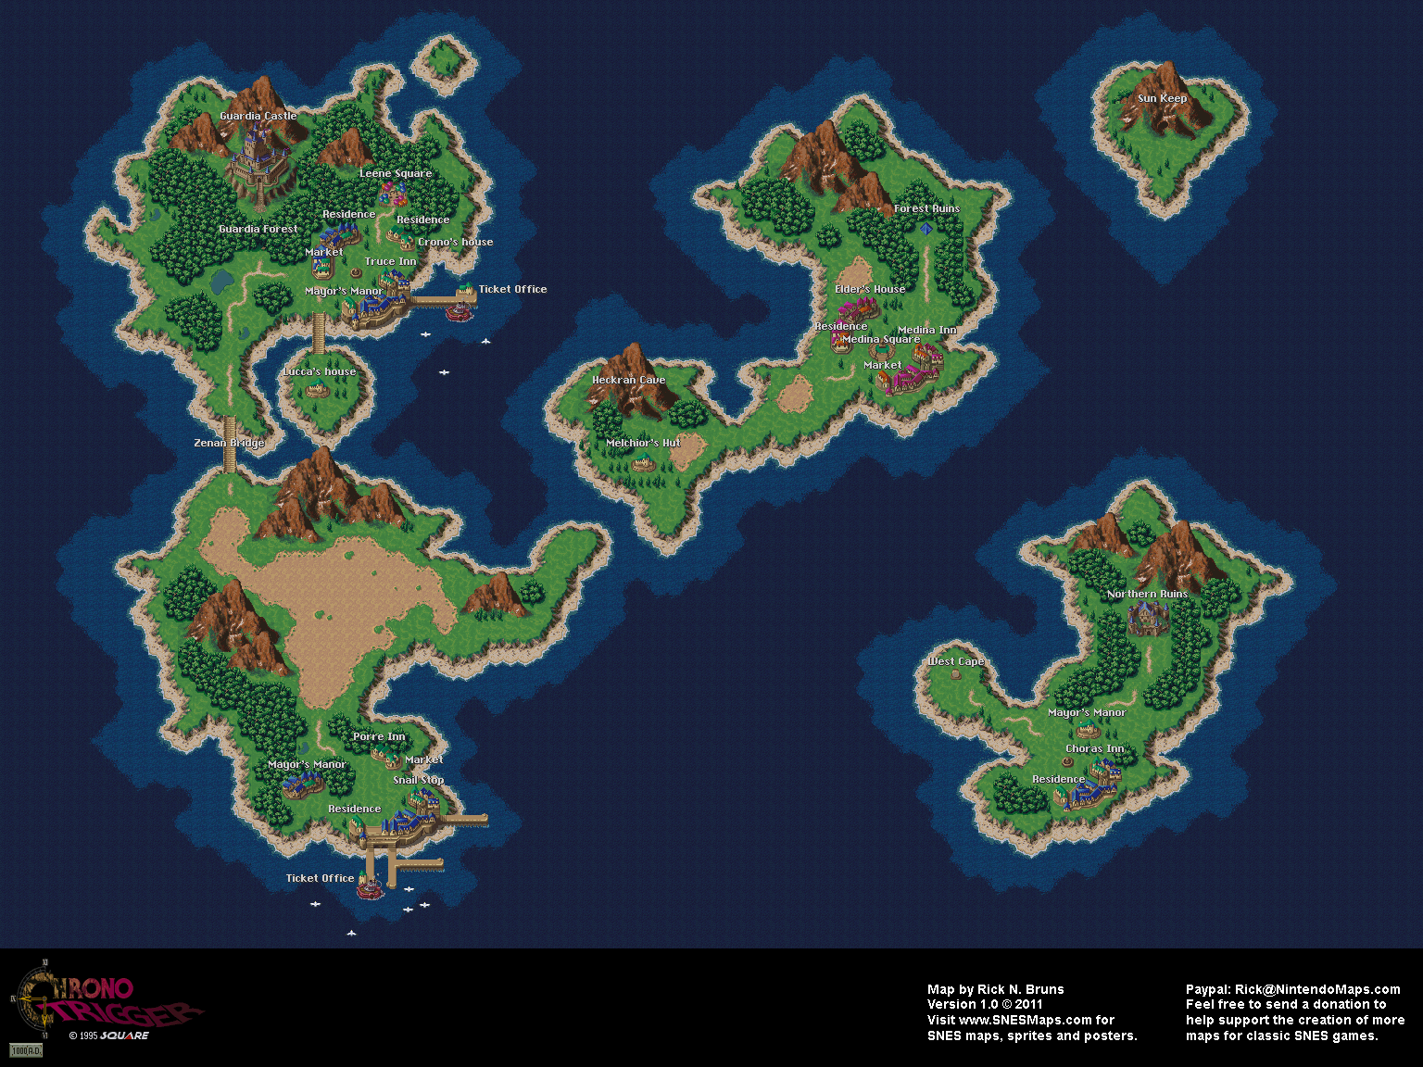
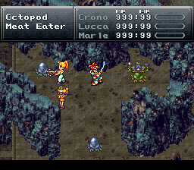
Your Role
Navigate the over world
Participate in decisions regarding story line.
Develop character with battles
Complete the storyline.

Slide 7
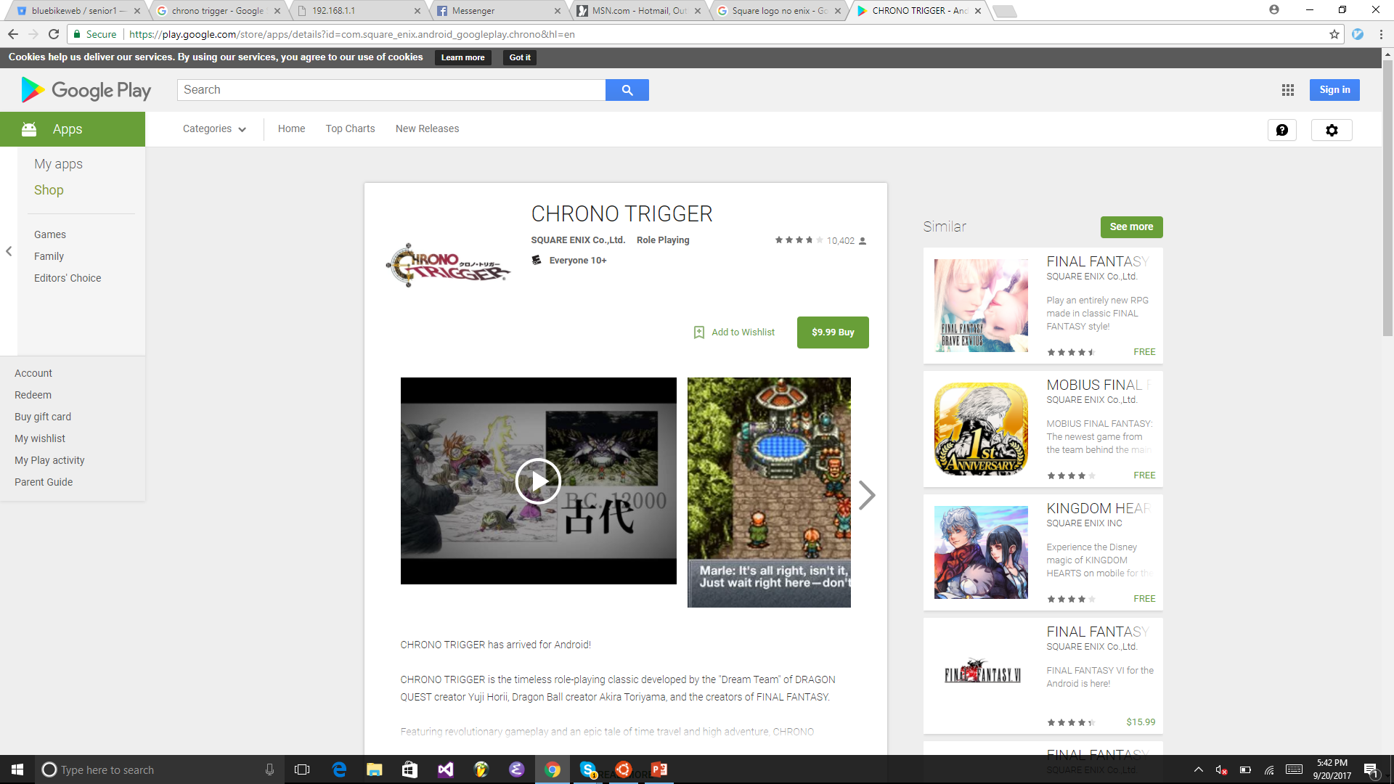
Installation
Console Game: Pop it into an SNES or DS and go!
Android users simply need to buy as an application, like any other app.

Slide 8
User Interface (1)

Slide 9
User Interface (2)

Slide 10
User Interface (3)

Slide 11
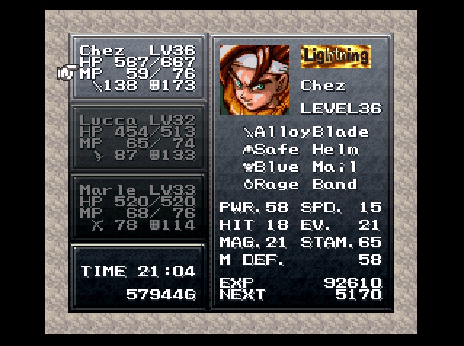
User Interface (4)

Slide 12
Gameplay

Slide 13
Music
https://www.youtube.com/watch?v=2r1iesThvYg

Slide 14
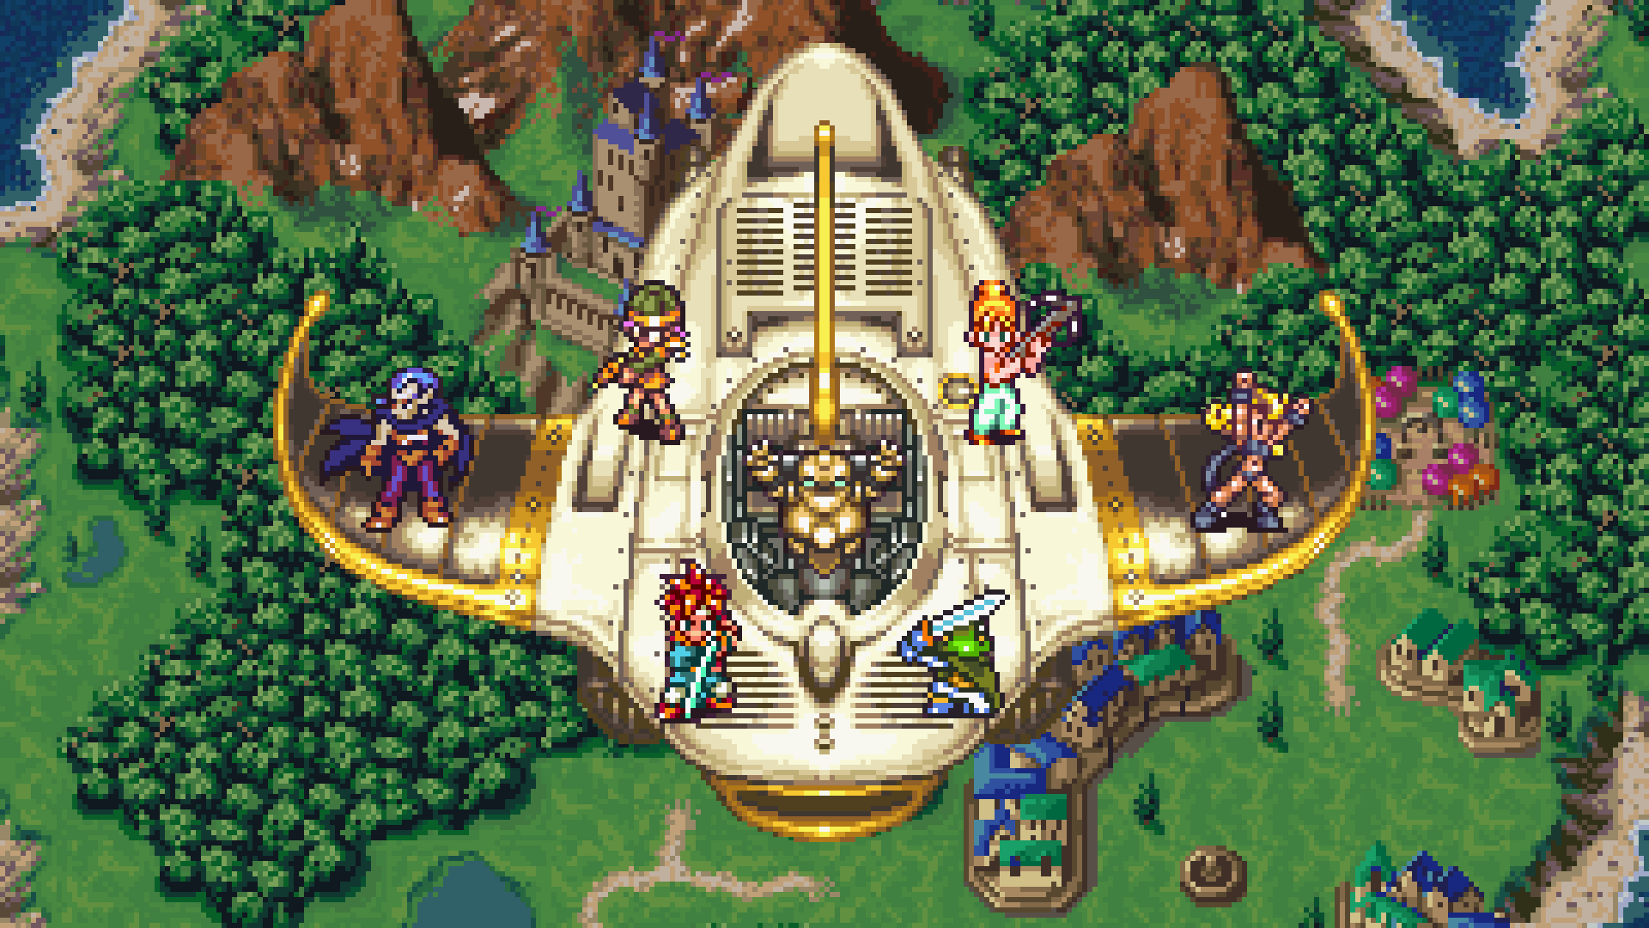
Special Features
Time Travel
Live Combat
New Game +
Overhead Monsters
Subplots
Dynamic Story

Slide 15
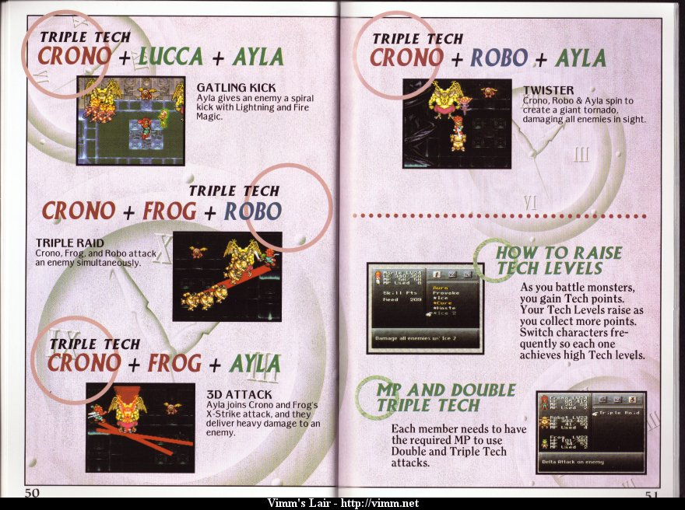
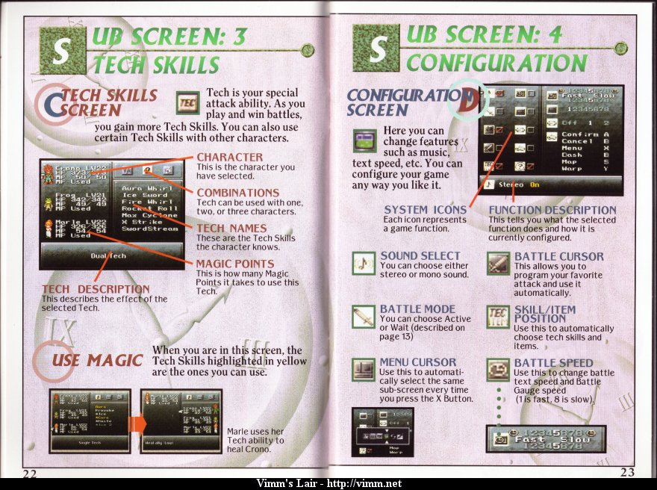
Manual

Slide 16
Game Review

Slide 17
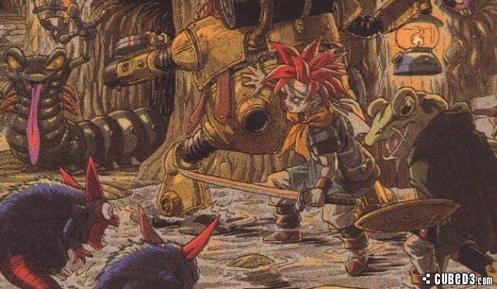
What Is Fun?
Battle Sequences
Macro and micro worlds make the game feel huge.
The story!
Character development
Multiple story lines
Beautiful 16 bit graphics

Slide 18
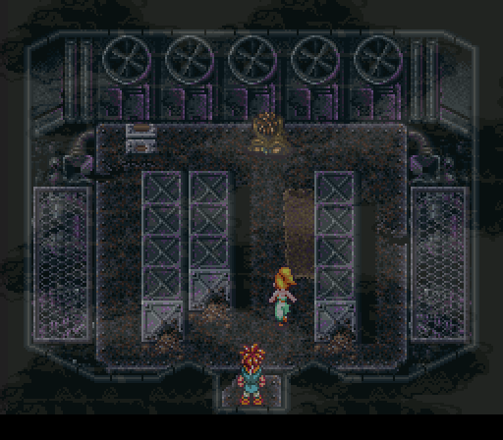
What Is Not Fun?
Too Short
Difficulty could be a little higher.

Slide 19
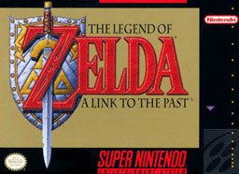
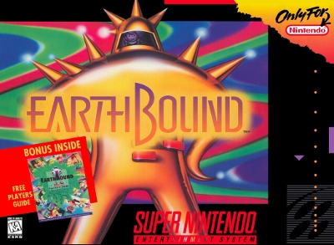
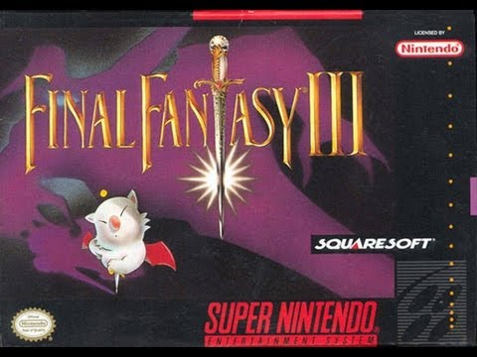
How Does It Compare To Similar Games?
Made by Square (Creators Of Final Fantasy)
Influences from Zelda 3 and FF
More Fluid Combat
Less Guesswork
Less Difficulty

Slide 20
Appropriate Audience

Slide 21
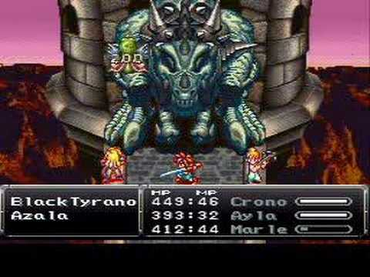
Design Mistakes
Trade off of depth and length?
Note technical constraints of the time
Real Time Action

Slide 22
Summary

Slide 23
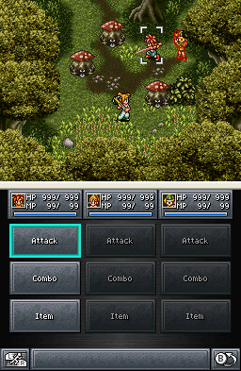
Strengths And Weaknesses
Strengths
Fun battles
Fun character development
Awesome story and single player experience
Replayability
‘
Weaknesses
RPGs of this era don’t really have “multiplayer”
Length per play

Slide 24
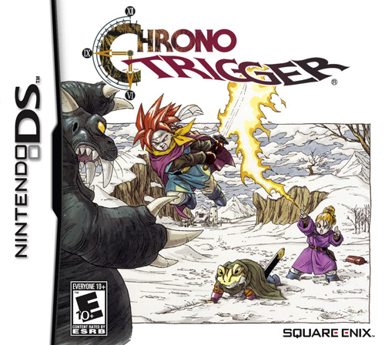
Is It Worth Purchasing?
Classic gamers who enjoy Japanese RPGs and haven’t already played Chrono Trigger will absolutely enjoy it. In addition, unlike years ago, the game is easy to find on modern formats.

Slide 25
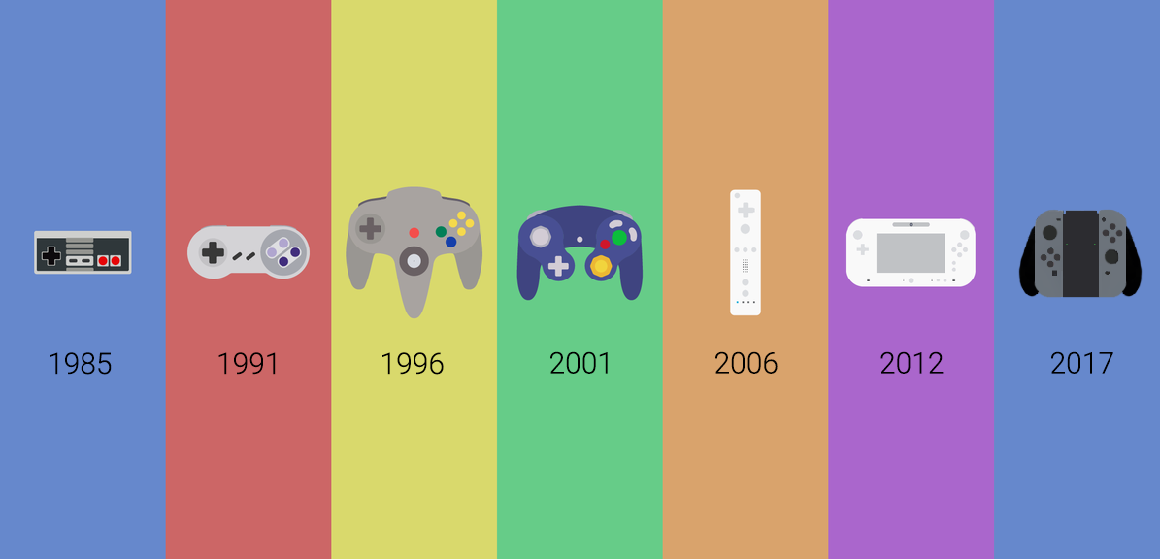
Improvement
Technical limitations of the SNES have been lifted and we can see what is possible given modern hardware with RPGS
MMORPGS
Immersive single player experiences

