Slide 1
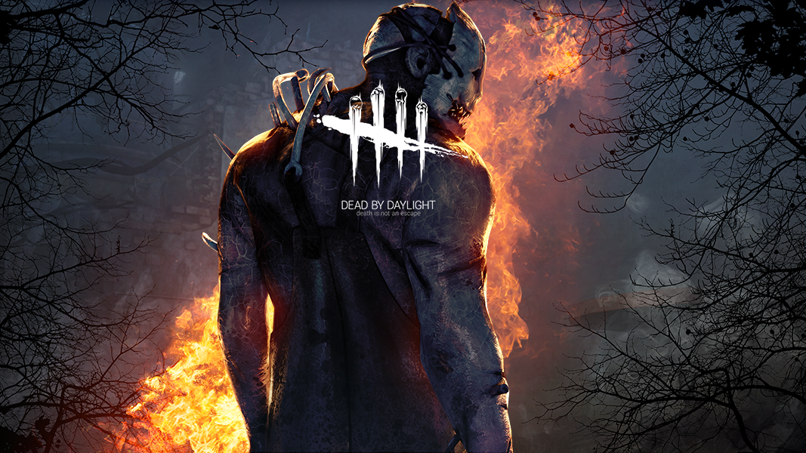
Dead By Daylight
A Review By Nick Crooker

Slide 2
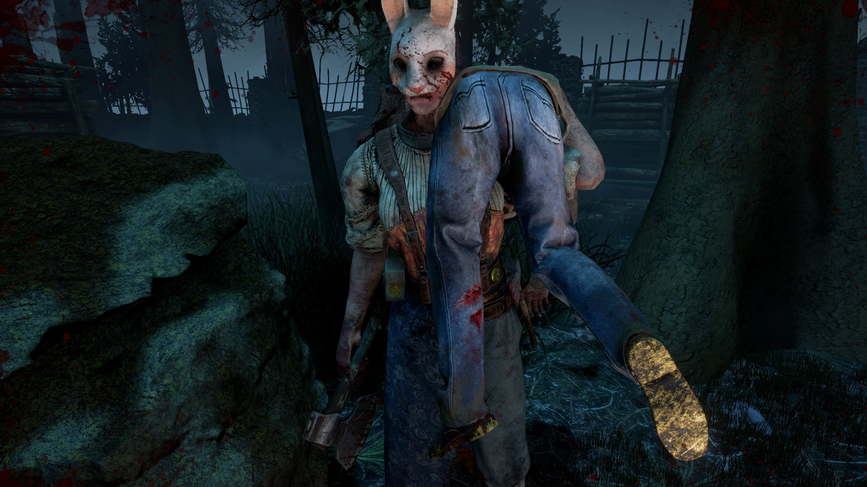
The Basics
Developed by Behaviour Digital Inc.
Published by Starbreeze Studios
$20 Progressive Survival Horror
Available to Install on Steam Engine
Minimum
OS: 64-bit Operating Systems (Windows 7, Windows 8 & Windows 8.1)
Processor: Intel Core i3-4170 or AMD FX-8120
Memory: 8 GB RAM
Graphics: DX11 Compatible GeForce GTX 460 1GB or AMD HD 6850 1GB
DirectX: Version 11
Network: Broadband Internet connection
Storage: 15 GB available space
Sound Card: DX11 compatible
Recommended
OS: 64-bit Operating Systems (Windows 7, Windows 8 & Windows 8.1 or above)
Processor: Intel Core i3-4170 or AMD FX-8300 or higher
Memory: 8 GB RAM
Graphics: DX11 Compatible GeForce 760 or AMD HD 8800 or higher with 4GB of RAM
DirectX: Version 11
Network: Broadband Internet connection
Storage: 15 GB available space
Sound Card: DX11 compatible

Slide 3
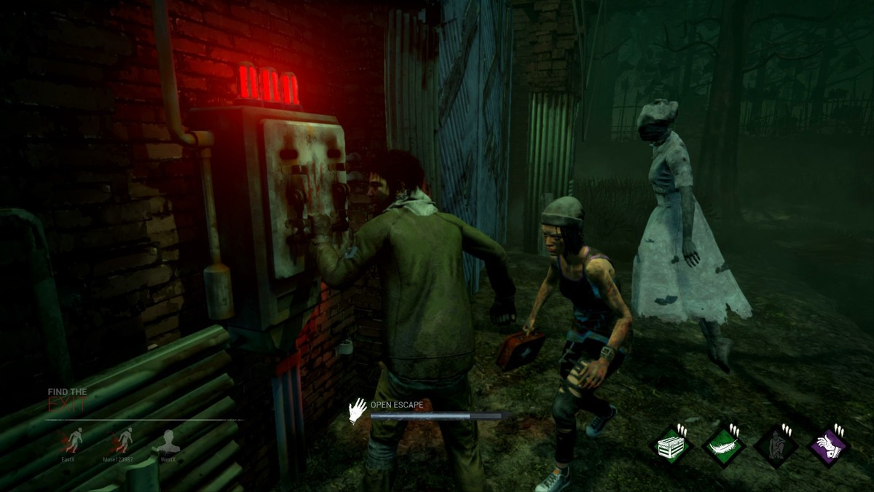
Summary
4 Survivors trapped in The Killing Ground
Work together to repair generators to escape
Avoid being brutally murdered by a merciless killer
Your Role as a Survivor
Repair Generators
Rescue and Heal the others
Avoid death by hiding in the shadows or running for your life
Your Role as a Killer
Find and Sacrifice the survivors to The Entity
Break generators that aren’t fully repaired
Set traps to capture your prey

Slide 4
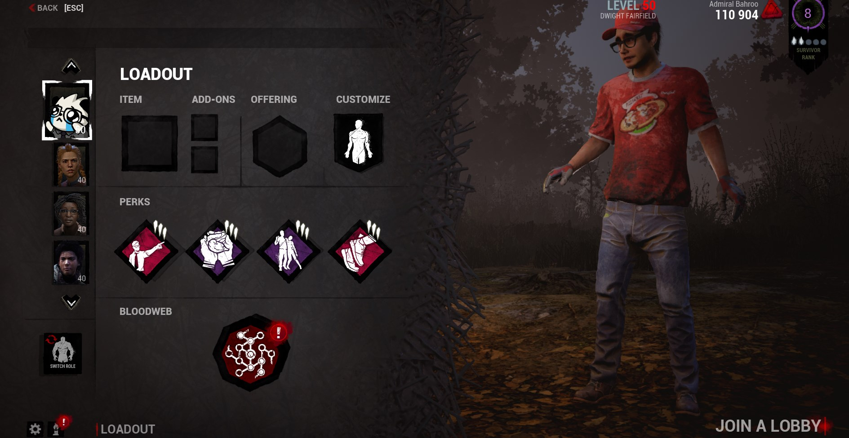
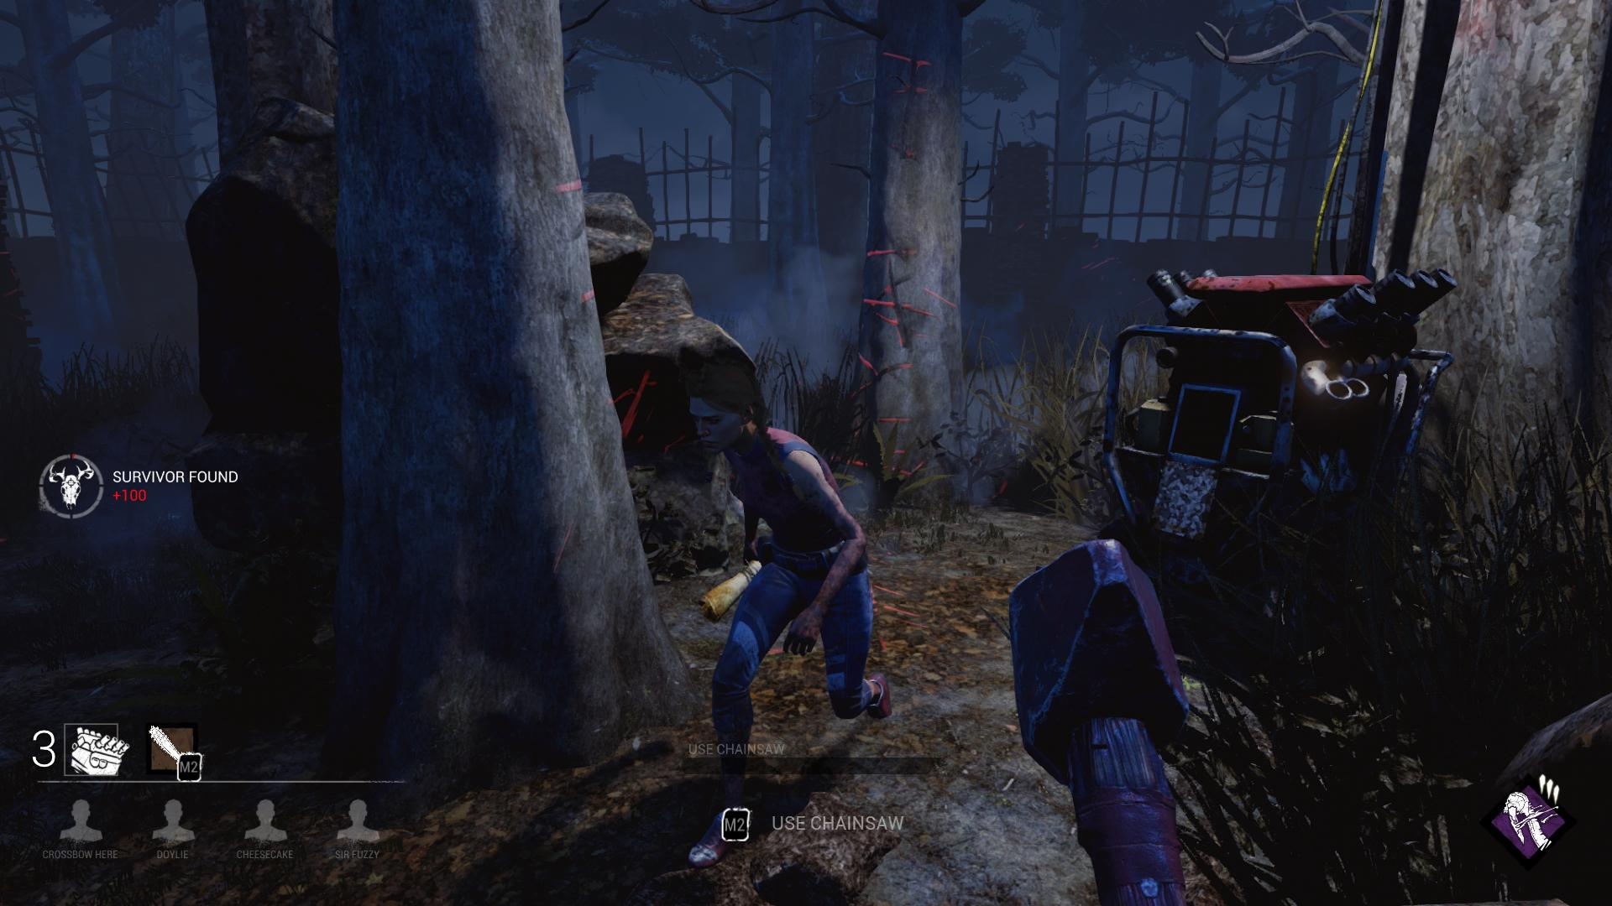
In Lobby UI
Survivor Gameplay
Survivors spawn in the Killing Ground in random spawn points. They need to find generators and repair them by holding down the left mouse button. Occasionally, there will be a skill check where the user must press space. If the skill check is missed, the killer is alerted. After repairing the needed generators, the survivor must open the escape door and run out. If another survivor is captured, there is the decision that has to be made, risk your life or save yourself.
In Game UI
Killer Gameplay
The Killer spawns in a random location. A unique perk of playing the killer is having the ability to see all of the generators’ auras, to help patrol. When a survivor is found, they must be chased and knocked down using your weapons and abilities. After the survivor is knocked down, the killer will carry them to a hook where they will be sacrificed to The Entity.

Slide 5
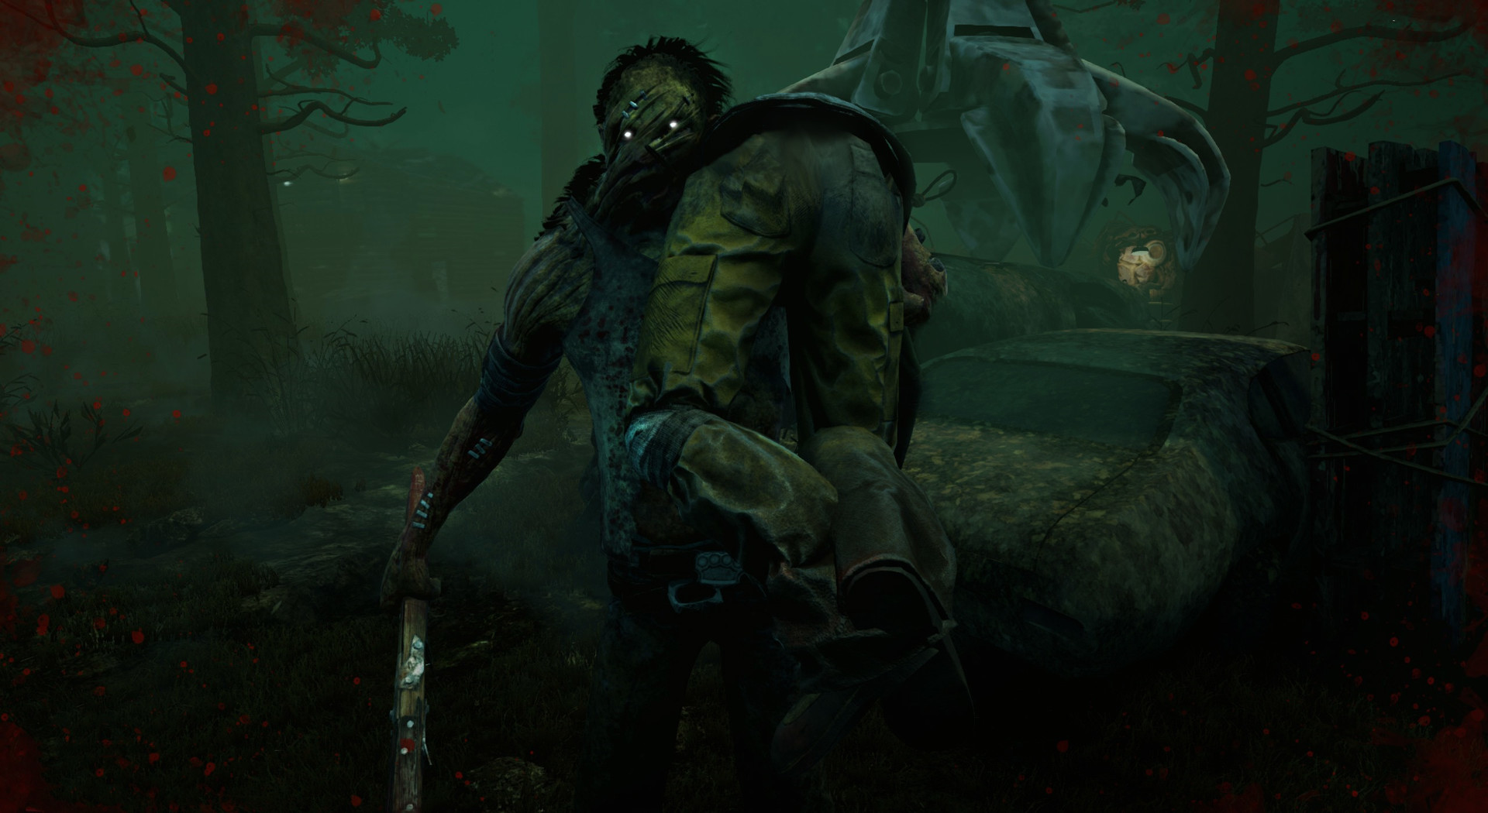
Scoring
Scoring has no effect on outcome of game
Scoring as a Survivor
Repairing generators
Helping other survivors
Escaping the killer in a chase
Escaping the Killing Ground
Scoring as a Killer
Chasing survivors
Hitting survivors
Damaging Generators
Hooking a survivor
Fully sacrificing a survivor
Bugs
The worst bug that was recently introduced, and it’s a bad one, is that all of your progress is lost upon logging in
Another long time member of the bug community is queuing up with a friend. Occasionally, you and your friend won’t join the same game

Slide 6
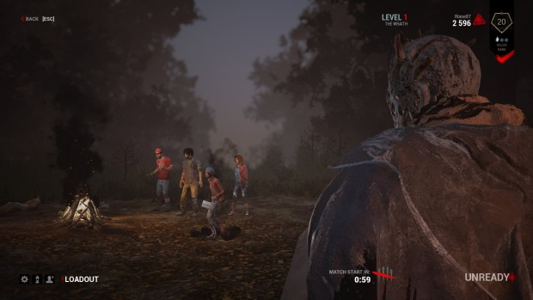
Review
Pros
Playing as the survivor provides a thrilling experience where the only thing standing between you and death is your ability to hide and elude a skilled hunter with all of the right tools
Playing as the killer gives you a sense of power so great that it seems almost TOO easy to win, but still requires a level of skill to actually succeed
There aren’t too many other games of this exact style, but in the survivor horror style, it ranks very highly on steam, coming in at number 3
I think it’s better than most games, because it has a really unique concept that hasn’t been overdone
Cons
Playing as survivor
Killer spawning too close and dying very quickly
No sense of team from teammates
Some killers feel extremely over-powered and almost impossible to defeat
Killers camping hooks so nobody can save you
Playing as killer
When it’s down to 1v1, the “secret escape hatch” opens and the last survivor can escape through there. The game immediately switches to finding that hatch and can drag on for a long time.
Sometimes your attacks will hit objects that weren’t anywhere near a visual collision

Slide 7
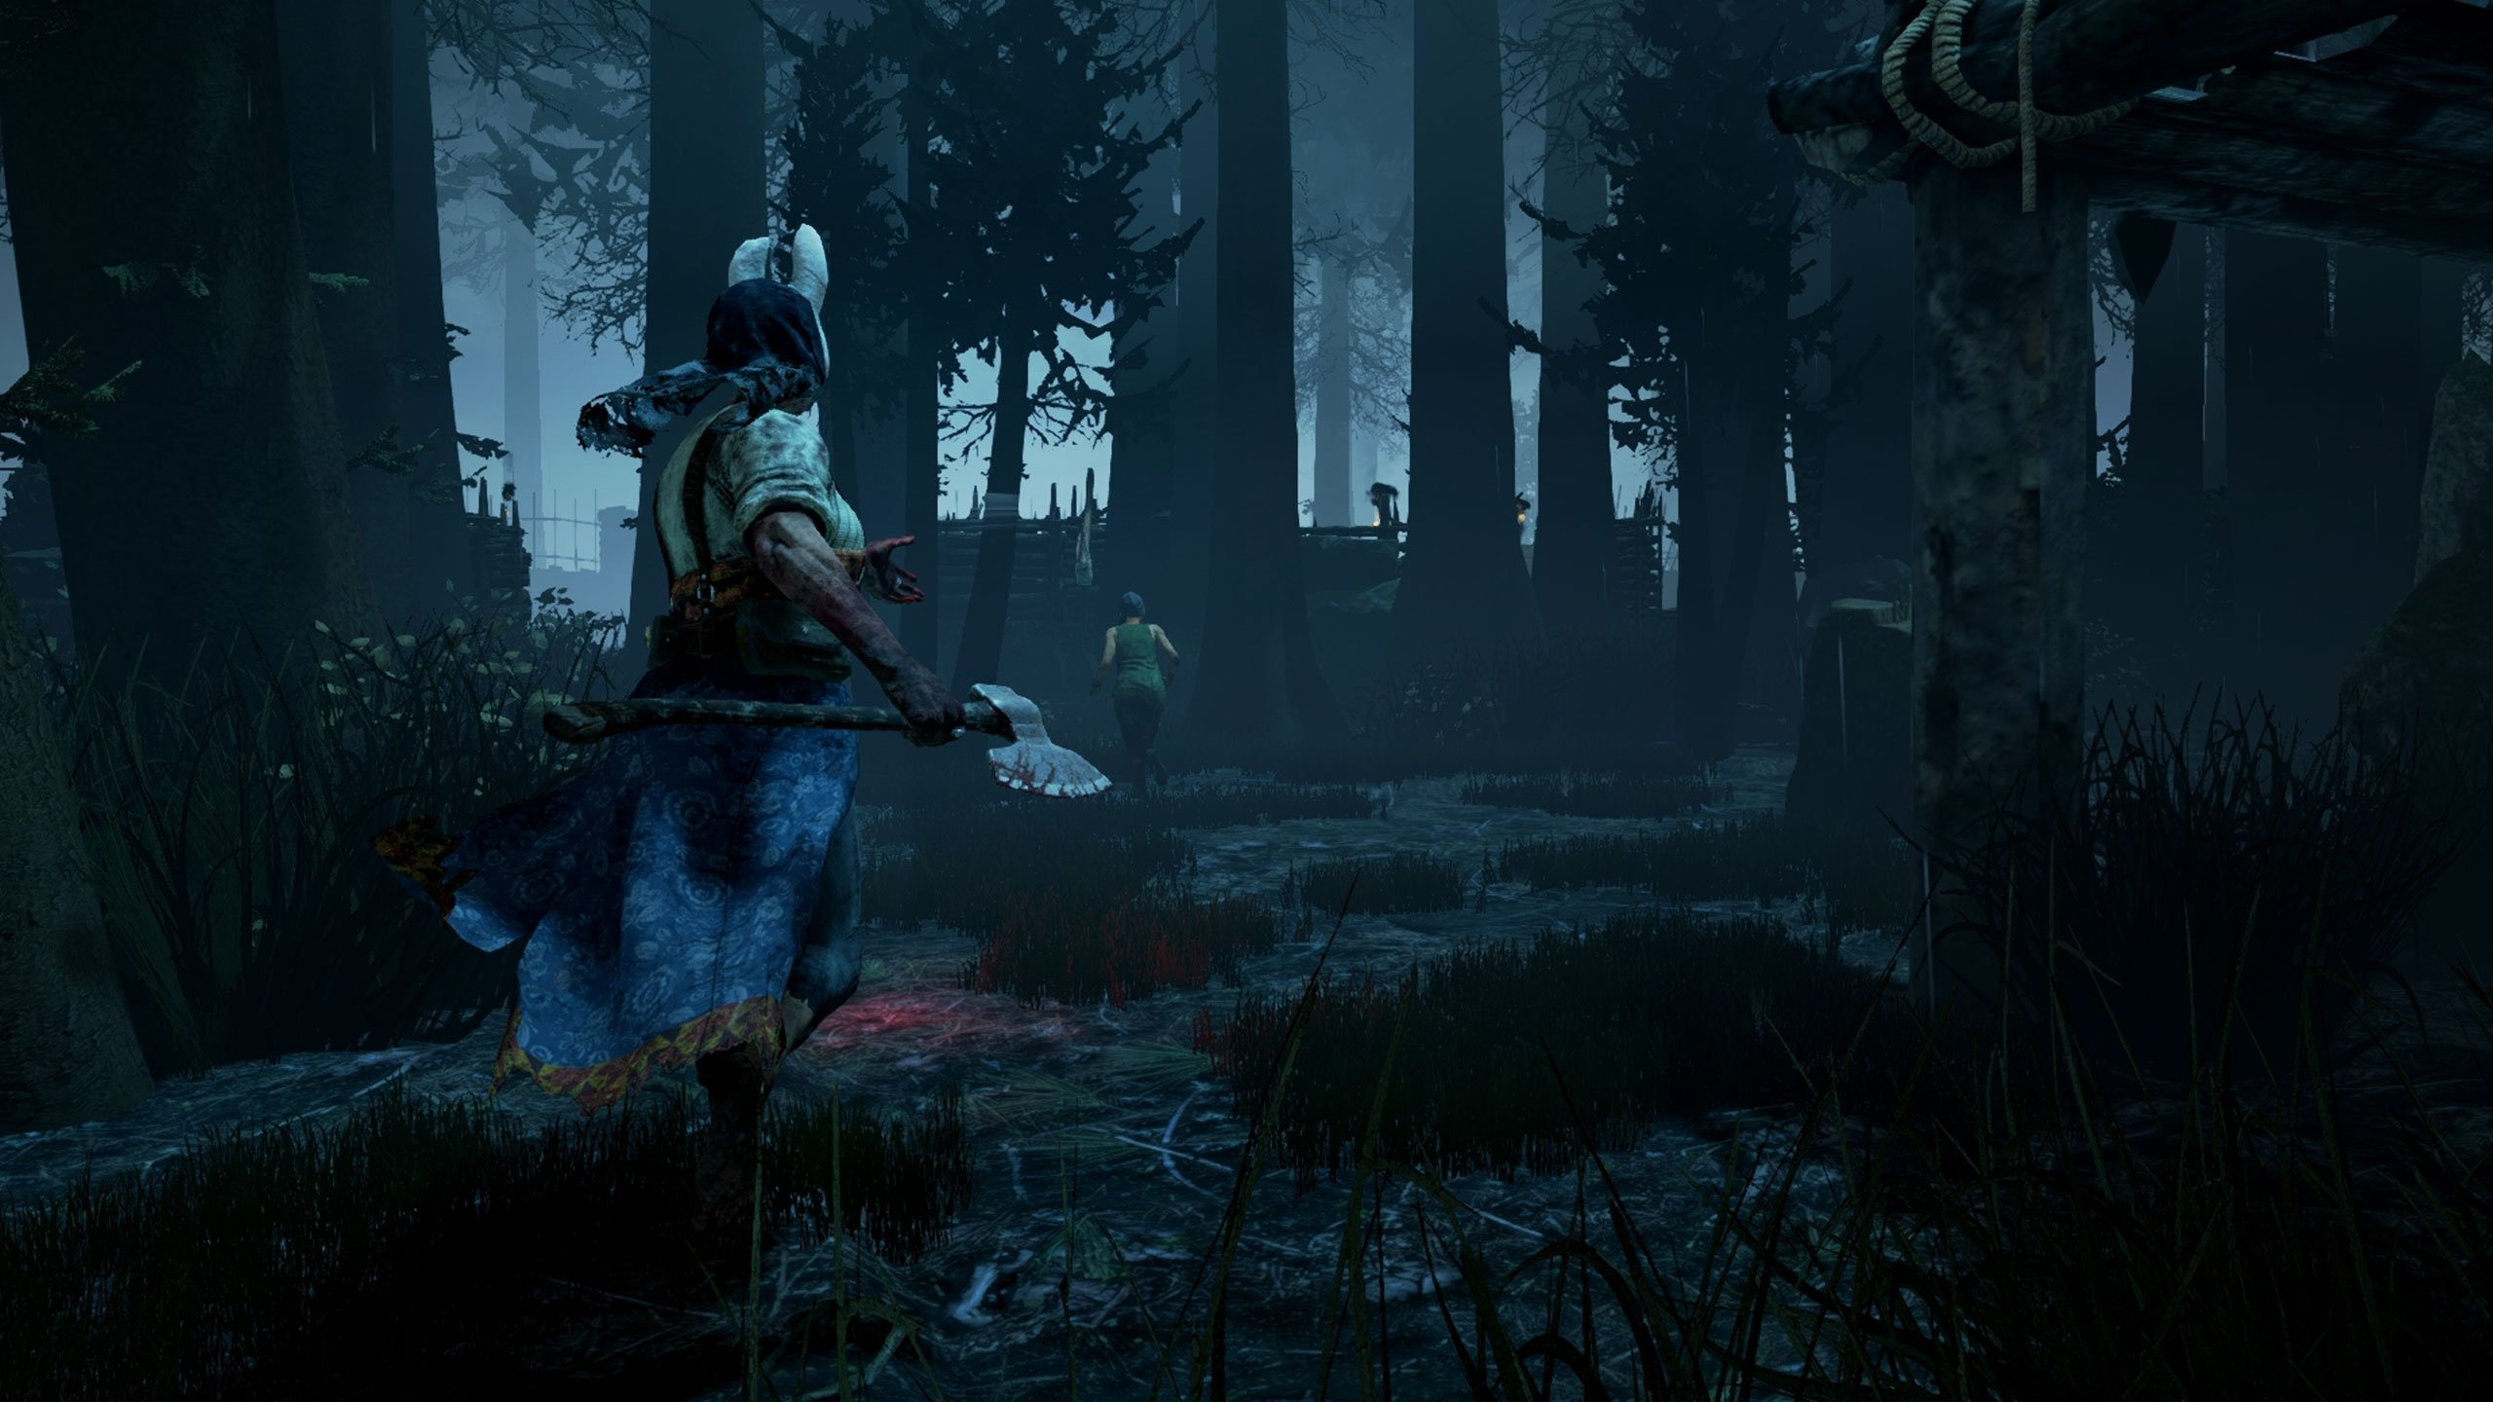
Summary
Great Unique Concept
Very thrilling to play as a survivor
Feeling of great power when playing as the killer
Community is very selfish
Worth the purchase

