Slide 1
Christina centivany

Slide 2
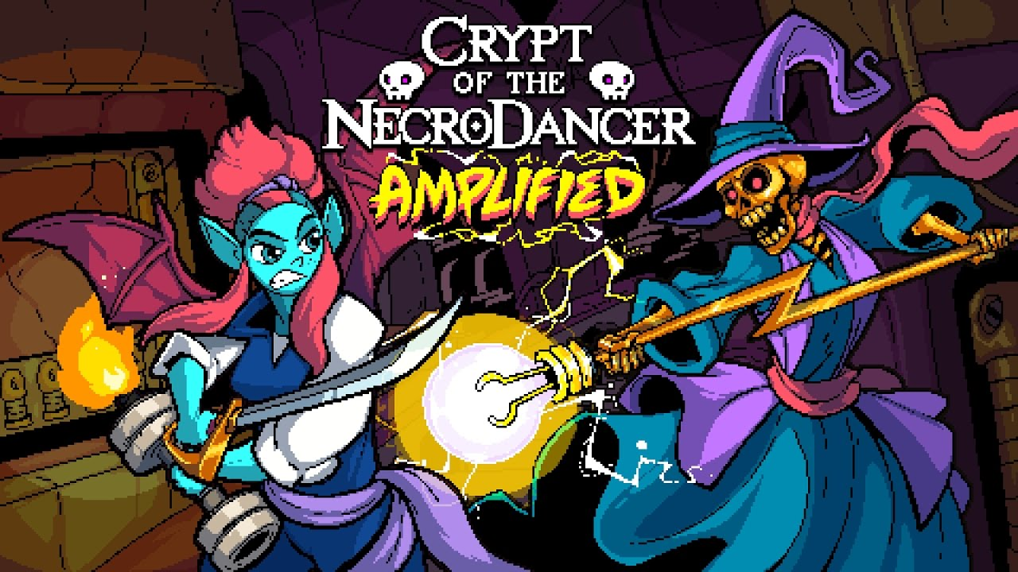

Slide 3
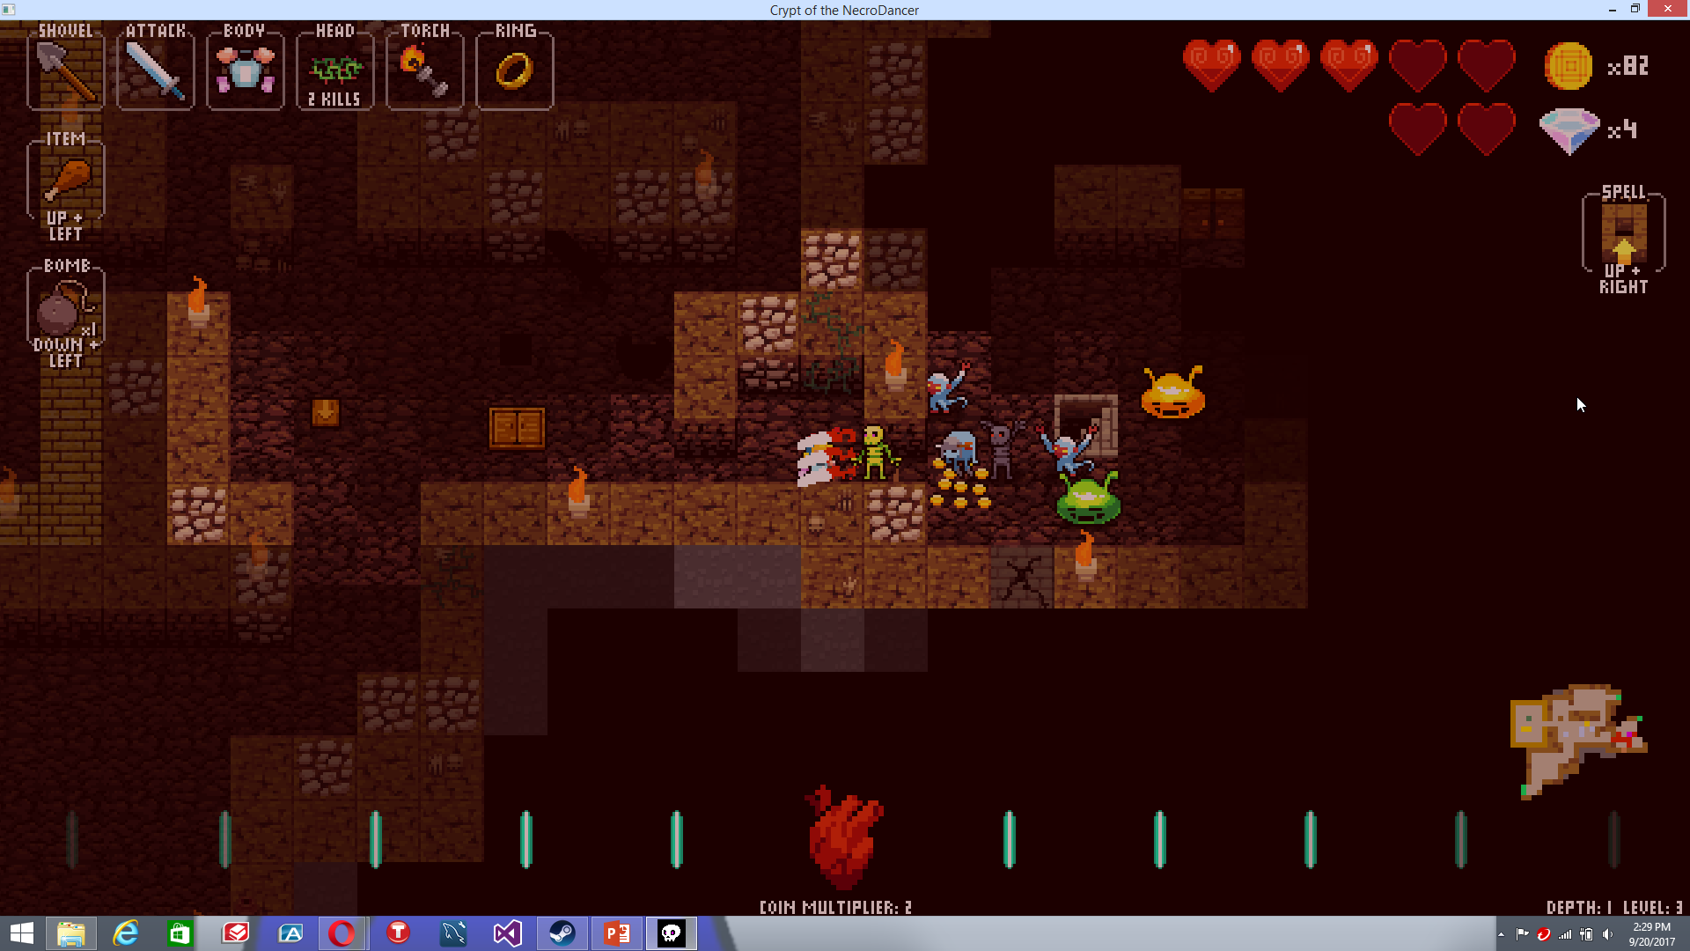
Basic Information
Game title: Crypt of the NecroDancer
Type of game: Roguelike/roguelite, Turn based, Rhythm
Price
Full Price for Original game: $14.99
Full Price for original Game and ‘AMPLIFIED’ DLC: $21.98
Actual hardware required
The game is now available on Windows, Mac, Steam OS + Linux, PS4, PS Vita, XBOX One, and a pocket version is available on iOS. The player can play with a keyboard, a controller, or a dance pad (such as would be used in dance Dance Revolution) for whatever appropriate system the game is on. The team is working on developing for more systems as well currently.

Slide 4
Minimum Hardware Requirements (only given for Computer version)
Windows
OS: Windows XP, service pack 3
Processor: 2GHz
Memory: 1000 MB RAM
Graphics: 512MB VRAM
Storage: 1600 MB available space
Mac OSX
OS: Minimum 10.6 to run the game, 10.7 if you also want to use your own music files
Processor: 2GHz
Memory: 1000 MB RAM
Graphics: 512MB VRAM
Storage: 1600 MB available space
STEAM OS + Linux
OS: Steam OS and Ubuntu 12.04 are the only supported Linux OSes
Processor: 2GHz
Memory: 1000 MB RAM
Graphics: 512MB VRAM
Storage: 1600 MB available space

Slide 5
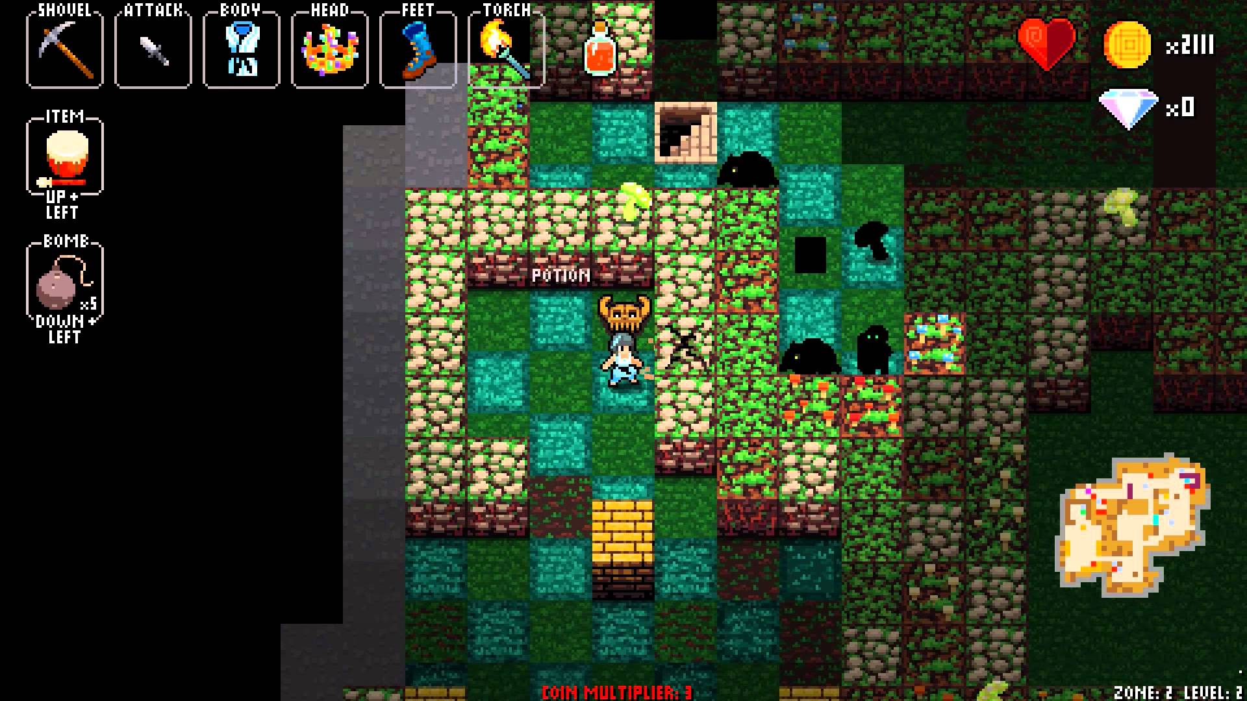
Companies and important people
Developers: Brace Yourself Games
Publisher(s): Brace Yourself Games and Klei Entertainment (PC version)
Director(: Ryan Clark
Producer: Heather Wilson
Designer: Ryan Clark
Programmers: Oliver Trujillo and Ryan Clark
Artists:
Pixel art and Animations: Ted Martens
High Res Art: Jesse Turner
Trailers and cut scenes: Marlon Wiebe
Writers:
Ryan Clark, Oliver Trujillo, and Kathryn Clark
Composer:
Danny Baranowsky

Slide 6
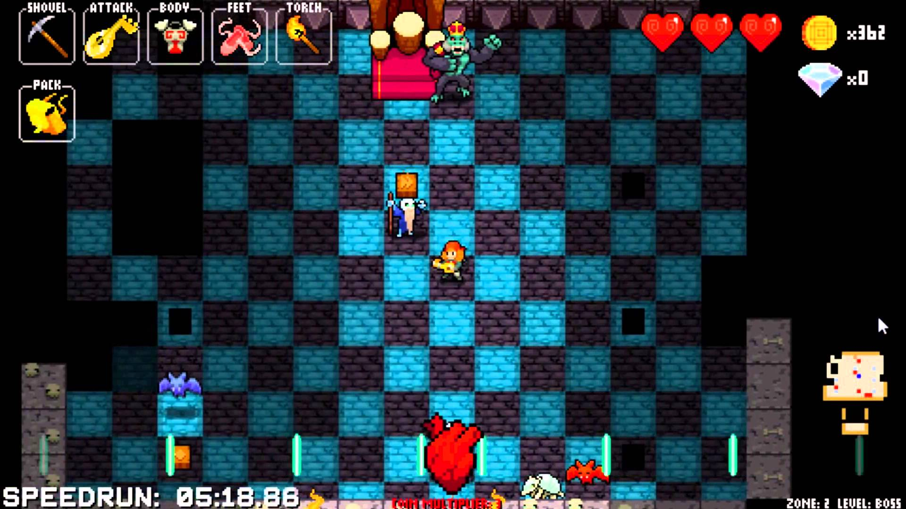
Game Summary
Quick overview:
Cadence must Fight through various dungeons in a crypt, facing the nefarious NecroDancer and his legion of the undead to save her father
Installation:
There does not appear to be a physical copy of the game; all versions are downloadable.
User Interface:
The Left of the screen down the side and across the top displays the active character’s weapon(s) (if applicable), the shovel being used, any item(s) on the character, and as applicable any: bombs the character is carrying, potions being held (which revive from death), any armor, any ring, any footwear, any headwear, Torch Being carried.
Along the bottom of the screen, any coin multiplier and the heart with the music’s beat are displayed
The top right displays how many hearts the player has left, the amount of gold coins, and any diamonds that the player has collected and is carrying at any given moment during gameplay

Slide 7
Game Summary (Cont.)
Player role:
The player always plays first person as the active character, and makes his or her way through the dungeons of the crypt, fighting various enemies large and small along the way.
Most characters can move in an arrow direction, and can use items, weapons, armors, footwear, headwear, bombs, and collect various rings (one allowed at a time) and charms
Game Play:
At the game’s onset, the player can unlock multiple shops in the lobby by rescuing caged NPCS
The Main merchant can randomly be replaced by an evil version of the merchant on any given level of any given zone, that upon entering his shop will relentlessly attack the player if he or she does not kill him
As diamonds are collected, the player can use them in the lobby to:
Buy permanent upgrades (such as extra hearts, multiplier boosts)
Unlock weapons, items, armor, wearable items, spells, and chests that can appear in the zones
Train against unlocked mini-bosses and enemies
(Eventually) purchase things for the player’s next run (excluding all-characters run)
Each level in a zone has a mini-boss to defeat, and each zone has a boss fight at the end
Gold can be used while in-zone to buy things from various merchants
Any and all movements (except as Bard) must occur on the beat of the zone and level’s song

Slide 8
Game Summary (Cont.)
If the song ends before the player reaches the end of the level, the character drops through a trap door to the next level of the zone and he or she must defeat any mini-boss(es) that were not defeated before time ran out in the previous level
Each character has different rules that he or she must play by or die immediately upon violation, with different restrictions and/or bonuses that are listed below:
Cadence: none; default gameplay
Melody: Must always use the Golden lute for her weapon; move next to enemies to kill them
Aria: one hit kills her; one missed beat kills her; must always use the non-enchanted dagger as her weapon; does not have to defeat sarcophagi in zone 4 to progress to next level
Bard: Moves freely with no beat; enemies act immediately after he takes action
Dove: Cannot carry a weapon other than her default flower, which confuses enemies temporarily instead of damaging them; her bombs teleport enemies instead of killing them; Does not have to defeat mini-bosses to progress
Monk: cannot collect gold or wear the ‘crown of greed’
Eli: cannot carry any weapons; has unlimited bombs; can kick bombs at enemies

Slide 9
Game Summary (Cont.)
Dorian: Cannot replace his Boots of Leaping or Platemail; Walking without ‘Boots of Leaping’ active will inflict 0.5 damage each step
Bolt: Bolt and all enemies move at double-speed
Coda: has the restrictions of Aria, Monk, and Bolt
Nocturna (DLC): has unique Transform spell to bat form (automatically activates upon a killing blow to Nocturna while she’s in vampire form); Zone 5 (only unlocked with DLC) infects other zones
Diamond (DLC): Can move diagonally with key combinations; Spells, Backpacks, Holster, weapons that need to be loaded and boots than can be toggled do not appear; Cannot throw weapons
Mary (DLC): Has a little lamb that follows her; if the lamb dies, Mary takes damage every beat until she is dead and can only be saved by going to the next level, respawning the lamb
Tempo (DLC): Deals infinite damage; Has a counter of 16 that goes down by 1 every beat and is reset by Killing enemies or buying items, killing tempo if the counter falls to 0; permanent telepathy effect (player can see all enemies); All enemies may appear, regardless of zone.

Slide 10
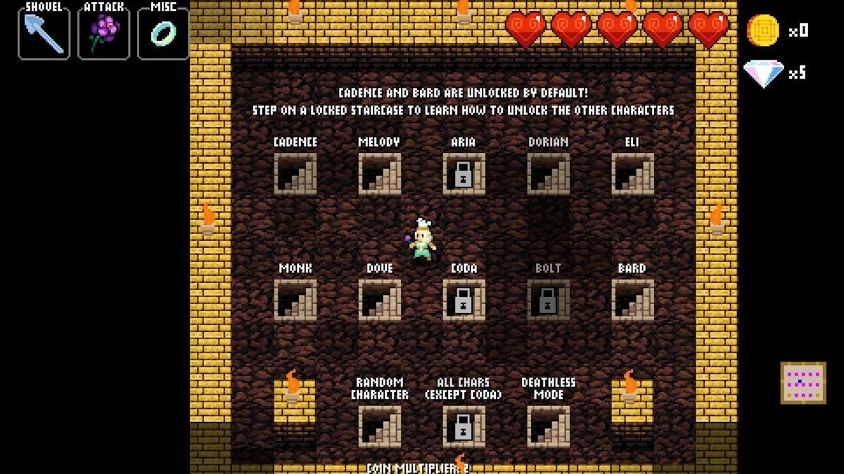
Game Summary (Cont.)
Scoring:
Most modes are scored by gold the player has collected in a run. There are some modes where there is a score system based upon how long the player takes and how far he or she gets in the meantime.
Artwork:
The animations for the opening sequences and cut scenes are beautifully done
The gameplay artwork is clean, nicely done 2D pixel artwork
the Pixel art and Animations done by Ted Martens,, High Res Art by Jesse Turner, and the art for the Trailers and cut scenes is by Marlon Wiebe
Sound and Music:
As mentioned, the music is composed by Danny Baranowsky (who also Composed the music for Titles such as ‘Super Meat Boy’ and ‘The Binding of Isaac’). Within the gameplay itself there is: minimal voice acting (mostly the current character you are playing as grunting or letting out a death cry), in and near the level shop the merchant sings along with the song, each enemy and movement has unique cries and movement noise, each movement, action, and item also has a sound.
some enemies (such as banshee) affect the sound of the area until defeated as well. The Game also features, through playing as different characters, remixes of Baranowsky’s work, most notably in the forms of A metal remix by FamilyJules7X and an EDM remix by A_Rival.
The cut scenes also are properly scored to convey the emotion that the writers had intended the player to feel or sense

Slide 11
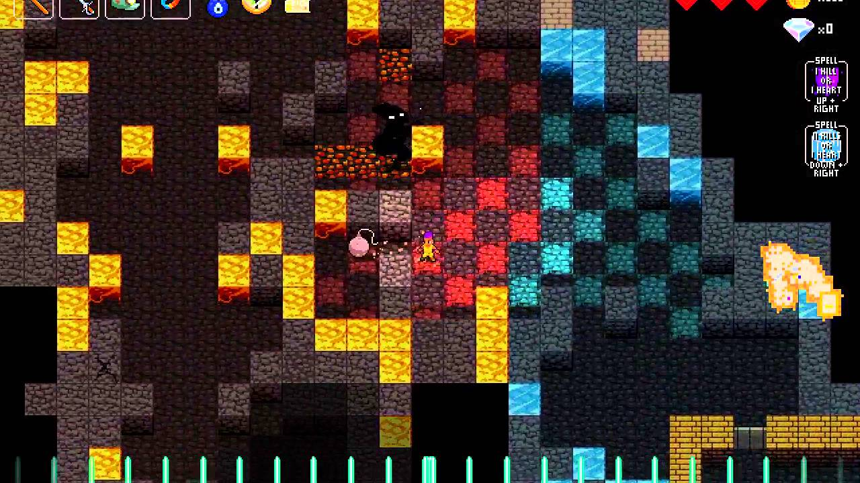
Game Summary (cont.)
Special features:
A wide variety of characters, single player modes, local co-op, and allowing the player to load his or her own music or to use any of the various remix volumes for the gameplay music.
Manual:
the closest thing to an ‘official’ manual is on steam and is by STEAM users Crypt Warden and Abnatha Pryde.
several playthroughs as various characters can be found on YouTube.
a channel that the official NecroDancer page online recommends that has some tutorials done by EladDifficult! At http://necro.dance/necrotome
Bugs:
player input is not always properly registered by the game, but happens much less frequently than it used to. Most of the bugs I have noticed in the past have been fixed, as the development team is very active, and very quick both to respond to bugs and are motivated to constantly improve the game

Slide 12
Story Line Part 1: Cadence
The original storyline follows Cadence, her journey to find her father (Dorian) after his prolonged disappearance hunting down yet another treasure, and the subsequent effects on her family.
It is revealed that Cadence lost her mother, Melody, to illness when she was seven years old. Her father then earnestly began looking for ‘The Golden Lute,’ which allows its player to revive and control the dead, and heal those on the brink of death. Eventually, he found the correct place to look, but has not returned in what has been two years prior to the game’s onset
She falls into a crypt has her heart stolen, cursed by the mysterious, evil NecroDancer, and she must fight her way through several zones of a crypt in rhythm to the music playing.
Eventually, She eventually reaches the end of the 4th zone, and fights who she afterwards finds out /is/ her missing father, who has also been cursed by the nefarious NecroDancer (who possesses the Lute). Upon defeating the NecroDancer together, Cadence and Dorian return to the world above and revive her mother.

Slide 13
Story Line Part 2: MELODY
Melody’s revival comes with a cost; in order to continue living under the magic of the golden lute, melody must continually play it. However, the longer someone plays the lute, his or her humanity is lost until he or she becomes such as the NecroDancer.
Melody herself travels through the crypt, telling the story of how her mother, Aria once left her family to find the Golden lute, returning upon finding it. Aria used the lute to heal the sick and dying, then left her family again to destroy the lute, and not only failed, but never returned.
She revives the NecroDancer, who was once a bard named Octavian, seeking to destroy the lute herself, and they battle. Upon defeating Octavian, melody’s mother Aria appears, a dagger in her chest, and shoves Octavian to his doom.

Slide 14
Story Line Part 3: Aria
FULL DISCLOSURE: I had to research the cut scenes for Aria because she is EXCEPTIONALLY difficult, and I have not beaten her Mode!
Melody is, of course, surprised to see her mother after all these years, and confronts her about abandoning her. Aria reveals that she did not mean to abandon her family; she herself had once revived Octavian seeking answers on how to destroy the golden lute. He tricked her into giving him the lute by saying he would sacrifice himself to destroy it, claiming he should ‘atone for what he had done’, and then stabbed her in the heart.
Aria then reveals the story of Octavian; how he had been a bard struggling to be noticed. He found the golden lute and realized its power, eventually building an army of the undead that he had raised. He sought and achieved immortality, and gained it but lost his humanity. Eventually, he grew weary, stopped playing to rest, and died.
However, before betraying Aria, he revealed how to destroy the lute. Aria travels to the shrine, and the lute itself turns into a monster and fights being destroyed. Eventually Aria defeats the lute, and sacrifices herself to destroy it. The ending scene shows Cadence, Melody, and Dorian standing at Aria’s grave, her sacrifice having allowed the three to truly reunite and live their life together happily.

Slide 15
AMPLIFIED Story line: Nocturna
The ‘prequel’ DLC follows a vampire girl named Nocturna, who has heard stories of a graveyard where the dead roam again.
She disobeys the council to investigate, and finds out that the rumors are indeed true.
She realizes, however, that they are being forcefully raised and controlled, and it is revealed she was forced to become a vampire. She vows that, since she no longer has her own freedom, to find the cause and prevent this from continuing to the dead around her.
She eventually fights her way to the center, and confronts the Conductor, a scientist who offers Nocturna her humanity again through the magic of the Golden Lute if Nocturna helps her. Though tempted, a battle breaks out.
Upon defeating the Conductor, Nocturna flies into a rage, destroying the lab in its entirety before raising the lute above her head, ready to slam it into the ground. However, her eye is caught, and she looks up only to see herself in a mirror, seeing herself as human again. Her rage dissipates, and she looks down at the lute before flying up out of the crypt and into the night, lute in hand.

Slide 16
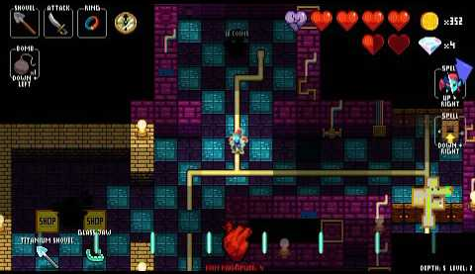
Game Review
The Good!
It’s very compelling with a fantastic soundtrack, and interesting gameplay that offers a wide, progressive variety of challenge
The bad…
The controls don’t always register very well, which for some characters (such as Aria and Coda) are fatal, and can make gameplay for those characters an exceptionally frustrating experience
How it compares up to games in similar genres, and why I think it’s Better!
NecroDancer is a rather unique experience.
it is not quite structured EXACTLY the same way as a normal roguelike (which leads to many classifying it as a roguelite). However, it is still very challenging, with a wide variety of characters who have different ‘handicaps’ to add to the difficulty.
I believe this is better than similar games because it has an engaging story, a lot of different challenges to playing it, a fantastic soundtrack, and incorporates roguelike elements with rhythm game elements, both of which I love

Slide 17
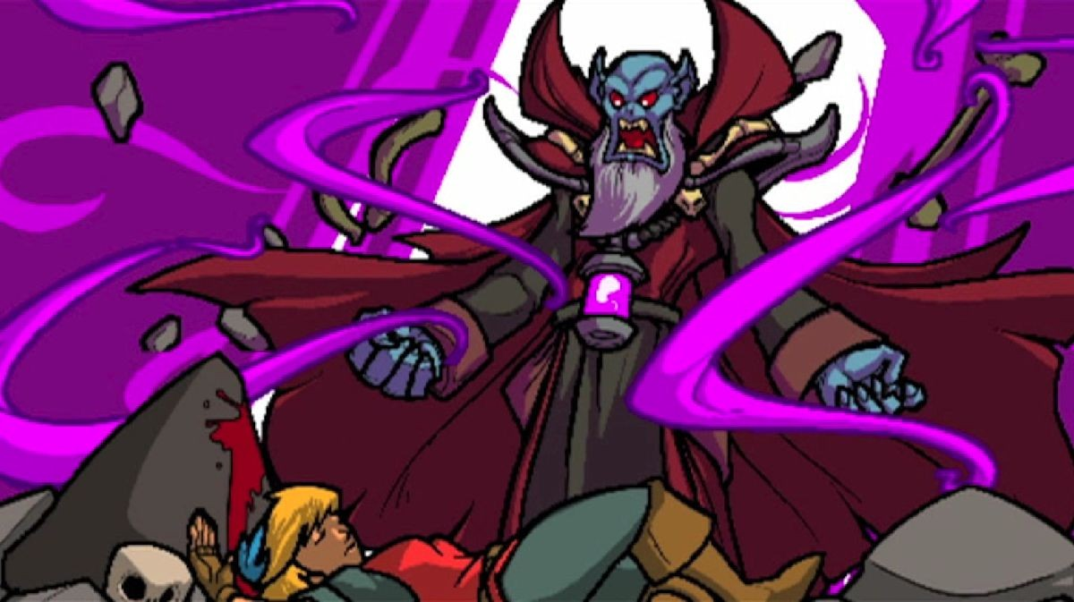
Game Review (Cont.)
Appropriate audience
The game is officially rated ‘T’ for fantasy violence and mild blood
However, I believe this to be a miscategorization. I Reasonably think this would be suitable for 10+ people who love rhythms and roguelikes. It also has a little bit of mild language (during one of her cut scenes, Melody uses ‘Damn’; not bad by any means, but not appropriate for the very young)
Are any design mistakes present?
None that I have noticed for certain. The characters do not reflect all of the different headwear pieces while they are currently active, but it is unclear if this is a mistake or intentional. There have been some clear design mistakes in the past, such as armor not showing a different on some character sprites, but those have since been fixed.

Slide 18
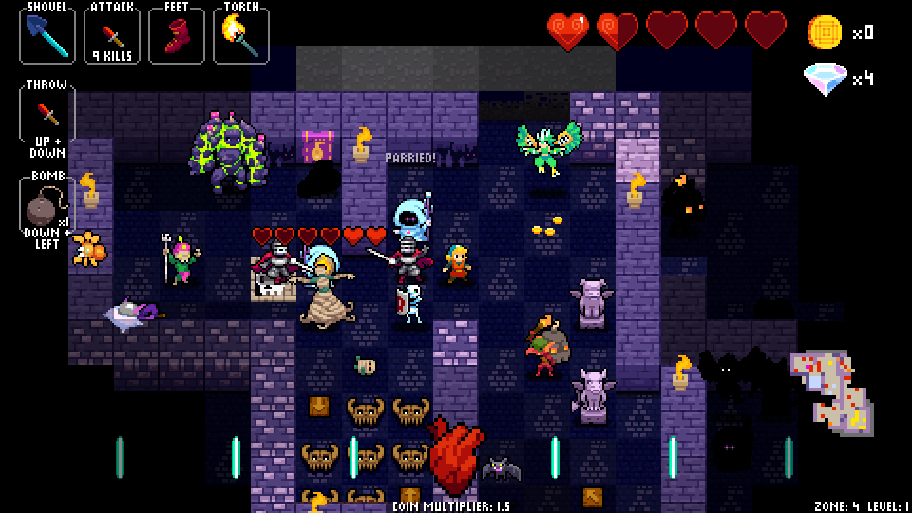
Summary
Overall strengths and weaknesses
Strengths:
The Game is challenging, fun, has high replay value, has multiple compelling story lines, has fantastic soundtracks, when bugs are found and reported the team is very quick to fix the bugs, and the team is continually improving the gameplay experience and adding new items and weapons
Weaknesses:
There are a few oddball characters that, though fun to play, do not have a clear tie to the compelling stories, and the input bug and menu bug are taking a longer time to fix
However, these weaknesses are nearly negligible, and except for the previously mentioned input bug, do not hinder the gameplay experience
Is the game worth purchasing?
This game is ABSOLUTELY worth purchasing!
Improvements
IMPROVE THE GAME’S REGISTER OF directional input
Allow the user to exit back to the menu from the ‘All Zones Mode’ seeding menu and the Character selection menu
Better connect the story of the prequel to the story of the original game

Slide 19
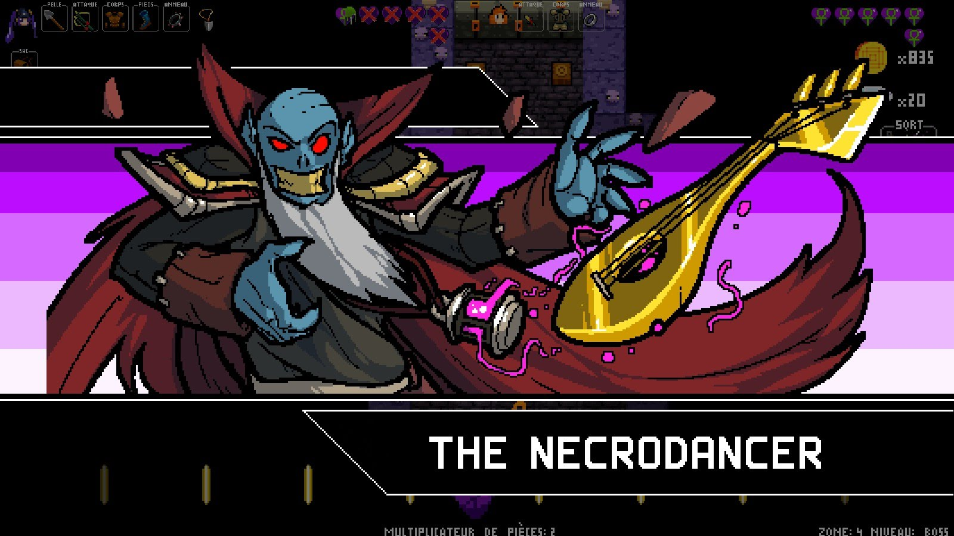
Comments, Questions, Concerns?

Slide 20
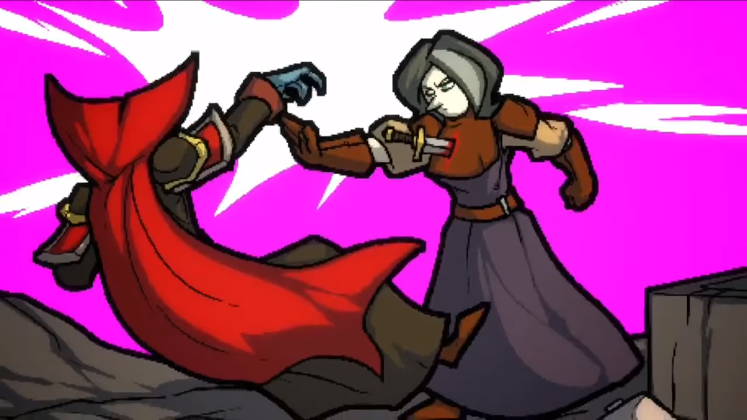
Citations
Information found on:
The Steam store page
http://store.steampowered.com/app/247080/
The official game page
http://necrodancer.com
The fan wiki regarding characters:
http://crypt-of-the-necrodancer.wikia.com/wiki/Characters
Cut scenes to Learn Aria’s story line
Zone 4: https://www.youtube.com/watch?v=IWdszTbT3dw
Zone 3: https://www.youtube.com/watch?v=sZbjRgUpnCo
Zone 2: https://www.youtube.com/watch?v=HmQhNQnVRMg
Zone 1: https://www.youtube.com/watch?v=Lt-BGT5So98
Inside the game itself!
Artwork
Most of the pictures are screenshots I took from my own gameplay
For The picture of Bolt gameplay (slide 11)
https://www.youtube.com/watch?v=whlimkZ3rLg
For The Picture of Aria Gameplay (slide 5)
https://www.youtube.com/watch?v=UnBWx724dUk
All artwork, of course, belongs to the artists and Brace Yourself Games

