Slide 1
CIS 487 Game Review Presentation
By Brian Burditt

Slide 3
Super Mario RPG: Legend of the Seven Stars
Developed by Square
Published by Nintendo

Slide 4
Basic Game Information
Game Type: Role-Playing game with some Platforming aspects.
Price: $50-$60 when it was released in 1996.
Hardware Requirements: Super Nintendo, controller, television.

Slide 5
Overview
Classic turn based RPG style game with a few twists
No random encounters
Timed hits
Overworld Platforming

Slide 6
Storyline
Game starts out as a typical Mario story. Bowser has kidnapped Peach and Mario must travel to Bowser’s Castle to rescue her.
During the rescue, a giant living sword crashes into Bowser’s Castle, forcing Mario, Bowser, and Peach all out of the castle.
The giant living sword is one of Smithy’s minions (Smithy being the main antagonist) and they have destroyed Star Road, preventing people’s wishes from coming true.
Mario teams up with Mallow, Geno, Bowser, and Peach to defeat Smithy’s Gang and collect the 7 stars to fix star road.

Slide 7
Player’s Role
Control Mario in the overworld
Select combat options for Mario and his companions in battle
Customize stats (to some degree), use items, change equipment
Occasionally choose dialogue options that don’t affect the story or game in any way whatsoever

Slide 8
Installation
N/A

Slide 9
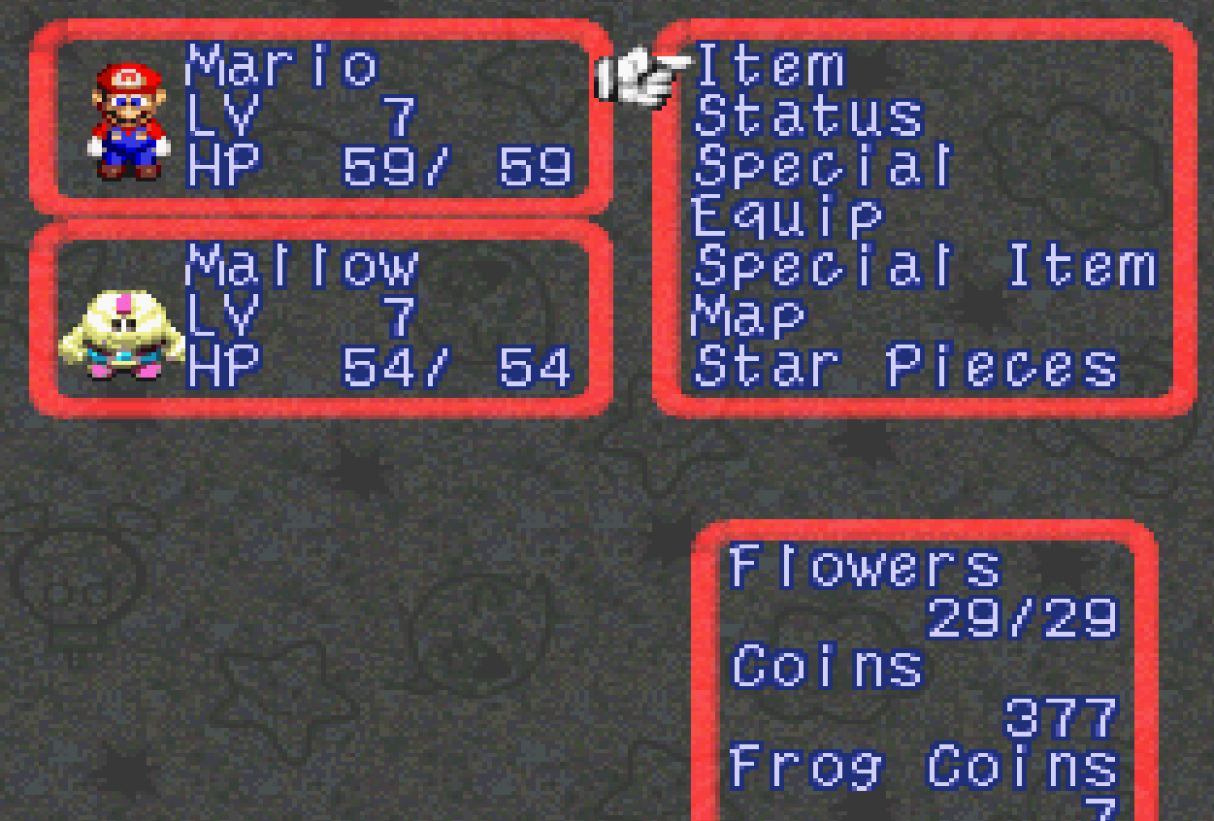
User Interface
Simple
Easy to use and understand
Not especially innovative

Slide 10
Gameplay - Overworld
Overworld map consists of 7 regions: Mushroom Kingdom, Pond to Pipes, Mole Mountains, Seaside, Land’s End, Nimbus Land, and Factory (Bowser’s Keep).
Forced pathing allows you to travel between specific areas within these regions (similar to Mario Bros. 3 and Super Mario World) and you can freely travel back to previous regions.

Slide 11
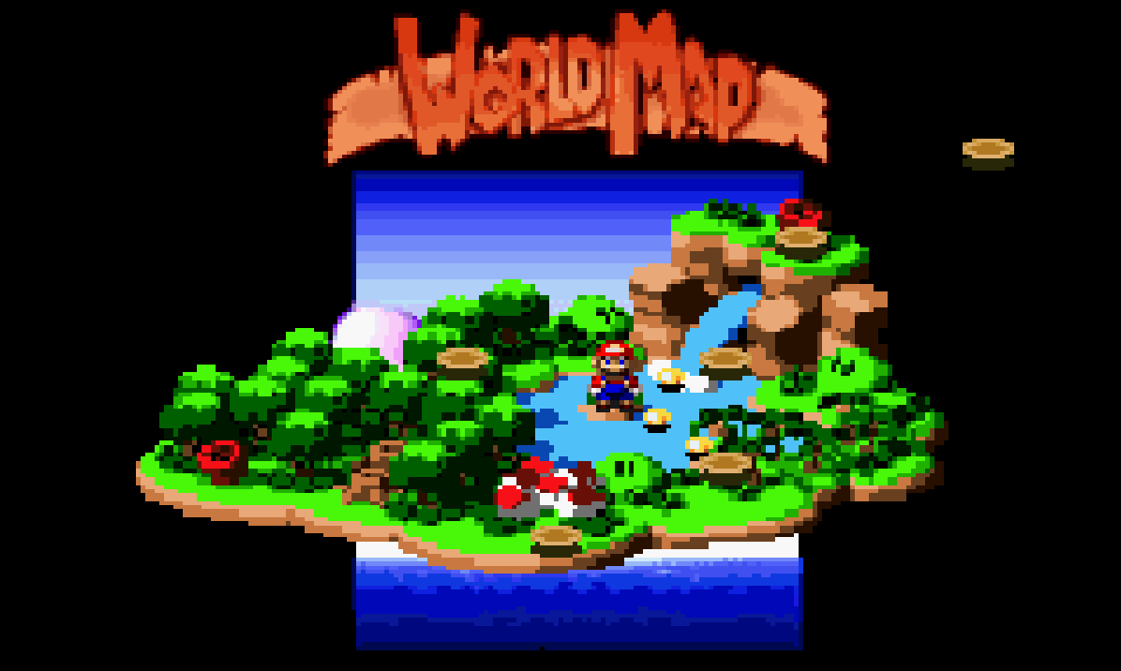
Gameplay - Overworld (cont’d.)

Slide 12
Gameplay - Movement
Once inside a specific area, you can freely move Mario around.
Mario can move in 8 different directions and also jump.
He can freely talk to NPCs, interact with specific items in his environment (Jump up to hit blocks, jump on switches, jump on trampolines, inspect certain items, etc.), and can enter battle with enemies he runs into.
Some NPCs are the owners of shops who will buy and sell items and equipment.

Slide 13
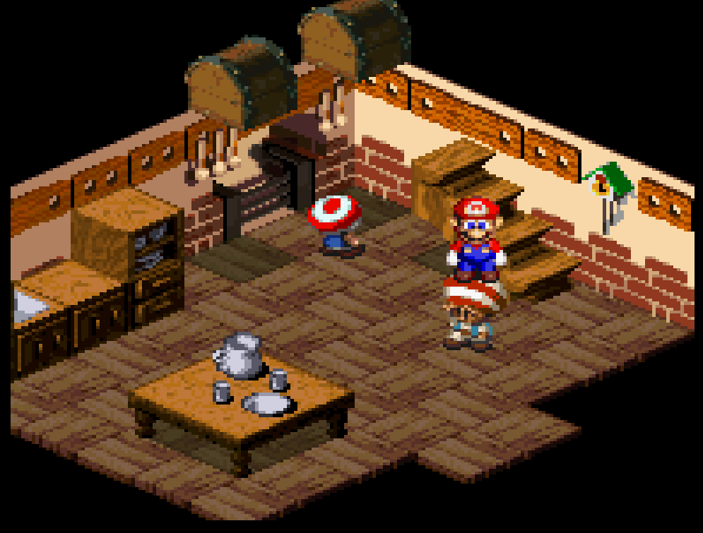
Gameplay - Movement
Most importantly, you can jump on top of an NPC’s head and ride them as they walk around.

Slide 14
Gameplay - Combat
Combat is triggered by touching an enemy or by storyline events (such as encountering a boss).
Combat is turn based.
Mario and up to 2 of his companions face off against enemy teams.
During the turn of Mario or one of his companions, there are 4 options to choose from. Attack, Item, Special, and Etc. (which includes Defend and Run Away).

Slide 15
Gameplay - Combat (cont’d.)
Timed hits are used during Attack, Special, and defending from enemy attacks.
During a regular attack, the player must hit a button at a precise moment to increase the potency of the attack.
Special Attacks vary depending on the attack. You may have to hit a button at a precise moment, hitting a button repeatedly, holding a button until a specific moment, etc.).
Players can defend from enemy attacks by hitting a button at a precise moment during the execution of the enemy attack to reduce the incoming damage.

Slide 16
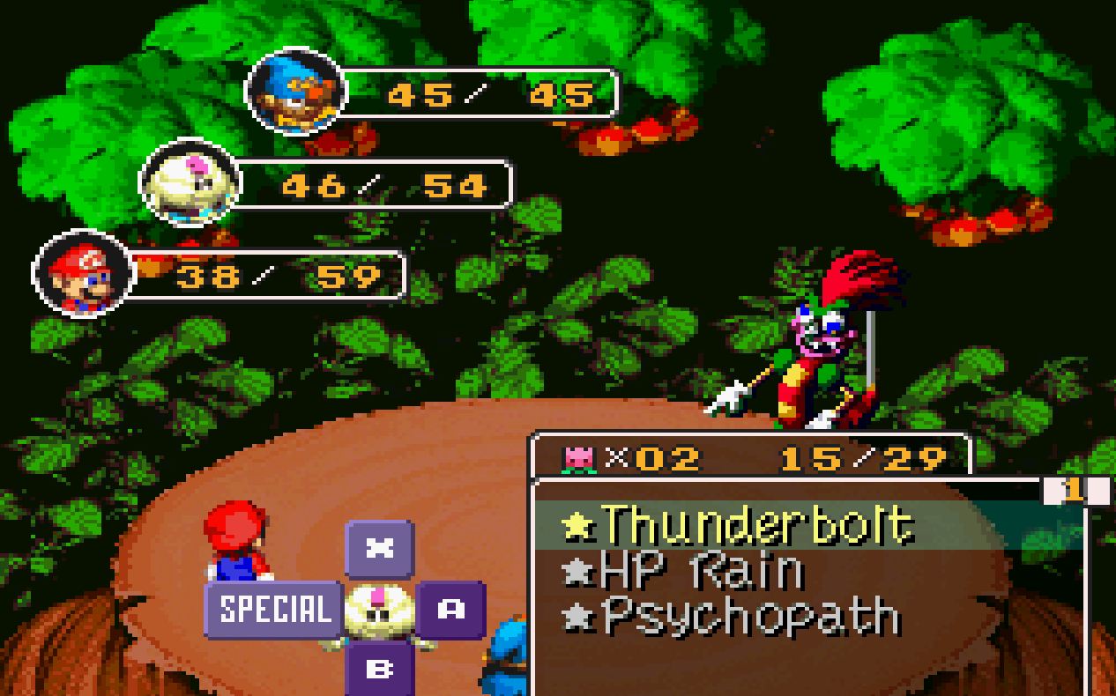
Gameplay - Combat (cont’d.)

Slide 17
Gameplay - Minigames
A river course where you collect coins while riding barrels.
Jumping on goombas (and avoiding spikes) to collect as many points as possible in 30 seconds.
An in game video game involving shooting shells while avoiding getting hit by them.
Racing Yoshis
Gambling
Composing music
Many others

Slide 18
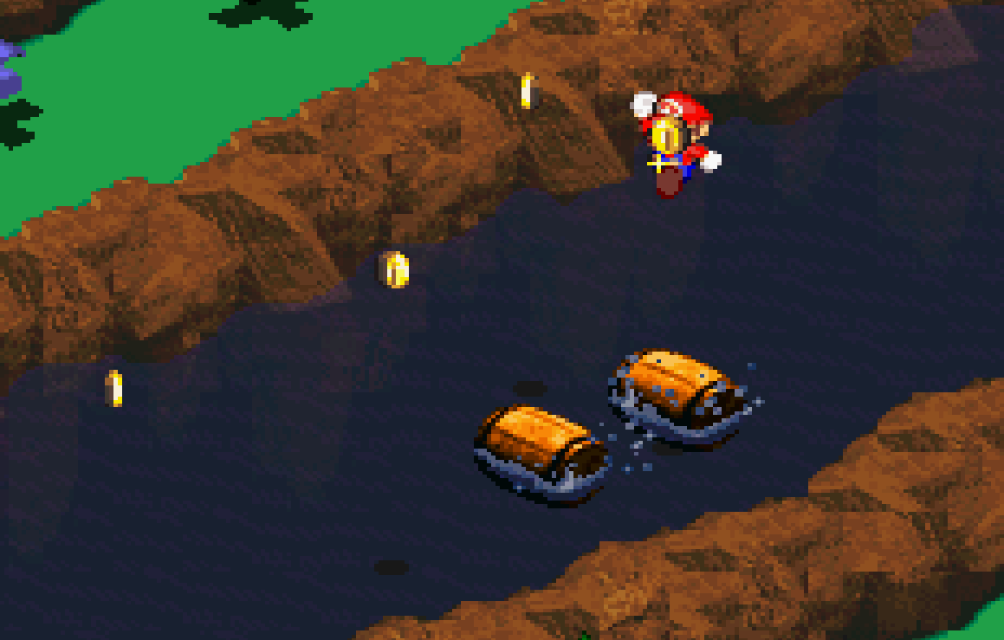
Gameplay - Minigames

Slide 19
Scoring
Beat the boss = win.
Lose all HP = lose (all party members must die to have a game over).

Slide 20
Artwork, Sound, and Music
Yes, it has all 3!
The game’s 3d graphics were considered impressive when the game came out.
The music in the game is very diverse, it contains themes from Mario games and Final Fantasy games.
Could use more sound effects (probably limited due to the amount of memory available at the time), but a range of sound effects are used in the game to cover various forms of jumping and attacks.

Slide 21
Special Features
None?

Slide 22
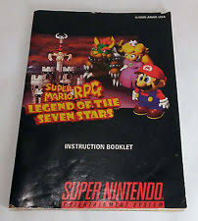
Manual
Physical manual comes with game
In game tutorials explaining mechanics

Slide 23
Bugs
Some minor graphical glitches
A boss can be skipped by making a couple very specific jumps (hard to activate unless you’re purposely doing it)

Slide 24
The Good
The timed hits make turn based combat more engaging, interesting, and skill based.
Mario characters brought into an RPG world was new and exciting when the game came out.
The storyline was light and fun. Lots of interesting and colorful characters.
Lots of mini-games and secrets scattered across the world keep the game from getting dull or too repetitive.
Mixing 2 game genres made it less likely to get bored.

Slide 25
The Bad
It isn’t very challenging
There is very little customization available for the characters

Slide 26
RPG Comparison
Has a lighter and goofier storyline than most RPGs
Much easier and kid friendly than other RPGs
Less character and ability customization
More mobility outside of battle (ability to jump)
No random battles (Monsters are visible outside of combat and you enter combat upon touching them, similar to Paper Mario)
First introduction (that I’m aware of) of an RPG using timed hit mechanics to enhance combat

Slide 27
RPG Comparison (cont’d.)
Hard to judge as better or worse than other RPGs of its time, it was a very unique game.
Less challenging, strategic, and serious.
More engaging, silly, skill based (to some degree), and casually fun

Slide 28
Game Audience
Rated Kids to Adult (today referred to as E for everyone)
Aimed more towards a younger audience, but still plenty of fun for adults

Slide 29
Design Mistakes
No ability customization and very limited stat customization
Too low of a level cap (level 30)

Slide 30
Overall Strengths
Story
Game Mechanics
Music
Graphics (at the time)
Humor
Minigames

Slide 31
Overall Weaknesses
Lack of difficulty

Slide 32
Worth Purchasing? Yes
Still yes.
Comes with the Snes Classic (if you can manage to get one).

Slide 33
How Could it be Improved?
More customization
Higher Level cap
Harder gameplay (or possibly difficulty options for anyone who wants more of a challenge)

Slide 34
Thank You!

