Slide 1
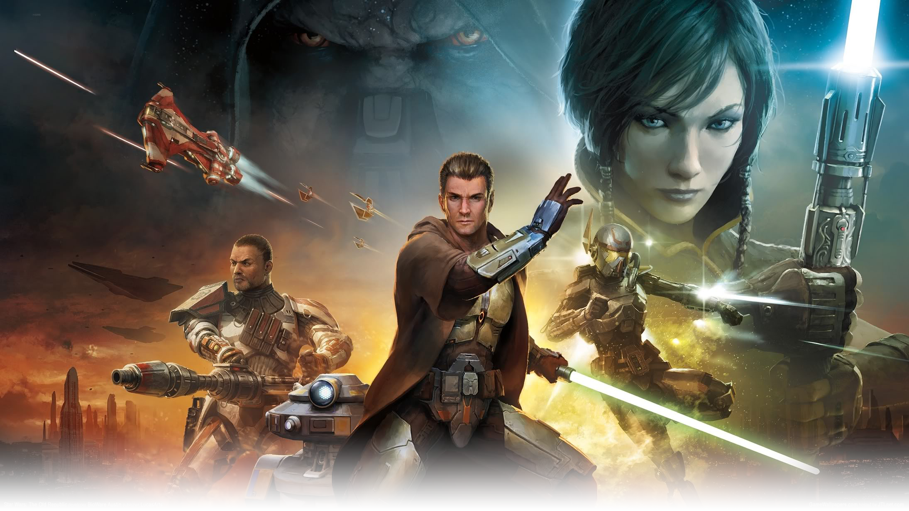
Star Wars: The Old Republic
CIS 487 - Game Evaluation
Jeff Wright
September 12, 2016

Slide 2
Game Summary

Slide 3
Basic Information
Title: Star Wars: The Old Republic
Developer: Bioware, Electronic Arts
Type: MMORPG
Price: Free with limited access
Subscription: $14.99/month for 30 days $13.99/month for 90 days $12.99/month for 180 days

Slide 4
Minimum Requirements
Operating System:
Processor:
RAM:
Graphics:
Windows XP, Windows Vista, or Windows 7
AMD Athlon 64 X2 Dual-Core 4000+ or better or
Intel Core 2 Duo Processor 2.0GHz or better
Windows XP: 1.5GB RAM
Windows Vista and Windows 7: 2GB RAM
PCs using a built-in graphical chipset, 2GB RAM recommended
ATI X1800 or better or
nVidia 7800 or better or
Intel 4100 Integrated Graphics or better (minimum of 256MB of on-board RAM and Shader 3.0 or better support)

Slide 5
Recommended Requirements
Operating System:
Processor:
RAM:
Graphics:
Windows 7 64bit SP1
AMD Phenom 2 X4 Quad-core 2.5GHz or better or
Intel Core 2Quad Processor 2.4GHz or better
4GB RAM or higher
ATI/AMD Radeon HD 4850 or better or
NVIDIA GeForce GTX 260 or better
512 minimum video RAM, Shader 3.0 or better fully compatible graphics card

Slide 6
Game Overview
The game starts off with character creation.
Players customize their looks, choose a side and a class, and then begin their storyline
The game offers main story quests as well as many side quests
There are also PVP and group quest options

Slide 7
Story Line
The game has 8 different story lines depending on the alignment and class the player chooses
Republic
Empire
Jedi Knight
Jedi Consular
Trooper
Smuggler
Sith Warrior
Sith Inquisitor
Bounty Hunter
Imperial Agent

Slide 8
Player’s Role
The player assumes the role of the class that they choose
They begin as an initiate or rookie and gain abilities, rank, and recognition as they level up
Once the player reaches the end of the characters main story line they are a high ranking and well respected member of their organization

Slide 9
User Interface
The game has an initial user interface setup
The UI is highly customizable for subscribed users
Free to play users have limited customizability

Slide 10
Default User Interface

Slide 11
User Interface Editor

Slide 12
Custom User Interface

Slide 13
Game Play
The player is given a main story line depending on their chosen class
Players make choices in every cut scene that affect their character, story, and companions
There are optional side quests which often contain multiple parts with small story lines
Group raids are optional
Include up to 16 players
Provides monetary and equipment rewards
PVP games are also optional
Provide monetary rewards

Slide 14
Scoring
Scoring is done with a leveling system
Higher levels can use better equipment
Leveling up unlocks new abilities
Other types of scoring include
PVP rank
Guild rank
Character titles

Slide 15
Artwork
The promotional campaign for SWTOR included three high quality animated game trailers
In game graphics are high quality, but not photo-realistic
Cut scenes in the game are higher quality than the actual game play graphics
The quality of in game graphics is customizable

Slide 16
Screen shot from movie quality animated trailer

Slide 17
Screen shot from movie quality animated trailer

Slide 18
Screen shot from movie quality animated trailer

Slide 19
Promotional art

Slide 20
Cut scene graphics quality

Slide 21
In game graphics

Slide 22
Sound and Music
The music in the game is all instrumental with some choir pieces
Based off of the classic Star Wars soundtracks, but completely original
Different planets have different musical themes
All characters, weapons, vehicles, etc. have their own individual sounds
Dozens of individual voice actors were used

Slide 23
Special Features
The game has special in game events during holidays and the game’s release anniversary
Other events are held periodically
Receive special equipment or titles for completing specific tasks
Receive limited edition equipment for pre-ordering expansions

Slide 24
Manual
There is an in game help system
Basic FAQ
Can submit a ticket for serious problems
Plenty of resources online
Strategy guides
Walkthroughs
Equipment databases
Guild members help each other out
Veteran players guide new players

Slide 25
Bugs
A game of this scale always has bugs
Very few bugs cause unexpected down time
Down time was usually scheduled for the early morning when player traffic is minimal
Patches were put through regularly to fix minor bugs and keep the game balanced for all players
Minor tweaks like changing the damage done by a certain skill or weapon
Graphical changes if UI didn’t load properly

Slide 26
Game Review

Slide 27
What Was Fun
Choosing your own story was the most interesting part of the game
The Star Wars universe is very rich in lore and offers a huge variety of environments and characters
Character customization was very thorough
Can play with friends or by yourself

Slide 28
What Was Bad
Some of the dialog choices are too polarizing
Completing the same quests over and over on different characters is redundant
The game can become more like a job if you want to be a top tier player

Slide 29
How Does It Compare
This game is very similar to other MMORPGs
Main competitor is World of Warcraft
The game started out really strong and has slowly tapered off
Most current players are still around because the game is Star Wars themed

Slide 30
Game Audience
The game is geared towards Star Wars fans
For age groups teen and up
Free to play option brought many players back

Slide 31
Design Mistakes
Any serious mistakes or game exploits are fixed immediately
Side quests used to be mandatory
Heroic quests could not be completed unless you were a very powerful character and brought friends into the quest
Traveling across large areas used to be very tedious

Slide 32
Summary

Slide 33
Strengths
Bioware is known for their excellent story telling
Fans of the Star Wars universe can live out all of their childhood dreams
Friends can play together or players can make new friends from all over the world
Each class takes 100+ hours to complete
New game modes and expansions are still being added

Slide 34
Weaknesses
The large amount of game play can be daunting
Updating the game often takes an hour or more
Some updates reset all of the characters unlocked combat skills
Lower level areas have a higher concentration of players and it can be hard to find NPCs required for quests

Slide 35
Worth Purchasing?
Free to play option makes it worth trying
The $14.99/month subscription is not too expensive if you enjoy the game
Must have a fairly high powered computer to run the game, upgrading a computer might not be worth it

Slide 36
Improvements
The game is continually evolving with new content and improvements
Space combat missions could be improved
New planets have been added, but there is always room for more

