Slide 1
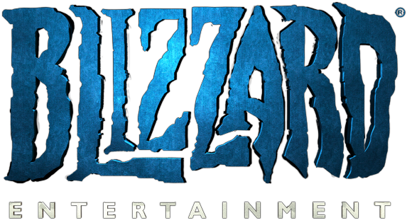
A Review by Jacob Tufts

Slide 2
Overview
Legion is an expansion pack for the Massively Multiplayer Online Role-Playing Game (MMORPG) World of Warcraft. You play the game by roaming the world, slaying AI-Controlled enemies and completing quests for non-player characters. You can also opt-in to player versus player combat

Slide 3
Storyline
As a player, you create an adventurer of one of 13 diverse races and 12 classes that is a member of the Alliance or the Horde, two factions at odds with one another. However, when the Burning Legion invades the planet, these two factions must learn to put aside their differences and unite against a greater threat.

Slide 4
Gameplay Overview
Only one consistent rule, eliminate opponents before they eliminate you by reducing their health to zero
The optimal way to do this depends on your class and specialization
Not everyone in a group is dedicated to dealing damage, some are dedicated to tanking, some healing

Slide 5
Gameplay Example
Unholy Death Knight: Main gameplay revolves around inflicting Festering Wounds on the opponent with Festering Strike, then bursting them with Scourge Strike for additional damage.
Both of these abilities also generate Runic Power, a resource used to cast Death Coil to deal more damage
Additional abilities all serve to supplement this core gameplay

Slide 6
How To “Win”
Artifact Power
Item Level
Raid Progression
PvP Rating

Slide 7
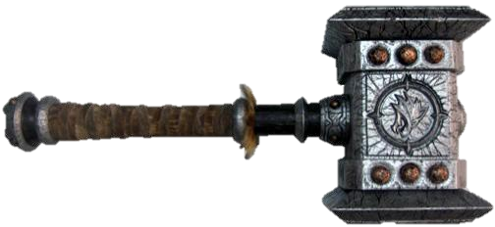
Artifact Weapons Overview
Most powerful weapons in the game world (Think Master Sword from Legend of Zelda)
Everyone gets one
Unique for each class and specialization
Grows in power throughout the game, and unlocks new abilities for your character

Slide 8
Artifact Weapons: The Good and the Bad
Provides an increasing sense of power throughout the game
Can be worked on incrementally
When everyone is special, no one is
Somewhat grind intensive
Not all weapons are created equal

Slide 9
World Quest Overview
Wide variety of quests(Assassination, resource gathering, stealth, riding a dinosaur through an enemy city trampling enemies.)
Each quest repeats every 3-5 days
Provide a variety of rewards, including power for your artifact weapon, in-game currency, and resources

Slide 10
World Quests: The Good and the Bad
Just enough time between quests repeating to keep the game from being overly repetitive.
Every quest is different, large amount of variety in gameplay
Provides an essentially infinite amount of content
Some rewards are relatively meaningless (in-game currency rewards are generally small and insignificant)
Some quests are overly long, others are too short

Slide 11
Raids and Dungeons Overview
Requires a group to complete (5 for dungeons, 10-30 for raids
Required to complete the main storyline of the game
Main objective: kill all enemies and bosses
Unlike other parts of the game, failure is expected
Dungeons take about 45 minutes, Raids can take multiple weeks to complete

Slide 12
Raids and Dungeons: The Good and the Bad
Bosses are interesting, with diverse game mechanics
Looking for Raid(LFR) and Dungeon Finder makes raids and dungeons more accessible to the common player
Mythic raids provide a goal to strive for, World First achievement
Requires a larger than normal number of people to play, and requires a large amount of time (up to 4 hours per night for Mythic raids)
LFR can give a false sense of the true difficulty of the game(You can kill the final boss very easily in LFR)

Slide 13
Player vs. Player Overview
Battlegrounds: Large-scale combat (10-40 players per team), based around and objective (Capture the Flag, Control Points, Escorting Payloads, etc.)
Arenas: Small-scale combat (2-5 players per team), team deathmatch

Slide 14
PvP: The Good and the Bad
Flexibility in number of players to play allows for people to play with friends
Strongly encourages team-based gameplay
Game is not balanced around individual classes and players

Slide 15
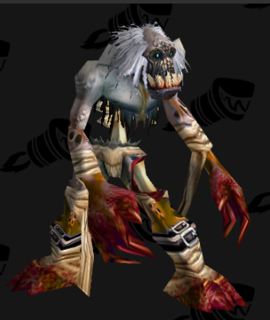
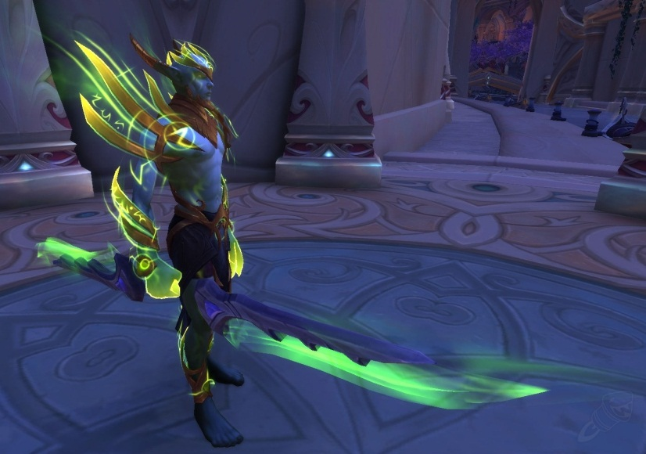
Art Review(screenshots courtesy of WoWHead.com)
Less realistic, more fun and colorful art style
Even with this in mind, there are still competitors that use similar art styles to better effect
Assets that were not introduced in the past two expansions are severely outdated
Character Customization is severely lacking

Slide 16
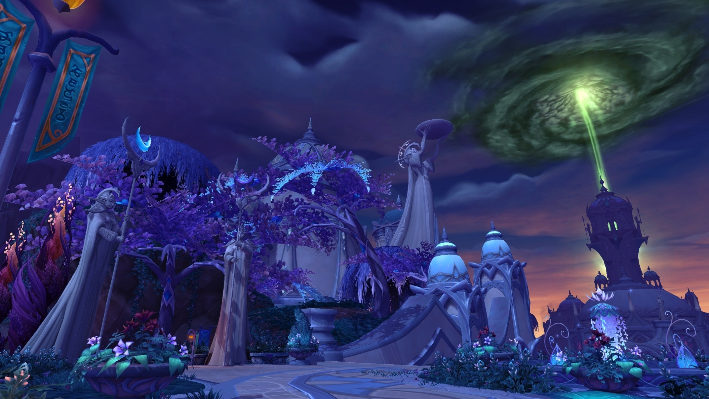
Art Review(screenshots courtesy of WoWHead.com)

Slide 17
Sound Review
Sound effects are responsive to let you know when you attack an enemy, when an enemy attacks you, etc.
Helps you to constantly know what is going on around you
The sound effects also fit the visual effects very well (i.e., frogs sound like frogs, fire spells sound fiery, etc.)

Slide 18
Music Review
Music itself is good, but is often reused from previous expansions, such as Cataclysm
However, the music still seems to fit the zones fairly well

Slide 19
Animation Review
Most animations in Legion are completely new, especially animations for player characters
Even with the new animations, there is still occasional clipping, even with player character models (big shoulderpads make it very hard not to clip)
If you can look past the faults, the new animations are visually stunning
https://www.youtube.com/watch?v=XxzlLazNmrE
Notes:
Watch up to 1:02

Slide 20
User Interface
Base UI does not give all of the necessary information for a player to make decisions in an easily readable manner (Boss health percentage, debuff stacks on enemies, etc.)
However, Blizzard allows third parties to create software that adjusts how the UI looks and the information that it provides

Slide 21
Bugs and Bug Handling
Even with all of the alpha and beta testing (over six months), there are still plenty of bugs
The game relies on its huge playerbase to find the bugs that the developers could not find, and bring them to the developers’ attention
Once a bug is identified, even a minor one, it is generally fixed within 1-7 days via a hotfix

Slide 22
Audience and Pricing
Base Game + Legion Expansion: $70
Monthly Subscription Fee: $15/month
Micro-transactions (limited, does not affect gameplay)
Intended audience: Ages 13 to 113

Slide 23
Comparison to Guild Wars 2
Graphics are much more realistic in Guild Wars 2, cartoony in World of Warcraft
Guild Wars 2 is generally much cheaper (one-time purchase)
Guild Wars 2 is more focused on small group gameplay

Slide 24
Comparison to EVE Online (Some points taken from http://thewatchmakerproject.com/how-eve-online-spoiled-every-other-mmo-in-the-world-for-me/)
EVE Online is much more based around trade than combat
Loss in EVE Online is permanent
Very little developer intervention in EVE Online; Scams are very common
EVE is much more of a sandbox game, Legion has more well-defined rules and is more closely watched by the developers

Slide 25
Comparison to Final Fantasy XIII: A Realm Reborn(Some points taken from http://www.mmogames.com/gamearticles/versus-world-warcraft-vs-final-fantasy-xiv-realm-reborn/)
The story plays a much more central role in Legion than in A Realm Reborn
The graphics in A Realm Reborn pull far ahead of Legion, even if you just include the assets added in Legion
More emphasis on smaller-group and individual content in A Realm Reborn than in World of Warcraft

Slide 26
Hardware Requirements
https://us.battle.net/support/en/article/7682
I can run it on my laptop (close to minimum specifications for windows) at high graphics settings
If anything, minimum requirements are on the safe side

Slide 27
Installation Process
Download and install the Battle.net App, then install World of Warcraft (both from this link: https://us.battle.net/account/download)
After about 50% of the game has been downloaded, the Battle.net App will actually allow you to play the game while non-essential files download in the background.

Slide 28
Overall Strengths and Weaknesses
Scale and Grandeur
Unrivalled for large-group gameplay
Constant support from development team
Animation, sound and music are high quality
Team-oriented
Large variety of things to do
Expensive
Art is lacking compared to competitors
Lack of focus on individual gameplay

Slide 29
Is World of Warcraft: Legion Worth Purchasing?
YES
For me, the unique experience of being part of an army is well worth the price tag
When you think about it, the subscription fee is less expensive than drinking a soda every day
While you are paying continuously, content is also being added and updated continuously

Slide 30
Design Mistakes and Improvements
Need to focus more on updating outdated assets
Further refine art style for current assets
Give players who prefer to play on their own more to do

