Slide 1
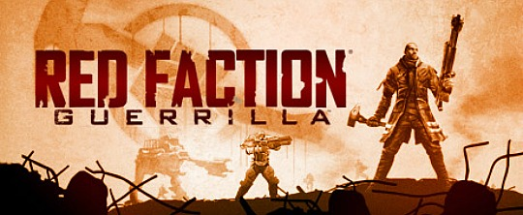
Developed by: Volition Inc., Reactor Zero
Published by: THQ Nordic

Slide 2
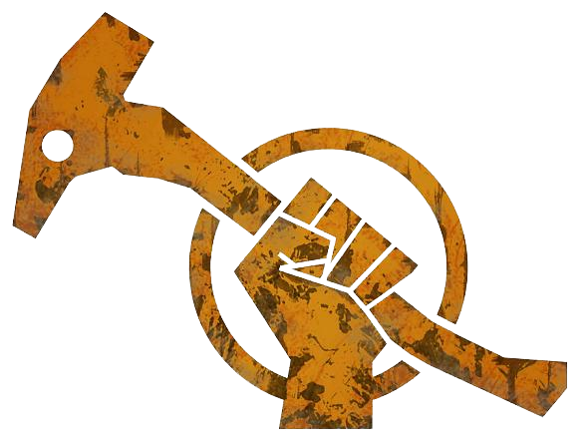
Basic/Technical Information

Slide 3
The Basics
Official Title: RED FACTION: Guerrilla
Companies Involved: Volition Inc. - Original Developer
THQ Nordic - Publisher
Reactor Zero - PC version
Game Type: Open-World Action-Adventure Third-person Shooter
Original Pricing: $59.99 USD (Xbox 360 & PS3) $19.99 USD (Steam Edition)
Release year: 2009

Slide 4
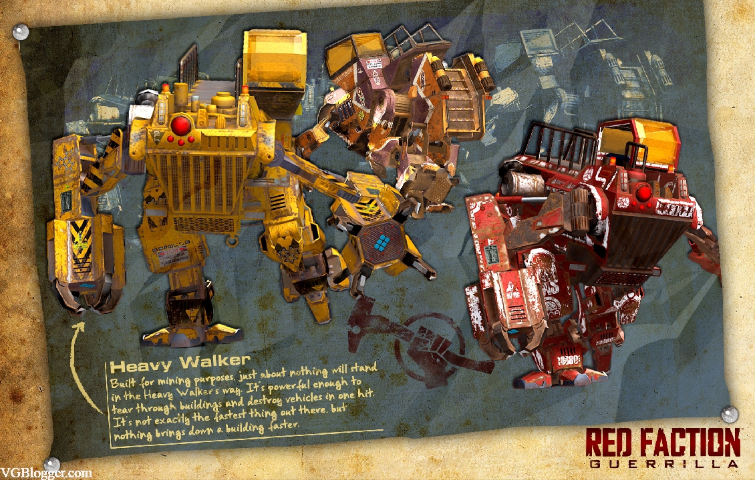
Technical Requirements
Platforms: Xbox 360, PS3, Microsoft Windows Vista/XP/7/8/10
PC Minimum Requirements: 2 Gig Processor, 1 GB RAM, 128 MB video Card, 15 GB Hard Drive Space
PC Recommended Requirements: 3.2 Gig Processor, 2 GB RAM, 256 MB RAM, 15 GB Hard Drive Space
*Internet Connection Required for Multiple (online) play*

Slide 5
Game Contents Overview

Slide 6
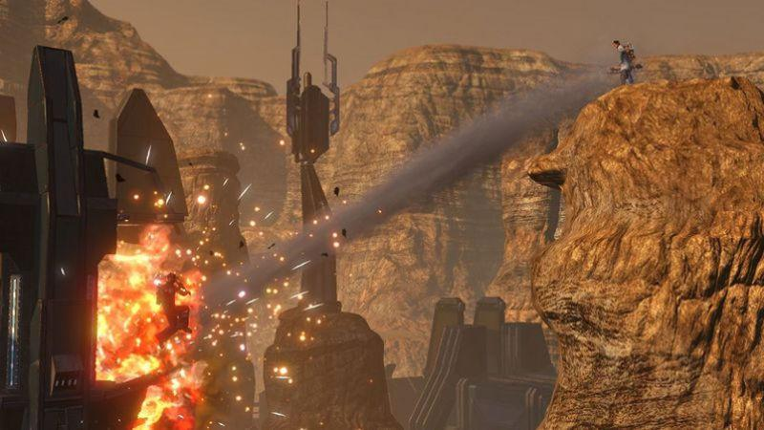
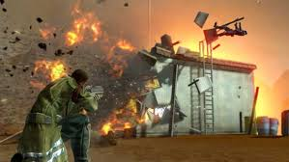
Quick Overview: Hammers and Demo Packs
22nd Century: Socialist Uprising on MARS?!?!
GTA: Mars
Destruction Destruction Destruction
See that building? Blow it up
See that car? Smash it to bits
See tha- *BOOM* ….nevermind
….and rockets

Slide 7
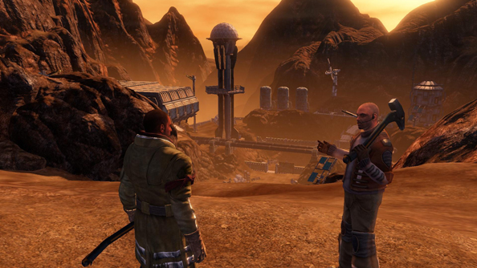
Storyline: ehhhhhh Guerrillas?
22nd Century: Mars has been colonized and exports raw materials to earth
EDF (Earth Defense Force) has taken over the populated areas and have devolved into an occupying force
Martian workers are put under forced labor and an uprising begins under (big surprise) THE RED FACTION.
Bottom line: if you aren't blowing everyone up - you are not helping them enough!

Slide 8
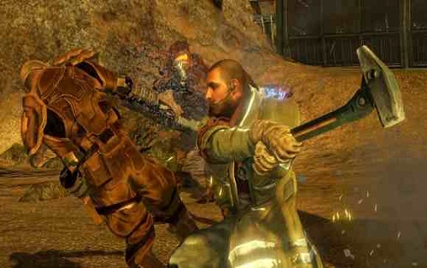
Player Role: That guy? Oh he’s THE GUY
You take on the role of Alec Mason, recent immigrant to Mars and expert with a sledge hammer
Complete missions for the Red Faction to help drive the EDF off Mars
Make awkward jokes to other characters
Super trustworthy because EVERYONE will let you borrow their car

Slide 9
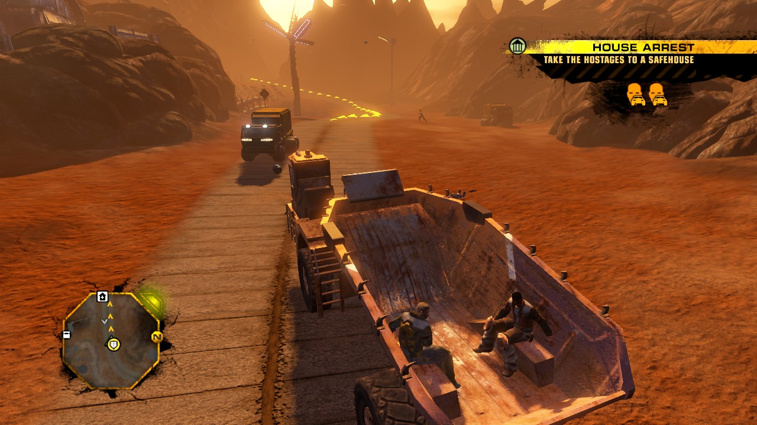
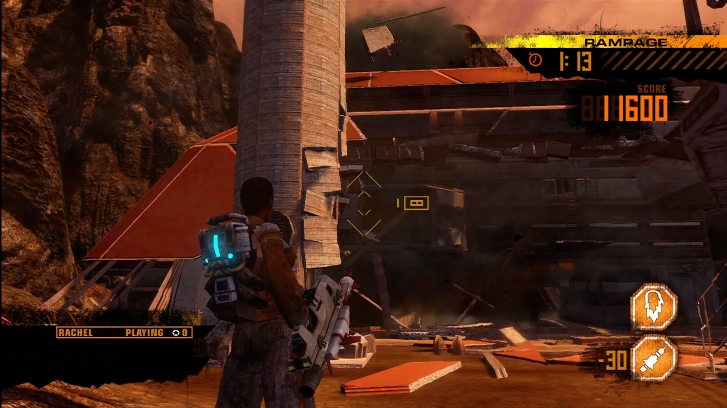
Gameplay: Singleplayer
Third Person shooter
Fully destructible environment
Excluding terrain
Large variety of weapons to unlock
Large open world
Various vehicles to traverse world
6 distinct sector environments
Various side mission types
Unique Storyline quests

Slide 10
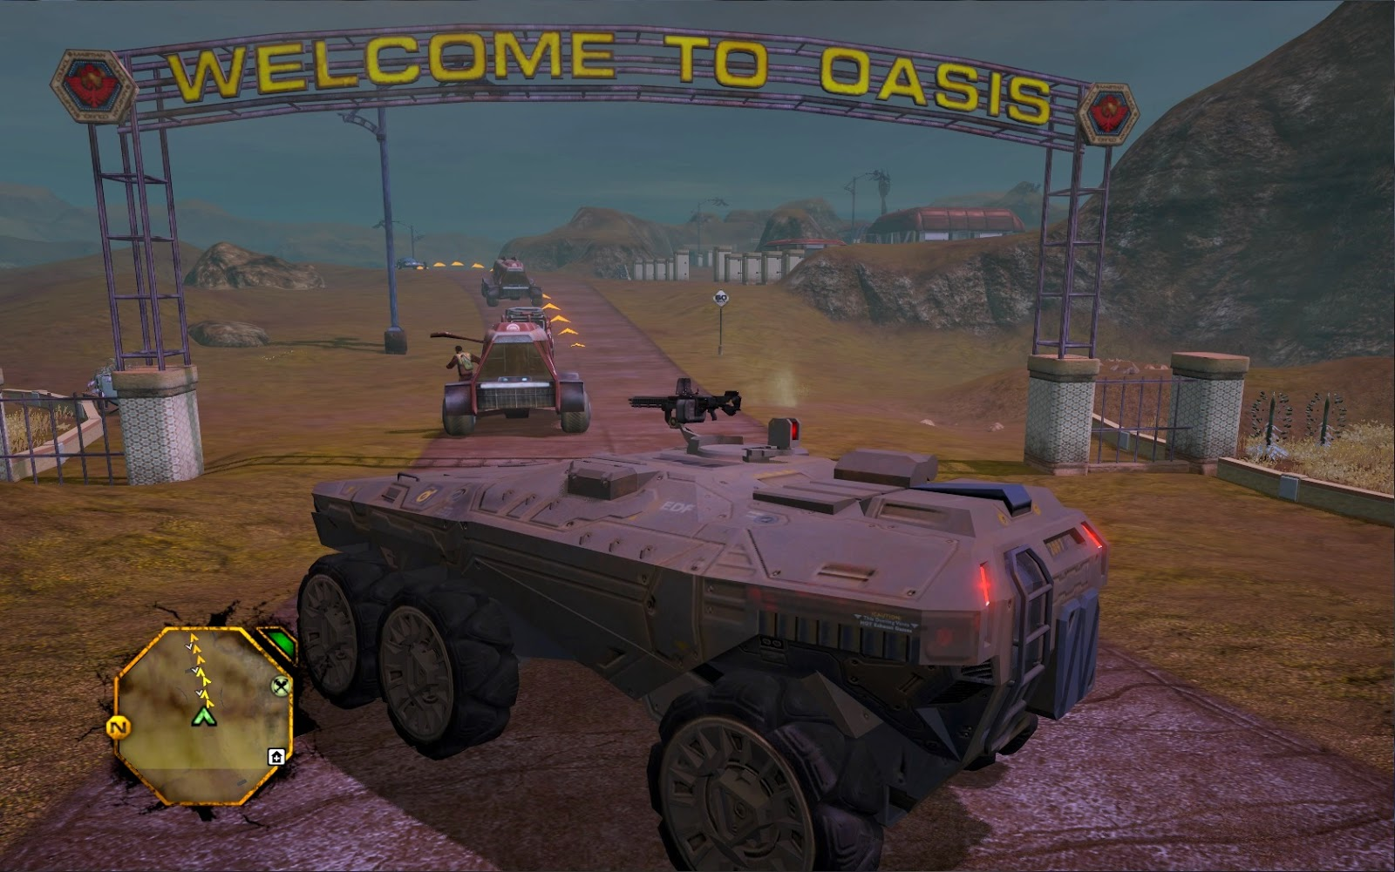
Gameplay: Singleplayer cont.
Through the sectors the player completes side missions to lower the EDF Control on the sector, and raise the Morale of the martian inhabitants. Then the freeing of the section culminates in various storyline quests in each sector.
During this time the currency: Salvage is collected to unlock weapons, armor and other things.

Slide 11
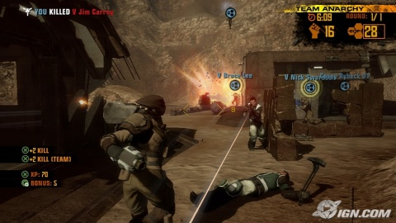
Gameplay: Multiplayer- online
Online play is separated into various game modes each with a different objective and player setup (free for all or teams).
Most modes tie in the destruction aspects of the game
Uses the standard single player arsenal with the addition of special backpacks
Experience system used to unlock aesthetic features for the player models
Wreck-er
Wreck-ee

Slide 12
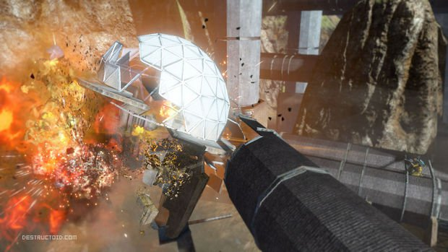
Gameplay: Multiplayer - offline
Pass-the-controller style play. Basically players compete to destroy a target faster than each other on their turn. Modes are different mostly by what equipment can be used in it.
Called Wrecking Crew

Slide 13
Visuals and Audio

Slide 14
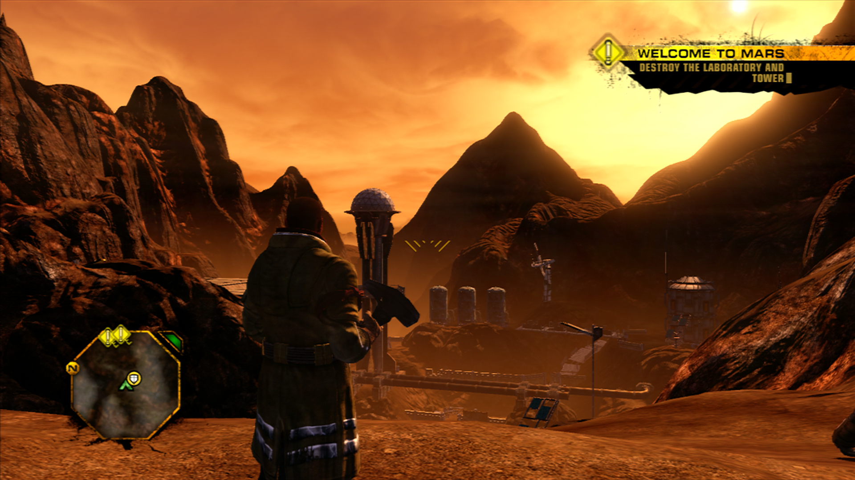
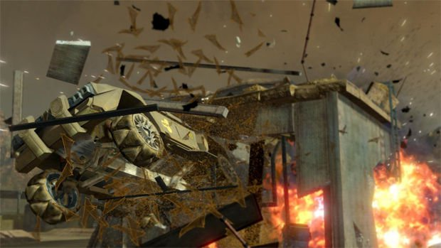
Visuals: Overall Presentation of the World
The game attempts to create a very raw environment. The world clearly shows that the player is on Mars rather than just earth #2 or a generic space installation.
Explosions and other fighting is excellent against the purposely barren wilderness and depressing 1984 esque industrial backdrop of towns.

Slide 15
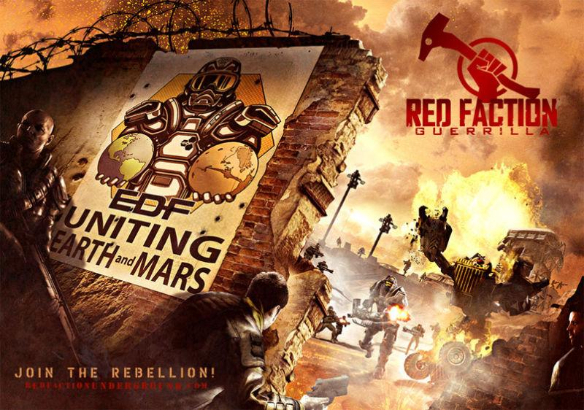
Audio
The music is a fusion of orchestral and futuristic electronic music attempting to create a feeling of vastness for the world. As well it plays up feelings of the Ol’ Wild West’s music.
Composed by Timothy Michael Wynn and Jake Kaufman
A total of 32 tracks combined to over 3 hours of music

Slide 16
Technical Features

Slide 17
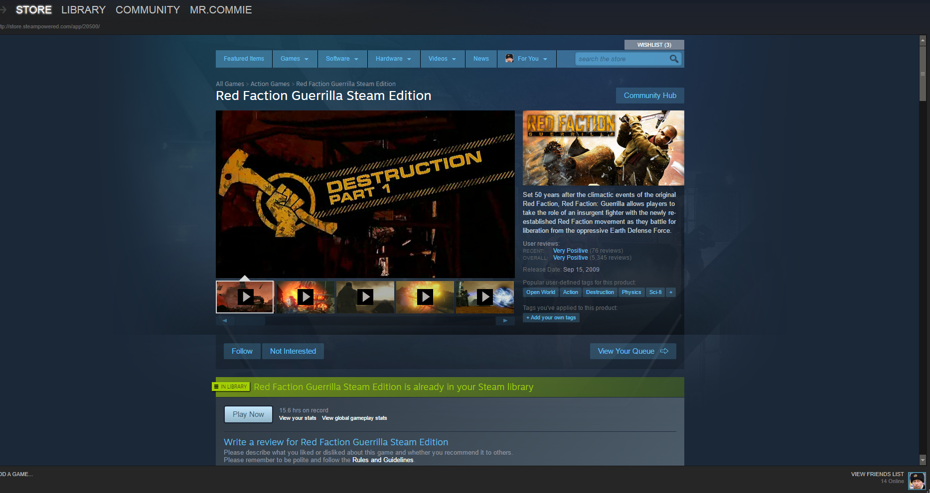
Installation
Total of 3 patches were released for the console versions of the game
Only minor setup wait time for consoles as game was sold as a disc only
PCs download the game through Steam only, thus connection speed creates wait time
No secondary overlay software (i.e. Origin or Uplay

Slide 18
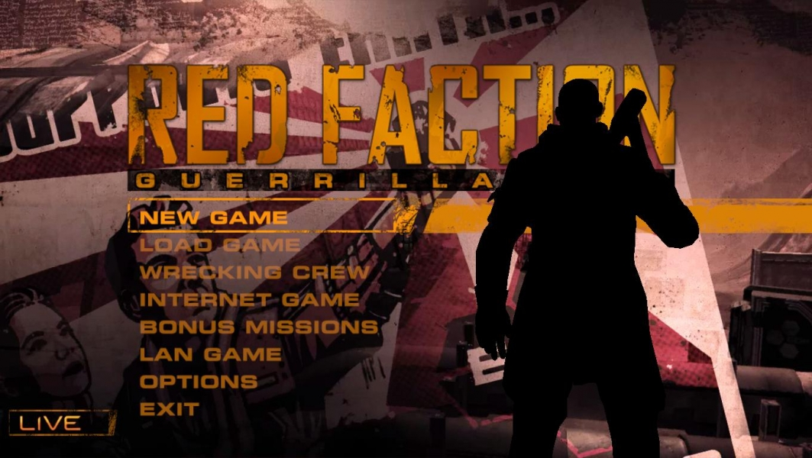
User Interface - Main Menu

Slide 19
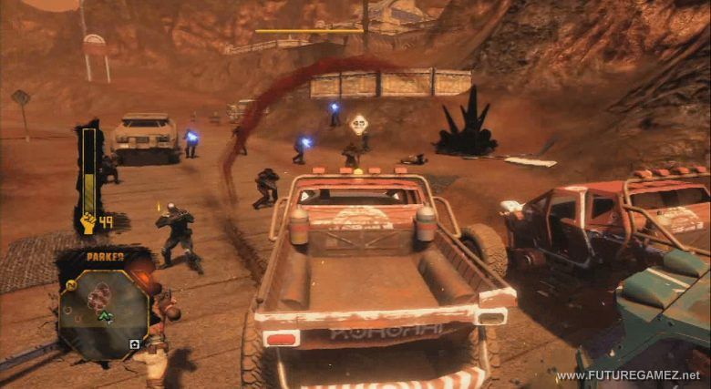
User Interface - Play Screen
Player Model
Mini Map
Death

Slide 20
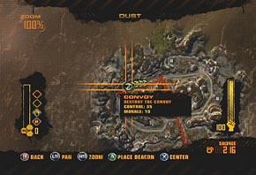
User Interface - Map Screen
Sector Name
Sector Morale
EDF Control Meter
Salvage Total (Currency)
Cursor

Slide 21
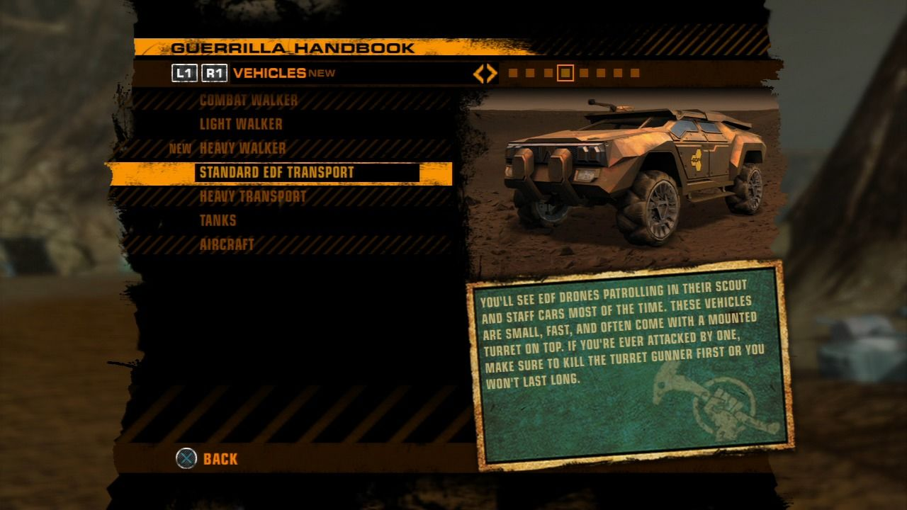
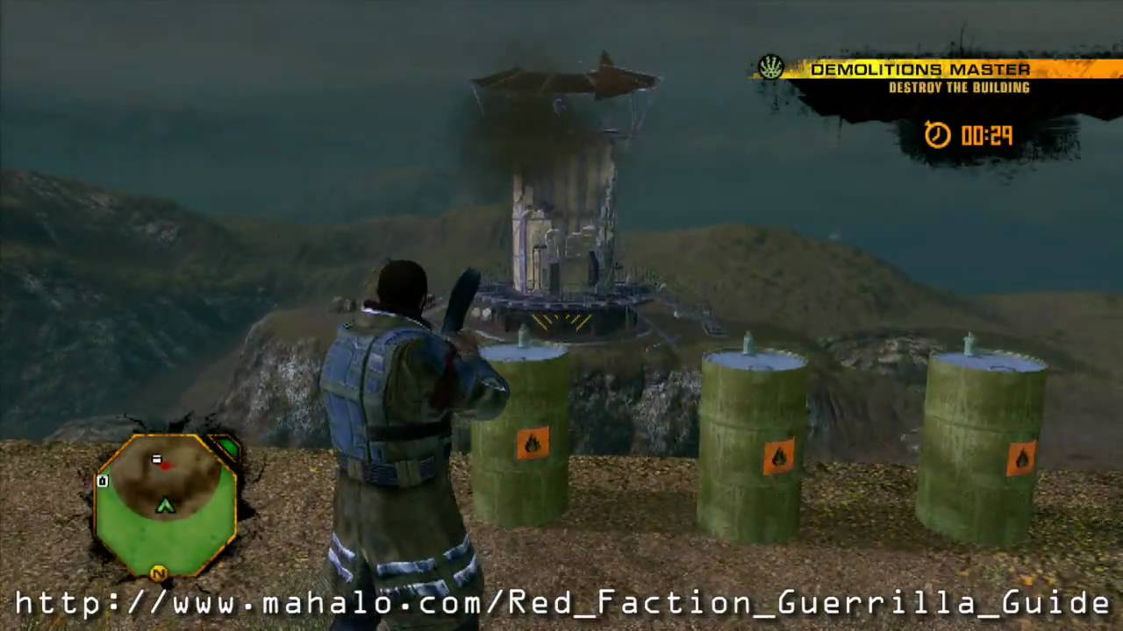
Learning Gameplay
Complexity progression as game unfolds
In-game manual for descriptions of gameplay mechanics
Specific mission type to teach destruction mechanics and techniques

Slide 22
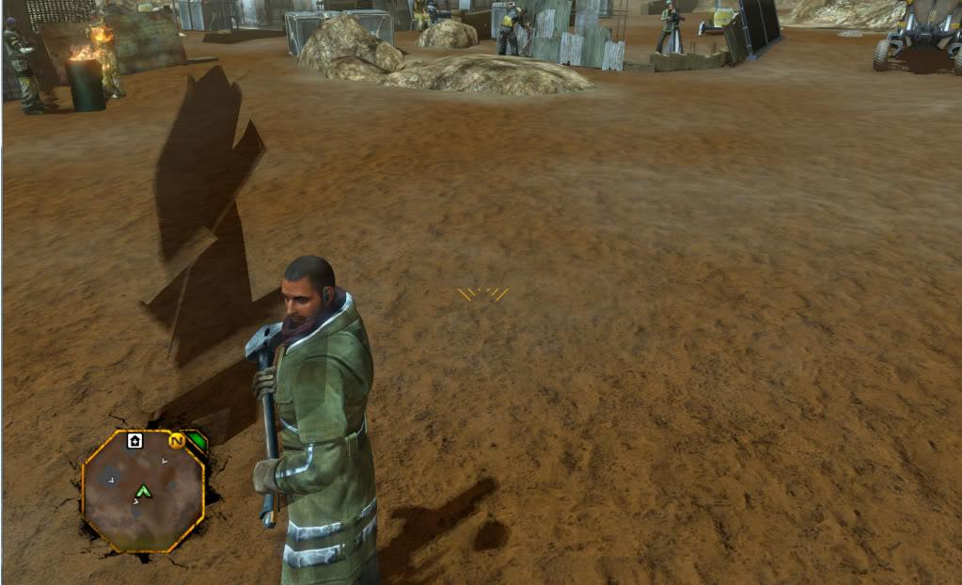
Bugs
Mostly Graphical involving the shadowing effects
Steam version can sometimes attempt to use directX 10 rather than the normal directX 9 causing game crashing effects

Slide 23
Game Review

Slide 24
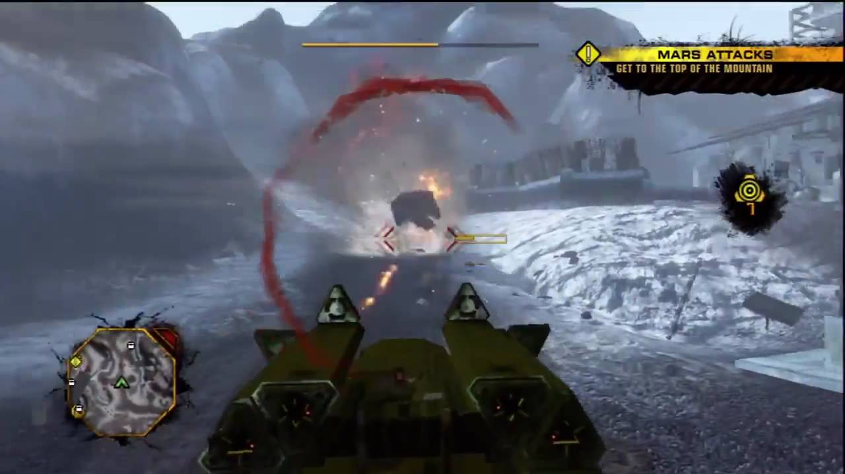
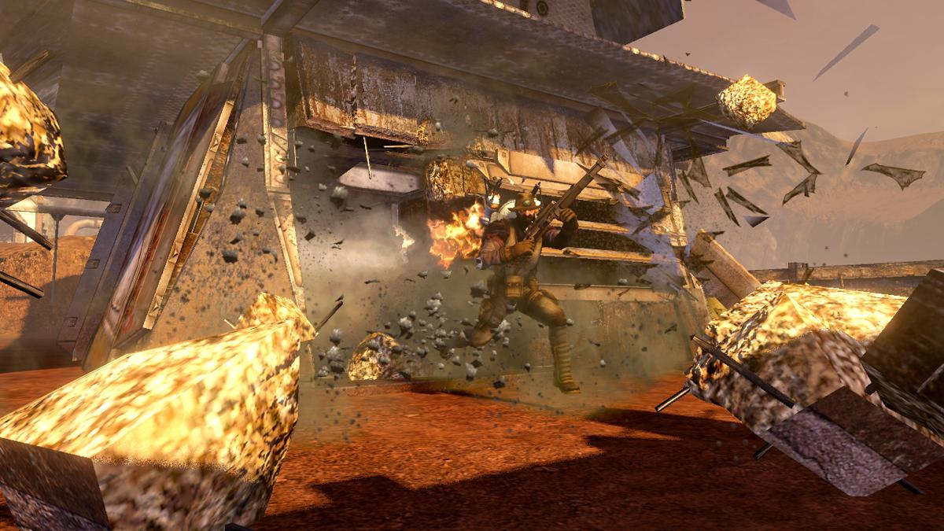
The Best Things
Destruction Destruction Destruction
Open world- “ness” allows for fun experimentation to solve problems
Variety of weapons, vehicles, enemies and missions

Slide 25
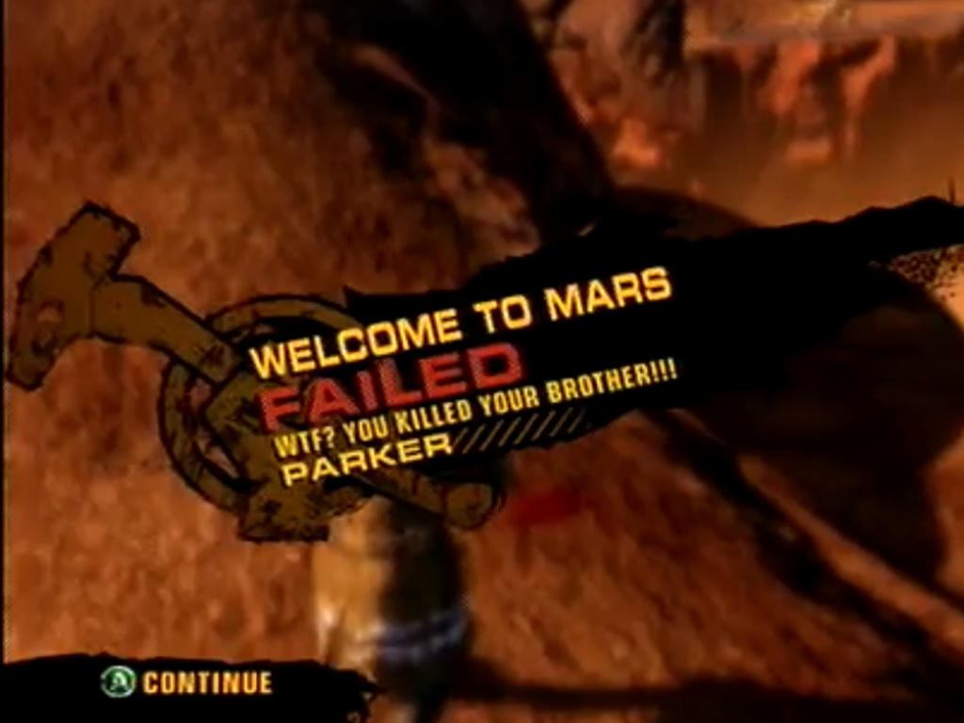
The Worst Things
Bland story, results in disconnect b/t player and their NPC allies
Ranged weapons often have too little ammo
Little penalty for death
Very bleak and dull landscape for the majority of areas

Slide 26
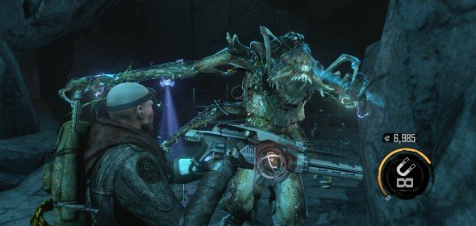
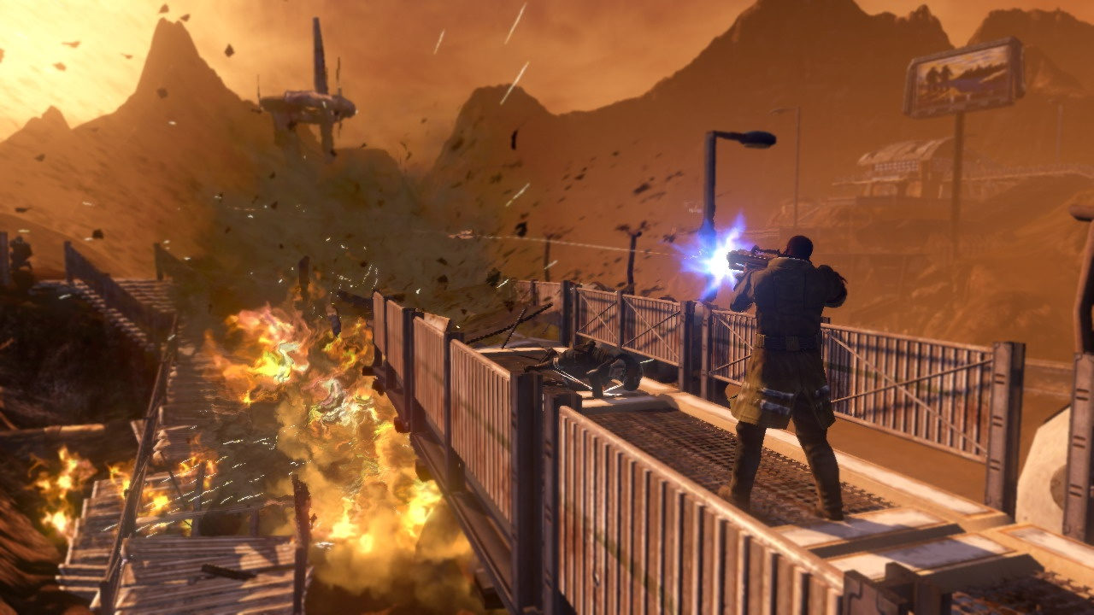
Red Faction Comparison: Guerrilla vs Armageddon
Reworking vs Revising
Game Progression type: Open vs linear

Slide 27
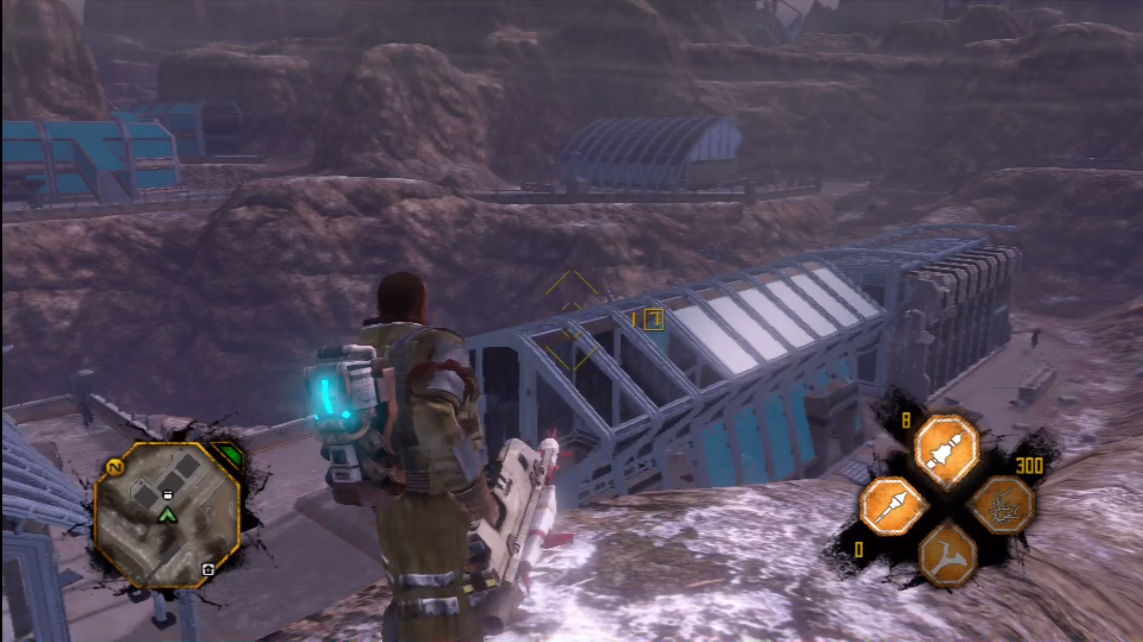
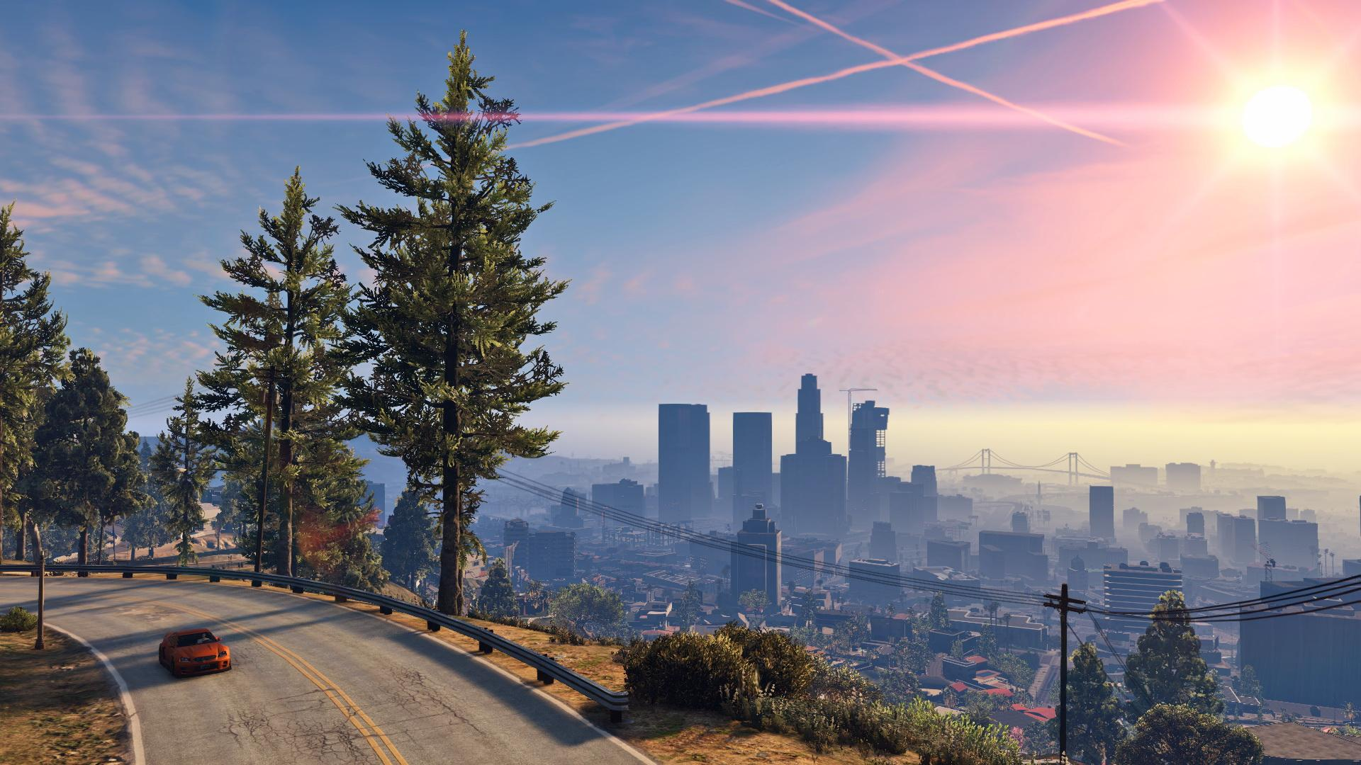
Open World Comparison: Guerrilla vs GTA
Does destruction add enough?
More missions versus more open world fun?

Slide 28
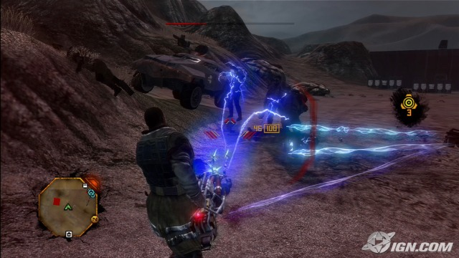
Game Audience
Rate M: with good reason...but does it have enough reason?
Dark atmosphere with heavy issue presented
Strong language, but little gore

Slide 29
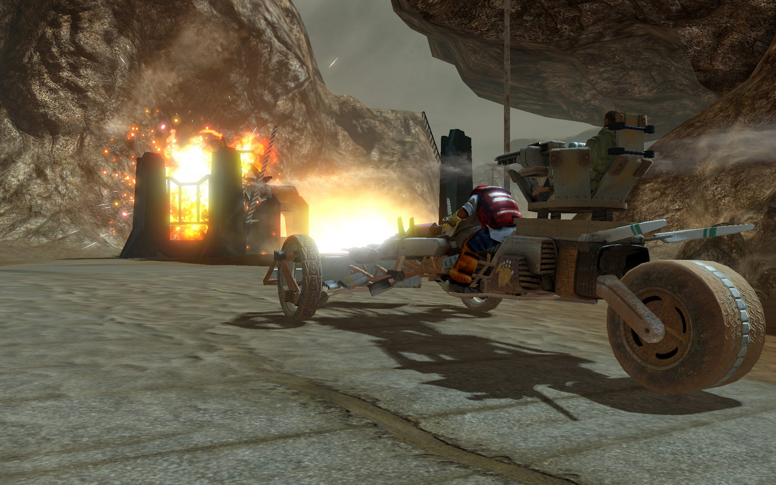
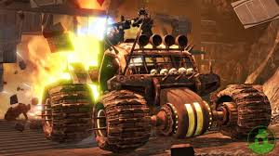
Design Mistakes
Shooting system has typical symptoms of any GTA knock off
Boring environment to drive through in a game with lots of driving
Lots of variety, but needs better use of it

Slide 30
Summary

Slide 31
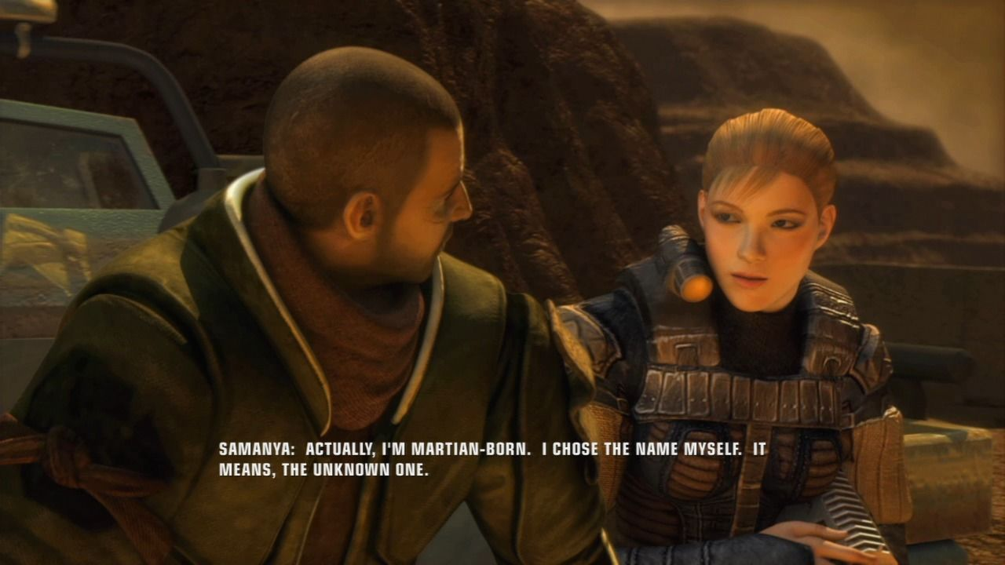
Summary points
Mechanics: 9/10
Story: 3/10
Repetitiveness: 7/10
Variety: 8/10
Execution of ideas: 7/10
Flow: 7/10
Originality: 7/10
Player-made fun: 10/10
Purchase? Yes
Room for improvement? Yes

Slide 32
Questions?

