Slide 1
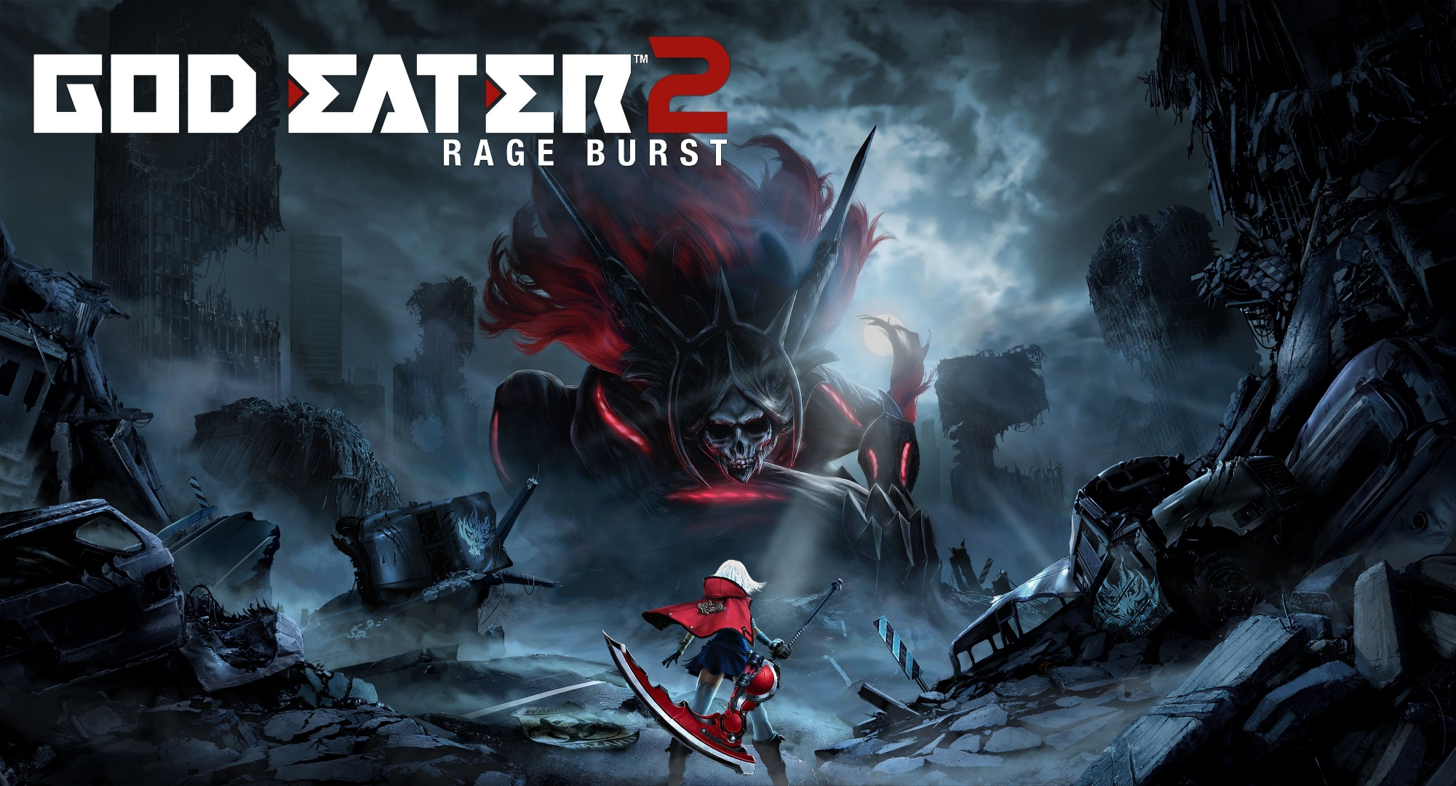
Patrick Taghap
Fall 2016 CIS 487
Game Evaluation

Slide 2
Basic Information
Company: Developed by Shift
Published by Bandai Namco Entertainment
Type of Game: Action RPG
Available on: PS Vita,PS4, PC
Price: Steam- $49.99 (includes God Eater Resurrection)
PS4- $59.99
PS Vita- $39.99

Slide 3
Hardware Requirements
MINIMUM:
OS: Windows 7
Processor: Intel Core 2 Duo E7500 2.93 GHz / AMD Athlon 64 X2 Dual Core Processor 5600+ 2.9GHz
Memory: 3 GB RAM
Graphics: NVIDIA GeForce 9800 GT 1GB / AMD Radeon HD 6670
DirectX: Version 9.0
Network: Broadband Internet connection
Storage: 15 GB available space
Sound Card: DirectX compatible or onboard chipset
RECOMMENDED:
OS: Windows 7, 8, 10
Processor: Intel Core i3 4130 3.4 GHZ / AMD FX-4100 Quad-Core Processor 3.6GHz
Memory: 8 GB RAM
Graphics: GEFORCE GTX560 1GB / AMD Radeon HD 6850 1 GB
DirectX: Version 9.0
Network: Broadband Internet connection
Storage: 15 GB available space
Sound Card: DirectX compatible or onboard chipset

Slide 4
Game Summary
Installation
For PC, requires a Steam client to install and play

Slide 5
Game Summary
Quick Overview
Remake/Expansion of God Eater 2
Contains most(all?) patches and dlc from the original game
Adds a new weapon, power up, survival mission type and expanded main story

Slide 6
Game Summary
Setting
Set in a post-apocalypse future
Humanity is in constant danger from Aragami, a race of monsters that can consume any thing
The only individuals capable of fighting them are God Eaters
Storyline
Takes place 3 years after the first game
The player(you) are the newest recruit to the Blood, a special unit whose members have the potential to gain special powers
Blood is tasked to take on special Aragami that normal God Eaters are unable to fight
The player has the special ability that will awaken the special powers of other members
Player’s Role
Undertake missions and hunt Aragami

Slide 7
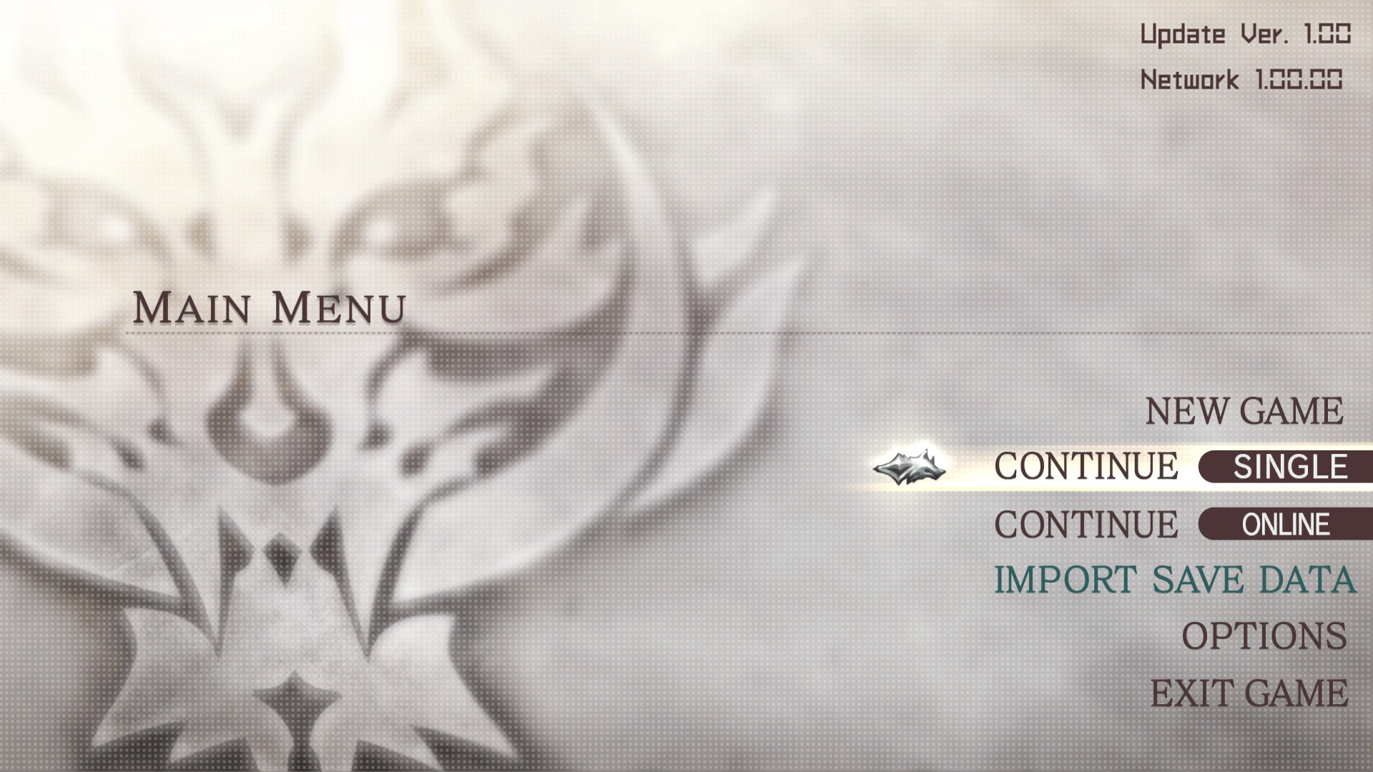
Game Summary
User Interface : Main Menu

Slide 8
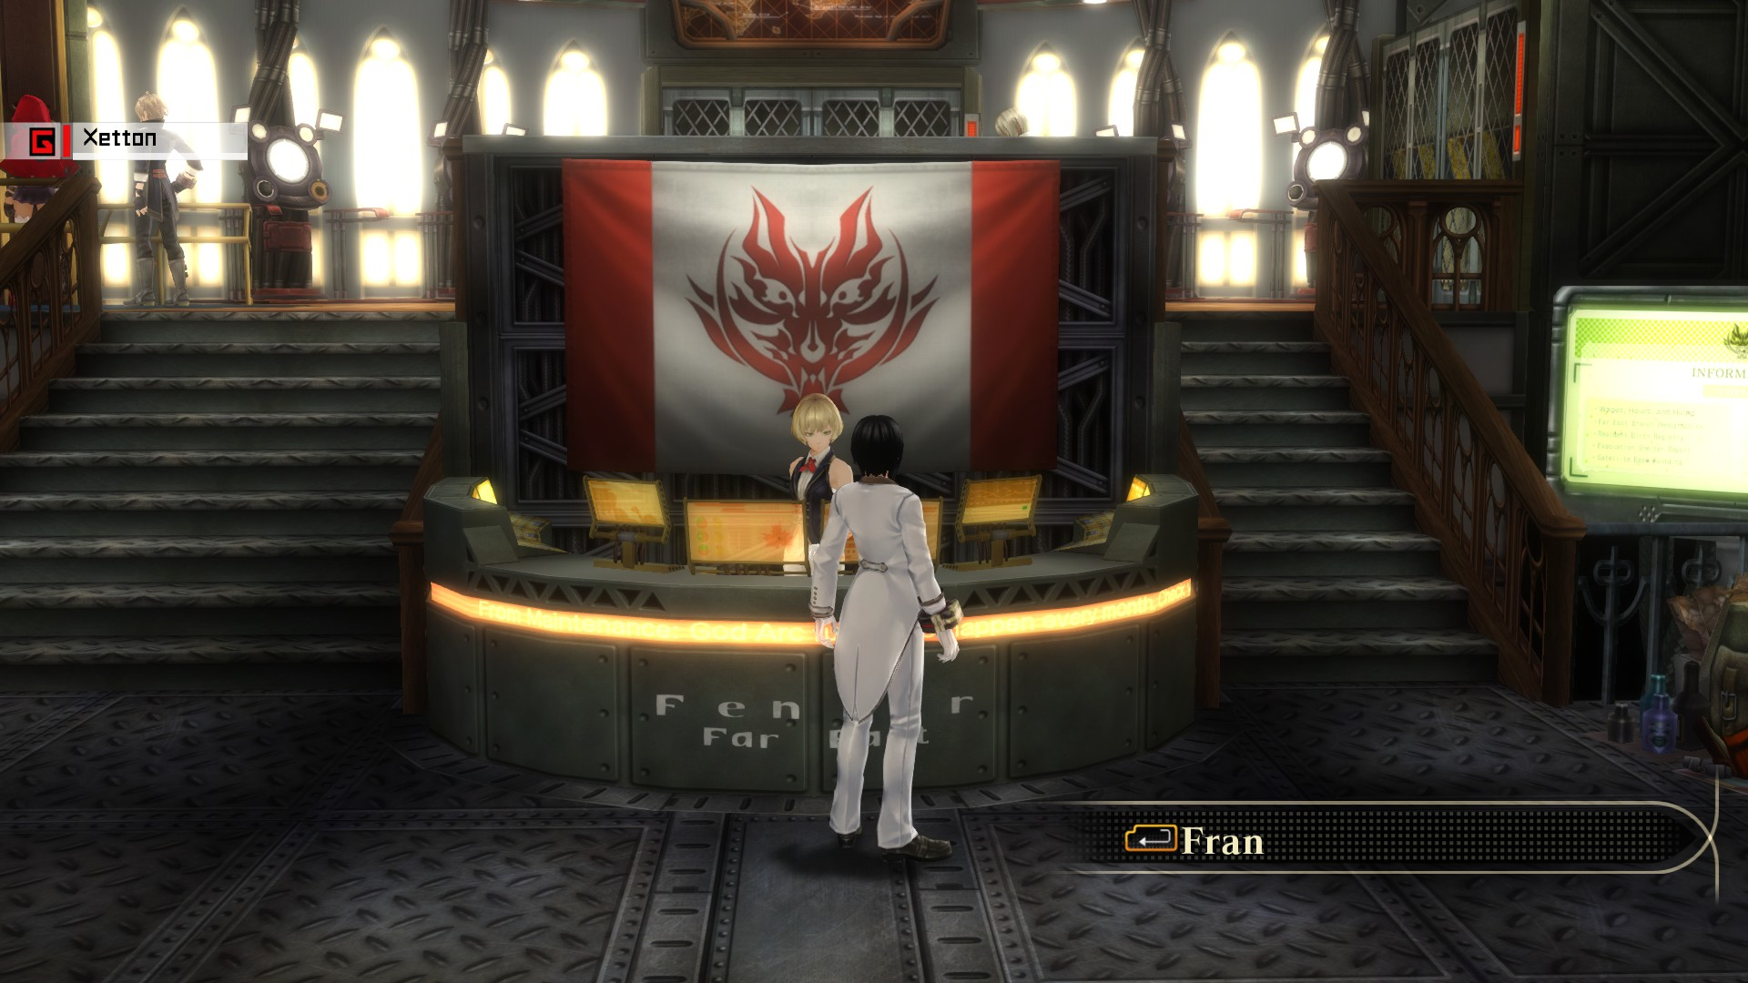
Game Summary
User Interface : In the Den

Slide 9
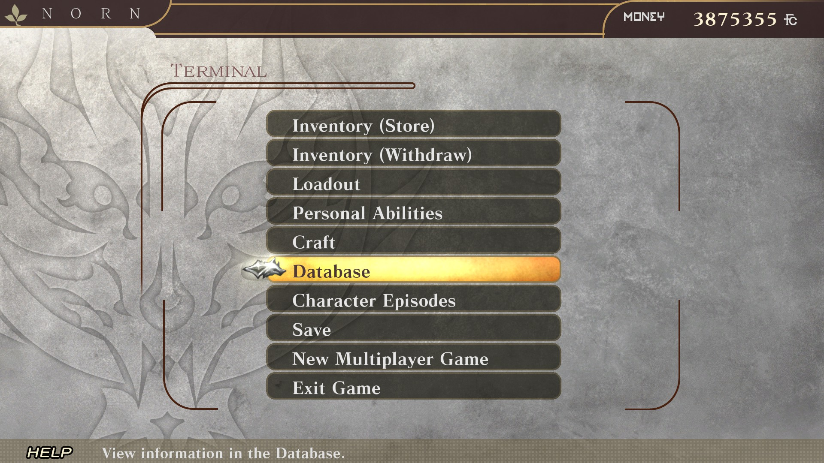
Game Summary
User Interface : Terminal use

Slide 10
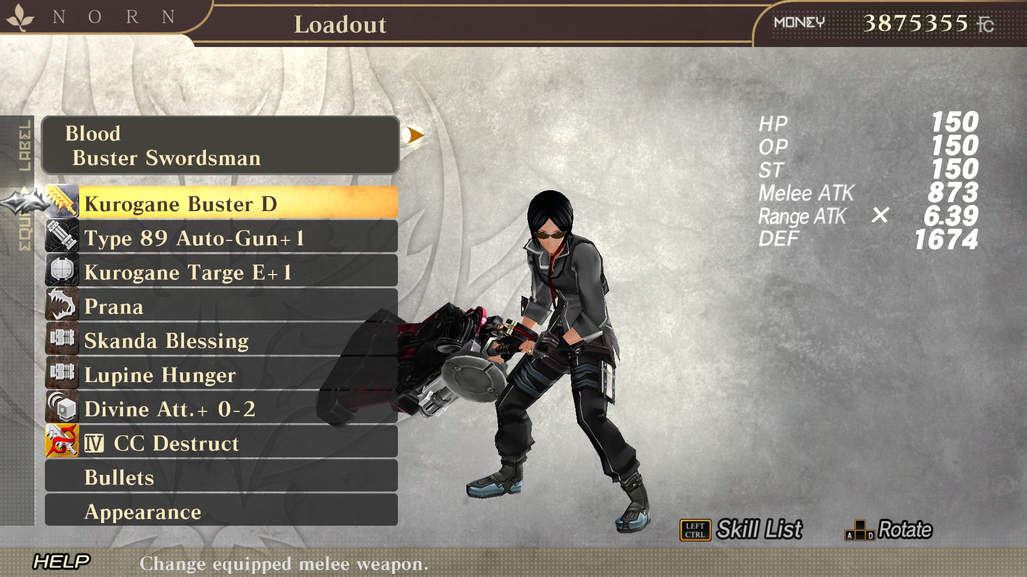
Game Summary
User Interface : Loadout

Slide 11
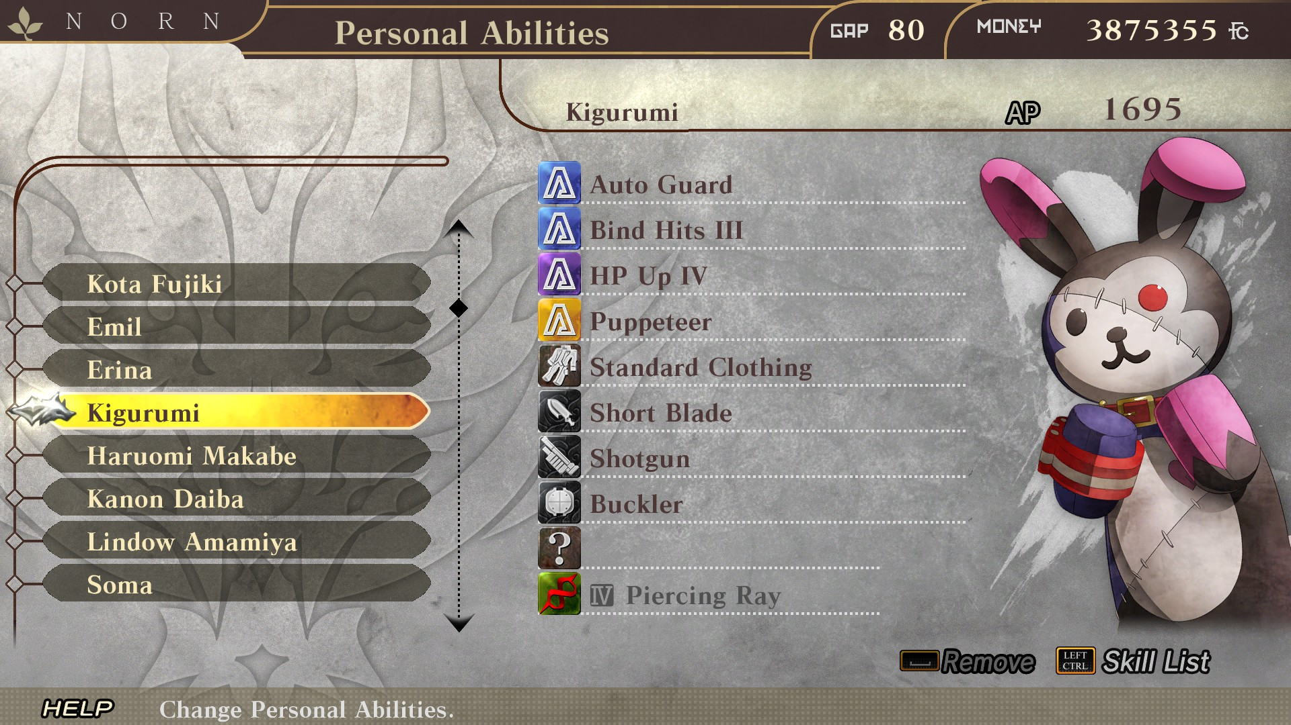
Game Summary
User Interface : NPC Customization

Slide 12
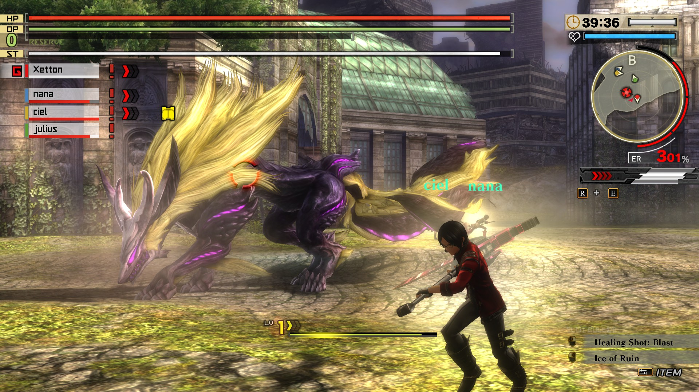
Game Summary
User Interface : In Mission

Slide 13
Game Summary
Gameplay
Gameplay video: https://www.youtube.com/watch?v=D4JMvkqAfpA

Slide 14
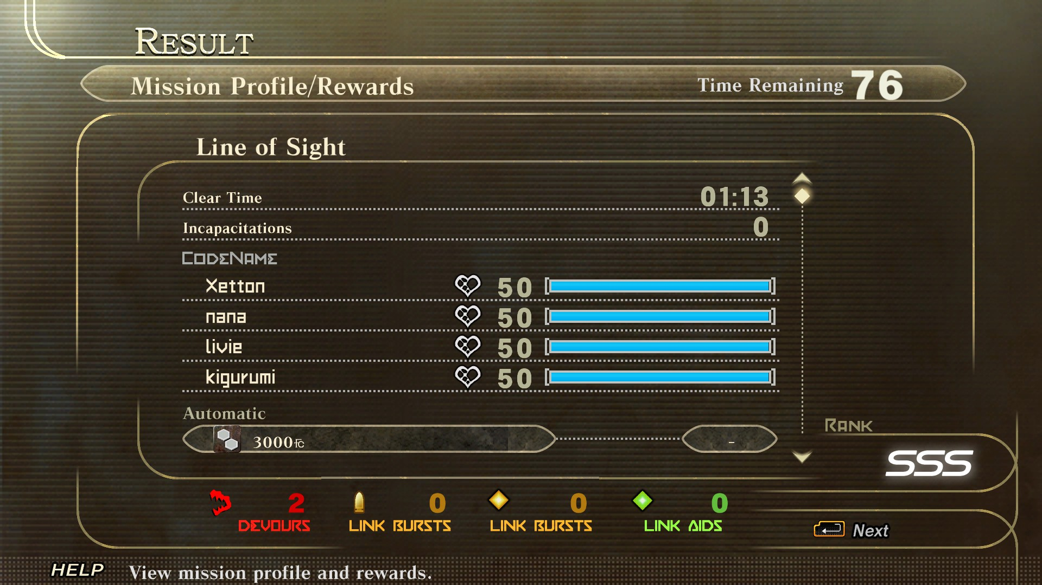
Game Summary
Scoring
Ranking System
Based on time, incapacitation, parts broken
Better rewards

Slide 15
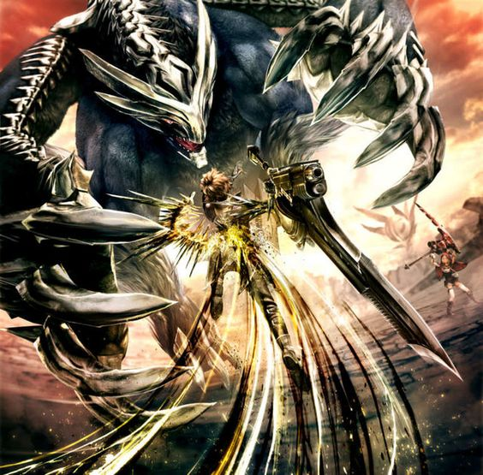
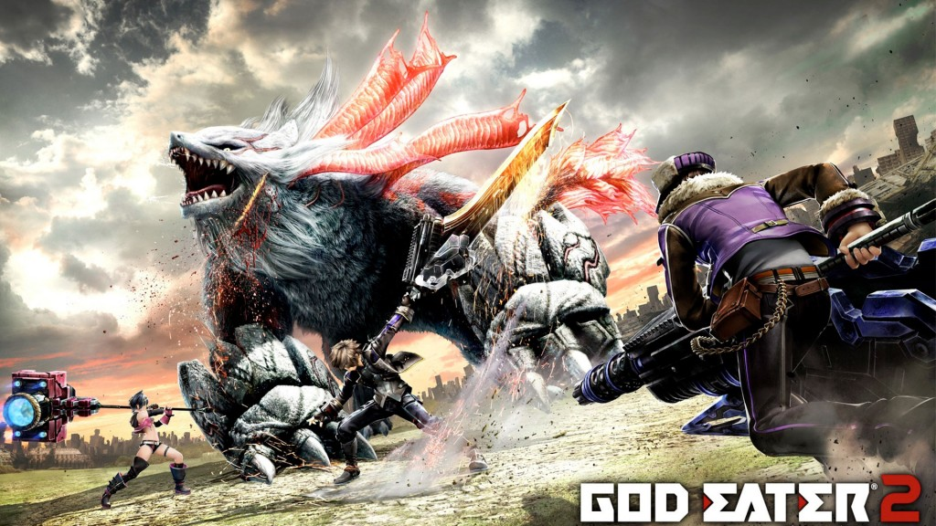
Game Summary
Artwork – Box Arts

Slide 16
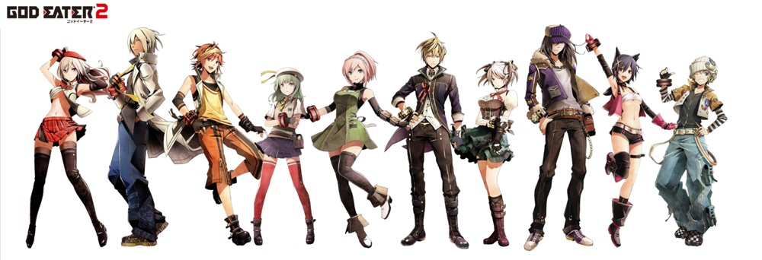
Game Summary
Artwork - Characters

Slide 17
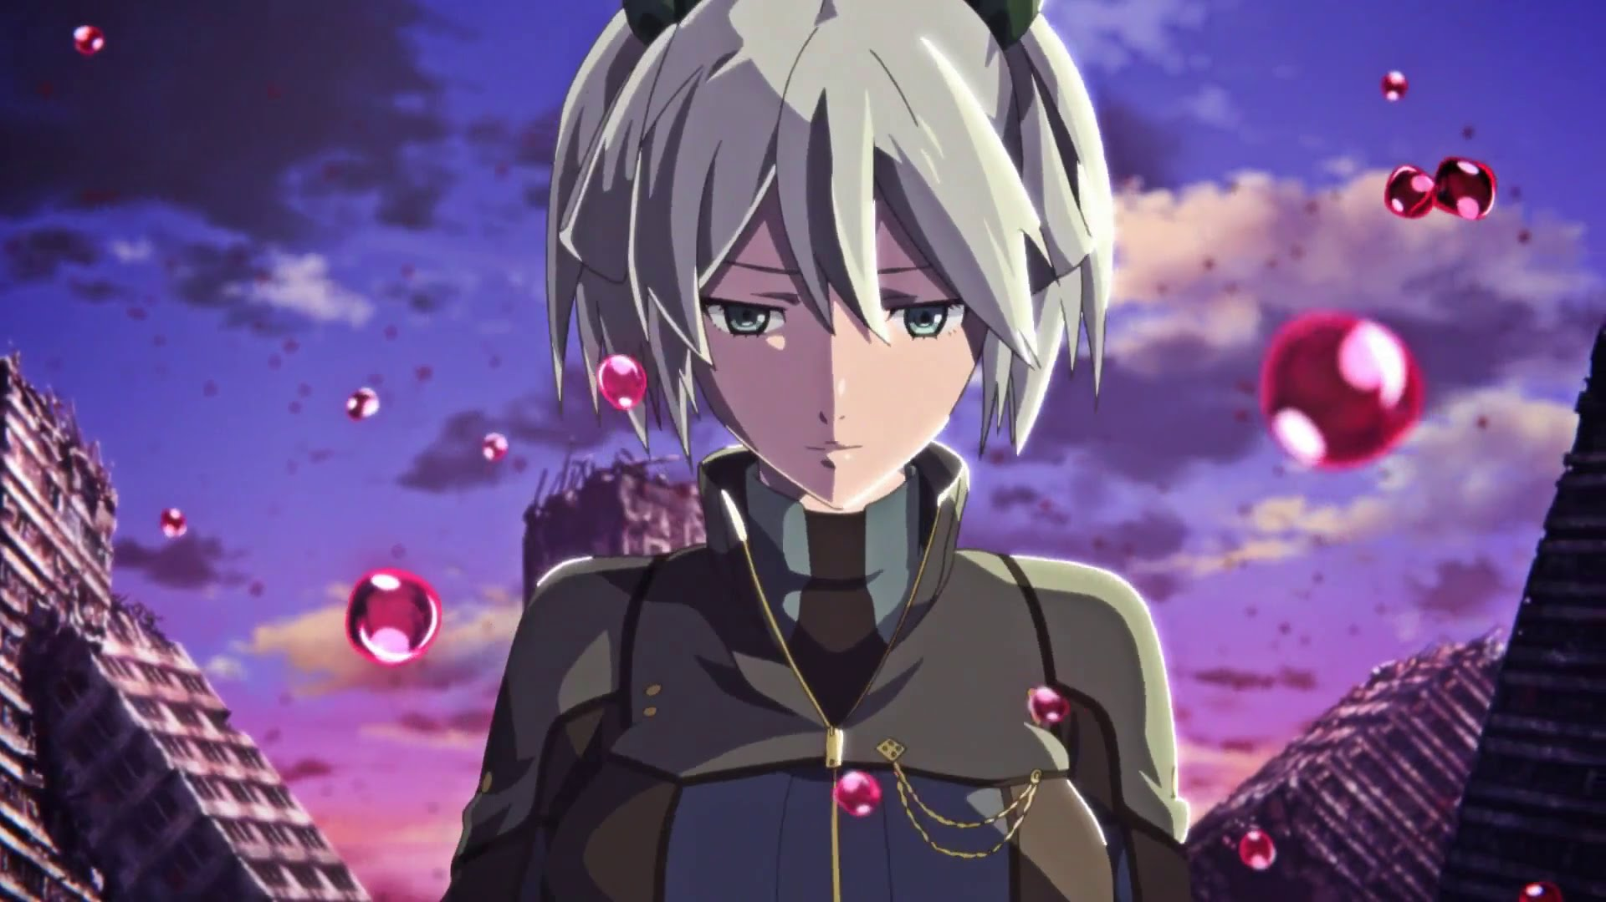
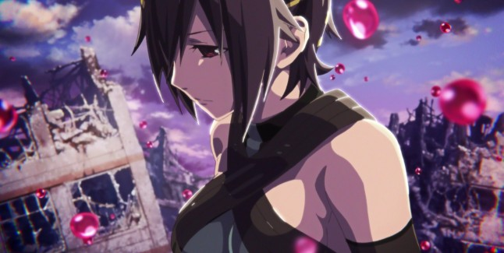
Game Summary
Artwork – Opening Animation

Slide 18
Game Summary
Sound and Music
Opening Song: F.A.T.E by KIHIRO NAMBA x TAKESHI UEDA
Soundtrack: Composed by Go Shiina
Also composed Tekken 6, Tales of Zestiria
BGM begins to play once you enter combat
English voices suited the characters

Slide 19
Game Summary
Special Features
Build a relationship with various other characters, in both Blood and other units
Help them unlock special abilities and skills
Craft, modify and upgrade your God-Arc to match any Aragami and situation
Stylize yourself in over 400 different kinds of clothes
Over 300 missions, easily 40 hours if just going for story alone

Slide 20
Game Summary
Bugs
Some graphical issues when moving
Crashing when facing certain enemies
Grammar issues in dialogue
During cut scenes, bgm tends to be louder than voices

Slide 21
Game Review: Fun
Many missions and varying difficulty
Variety of different characters to take on missions
Getting to know and building a relationship with the different characters
Many different kinds of weapons to craft
Many different combinations of God-Arc
The AI is good enough to support you

Slide 22
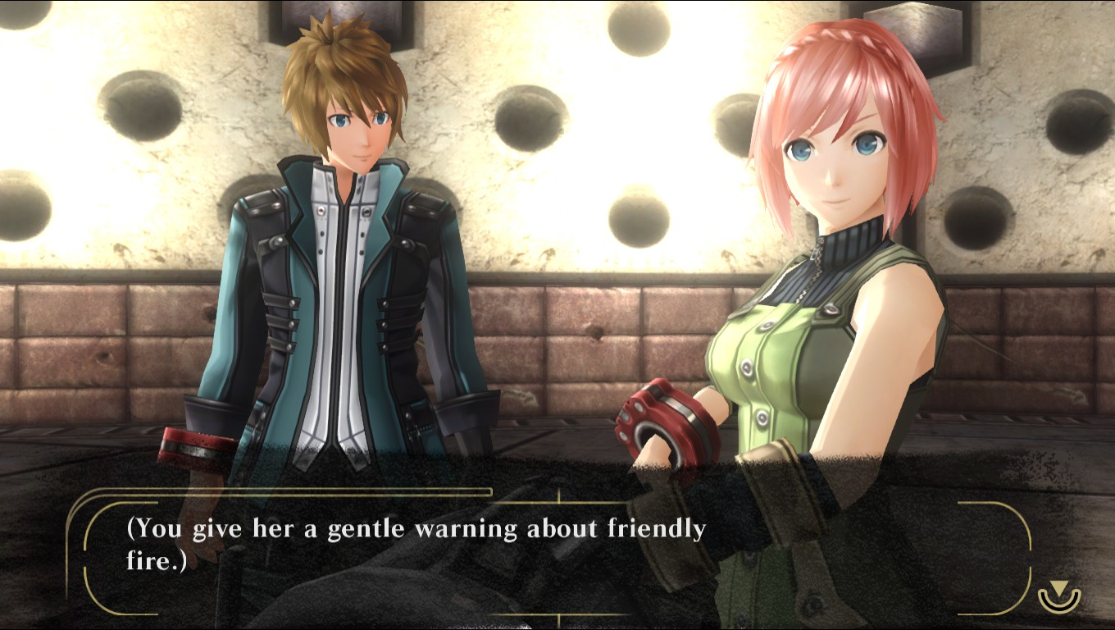
Game Review: Unfun
Repetition of maps and monsters
First half of the story line is linear and predictable
Multiplayer issues and region-lock
Kanon

Slide 23
Game Review: Compeition
Monster Hunter
Does not have as long of a history or prestige as Monster Hunter
Crafting system is not as deep as Monster Hunter
However, God Eater is noted to have faster combat and an actual story
Overall, different setting and environment
Fantasy vs Post-Apocalypse

Slide 24
Game Review: Audience
Fans of Monster Hunter
Watchers of the animation
Someone who likes the setting and wants to play around with the hunting genre

Slide 25
Game Review: Design Mistakes
Lip sync issues with the voices
Multiplayer
Chat censorship and word limits
Inability to rearrange item inventory
Confusing bullet editor

Slide 26
Summary
Strengths
Customization
In-depth characters and story line
Interesting world
Fast-paced combat
Weaknesses
Starting story line is predictable
Repetition
RNG
Multiplayer
Choices in dialogue are mostly linear

Slide 27
Summary: Purchase?
If you are a fan of the series, definitely
The Steam version is very good deal, 2 games for 1
Keep an eye out for Steam sales

Slide 28
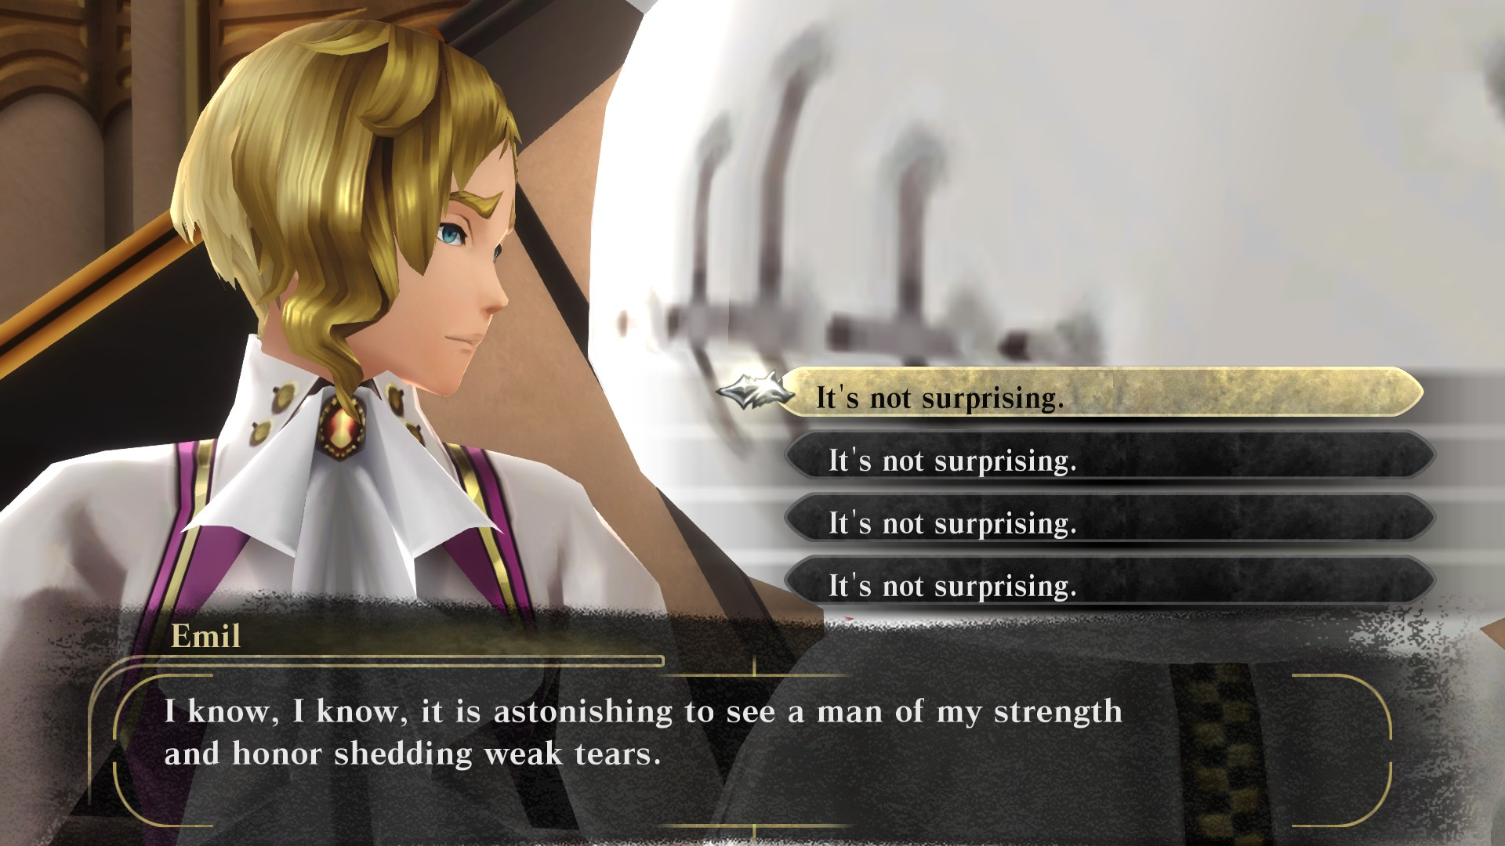
Summary: Improvement
More meaningful choices
Better AI
More variety of maps
More stealth options

Slide 29
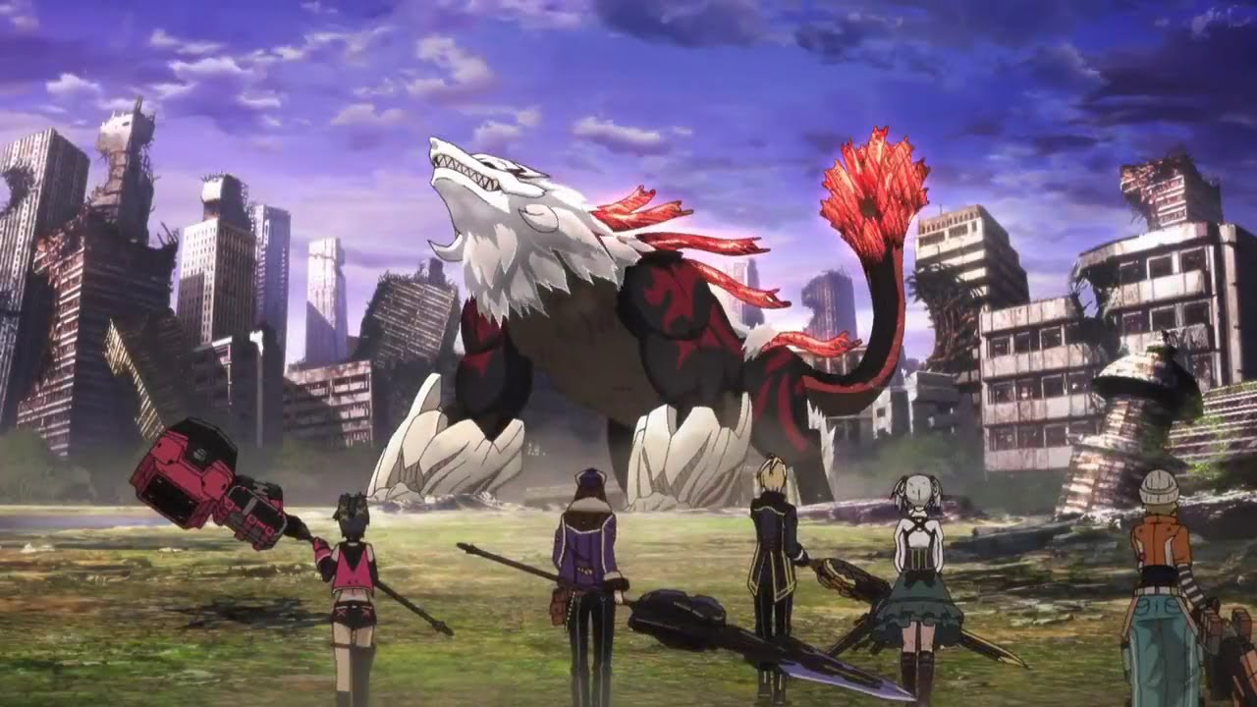
Questions?

