Slide 1
Assignment 1: game review
By:
David Stephanoff

Slide 3
Basic Information:
Game Title: Starbound
Company/Author: Chucklefish Games
Type of Game: Side-scrolling Adventure/Action
Price: $14.99 (at time of writing)
Minimum requirements: Core 2 Duo, 2GB Ram, 256mb graphics memory and DirectX 9, 3GB available space
Actual hardware required: Core i3, 4GB Ram, “discrete” graphics capable of DirectX 9, 4GB available space

Slide 4
Game Summary
Overview: 2D, Side-scrolling game about collecting resources, crafting, exploring, and combat.
Storyline: Earth has been destroyed, and your character was able to get into a space shuttle and escape. Without someone manning the ship, it hurtled through space and orbits an undiscovered planet far away. Your adventure begins with you entering the new world.
Player’s role: Protagonist, and only known survivor of attack on Earth
Installation: Use Steam
User Interface: See next slide

Slide 5
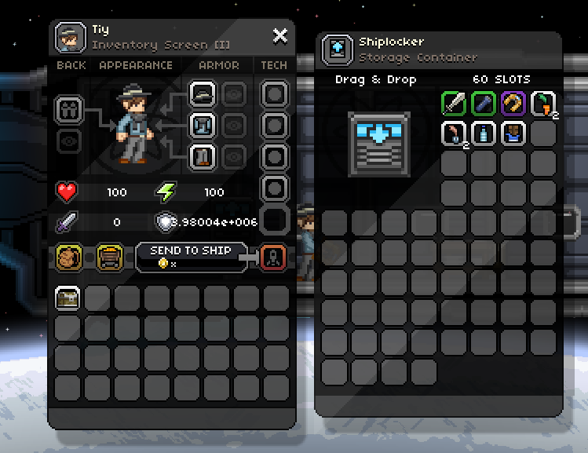
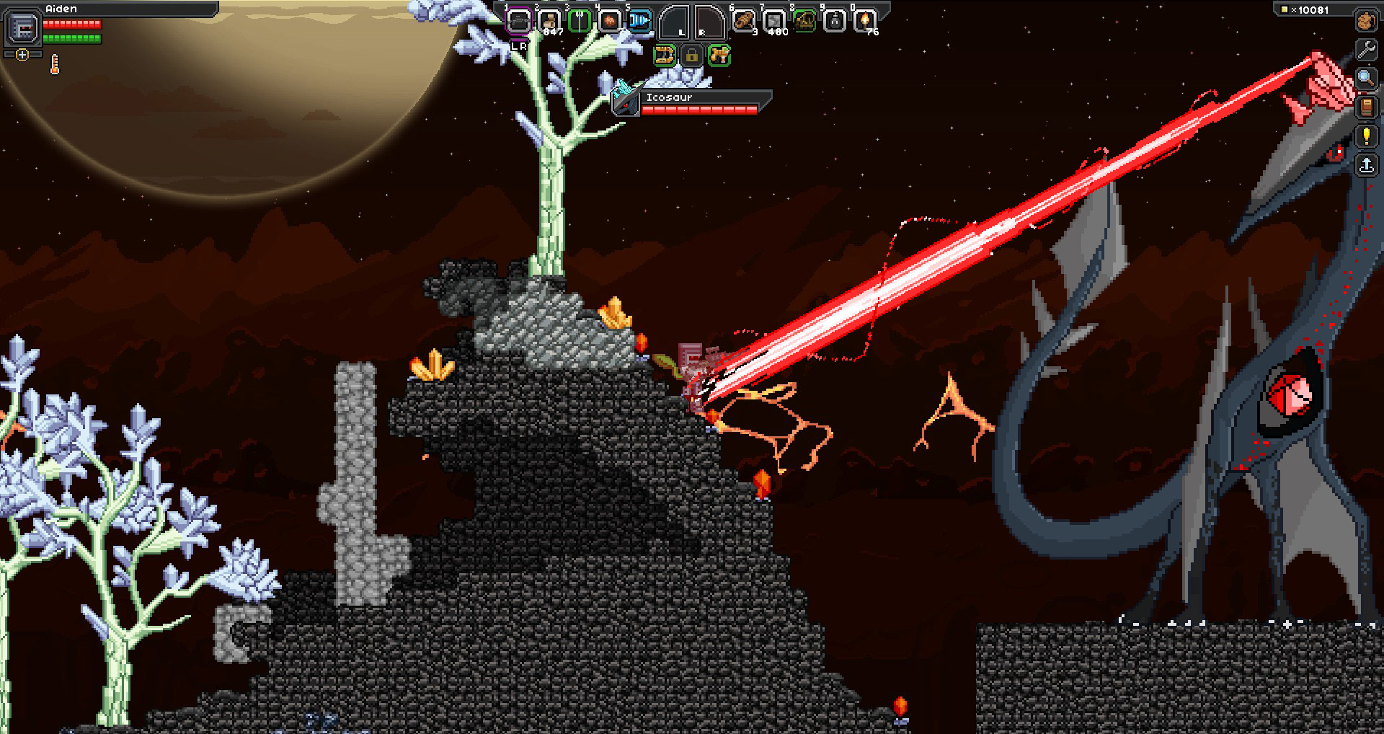
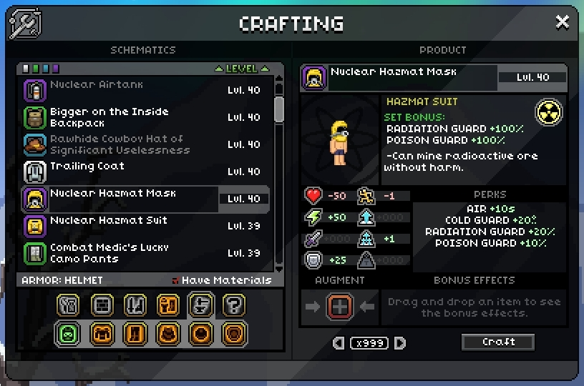

Slide 6
Game Summary (pt. 2)
Game Play: Very exploration based, combat and mining sprinkled throughout the exploration. Mining can be as abundant or as sparing as you choose, but it determines progress.
Scoring: Not much of a “scoring” system, but there is a currency system which relies on their money called Pixels
Artwork: Voxel, but still feels less blocky compared to things like Minecraft. Artwork is diverse and very well done.
Sound and Music: Excellently captivating, keeps players emotions changing with the gameplay
https://www.youtube.com/watch?v=5WYnTsHSsLE&list=PLDWrj6ynqDME9jOsMBIS-vSB3bk6_a0lh&index=5

Slide 7
Game Summery (pt. 3)
Special Features: None to really talk about. Many hinted at features coming in future updates, however.
Manual: http://starbounder.org/Guide:Getting_Started
Bugs: http://starbound.gamepedia.com/List_of_known_bugs

Slide 8
Game Review
What is good/fun about the game and why?:
The exploration, the enemies, the looting, the pre-generated structures, the worlds you can visit, the ship and modifying it.
What is bad/not fun about the game and why?:
Can feel grindy at times, sometimes enemy AI is extremely stupid, procedurally generated worlds can actually leave you with a severe disadvantage at start
How does it compare to similar games in its genre?
Very well. Terraria, Minecraft, Spelunky(sort of)

Slide 9
Game Review (pt. 2)
Why is it better or worse than similar games?:
Better because of procedurally generated worlds, and ability to visit multiple worlds as game progresses. More diverse enemies, large variation in different weapons, etc. Worse because of a wonky UI for the players tool bar and “events” or bosses.
What is the appropriate audience for this game?
I think that this reaches a pretty wide audience, where kids of a very young age can still play and have fun, but adults can play and enjoy some more advanced features
Any design mistakes present?: THE USER INTERFACE… BLAH

Slide 10
Summary:
Procedurally generated worlds is fantastic and really gives it an edge over games like Terraria, the soundtrack is nothing short of glorious, the gameplay is fun and addictive without feeling to overbearingly grindy, and exploration is always enticing. The clunky UI for the player’s toolbar is frustrating but not so much that it ruins the game.
The game is absolutely worth purchasing if this style of game is something that you enjoy. If you liked Terraria but didn’t like how bosses limited your progress, then this is for you.
It could be improved by a nice UI overhaul, but after looking at the upcoming features list, the devs have some very nice plans for the game.

