Slide 1
Magic The Gathering:
Duels of the Planeswalkers 2012
Joe Starr
Notes:
Game Summary
Quick overview
Story line (if any)
Player's role
Installation
User Interface
Game Play
Scoring
Artwork
Sound and Music
Special features
Manual (if any)
Bugs
Game Review
What is good (fun) about the game? Why?
What is bad (not fun) about the game? Why?
How does it compare to similar games in the same genre?
Why is it better or worse than similar games?
What is the appropriate audience for this game?
Are any design mistakes present?
Summary
Overall strengths and weaknesses.
Is the game worth purchasing?
How could it be improved?

Slide 2
Basic Information
Company & Author: Stainless Games Ltd / Wizards of the Coast LLC
Type of game: Strategy
Price: $19.99

Slide 3
Basic Information: Hardware Requirements
OS: Windows 7/Vista/XP
Processor: 2GHz CPU (Pentium 4 or equivalent)
Memory: 1GB RAM (2GB for Vista)
DirectX®: DirectX 9.0c or later
Hard Drive: 700MB
Sound: DirectX 9.0c compatible sound card
Video: 256 MB VRAM GPU capable of Pixel Shader 3 or better

Slide 4
Overview
Digital version of “Magic The Gathering” card game
Played locally against AI or multiplayer on the internet
Notes:
Quick overview

Slide 5
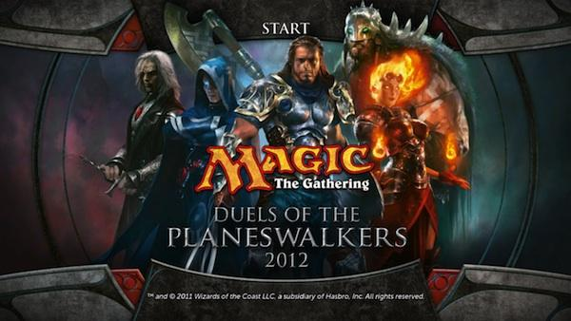
Pre-Gameplay
Standard Steam installation
Notes:
Installation
User Interface

Slide 6
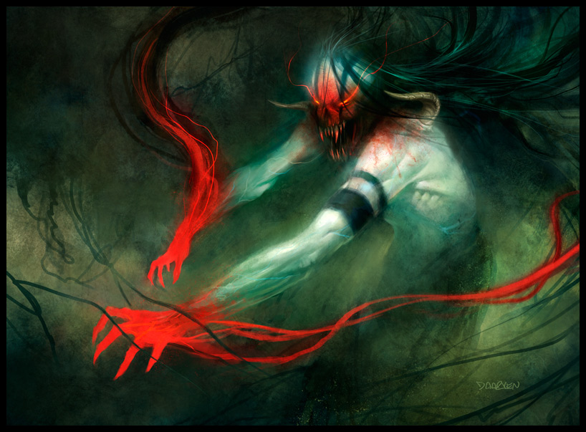
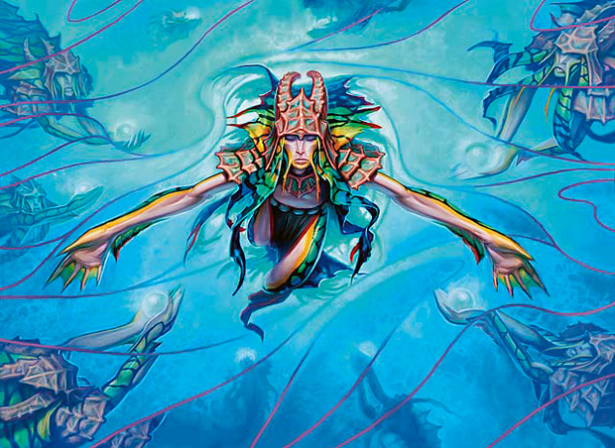
Artwork and Sound
Notes:
Artwork
Sound and Music

Slide 7
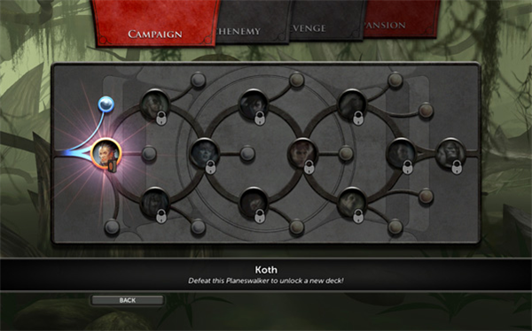
Story and Gameplay
The story consists of “duels” against the other “Planeswalkers” to ultimately defeat the final boss Karn, Silver Golem
Planeswalkers are defeated by winning
a game of Magic
Campaign also includes puzzles to solve
Cards are unlocked after every win
Several Game modes
Notes:
Story line (if any)
Player's role

Slide 8
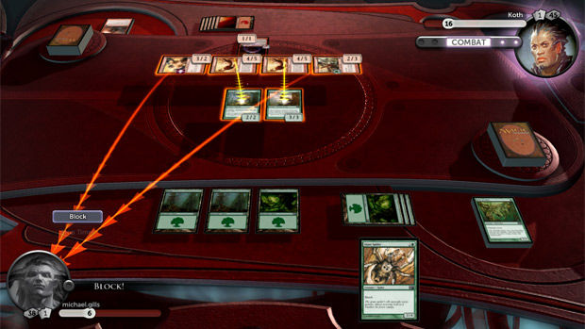
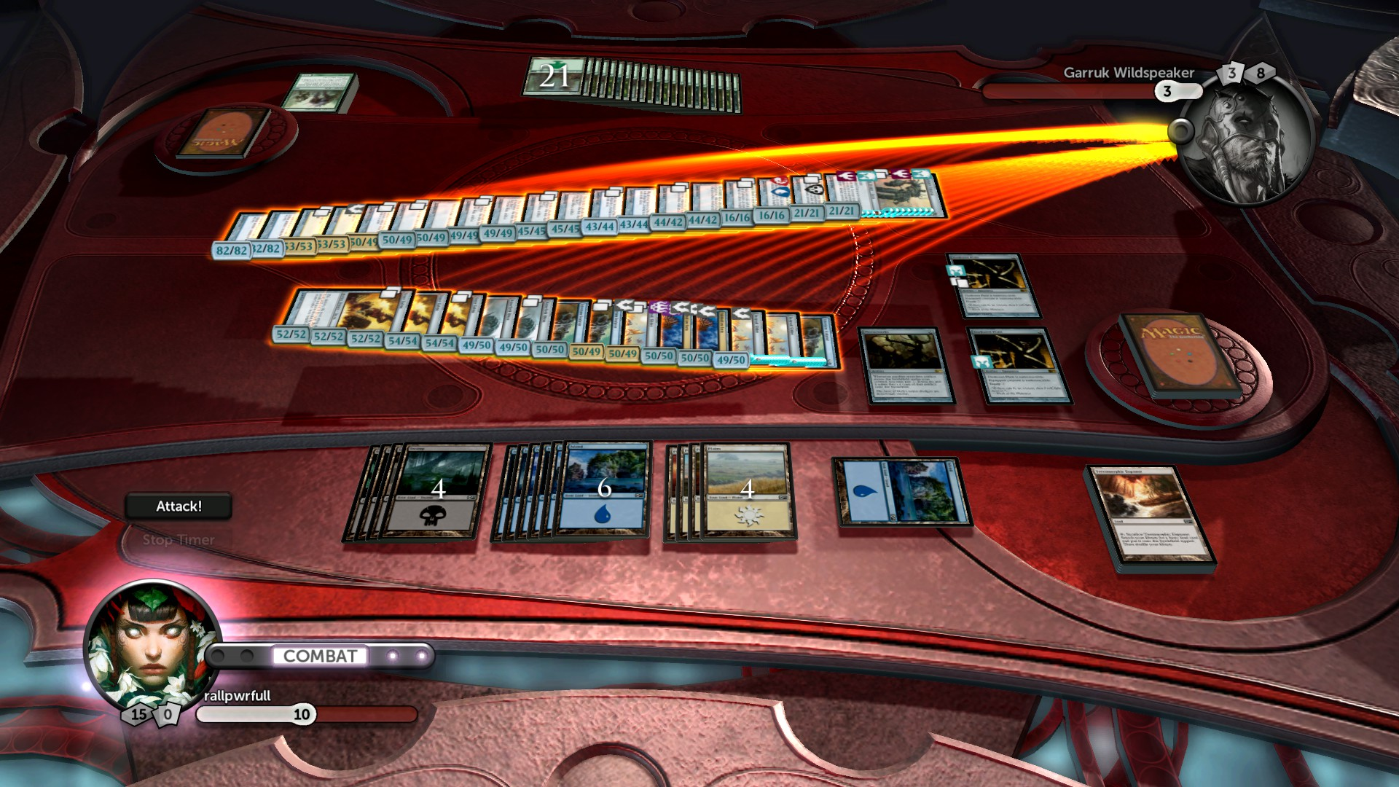
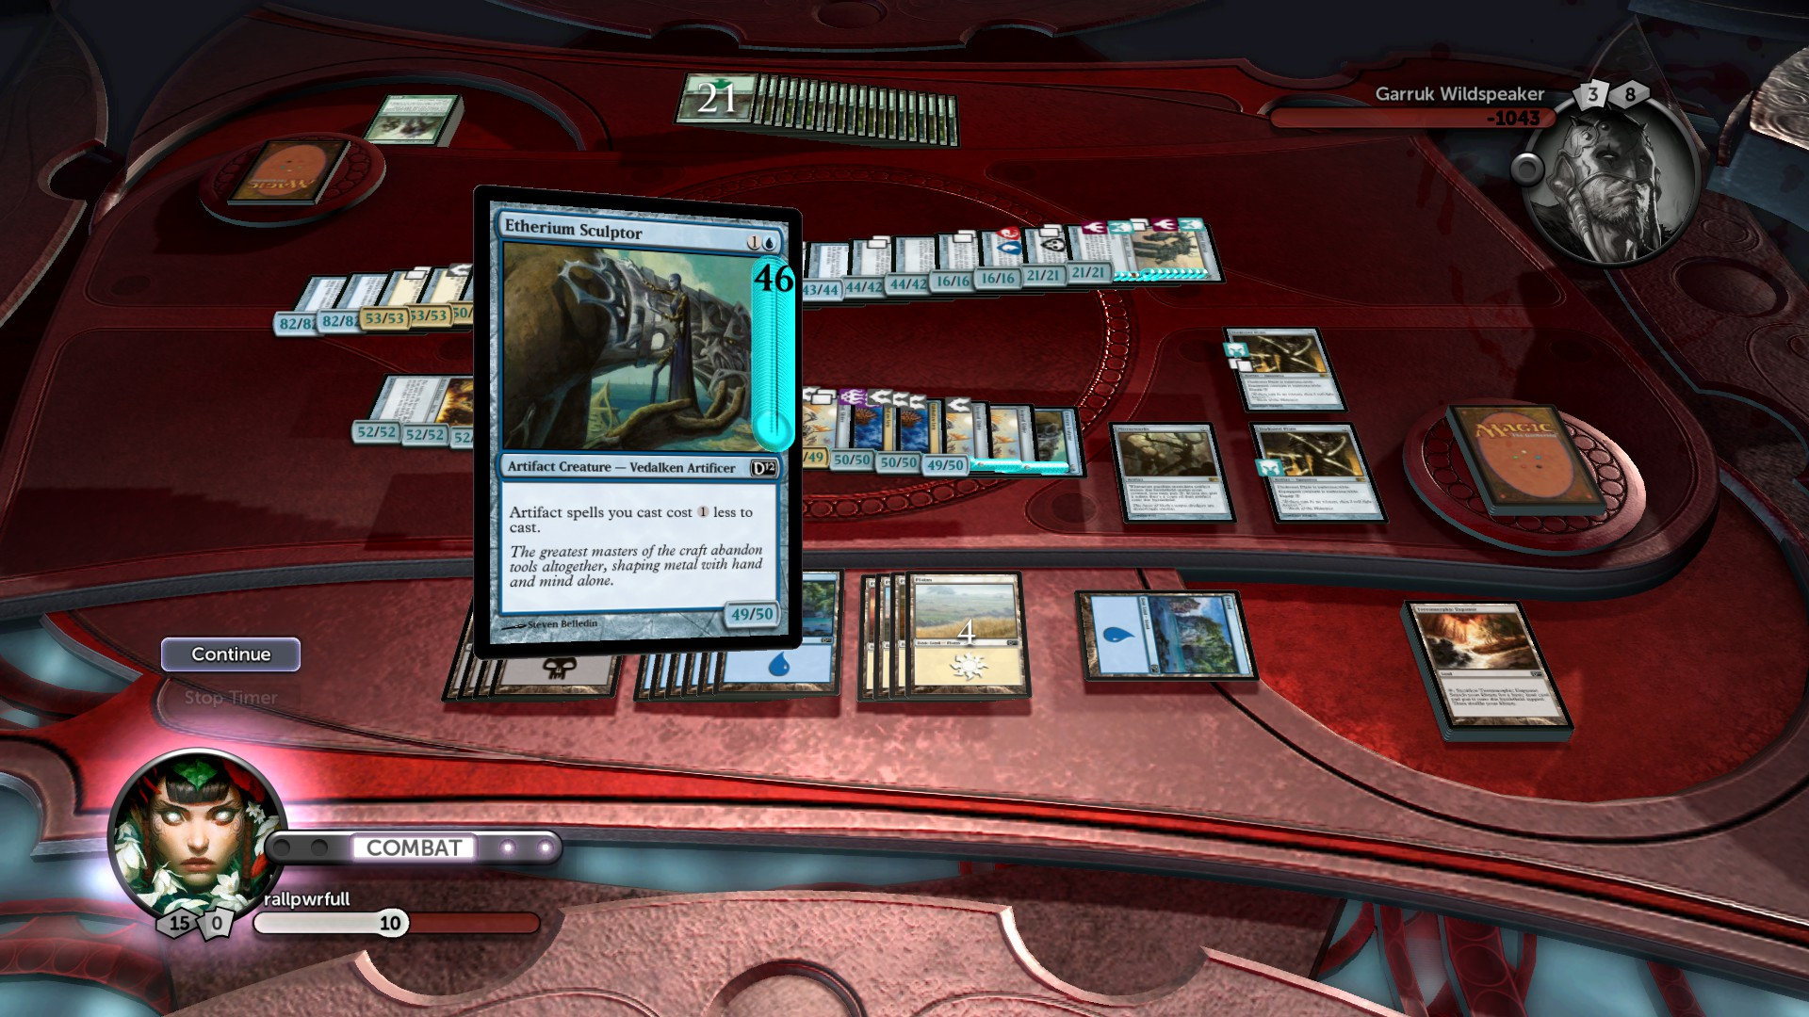
Gameplay
Games of Magic cards
Start with 20 life
Take turns
Win Conditions:
Other player has 0 life
Other player has 0 cards in deck
Very weak AI
Notes:
Game Play
Scoring

Slide 9
Misc.
Special Feature: “Foil” versions of cards and decks
Manual/”How to play” is included within the settings menu
No major bugs
Notes:
Special features
Manual (if any)
Bugs

Slide 10
Review/Summary
DoTP is fun as it allows you to play Magic on demand
DoTP falls short when it comes to AI. Weak AI makes the game to easy.
I enjoy the mechanics of Magic more than Hearthstone, Dominion, or Similar strategy games.
The audience for this game is pretty limited, mostly consisting of people who already play magic.
The UI is not optimized for tablet play. This was probably a consequence of when the game was published.
I would purchase this game again, I have gotten a good amount of replay out of it.
Notes:
Summary
Overall strengths and weaknesses.
Is the game worth purchasing?
How could it be improved?

