Slide 1
Quantum Conundrum
Michael Smellie

Slide 2
Basic Information
Publisher: Square Enix
Director: Airtight Games
Type of Game: Puzzle, Platformer
Price: Currently $9.99
Audience: 14+ who enjoy platformers
Minimum Stated Hardware:
Xbox 360
PS3
PC with 2GB of RAM, 2.2Ghz Core 2 Duo, GeForce 8800
Actual Hardware:
Xbox 360
PS3
PC with 2GB of RAM, 3 Ghz Core 2 Duo, GeForce GT 9500

Slide 3
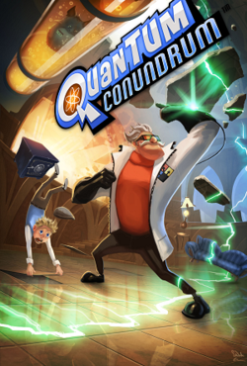
Overview
This game is sometimes considered the spiritual successor to portal. It is a fairly simple to learn, humorous, puzzle-platformer. The player switches through dimensions and moves objects around the game world to solve simple to complex puzzles.

Slide 4
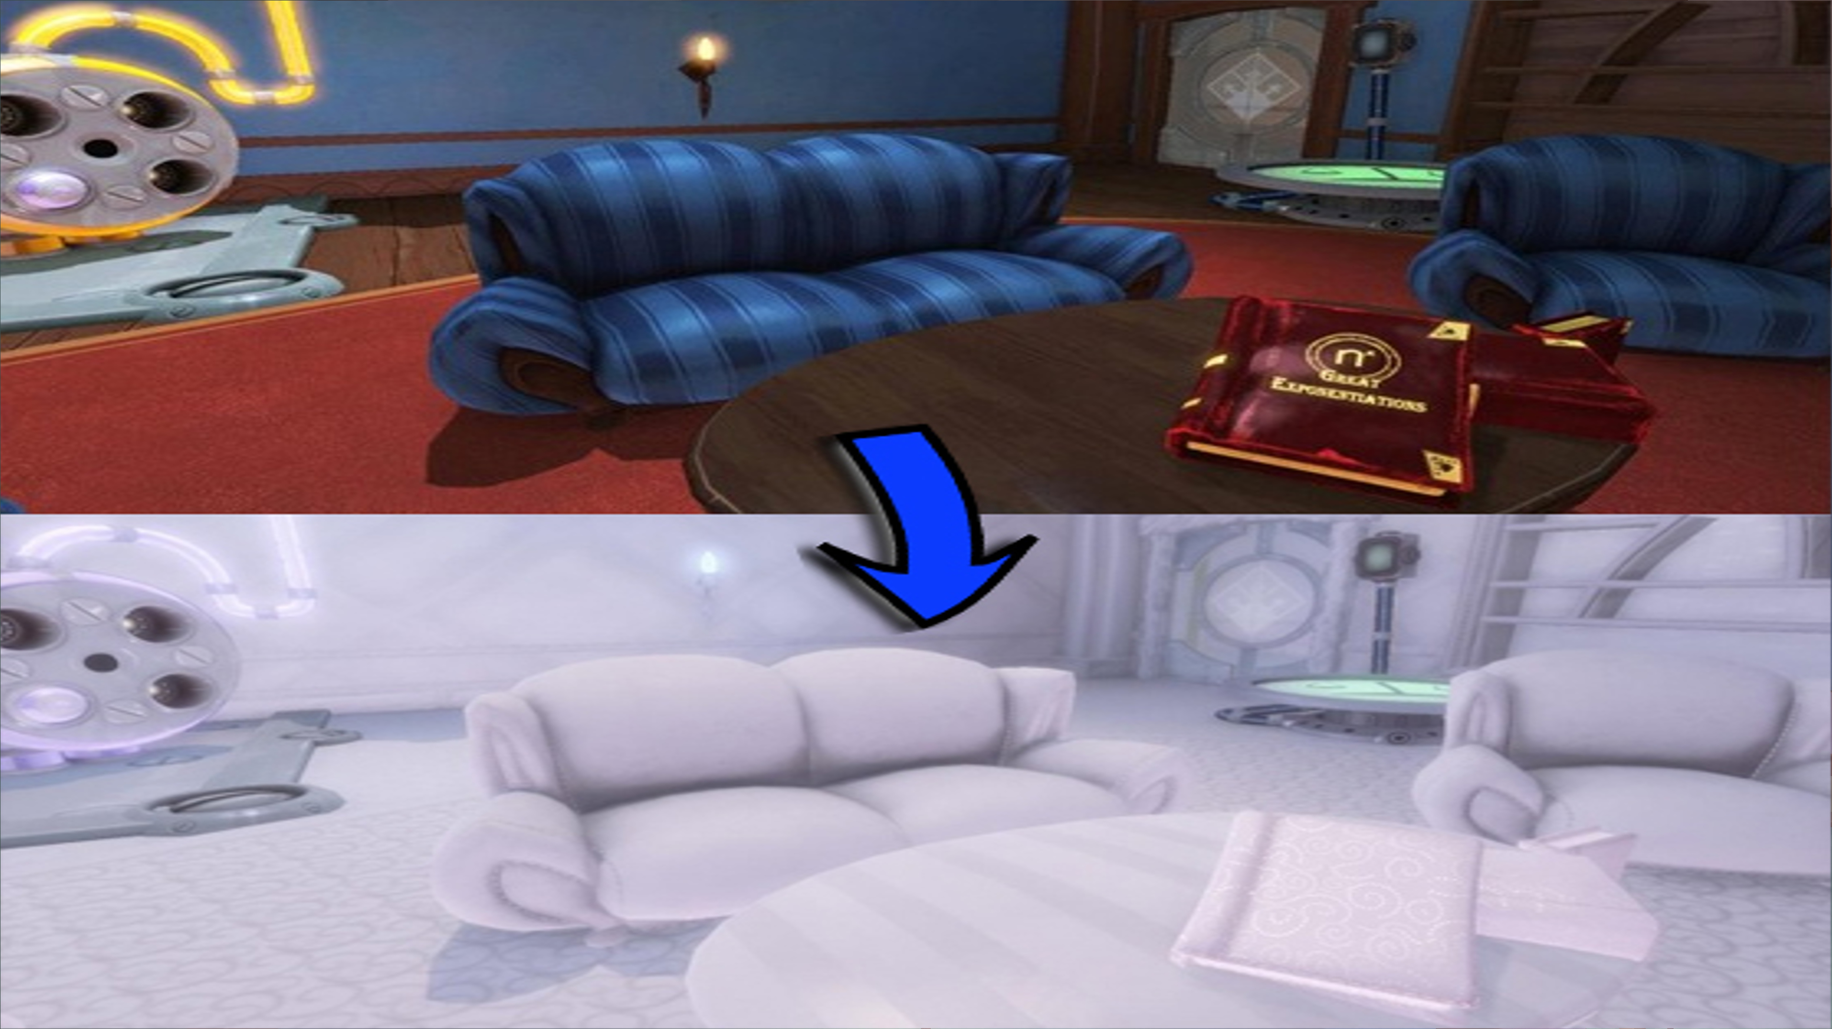
Story
Quantum Conundrum takes place in a large almost endless mansion. The game starts with a short explanation about the main character who is a 10 year old visiting their eccentric uncle’s family mansion. This uncle happens to be a sort of mad scientist who develops various inventions. When testing out his newest invention, a glove that allows the wearer to shift through dimensions, the uncle traps himself in some pocket dimension. In the process of doing this, he has triggered a security lockdown on his house. The player is then tasked with the job of taking a prototype of his interdimensional glove, and using it to turn on the power throughout the mansion. This will lift the security lockdown and allow the uncle to return from the pocket dimension.

Slide 5
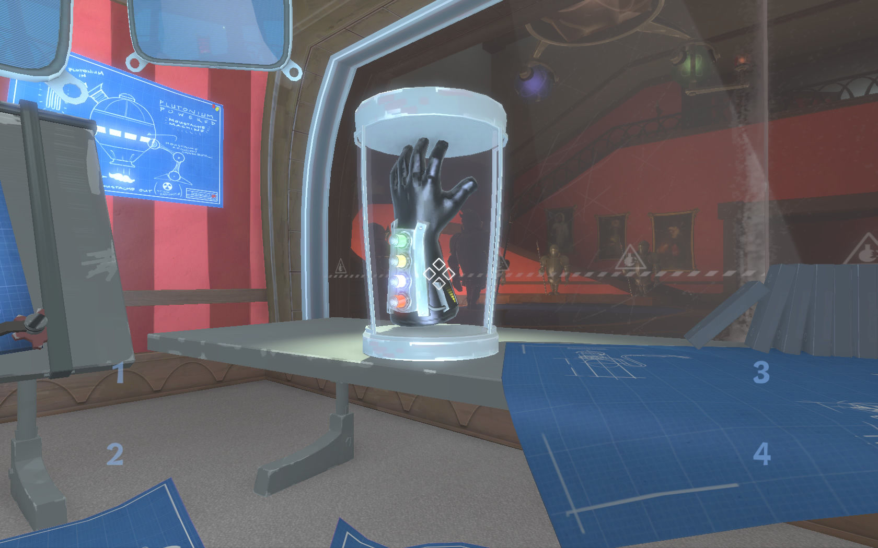
Player’s Role
The nephew is controlled from a first person perspective.
Player can use the glove to switch through dimensions to help solve puzzles.
Player navigates the nephew through the puzzles by jumping and moving objects.

Slide 6
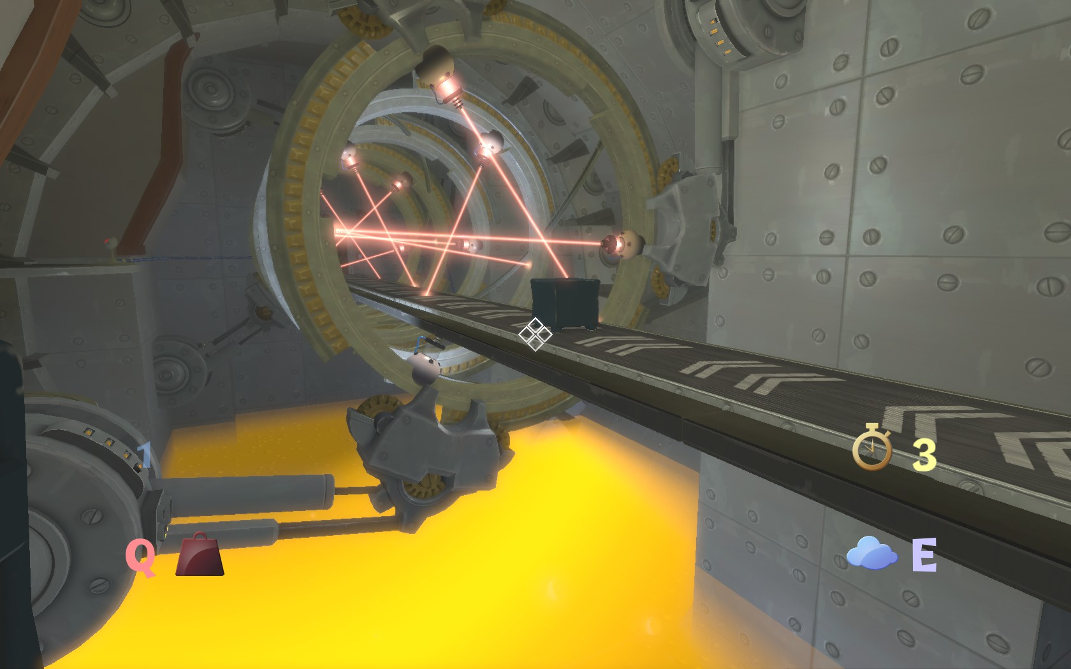
Gameplay
The gameplay consists of the player switching through various dimensions to solve puzzles. These dimensions allow the player to move and interact with objects in various ways. The player then uses the static objects as well as the intractable ones to platform their way to the end of the puzzle.

Slide 7
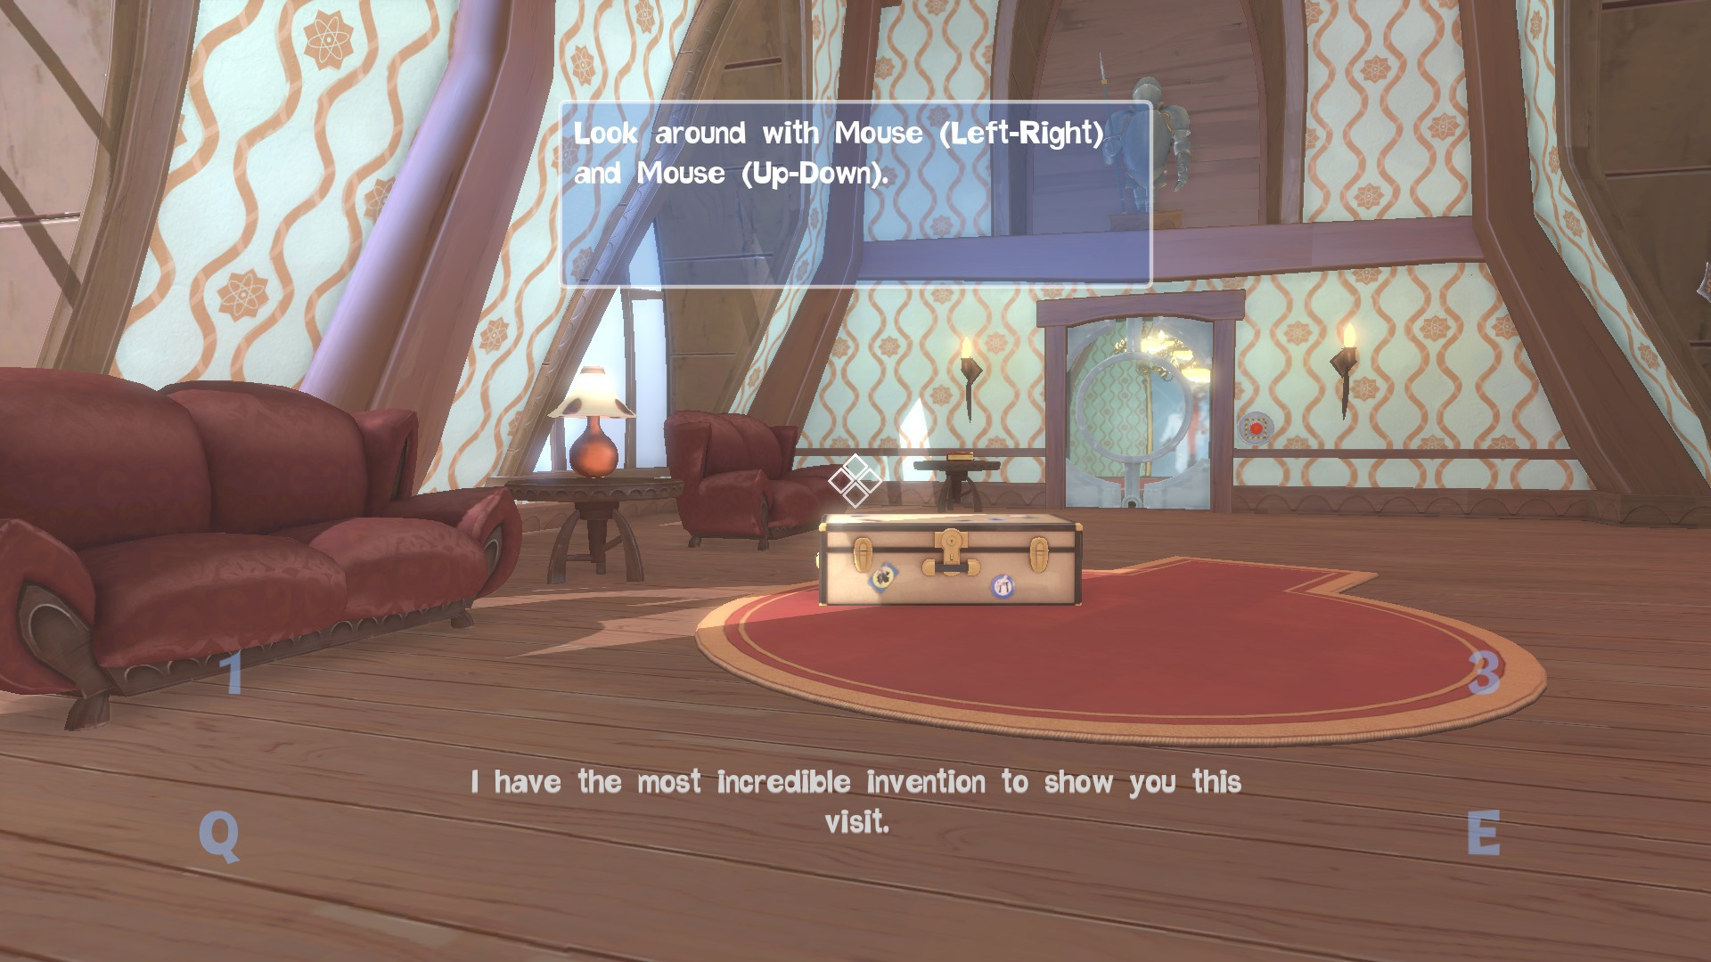
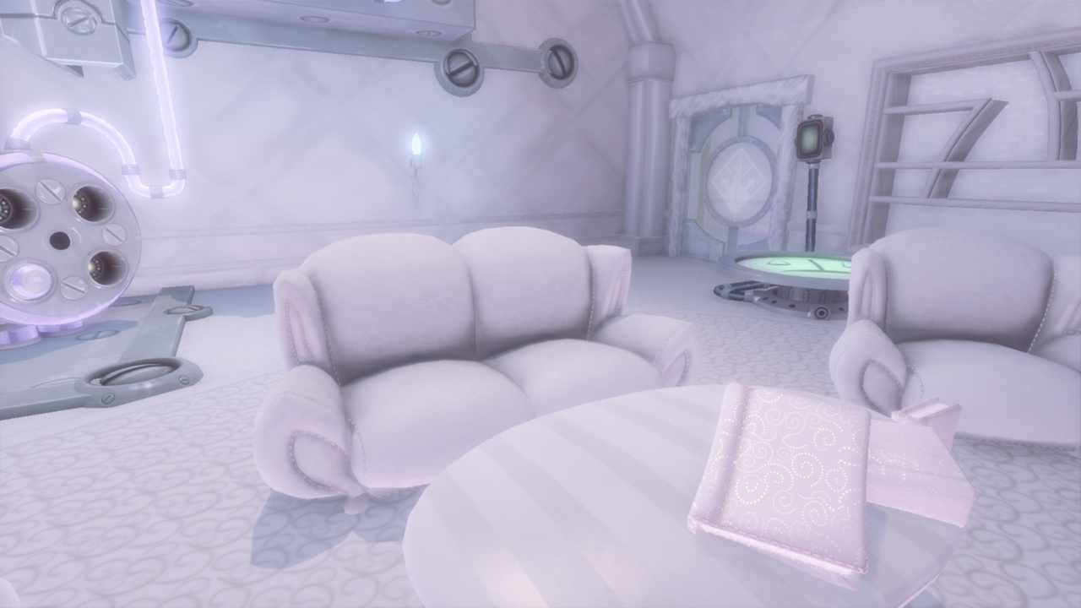
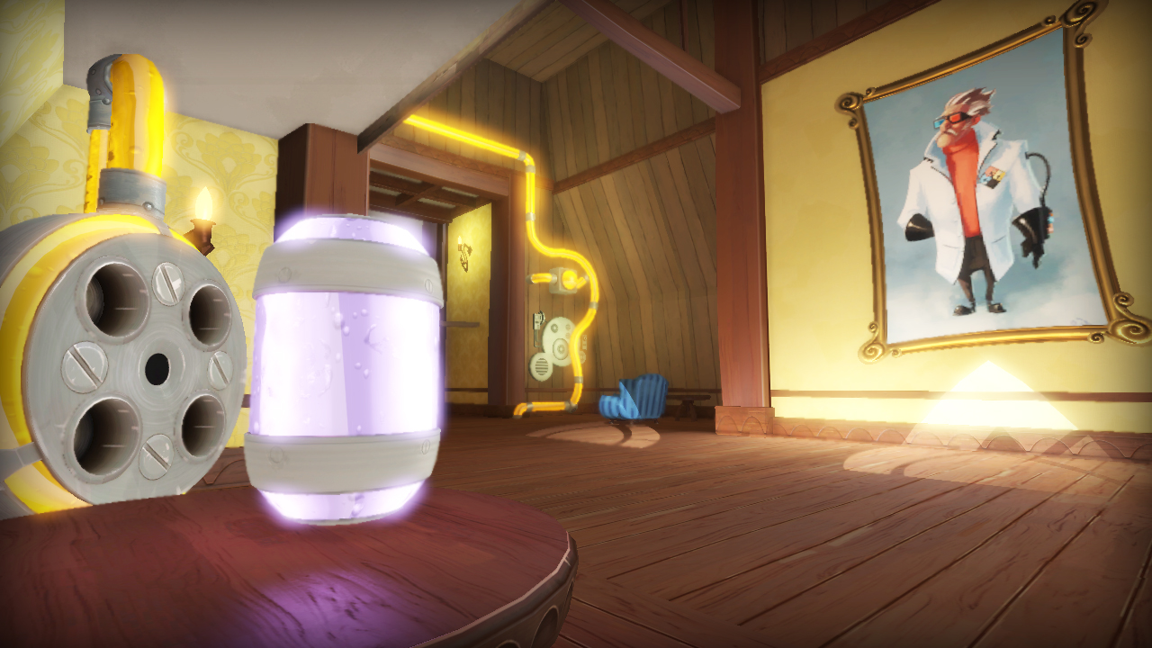
UI and Artwork

Slide 8
Installation and Bugs
The game can be installed from Steam, or on the Xbox Live Market Place. The game used to be on the PlayStation Network but has since been removed.
The major bugs seen in the game are that many of the platforms can be fallen through even though they look solid.
The game crashed once when entering one of the levels however relaunching the game seemed to resolve this issue.
There were a few times when the character would get stuck between a game object and the wall but with a bit of fidgeting getting unstuck was possible.

Slide 9
What was good?
The puzzles were all solvable in more than one way.
The solutions to all puzzles were not obvious right away so they took some thought, the player cannot easily solve all of them.
The objects used to solve puzzles were the same and the player could get used to using them and know how they function.
The platforming was difficult and varying enough that it did not seem repetitive
This game did an excellent job of slowly introducing new things. It allowed the player to not be overwhelmed by everything all at once without needing an explicit tutorial level.
There are extra collectables and challenges for each level which allow the game to be continued to be played even after the story if finished.

Slide 10
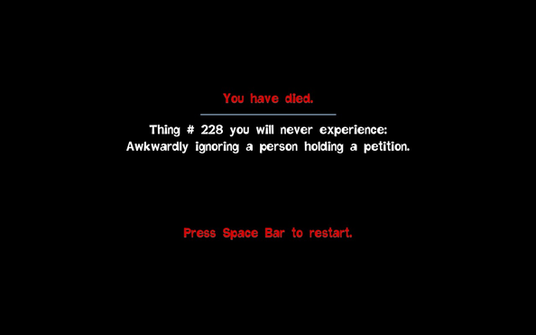
What was good? Continued
The game added humor to every level through the use of a humorous voiceover by the uncle throughout the entire game.
The game made dying not as upsetting too, by adding a bit of dark humor along with every death “Things you will never experience:”

Slide 11
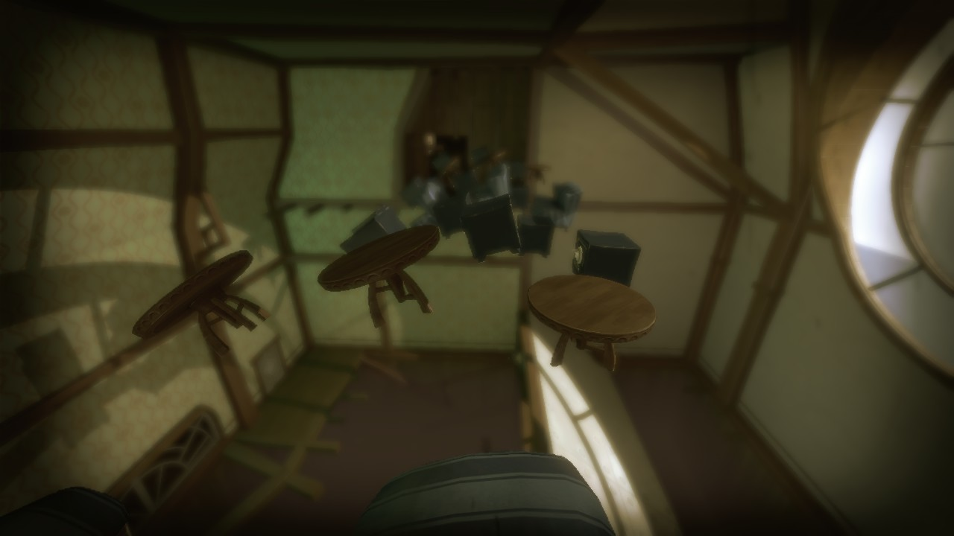
What was bad?
Platforming can get very difficult at times, which can get upsetting when a certain jump can’t be made.
Towards the end of the game it seems the developers got bored of making the game where the beginning feels long and finished. Towards the end the puzzles get less elaborate and there are fewer of them.
There are a few places in the game that there are scenery objects in the way of the puzzle. The character can move through these objects, but they make a few of the puzzles unintentionally hard to solve.
There is a bonus area that seems to allow you to unlock something, after doing some research online however, it just turned out to be a sandbox room.

Slide 12
Other Similar Games
The game that is most similar to this game is portal. I feel portal does a better job of the puzzle platformer. It does not get as frustrating as Quantum Conundrum does and the story line seems to be a bit more succinct.

Slide 13
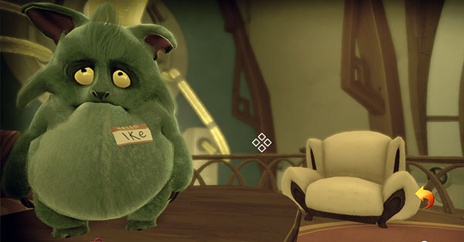
Design Mistakes
Platforming that can get very frustrating.
Objects that look solid are not actually intractable.
Effort put into the game seems to decrease as the game progresses.

Slide 14
Summary
This game should definitely be purchased by anyone who is a fan of platformers. It adds a unique challenge to the normal idea of a platformer.
Things it did well:
Slowly introduced concepts of the game
Made good use of puzzles so they were very different from each other
Integrated puzzles and platforming
Things it didn’t do so well:
Keeping the game consistent.
Keeping platforming within reason.
Ways it could improve:
Make some of the platforming aspects easier
Flesh out the end of the game so it is more consistent
Make it more obvious which objects can be used to platform and which cannot.

