Slide 1
Cities: Skylines Review
Andrew Rodman
CIS 487 Fall 2016 Assignment 1
Andrew Rodman

Slide 2
Title: Cities: Skylines Developed By: Colossal Order Published By: Paradox Interactive City Builder Game Price Now: $29.99 Original Price: $39.99 Released: 3/10/2015
Game Basic Information

Slide 3
Minimum Stated Hardware Requirements:
OS: Microsoft Windows XP/Vista/7/8/8.1 (64-bit)
Processor: Intel Core 2 Duo, 3.0GHz or AMD Athlon 64 X2 6400+, 3.2GHz
Memory: 4 GB RAM
Graphics: NVIDIA GeForce GTX 260, 512 MB or ATI Radeon HD 5670, 512 MB (Does not support Intel Integrated Graphics Cards)
DirectX: Version 9.0c
Network: Broadband Internet connection
Storage: 4 GB available space

Slide 4
Recommended Hardware Requirements:
OS: Microsoft Windows 7/8 (64-bit)
Processor: Intel Core i5-3470, 3.20GHz or AMD FX-6300, 3.5Ghz
Memory: 6 GB RAM
Graphics: NVIDIA GeForce GTX 660, 2 GB or AMD Radeon HD 7870, 2 GB (Does not support Intel Integrated Graphics Cards)
DirectX: Version 11
Network: Broadband Internet connection
Storage: 4 GB available space

Slide 5
Hardware Requirements Analysis
I tested Cites: Skylines on a computer system with similar specifications as the Recommended Hardware requirements. The test system did have a more powerful video card than the recommended requirements.
The test system had an i5 2500k, 8gb Ram, a 512gb SSD, and an AMD 390 on Windows 10. All other specifications are the same. I found that this system provided smooth gameplay at 1080p resolution. Even when I had huge cities, my framerate never dropped below 45 fps on almost max graphics settings. I did not have a system to test with minimum graphics specifications so I am unaware if what provided by the company is accurate.

Slide 6
Quick Overview
Cities: Skylines is a PC video game where the user is in control of building and managing a city on large maps.
The main objective of the game is keep raising the population of your city. As the city gets bigger, it will be harder to maintain and grow the population.
Building and street placement are important.
You can purchase more land for your city as your population rises to make the map larger.
There is no storyline
Sim City is a comparable game franchise.

Slide 7
The Player’s Role
The player has an overhead view of the city to view and select buildings, people, and services.
The player is taking a role of a Mayor or city developer and is in charge of building and managing a city.
The player must manage the budget, choose polices, control traffic flow, manage modes of transportation, buy land, and most importantly to grow population, keep the city’s citizens happy.

Slide 8
Installation
I am reviewing the Steam version of the game so the Steam software must be installed prior to installing the game. Also a Steam user account is required. Installation on my system after logging into my steam account and downloading the game was around 5 minutes. This was about normal for a game that takes up 5GB of storage.

Slide 9
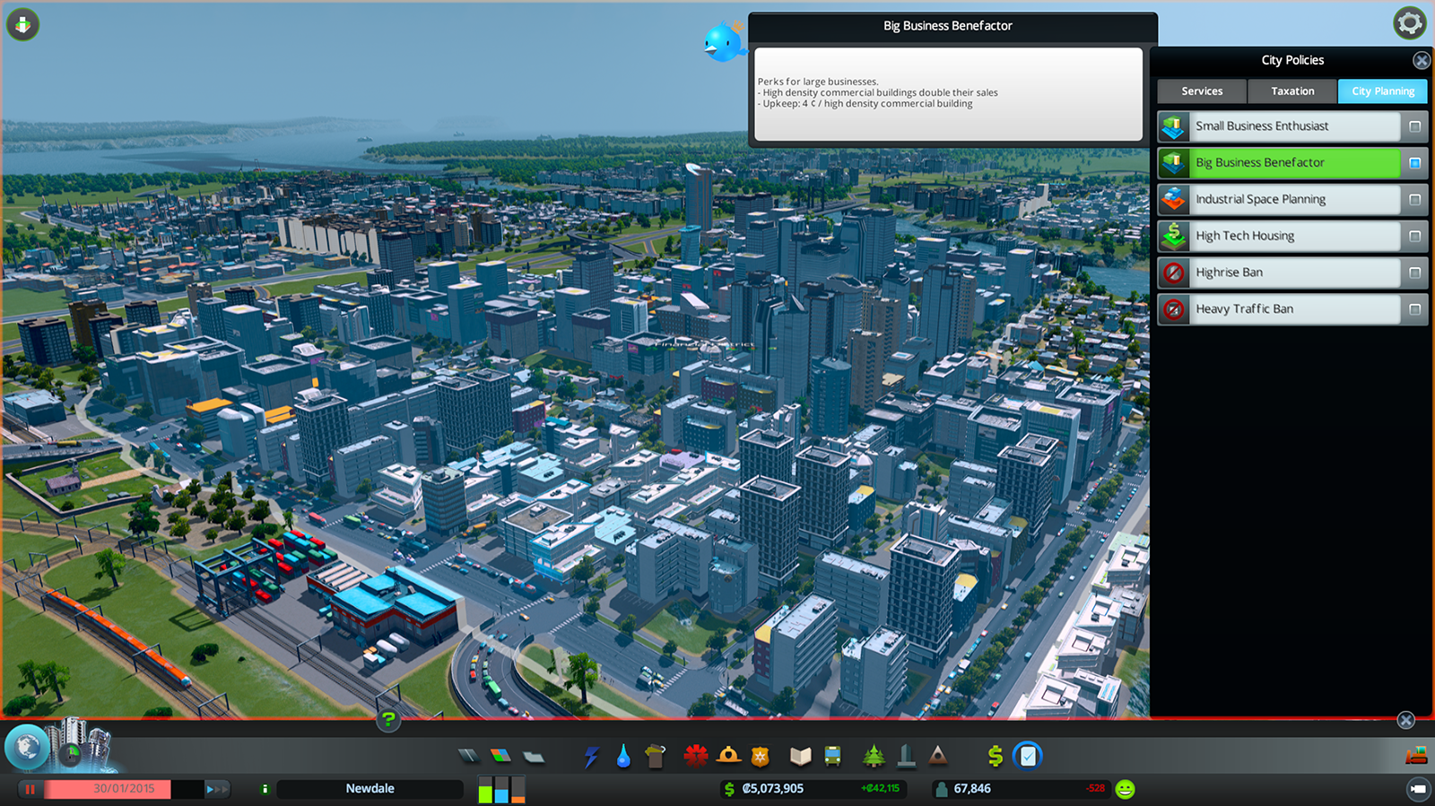
User Interface
The user interface for Cities: Skylines does take a little learning. The developers did a good job placing everything logically. The game does a good job teaching you through the interface and its options as the game progresses and more things unlock.

Slide 10
Gameplay
Gameplay starts off slowly because when starting a new city, there is nothing but a connection to a highway. Also you do not have much money and few buildings and options are locked.
The player starts by building basic buildings to start their city.
The player can purchase more squares of land as the population grows.
More advance buildings and services (power, water, etc..) are unlocked as the player reaches higher population counts.
Population count can be raised mainly by making people happy.
The camera controls can take some time to get used to. With all the rotating, zooming in and out, its worth learning all the mouse functions and hotkeys.

Slide 11
My Recorded Gameplay Video

Slide 12
Scoring
City: Skylines does not have a traditional score counter. Population is the main metric people use to describe the size of their city so population could be considered a score.
Money could be used as a type of score. More money does not necessarily mean a bigger city though.

Slide 13
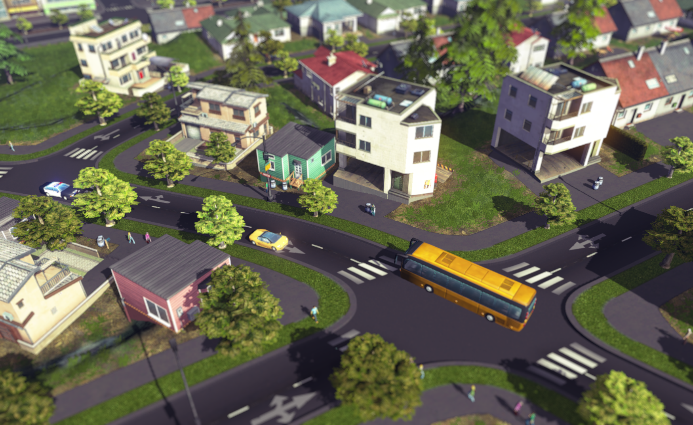
Artwork
The developers put much time into the artwork in this game. The artwork is colorful and very detailed. I find it very impressive.
Looks best at night.
What always amazes me is the detail when you zoom into your city. You can zoom in right to each person in the city.

Slide 14
Sound and Music
You can tell that much time was put into the sound and music in Cites: Skylines. The music fits very nicely into the setting.
The pop up alert sounds are very helpful when a problem comes up that needs immediate attention.
The music is laid back and very relaxing.
Here is a sample from the main theme of the game to get an idea of the type music this game offers.

Slide 15
Bugs
Sometimes the box that comes up when zoning areas has lines going diagonally through it.
I found when the game first came out, cars and trains would disappear all of the sudden after following them for a minute or two.

Slide 16
What Makes Cites: Skylines Fun
The main thing that makes Cities: Skylines fun is the ability to build huge cities from nothing. Keeping an increasing population gets more and more difficult as the city gets bigger. You must make small and big decisions on how to keep the population from going down.
Another aspect I enjoy is how much land you can continue to purchase throughout the game. Much more space is available to build on than the latest Sim City game in the franchise.
Managing the city’s income in also very satisfying. It gets challenging to make a city that generates more income than it takes as the city gets bigger. You always have the choice to raise or lower taxes.
Polices make the game a little more interesting. It is a way to make the citizen’s more or less happy while benefiting or not benefiting your city.

Slide 17
What Makes Cites: Skylines Not so Fun
Where this game falls short is objectives. In similar city building games, the player will be placed in the middle of a scenario with an objective to complete. Cities: Skylines does not have scenario’s or objectives (in the vanilla version I am reviewing.) Instead, the game really has no end or stopping point. This is a big design mistake in my opinion. I can be fixed though.
One of the reasons Sim City had such a high replay value was the scenarios and objectives presented to players.
Sim City has disasters such as earthquakes and tornados while City: Skylines does not have any. Disasters create a twist because when one comes along, it throws a wrench in your city building gears. It just made the game more interesting overall. It makes City: Skylines seem predictable after a while. In Sim City, you were always on edge hoping a new disaster would not strike.
This does in turn make Cities: Skylines a more laid back game to play, which some may find more enjoyable.

Slide 18
Appropriate Audience
City: Skylines is geared towards young teenagers and up. The game is appropriate for a younger audiences but because of time it takes to learn the user interface and game mechanics, some might find it confusing. That’s not to say a child could not play this game.

Slide 19
Strengths / Weaknesses
Strengths
Huge maps
Very Fun Gameplay
Many different buildings / services
Detailed graphics
Many options to manage the city
Weaknesses
No scenarios/objectives
No disasters
Low replay value

Slide 20
How Cities: Skylines can be Improved
Replay value can be fixed in a few ways.
Add scenarios or objectives that would present the player with a challenge with a time frame. This will greatly increase the replay value giving people more reason to play the game.
Add a disasters option into the game. This will ad some excitement in this game which I feel is lacking.
These design changes would make this a even more enjoyable game that does not get stale as quick.

Slide 21
Cities: Skylines: Worth it?
I purchased Cities: Skylines when it first came out for its original price and I do not regret buying it then.
I recommend this game for anyone that was a fan of the Sim City Franchise. It does improve on it many ways.
While I am only reviewing the original vanilla version, there are expansions out that fix some of the issues I had problems with.
Many mods are available on Steam.
I would give this game a 8/10.
Yes, this game is worth purchasing.

Slide 22
Sources
https://en.wikipedia.org/wiki/Cities:_Skylines
http://store.steampowered.com/app/255710/?snr=1_7_7_151_150_1
https://www.paradoxplaza.com/cities-skylines

