Slide 1
Game Evaluation Witcher 3: Wild Hunt
Anthony Robinson
CIS 487

Slide 2
Basic Information
Developer: CD Projekt RED
Genre: Action Role-Playing
Price: Standard($25.99); Complete Edition($49.99)
50GB on PS4 and Xbox One

Slide 3
Game Summary
You play as Geralt of Rivea, a Witcher, monster killer for hire as he searches for his adoptive ward Ciri, who is on the run from the fearsome Wild Hunt.
On your journey you meet up with varying characters both new and old that help you on your search while taking on Witcher contracts along the way.

Slide 4
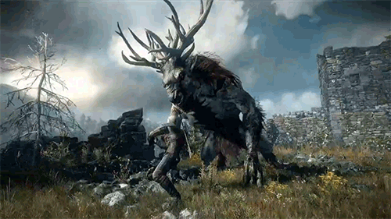
Game Summary
The user interface seemed a little cluttered and complicated at first, but as time went on, I got a lot more comfortable with it.
Gameplay:
3rd person
Swordplay as well as magic abilities
Horseback riding/ mounted combat
Ranged combat(crossbow, bombs)
Witcher sense
No bugs that I have encountered

Slide 5
Game Review
What’s good:
The story; it has a certain suspense to it as you try to track down Ciri and see what she’s been doing. Suspense also comes form the various contracts you take on as you try to determine what type of monster the contract is referring to.
The combat; it is tactical to an extent. You can’t just hack and slash your way to victory, when dealing with monsters you need to research them and see what oils(for your sword), potions and magic abilities are best for taking it on. For humans, you need to utilize all of your abilities because you are often surrounded by enemies.

Slide 6
Game Review
What’s bad:
You can’t quite escape the repetitiveness of the contracts. If you do enough, you might see similar if not the same species of monsters as the culprit.
The “normal” difficulty is too easy and though the difficulty above it is an improvement, the game isn’t extremely challenging unless played on hardest difficulty
How does it compare:
I feel like its one of the best ARPG games I have played. The world is a lot bigger than most other games and the characters are so different as far as their personalities are concerned that it further submerges you into the world.
I believe it is better than most of the other games in its genre because of its story, combat and intriguing world.

Slide 7
Game Review
Audience:
Mature (18+)
Design Mistakes
Difficulty balancing
Game is arguably too easy if not played on “Death March” the hardest difficulty.
Improvements
Adding more interesting farming elements. (dungeon raids)

Slide 8
Summary
Overall strengths:
Story
Combat
Game world/characters
Overall weaknesses
Difficulty
Slight repetitiveness
Worth buying?
Absolutely

