Slide 1
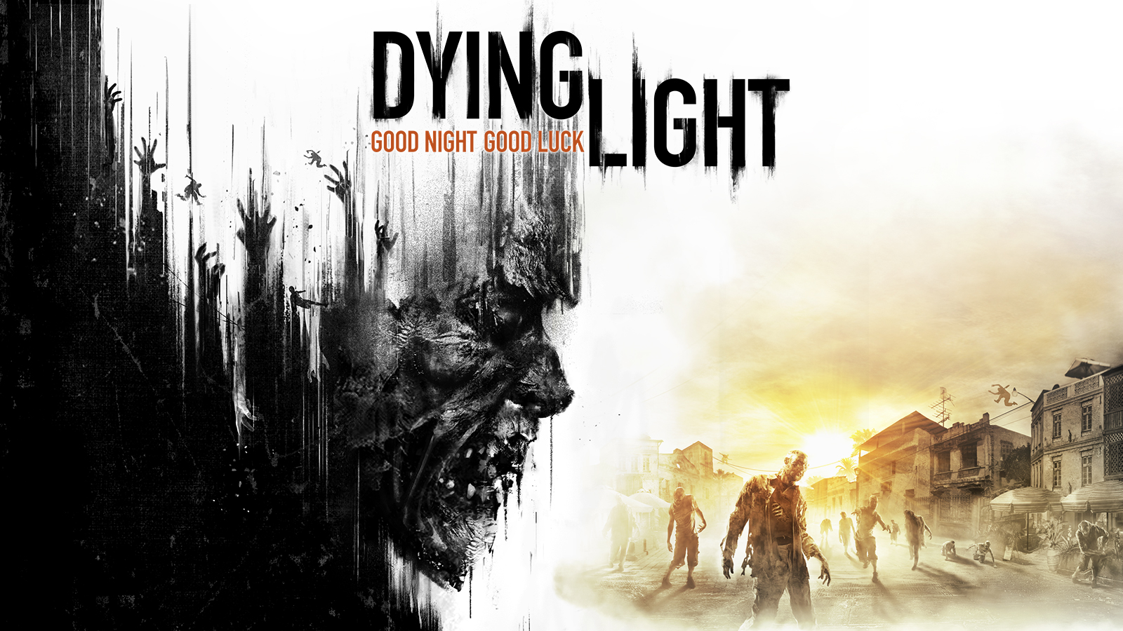
Evaluation
by Nicholas Rebain

Slide 2
About Dying Light
Dying Light is an open world first person zombie survival game
It was developed by Techland and published by Warner Bros in January of 2015.
Sold for $60 at release.

Slide 3
Requirements
Minimum
CPU: Intel i5-2500
Ram: 4GB
GPU: GeForce GTX 560 / AMD HD 6870
Recommended
CPU: Intel i5-4670K
Ram: 8GB
GPU: GeForce GTX 780 / AMD R9 290

Slide 4
Game summary
You are an undercover agent dropped into the city of Harran which has suffered a devastating outbreak that turned much of the population into zombies.
Your mission is to look for a secret file that was stolen from your agency that is related to the outbreak.

Slide 5
Game Play
The game starts like a typical RPG having you start by doing small jobs for what little survivors are left in the city. You help people gather supplies and what not while slowly getting closer to identifying what happened to the file you are looking for.
Combat is mainly hand to hand using melee weapons because gunshots send hordes of zombies your way since they are attracted to loud noises.
The game heavily uses parkour elements to have you move around the city and escape zombies. It is this feature that vastly separates dying light from Techlands other zombie survival game, Dead Island.

Slide 6
Visuals
The city of Harran is filled with minor details that makes the map look great.
Character models, while not amazing, are as good as expected in a game like this.
Graphics have been mostly re done since the games first release in a free update.

Slide 7
User Interface
The UI consists of a few simple features like a mini map and a level progress bar along with your health.
UI elements are very see through and do not distract much from the visuals of the game

Slide 8
User Interface

Slide 9
Sounds And Music
Music is great in this game. It goes from epic music during an action scene to eerie music during the more horror like scenes.
The music does a great job of making the game feel more atmospheric.

Slide 10
What the game does right
Parkour elements make moving around the city a blast, a lot of fun can be had by simply just running around.
Story was a bit lacking but had me interested the whole way through.
Early game combat has you constantly thinking if it is better to run or fight.
World is beautiful with lots of detail.

Slide 11
What the game does wrong
Late game combat is way too easy. The thrill and fear of getting caught in the wrong place out in the world is all but gone as most zombies are easily killed with 1 or 2 hits.
Crafting system leaves much to be desired. You mostly just feel like you’re just collecting random crap over and over.
Could use more character development. Sure you want to help the survivors in the city due to their awful circumstances, but the game never really gives you a deeper reason to care about these people or even the main character.

Slide 12
Summary
Despite me not being that into zombie games, I loved dying light. It was a much different take on the genre than we have seen before.
I would definitely recommend this to any fans of Dead Island and Mirrors Edge as it often times feels like a combination of the 2 games.

Slide 13
Video Presentation Click thumbnail

