Slide 1
Starbound Game evaluation
CIS 487 FALL 2016
Nicholas Pilzner
49376401

Slide 2
Basic Information
Game Title: Starbound
Company & Author: Chucklefish
Type of Game: Action-Adventure
Price: $14.99

Slide 3
Basic Information
Minimum Stated Hardware Requirements
OS: Windows XP or later
Processor: Core 2 Duo
Memory: 2 GB RAM
Graphics: 256 MB graphics memory and DirectX 9.0c compatible gpu
DirectX: Version 9.0c
Network: Broadband Internet connection
Hard Drive: 3 GB available space

Slide 4
Game Summary
Story Line
Starbound begins with the player inside a spacecraft after the destruction of Earth, home of the Terrene Protectorate, an intergalactic peacekeeping organization, while just having graduated from its ranks. With nothing to guide it, the shuttle shoots into space without direction, becoming lost in a sea of stars. The space shuttle orbits a habitable planet and an adventure begins that takes the player hurtling across the universe. Starbound contains both quests and story driven missions, buried inside its vast sandbox universe. The space shuttle acts as the player's vehicle while exploring the galaxy, containing a teleport pad the player can use to teleport down to the planets the shuttle is visiting, a ship locker for storing items, a fuel panel for refueling the ship and a cockpit for piloting the ship. The interior of the ship is also fully customizable, with any blocks able to be placed in the ship.
http://starbounder.org/Starbound_Wiki
https://en.wikipedia.org/wiki/Starbound

Slide 5
Game Summary
Player’s Role
The player controls their own unique Avatar. The player’s avatar has the ability to roam to different planets in order to collect precious materials to build armor, décor, and other various items in the game.
Installation
To install this game, you must first purchase it through the Steam store. Once it is purchased, and the EULA is accepted, the game will automatically be installed to your hard drive.

Slide 6
Game Summary
Game Play
The came consists of the player navigating their avatar to different planets to collect resources. These resources can be gathered by killing monsters, mining, or doing various quests.

Slide 7
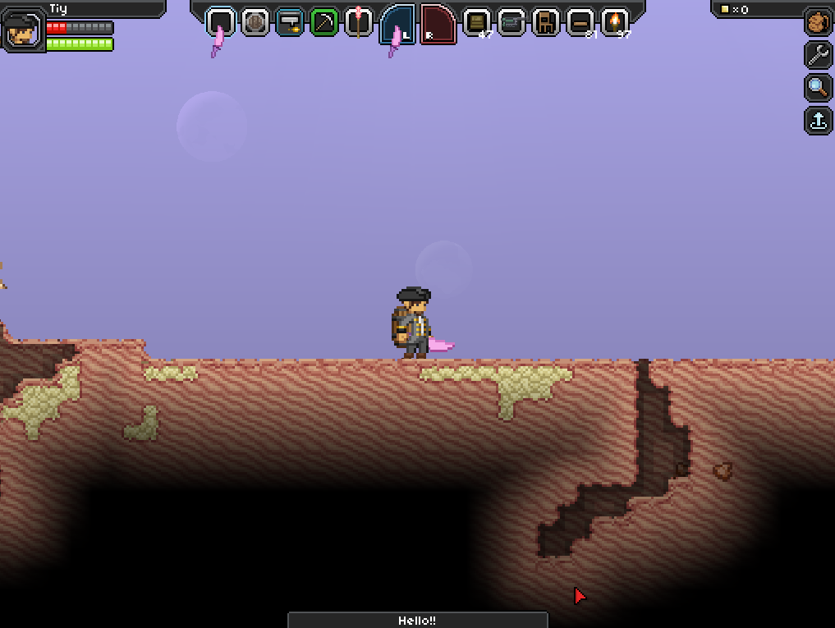
Game Summary – User Interface

Slide 8
Game Summary
Scoring
There is no overall scoring in the game as the game is entirely driven by the fact that players can build their own environment and play as they want. While they can progress through the storyline, no score is derived from the game.

Slide 9
Game Summary
Sound and Music
All the sound and music is composed by Curtis Schweitzer.
Special Features
All of the games special features and programming was developed by Catherine West, Michael Reilly, and Alex Lawson

Slide 10
Game Summary
Manual
All of the games manuals and resources are located at their wiki website: http://starbounder.org/Starbound_Wiki
Bugs
The developers rely on the players to report bugs to their forums. By making reports here they can track issues that are frequent and provide easy to access updates.

Slide 11
Game Review
What is good (fun) about the game? Why?
Playing on a private server offers friends a way to play together and form their own environment
The amount of items and customization available in the game provides endless ways to build and personalize it to your liking.
Its unique approach to a side scrolling game offers numerous hours of content to play through.
What is bad (not fun) about the game? Why?
A lot of the materials and resources are hard to find. A lot of investment has to be put into the game in order to adequately get what you need.
Players may find the necessity to look for external resources to help further game play.

Slide 12
Game Review
How does it compare to similar games in the same genre?
This game fairs well in comparison to Minecraft and other similar games. It offers a unique storyline and platform.
Why is it better or worse than similar games?
While you have vast options, other games have more developed quest lines that allow players to follow more structured play.

Slide 13
Game Review
What is the appropriate audience for the game?
The audience that would be best targeted for this game would be Teen. There is some crude language in the item names, and object names that would not be best suited for younger kids or children.
Are any design mistakes present?
The game was originally released in the Alpha stages so there were a few mistakes present. Thankfully over time the development team has remedied these.

Slide 14
Summary
Overall strengths
Vast variety of content
Multiple Play styles accomidated
Numerous hours of potential gameplay
Overall weaknesses
Limited Quest line
Some lore, but not much back story
2D Side scrolling provides limited depth

Slide 15
Summary
Is the game worth purchasing?
If you are a fan of sci-fy, action-adventure games then you will easily get your moneys worth. The games unique playstyle and content will give you challenges that are well worth the investment.
How could it be improved?
With constant feedback on the forums, the game is constantly being molded to popular requests from the public. With more active staff on the forums they will be able to better implement changes and suggestions to help further the progression of the game.

