Slide 1
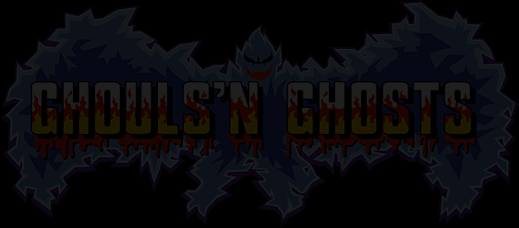
CIS 487 Game Evaluation
By: Aristotelis Papaioannou
9/21/2016

Slide 2
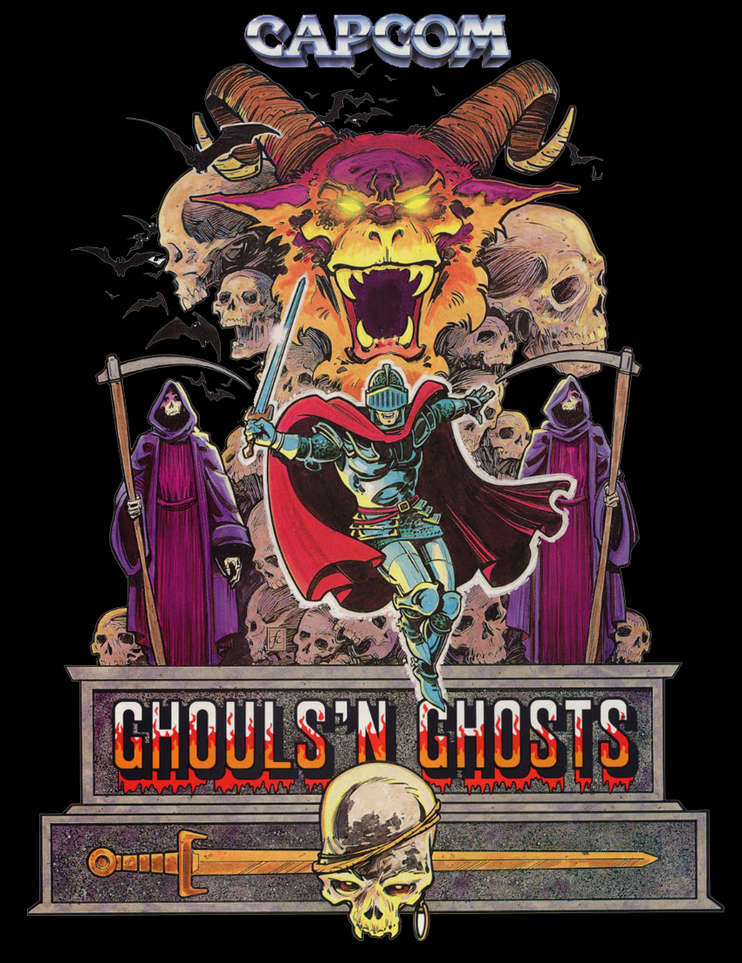

Slide 3
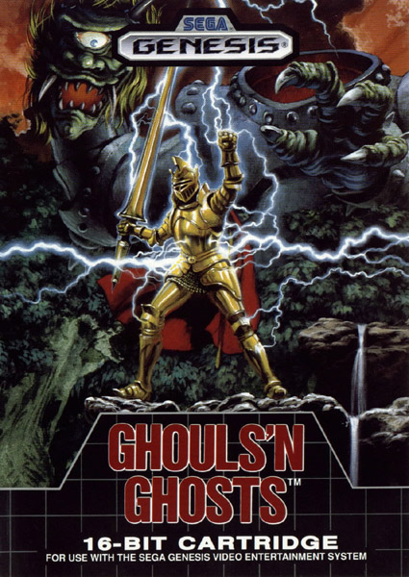
Basic Information
Game title: Ghouls ‘N Ghosts
Developer/Publisher: Capcom
Genre(s): Run and Gun, Platformer
Price: $70(1989), Factory Sealed $450(2016),
Loose $23(2016).
Hardware required: Sega Master Drive/Genesis

Slide 4
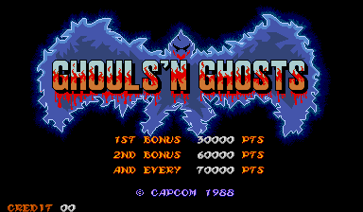
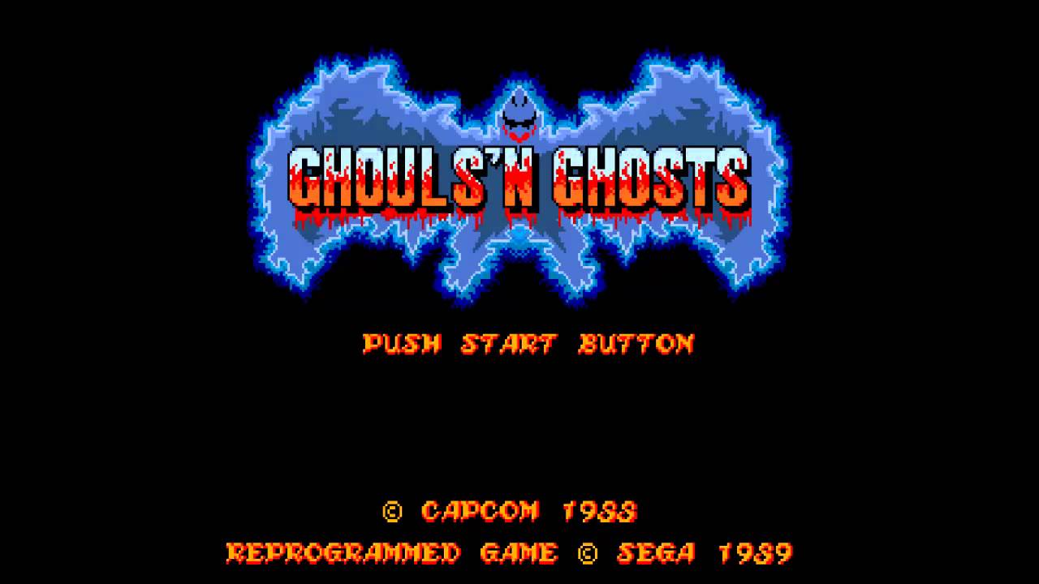
Game Summary
Quick Overview:
Ghouls ‘N Ghosts is a side scrolling action platform game developed and published by Capcom.
It was originally released as an arcade game in Dec. 1988, then in 1989(1990 in EU) it was ported to the Sega Master Drive/Genesis (and some other consoles).
The Genesis version omits some color and Background details from the arcade version, it also doesn’t have the opening intro
The Second game in the Ghosts ‘N Goblins Series

Slide 5
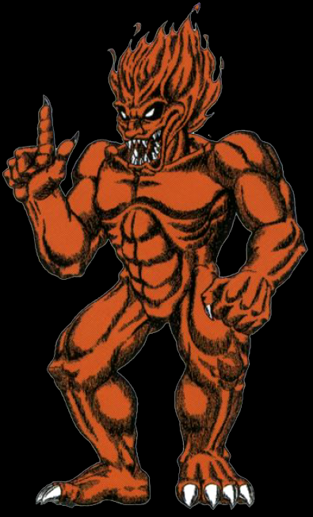
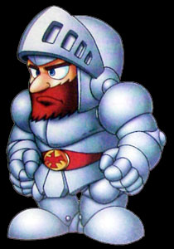
Game Summary
Story:
Set 3 years after Ghosts ‘N Goblins
Loki, the ruler of the Demons, takes the souls of everyone in the kingdom including Knight Arthur’s love Princess Prin Prin. So, it is up to Knight Arthur to restore everyone’s life.

Slide 6
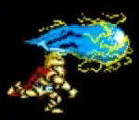
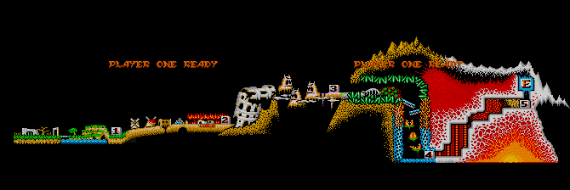
Game Summary
Player’s Role:
You play as Knight Arthur and need to beat the game twice(second run adds more enemeies).
You go through the game once beating 5 levels, then are sent back to the first level because you are not “Strong enough” to face Loki. After being sent back you are now able to get a new weapon, the Psycho Cannon, which is “needed” to defeat Loki.
Loki
Lvl. 1
Lvl. 5

Slide 7
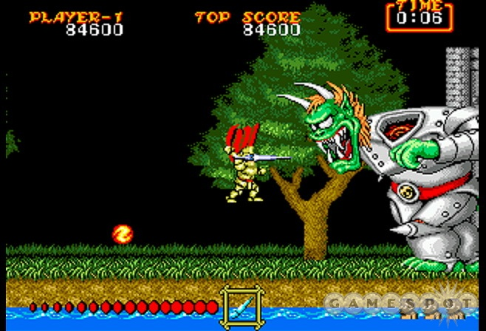
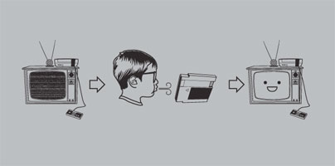
Game Summary
Installation:
Insert the cartridge into the Genesis, if that doesn’t work blow on the cartridge and try again.
User Interface
Simple Interface; Score in upper left, top score in the middle, time elapsed in the upper right, power bar bottom left(when you have gold armor), weapon in bottom middle, and finally lives in the bottom right corner.
Score
Top Score
Time
Power Bar
Weapon
Lives

Slide 8
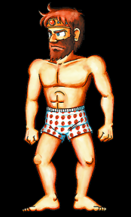
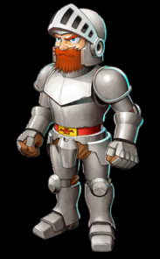
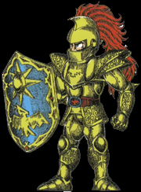
Game Summary
Gameplay
The Game is very stressful for the majority of the play through. However, it still is a lot of fun to play, the enemies will constantly pop up keeping you on your toes. Also, don’t punch the ground from the frustration, the vibration rattled the genesis which caused the game to restart. Instead, punch the closest person to you.
You start with your steel armor and can only be hit twice (even with gold armor). The Gold Armor allows players to charge up a weapon to release a powerful magical attack.
Concentration is key, you need to watch out for enemies, projectiles, and where you're going.
Chests are your friends (sometimes) because they can have golden armor, steel armor, weapons, or a wizard which can transform you into an old man or a duck making it even harder to survive.

Slide 9
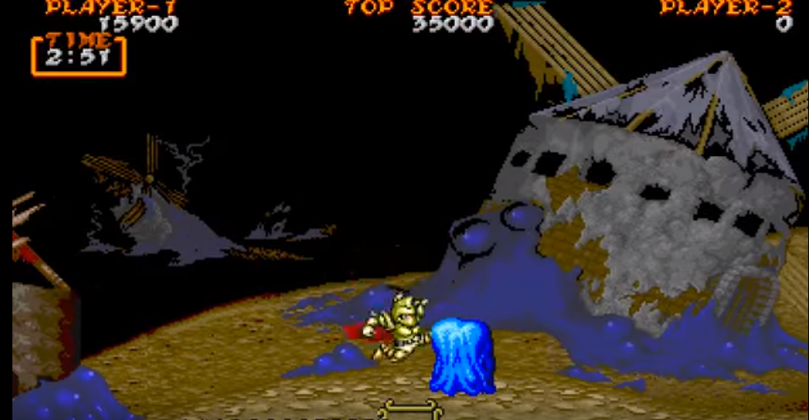
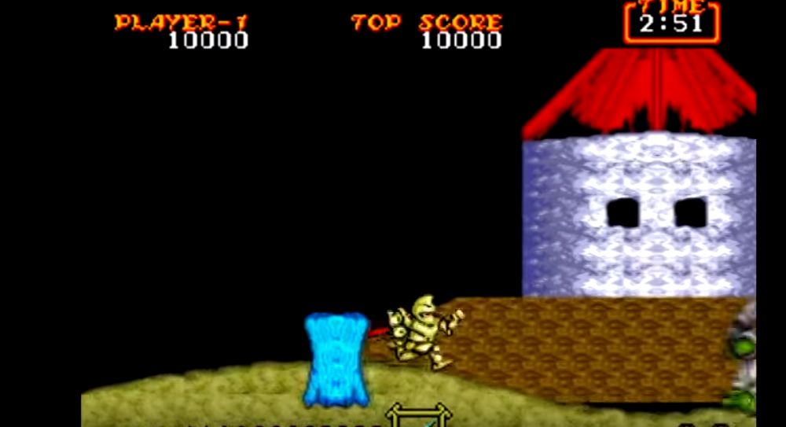
Game Summary
Scoring:
Killing enemies and completing levels will give you points. The most points come from completing a level (level complete bonus).
Artwork:
It is pretty detailed 16-bit artwork, I think everything looks good, except when compared to the arcade version, and nothing seems to be out of place.
Would of liked to have the more detailed art as seen in the arcade version. The arcade version also has a better/more detailed parallax scrolling.

Slide 10
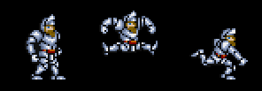
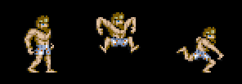
Game Summary
Sound and Music:
With the repetition of death, the opening notes of each song get more and more annoying until you find yourself screaming them at the start of your 30th life.
On the bright side, the soundtrack is pleasant, catchy, and seems well crafted.
The game also has some very good sounds for the weapons and the enemies. Everything has a distinctive sound.
When the game came out the reviews mention the games catchy soundtrack.
Special Features
Unlike its predecessor Arthur can attack in four directions.
Gold Armor was introduced.
Translated from Japanese

Slide 11
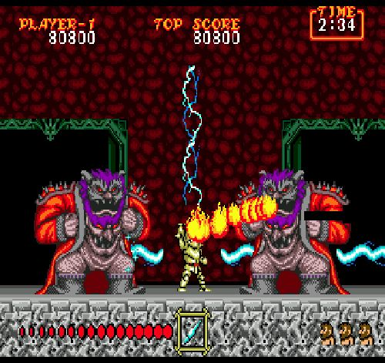
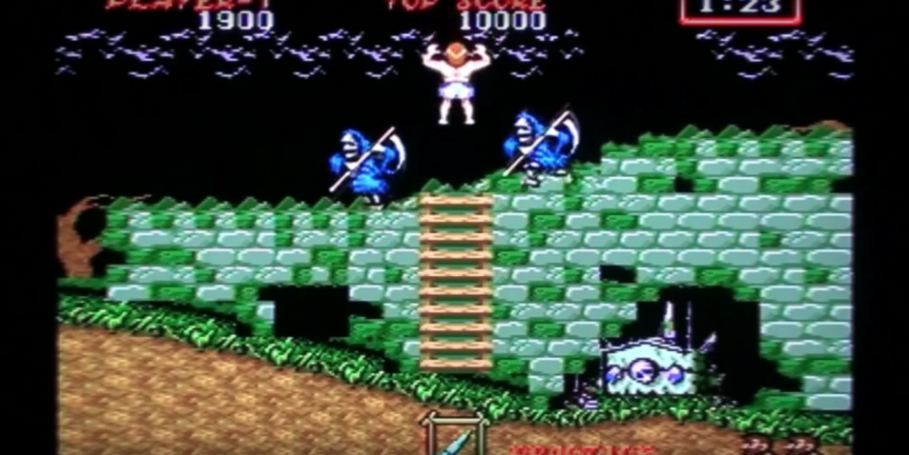
Game Summary
Manual:
The manual seems to be a basic manual; it explains how to load the game, the controls, the visuals, and what to expect in each level.
Bugs:
Did not encounter many in my play through.
Major one I encountered was the hitbox on certain enemies was different from the actual sprite of the enemy.
Another one I encountered is at a certain part of the game. When fighting two Lucifer's the fire breaths will sometimes glitch out and just be black bars going across the screen.
Another known glitch is being able to climb off the screen by climbing a certain ladder in the first level.

Slide 12
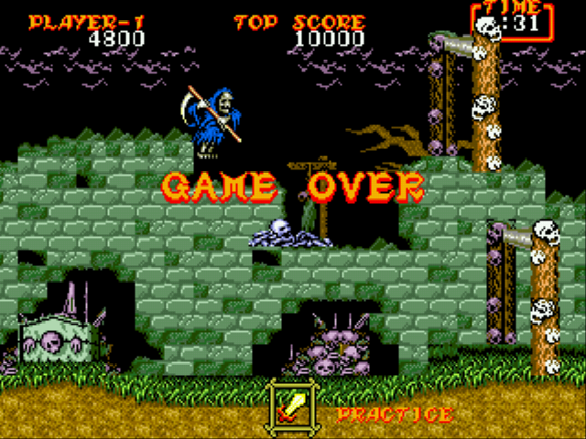
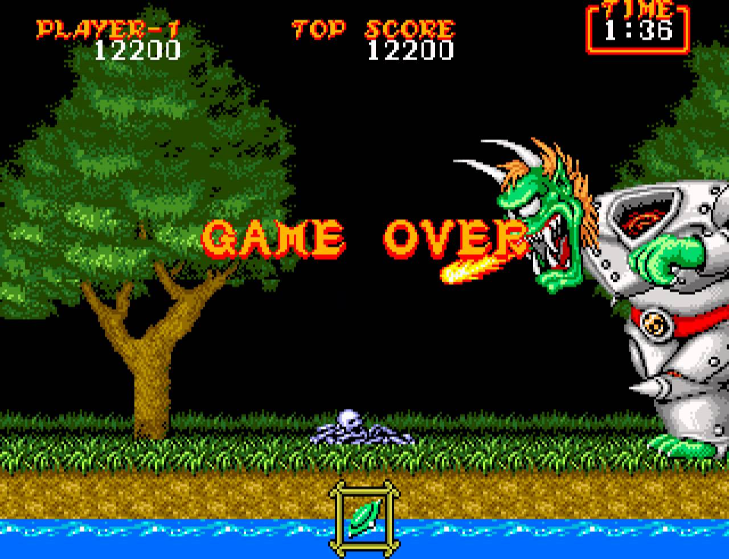
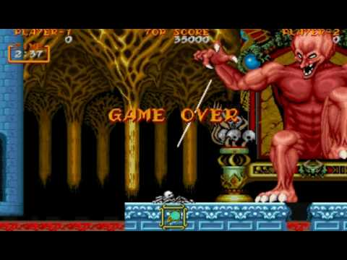
Game Review
What is good (fun) about the game?
The constant challenge and having to play smart.
Each level has a certain weapon that makes it easier to beat.
The enemies/bosses are creative and each require different tactics to kill them.
Each level is unique and has no repetition.
What is bad (not fun) about the game?
The amount of times you see the words Game Over on your screen.
The fact you have to complete the same game twice, would have preferred more levels.

Slide 13
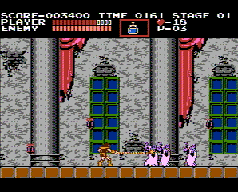
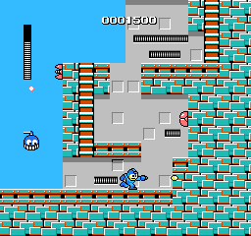
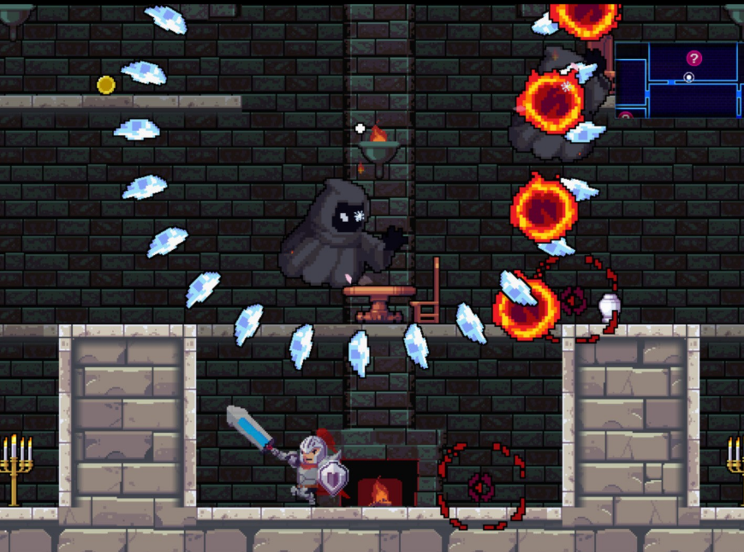
Game Review
How does it compare to similar games in the same genre?
Ghouls ‘N Ghosts is similar to games like Castlevania or Mega Man, the same concept is used in all three games and at some points they even play the same.
Why is it better or worse than similar games?
I would say the game is on par with the similar games, it is neither better or worse.

Slide 14
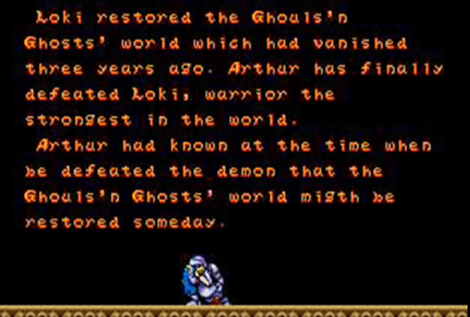
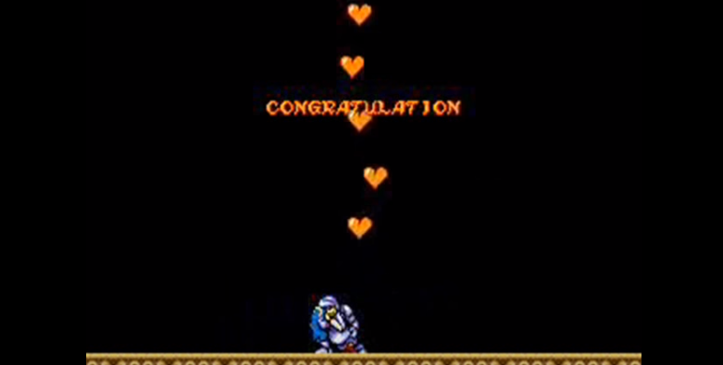
Game Review
What is the appropriate audience for this game?
The game is rated E for everyone, so I would say anyone that likes platformers.
Are any design mistakes present?
The game was poorly translated from Japanese to English. The best example of this is the epilogue or the fact it says “Congratulation” when you save Prin Prin.

Slide 15
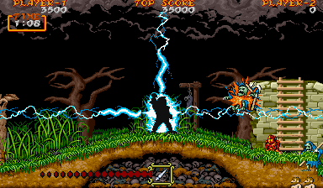
Summary
Overall:
The strengths of this game would be the unique enemies, cleverly designed levels, gameplay, and the sounds/music.
The weaknesses of this game would be the downgraded artwork from the arcade version and lack of more levels.
Is it Worth the Price?
A loose copy for $20 bucks is worth it, but the 1989 price ($70) is way to much.
How could it be improved?
Rather than having the player beat the five levels twice just add more levels.
Fix the broken English.

Slide 16
