Slide 1
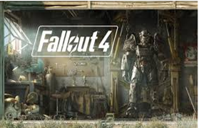
(Xbox One)
Review done by:
Luke Pacheco, CIS 487 – 09/20/16

Slide 2
Basic Information:
Fallout 4
Developed by Bethesda
Post-Apocalyptic Action/Adventure RPG
Pricing at release: Base game, $59.99 for all platforms. Season pass for all DLC, $29.99. DLC sold separately for different prices each DLC. Current price: $39.99
First or Third Person shooter
Linear storyline and non-linear side stories.

Slide 3
Hardware Requirements
Xbox One and Playstation 4 consoles are already outfitted with proper hardware requirements.
PC Minimum Requirements consist of:
Operating system: Windows 7/8/10 (64-bit OS required)
Processor: Intel Core i5-2300 2.8GHz / AMD Phenom II X4 945 3.0GHz or equivalent.
Memory: 8 GB RAM.
Hard disk space: 30 GB free HDD space.
Video: NVIDIA GTX 550 Ti 2GB / AMD Radeon HD 7870 2GB or equivalent.

Slide 4
Game Overview
Expansive open-world roaming.
Multiple levels of difficulty that can be chosen at character creation and again at any point throughout the game, switching back and forth at will.
Ability to save anywhere as long as it is not during combat.
Large amount of side-quests allow for players to progress in levels without being constantly beaten in the main quest.

Slide 5
Storyline & Player’s Role
The main story focuses around a father (if chosen a male character) or a mother (if chosen a female) rescuing their newborn who was stolen from them after they awake from a cryo-sleep. The player tries to make their way through the environment, making plenty of friends and enemies along the way and choosing sides.
There are a vast amount of side-story questlines involving allies, enemies, and other random NPCs.
Use your character skills, chosen by you, to either use your physical or mental abilities, and sometimes both, to fight, stealth, negotiate, and intimidate your way through your opponents.

Slide 6
User Interface & Gameplay
Health/Radiation Based
Skills, Perks, Special weapons (melee and ranged)
V.A.T.S (Vault-Tec Assisted Targeting System)
AP (Action Points) spent during V.A.T.S interface
Interactive Map (Follow quests, fast travel, waypoints)
Player choice-based conversation

Slide 7
Visual and Audio Ambience
Visual:
Post-apocalyptic version of Boston, Massachusetts in 2287.
Destroyed buildings, desolate wastelands, radiated food and water.
Day and Night cycles that affect enemies and players.
Audio:
Radio stations (Both real-world and non-real world songs)
Each radio station is themed (40s-60s Music, talk radio)
Some channels that relate to questlines and story missions.

Slide 8
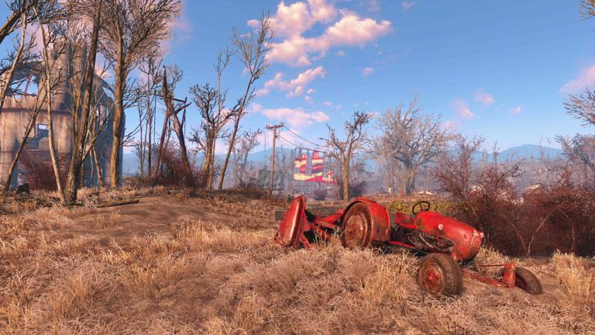
The Wasteland

Slide 9
Bugs
https://www.youtube.com/watch?v=UMYEs7LT3_o Part 1
https://www.youtube.com/watch?v=Aw5xxwjNoR4 Part 2
The game had many graphical bugs and glitches at release like characters disappearing, dialogue skipping or repeating, and UI not responding, some of which have been fixed. There were also a few game breaking bugs that cause games to crash and save files to corrupt that happened when following certain questlines.

Slide 10
Game Review
What is good about the game?
Fallout 4 is a very fun game. It provides a shooter-style experience in an RPG-style game without trying to favor one over the other.
Insane amounts of replay-ability, plentiful content and questlines.
Plenty of options to create each experience feel like a new game.
What is bad about the game?
The game features lots of bugs and glitches which can make it annoying to player at certain points.
Tried to do too much. Many aspects were not polished and tested.

Slide 11
Comparison to similar games
Mass Effect Series: It shares several aspects like choice of dialogue, companions, open-world, and both linear and non-linear quests. Personally I prefer Mass Effect because overall it feels more polished and finished, and the story is more to my liking.
Borderlands: The similar combat (shooter RPG) makes this an interesting choice. It’s less buggy than Fallout, but can’t even hold a candle to the content in comparison to Fallout. Personally Fallout 4 is a better game to me.

Slide 12
Design Mistakes
While some people may find these to be pros instead of cons, some of Fallout 4’s glitches allow players to access high level armor and weapons at low levels. The point of an RPG is to start small and work your way to something big, rather than just start out destructive and never falter or feel unsafe.

Slide 13
Overall Summary
Overall, the game is buggy and can be overwhelming to some players, or too non-linear, but the combat system, the ability to customize your character, chances to attribute upgrades as you like, and the uniqueness of choosing your own dialogue make it so much fun to play.
Rating: 8.5/10
Improvements?
More testing for glitches and patches to fix bugs.

