Slide 1
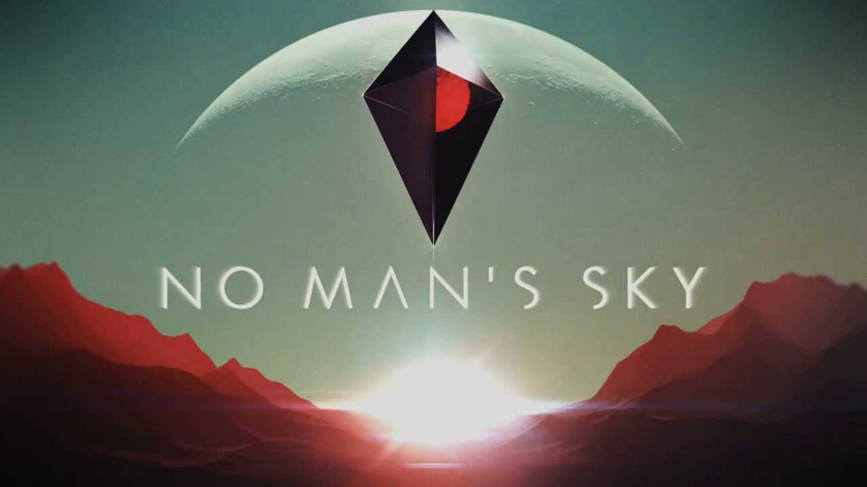
Mohamed Nasrallah
CIS 487
9/21/2016

Slide 2
Basic Information
Company & Author:
Publishers: Hello Games, Sony Interactive Entertainment
Developer: Hello Games
Designer: Gareth Bourn
Type of Game:
Action-adventure survival
Price: $59.99
Minimum stated hardware requirements:
CPU: Intel Core i3
RAM: 8 GB
OS: Windows 7/8.1/10 (64-bit versions)
Video Card: nVidia GTX 480, AMD Radeon 7870
Free Disk Space: 10 GB
Actual hardware required: PS4 or Windows PC (with min requirements listed or greater). 1 Controller for PS4, mouse and keyboard for PC.
Release date: August 9, 2016

Slide 3
Game Summary
Quick overview
A science-fiction game set in an infinite procedurally generated galaxy
Story line (if any)
No real story line.
Player's role
Player is thrown into a universe, looking for resources to maintain survival and traveling equipment. Mining resources is the main objective. This is required to rebuild health, and to upgrade equipment and space ship.
Installation
Very fast and easy. Game size is under 10gb. (My game with current updates on the PS4 is roughly 6gb)
User Interface
Good user interface. Menus are easy to navigate

Slide 4
Game Summary (cont.)
Game Play
Gameplay in terms of mechanism is FP/RPG. The gameplay also includes cockpit spaceship shooting, and puzzles via trivia.
Scoring
Scoring is mainly dependent on discovery. The more planets, animals, and minerals you discover and upload, the more points you accumulate.
Artwork
Artwork is mainly consistent with vivid colors and landscapes with randomly generated animals and open skies. (Examples in next slide.)

Slide 5
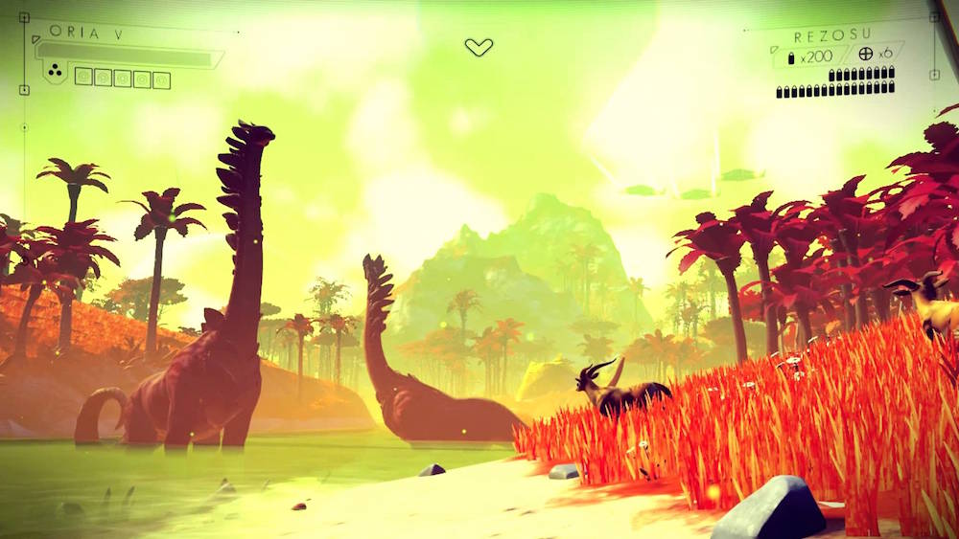
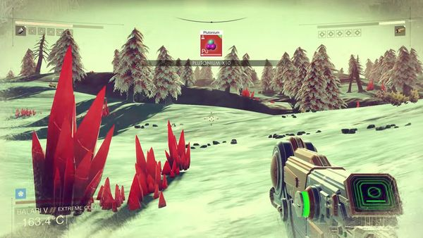
In- Game Images

Slide 6
Artwork

Slide 7
Sound and Music
Sounds are very fit for the genre. Derived from Sci-fi and epic tracks. Very wide use of instruments. Soundtrack is also linked below and is available for sale on online stores for $12.99.
Full soundtrack: https://www.youtube.com/watch?v=EZMJPNekzds

Slide 8
Game Summary (cont.)
Special features
This game is basically specialized with the way its algorithm is built to create infinite player fields. The planets are not the same for any 2 players. The algorithms also are based off the processor of some machines, where the developer said that the PS4 and the upcoming PS4 Pro will generate worlds a bit differently. All the planets, environments, resources, and creatures made within them are randomly generated. This is what made the game really hyped up from the developers to the audience.
Manual (if any)
Manual is included within the help section of the menus. No hardcopy manual included.
Bugs
Game is released in a very rushed form, plenty of bugs and crashes. The game has received 9 updates from August to September (one month since release), with more promised fixes to come.

Slide 9
Game Review [5/10 Steam] [71% Metacritic]
What is good (fun) about the game? Why?
In the beginning, the game was exciting, where curiosity of what was to come next made it fun. Getting the resources from a huge planet you were based on really made it intriguing. Going onto the other planets, and buying new ships really got me at first.
What is bad (not fun) about the game? Why?
Although the previous GOOD things of the game were just stated, they turned into the bad things also after time. The game gets oddly stale with the more time its given. Going to different worlds and mining the same things, doing the same stuff over and over again with no story really tore the game apart.

Slide 10
Game Review (cont.)
How does it compare to similar games in the same genre?
The game does not live up to the hype of what a sci-fi action RPG was expected to be.
Why is it better or worse than similar games?
Worse. Lacks creativity. The creativity is solely based on an algorithm that feels flavorless with its randomly generation and lack of story.
What is the appropriate audience for this game?
People who don’t mind doing the same thing over and over again, not advancing in levels or dealing with bosses.
Are any design mistakes present?
The main design mistake was what seems to be the main complaint by people: What’s the point of this game? (This caused major buyer’s remorse and refunds at times. It bent refund policies at some online retailers)

Slide 11
Summary
Overall strengths and weaknesses.
Strengths of the game is the way its trying to be different and exploring what randomly generating algorithms are possible of doing when creating various worlds for the players
Weaknesses is that aside from walking around and mining for resources, it really lacks flavor. The game seems to take a twist on Mine Craft, but failing with a poor attempt.
Is the game worth purchasing?
It was reported on some news sites that the game lost 90%+ of its player base. This caused it to not be worth purchasing, and its available as a used title at many stores in excessive quantities.
How could it be improved?
Implement free DLC to existing copies via downloadable updates, containing story lines and other things to add objectives. Include those updates with new copies of the game to make it seem like it’s the original intention of how the game was meant to be played.

Slide 12
Gameplay and Popular Review Videos
New disappointment discovered : No Man's Sky
https://www.youtube.com/watch?v=A8P2CZg3sJQ
No Man's Sky: 21 Minutes of New Gameplay - IGN First
https://www.youtube.com/watch?v=D-uMFHoF8VA

