Slide 1
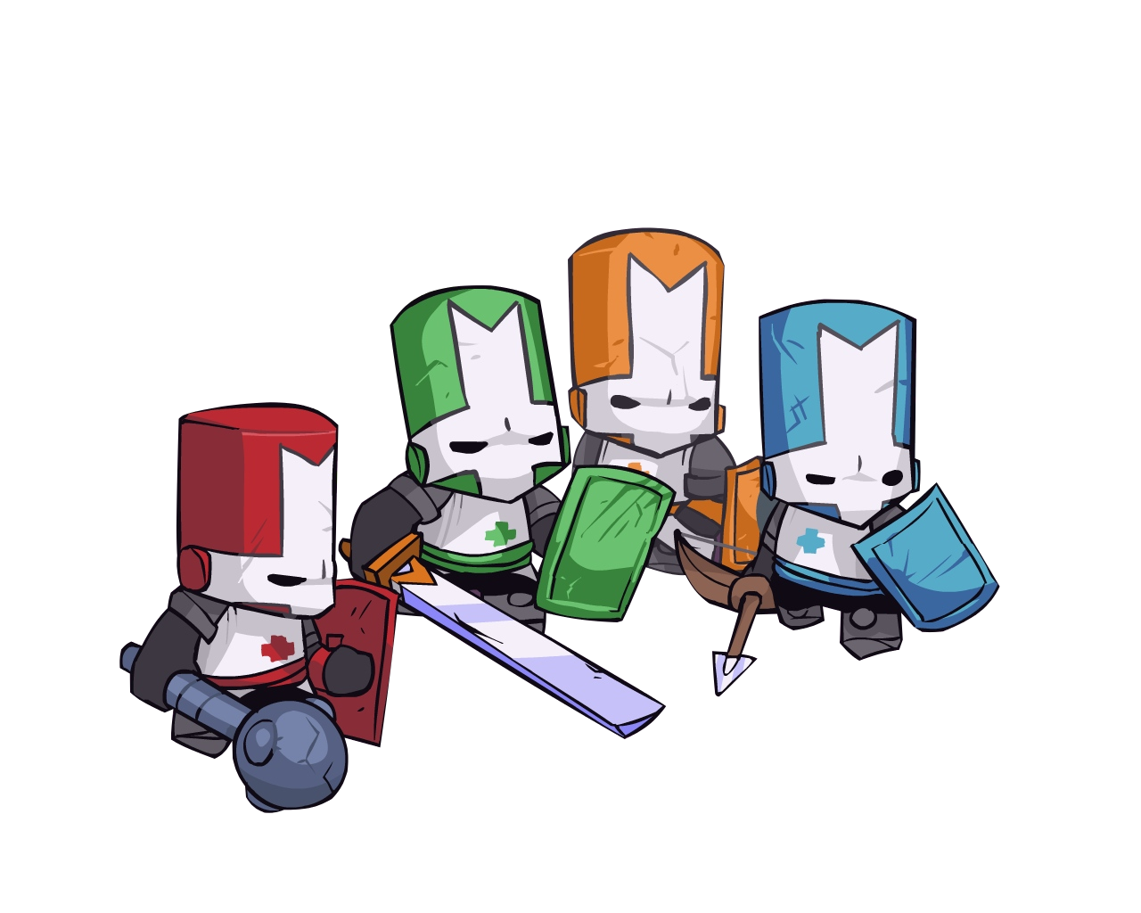
Castle Crashers
Alex Myers
CIS 587 – Fall 2016
Assignment 1 – Game Evaluation

Slide 2
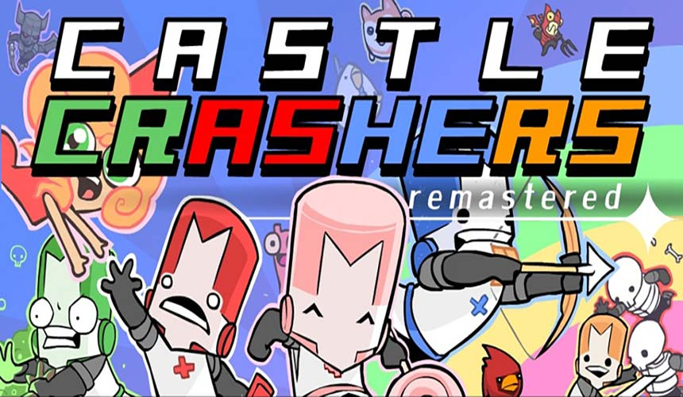
Basic Information
Title:
Castle Crashers
Developer:
The Behemoth
Publisher:
The Behemoth
Microsoft Game Studios (Xbox)
Sony Computer Entertainment (PlayStation)
Genre:
2D Hack and Slash
Action RPG
Release Date:
Original: August, 2008
Remastered: September, 2015
Platforms:
Original: Xbox 360 PlayStation 3 / PC
Remastered: Xbox One / PC.
Price:
Main game: $14.99
DLC packs: $1.99 each
There are 3 DLC packs which contain extra characters and weapons.

Slide 3
Basic Information (Cont.)
The minimum requirements for PC are as follows:
OS: Microsoft® Windows® XP / Vista / 7 /
Processor: Intel Core 2 Duo 2GHz+ or better
Memory: 1 GB RAM
Graphics: 256 MB video card
DirectX®: 9.0c
Hard Drive: 255 MB HD space
Sound: DirectX compatible
Other Requirements: Broadband Internet connection
Additional: Ultra Graphics Mode requires a 64-bit OS, at least 4GB of RAM, and a 2GB VRAM.
The minimum requirements should be close to the actual requirements. The game is not graphically intensive, especially without “Ultra Graphics Mode” which was added in 2015 when the game was remastered.
Installation:
This game is only available digitally, so installation simply requires downloading the game from the chosen platform’s respective digital store.
Xbox - Xbox Live Arcade
PS3 - PlayStation Store
PC - Steam

Slide 4
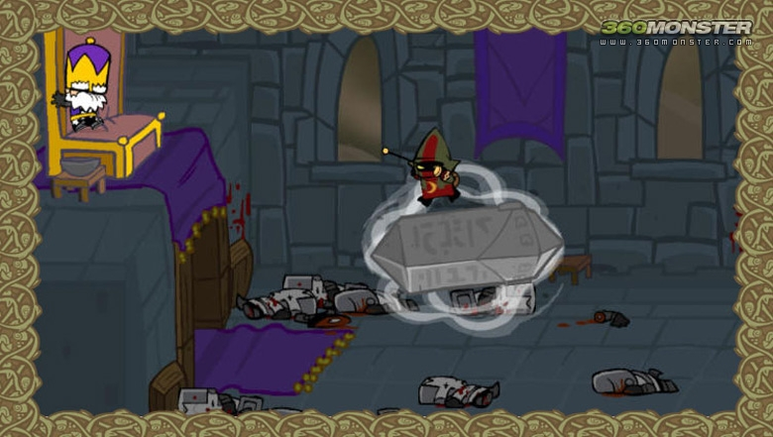
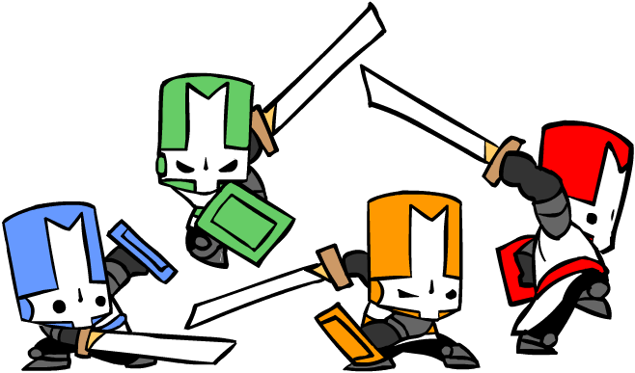
Game Summary
Overview
Castle Crashers is a fast-paced action RPG that is playable with 1-4 players (online or offline). It incorporates several RPG elements such as gaining experience and leveling up to increase stats.
Story:
Castle Crashers takes place in a fictional medieval setting where the main characters are four knights, each named by the color of their armor.
At the start of the game, four princesses are kidnapped by a dark wizard. This prompts the king to send the four knights on a quest to rescue the princesses and destroy the wizard.

Slide 5
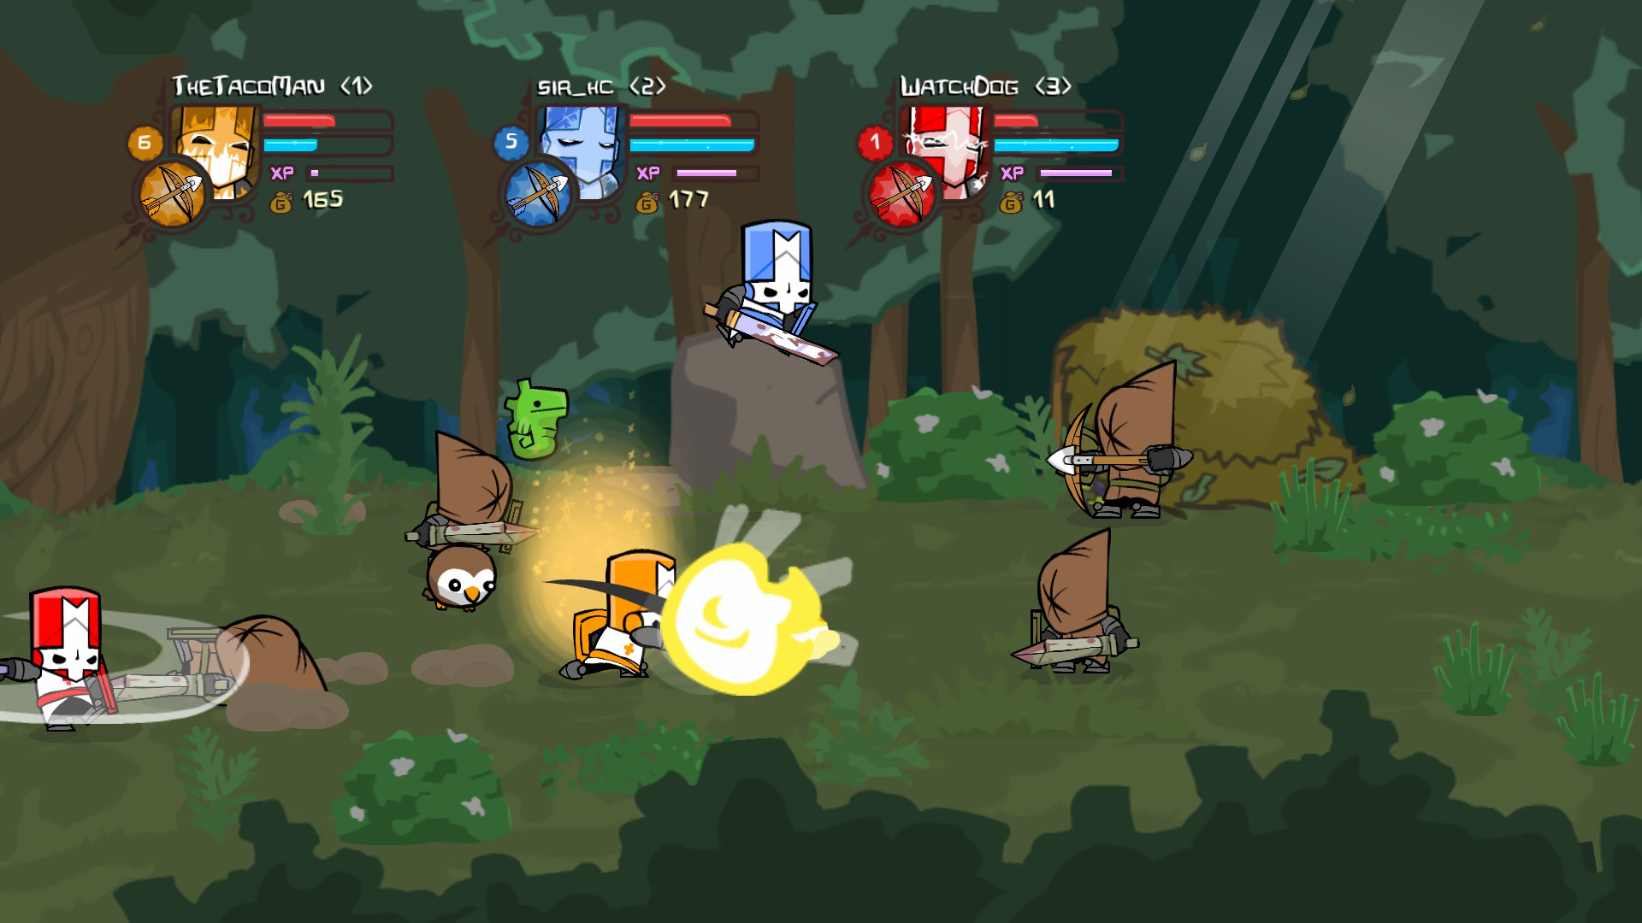
Game Summary (Cont.)
Player’s role:
The player takes control of one of the four knights. Their goal is to destroy all enemies/obstacles on their path to save the four princesses.
User Interface:
The UI is minimal and only displays each player’s health, magic, and experience bar, as well as their gold and currently selected item.

Slide 6
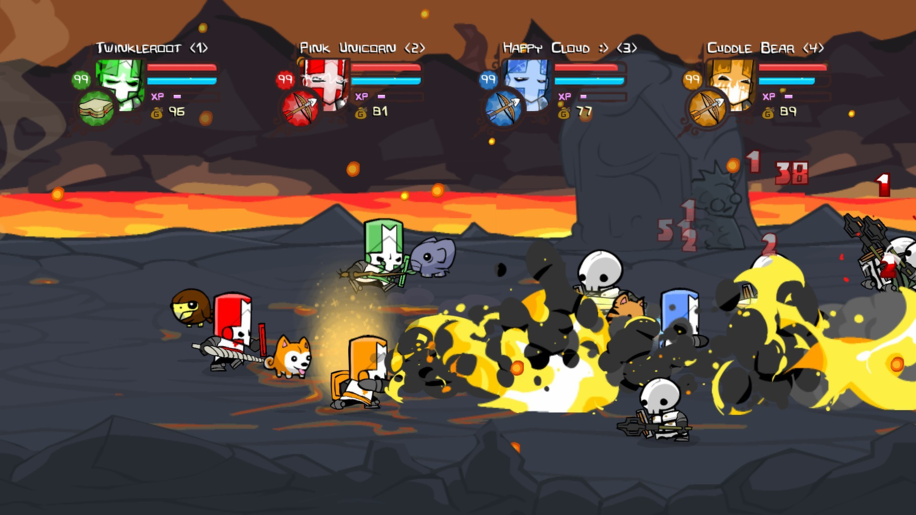
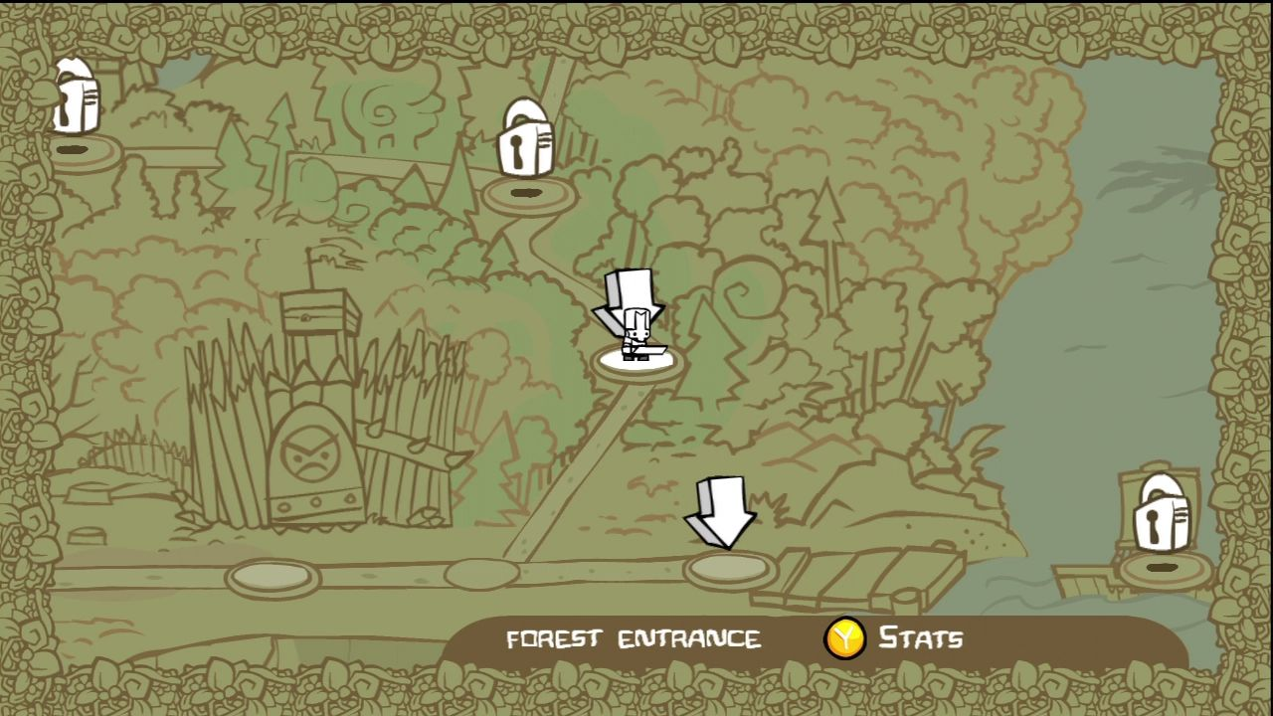
Game Summary (Cont.)
Gameplay:
Sidescrolling co-op adventure
The story can be played alone or with up to 4 players.
The players destroy enemies through various means:
Melee weapons (swords, axes, etc.)
Magic abilities
Bow and arrow
Gameplay is fast paced and the combat is very simple.
Progression is linear. However, the player can go back and replay previous levels at any time by selecting them on an overworld map.

Slide 7
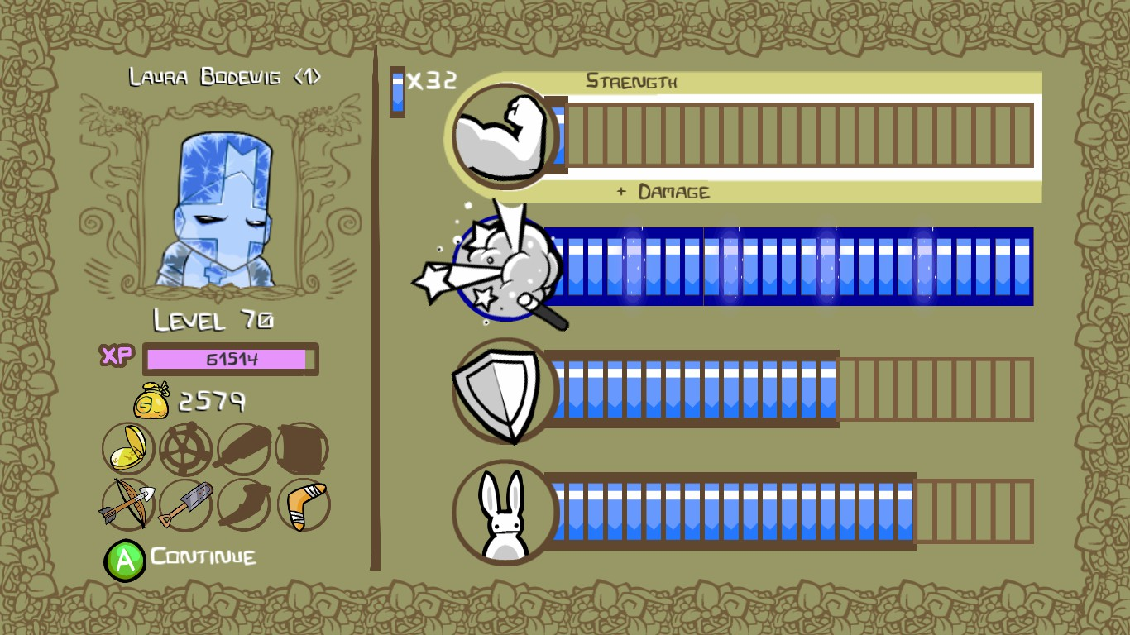
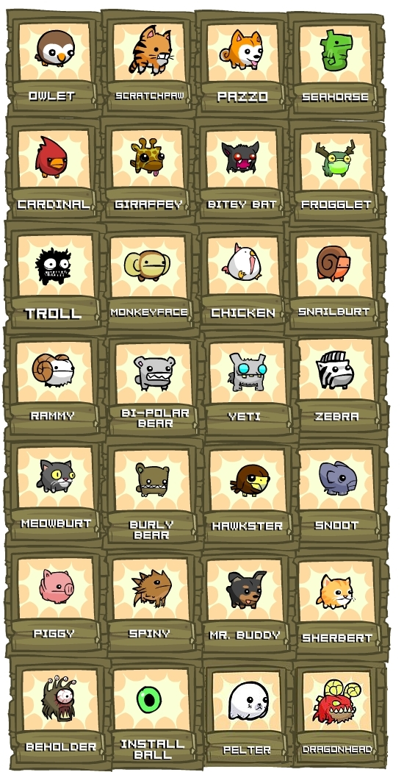
Game Summary (Cont.)
Gameplay (cont.):
RPG Elements
Throughout the adventure each player earns experience based on how much damage they have dealt, and they can use this experience to level up their strength, defense, magic, or agility.
Strength – Melee weapon damage
Magic – Magic damage and abilities
Defense – Health
Agility – Movement speed and bow damage
You can find animal companions and weapons throughout the game to further increase your stats.

Slide 8
Game Summary (Cont.)
Scoring:
There is no formal scoring system in Castle Crashers. At the end of each level the game displays the amount of experience and gold earned by each player, but this is more of a summary than a goal.
Artwork:
The entire game consists of a polished cartoon art style.
Sound and Music:
The sound effects and music are also cartoonish in style, and go well with the art style.
The tracks range from serious to silly and help set the tone for each level.
The music was created by several members of the Newgrounds website.

Slide 9
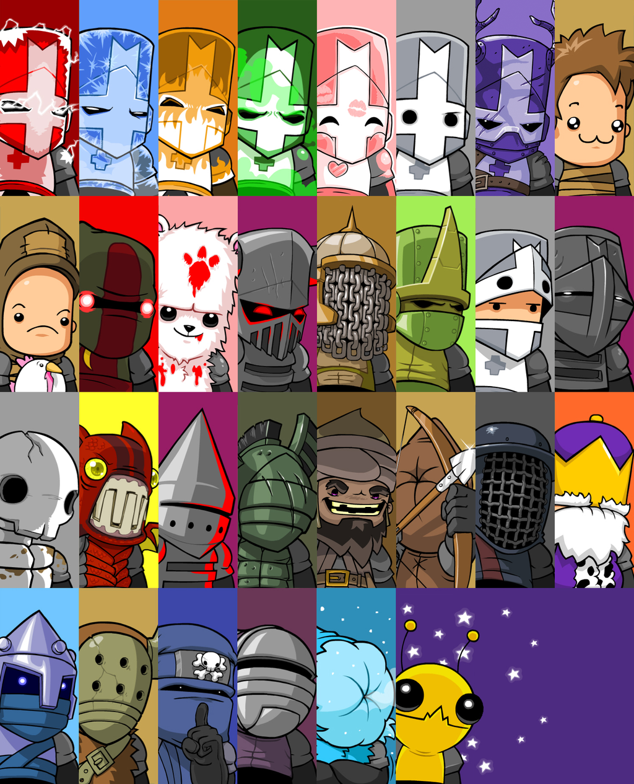
Game Summary (Cont.)
Special Features:
Achievements
Bonus characters with unique abilities
When the player beats the game with certain characters, a new character is unlocked. New characters typically have a unique magic ability.
Collectibles
There are many weapons and animal companions to search for.
Mini games
There are several mini games that are playable with up to 4 players offline or online.
New Game+
Once the game is completed with a character, that character has the ability to play through the game again on a harder difficulty.
Bugs:
There are no obvious bugs in this game. However, it has been reported that some players have had issues with online matchmaking features.

Slide 10
Game Review
Good:
The combat and level up systems are simple yet fun, allowing it to be enjoyed by players of any skill level.
The art style, music, and characters are unique and allow the unoriginal story to be executed in a completely original and memorable way.
The AI is just smart enough to provide an appropriate challenge level for the player given the style of game.
Strong Replayability
The ability to find new weapons, and animal compansions, as well as to unlock new characters after each completed game makes it so the player will find playing through the story multiple times to be satisfying.
The players can play in different ways based on their stat point distribution (e.g. magic vs. melee).
Good co-op System
The co-op and level up system promotes an active style of play from each player. They have a common goal with their teammates to beat the level and the goal of getting as much experience as possible for themselves by killing enemies.

Slide 11
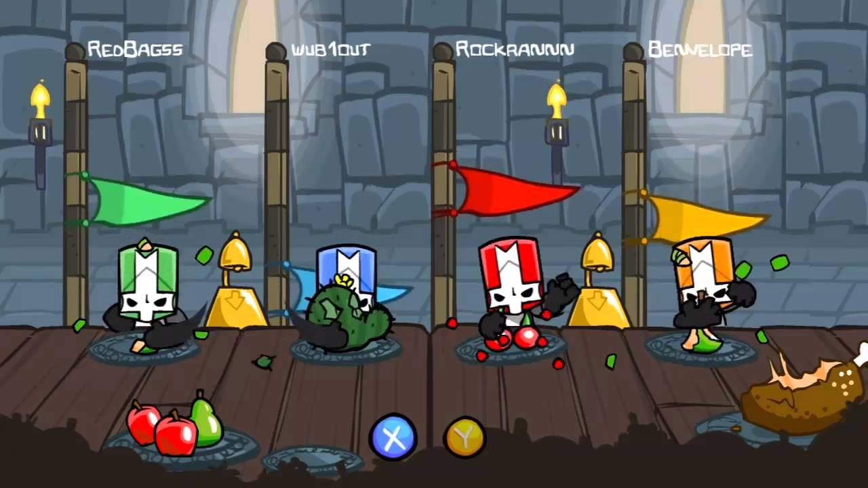
Game Review (Cont.)
Bad:
No compelling reasons to play the game on hard mode.
Some achievements are not fun (e.g. winning a mini game 20 times that requires pressing 2 buttons as fast as you can for 30 seconds).
The character unlock system is hidden so players have to go online to figure out which characters they have to beat the game with to unlock new ones.
“All you can quaff” mini-game. Press X & Y fast repeatedly to eat as much food as possible.

Slide 12
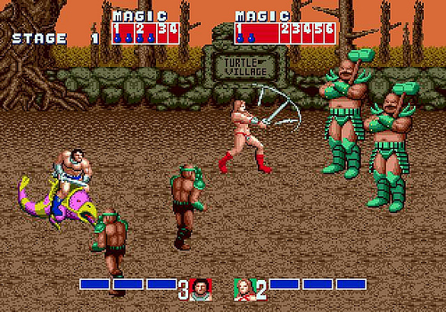
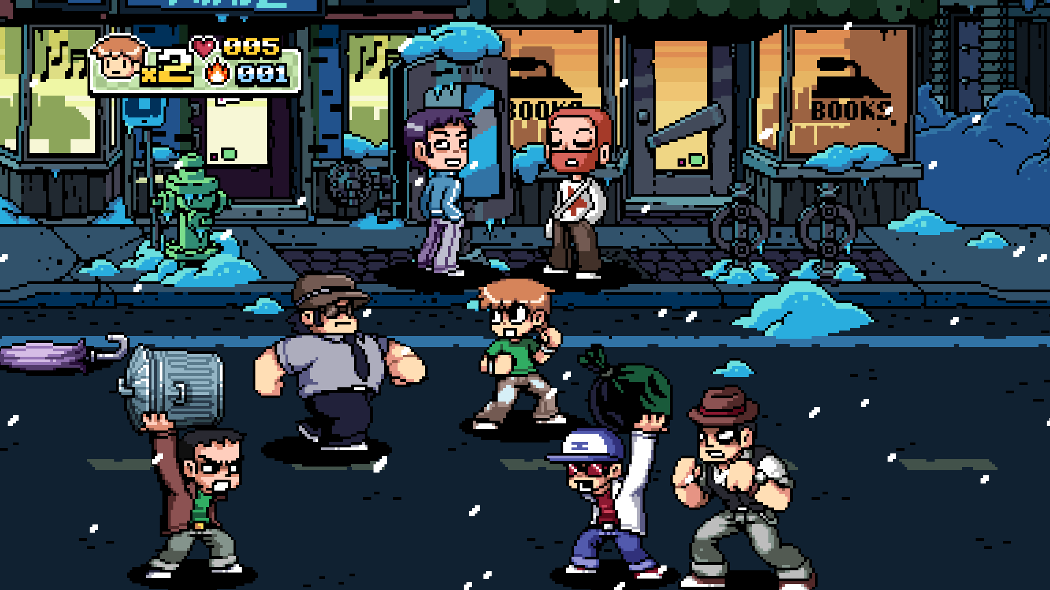
Game Review (Cont.)
Comparison:
This game can be compared to any other 2D side scrolling RPG that requires destroying waves of enemies to progress. This includes games such as Golden Axe, and more recently, Scott Pilgrim.
Art style aside, I feel Castle Crashers is better than other games in its category because simple combat and co-op systems allow for more variety in play style. Additionally, it has more collectibles and reasons to want to replay the game.

Slide 13
Game Review (Cont.)
Audience:
The game could be enjoyed by anyone who appreciates classic side scrolling adventures or RPGs.
Castle Crashers has an ESRB rating of “Teen.”
It contains blood and gore, cartoon violence, and crude humor.
Helps draw a younger audience
Design Mistakes:
None noticed

Slide 14
Summary
Strengths:
Simple and effective combat/level-up/co-op systems
Unique art style
Appropriate AI
Plenty of collectibles and other reasons to play the game multiple times.
Online play
Weaknesses:
Hidden character unlock system
Mini games are not great
Hard mode has few tangible rewards

Slide 15
Summary (Cont.)
Is the game worth purchasing?
Yes. For $14.99, this game is well worth a purchase. While the main story can be completed in around 4 hours, the replayability and co-op features can easily keep someone playing for 20+ hours.
How could the game be improved?
There are no changes I would make to the mechanics of this game. However, I would add additional rewards to the hard mode of the game to encourage players to go through it at least once. Additionally, I would consider altering achievements to ignore the mini games or just remove the mini games altogether.

