Slide 1
Dominions 4:
Thrones of Ascension
Lucas McIntyre

Slide 2
Game Information
Title: Dominions 4:Thrones of Ascension
Dev: Illwinter Game Design
Genre: Grand Strategy
Price: $40

Slide 3
Requirements
Game Information
OS: Windows XP/Vista/7
Processor: 1GHz
Memory: 1024MB
Storage: 500MB

Slide 4
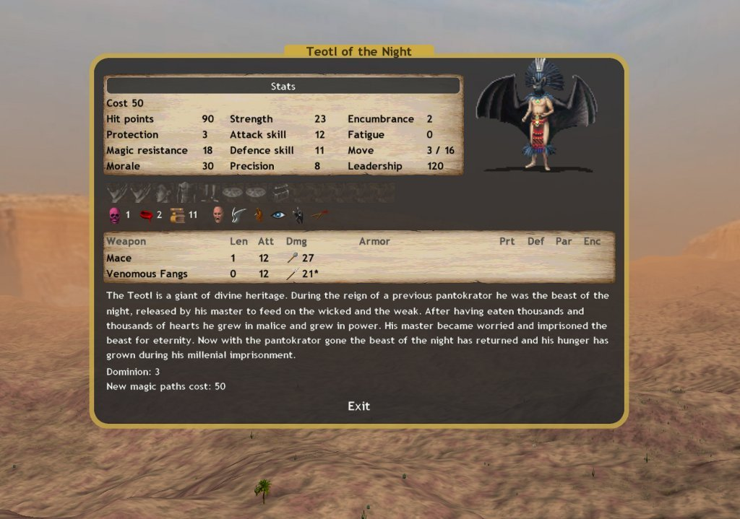
Story/Lore
The God of the land (Pantokrator) has left the World
Play as a Pretender God left behind by Pantokrator
Defeat the other Pretenders and claim the throne of the World for yourself

Slide 5
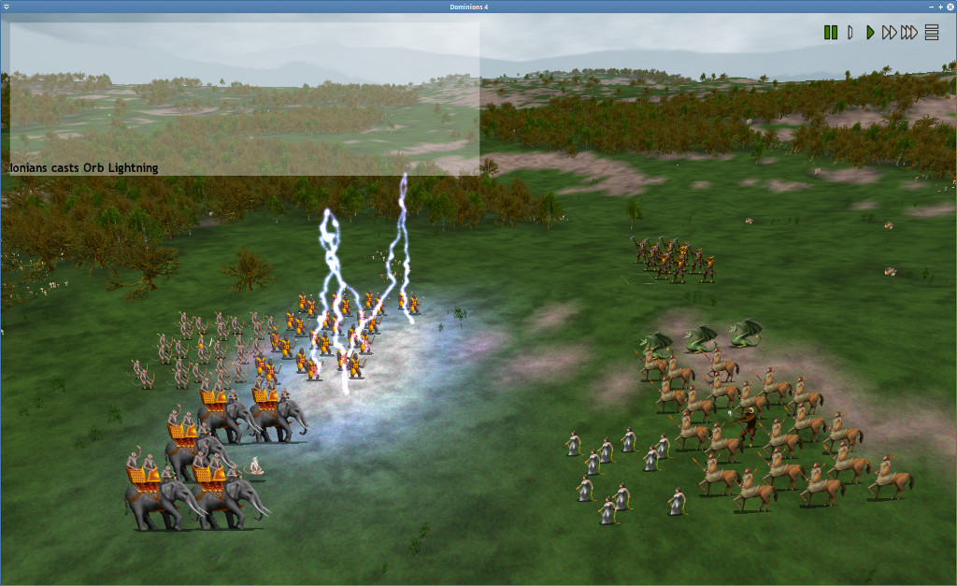
Gameplay/Scoring
Turn-Based Grand Strategy
First part of the turn has you constructing buildings, recruiting, and managing units
Second part of the turn automatically resolves battles based on where the armies moved the first part of the turn
Game finishes when the win conditions set before the match are completed
Main mode involves taking and holding the thrones of Ascension on the map

Slide 6
Graphics/Sound
Entirely Sprite based and static images
No animation at all
Sounds effects are only used for the user interface and battles and are both low quality, and do not fit the action they’re used with
Music is nice, but quickly becomes repetitive since it is a 30 minute loop

Slide 7
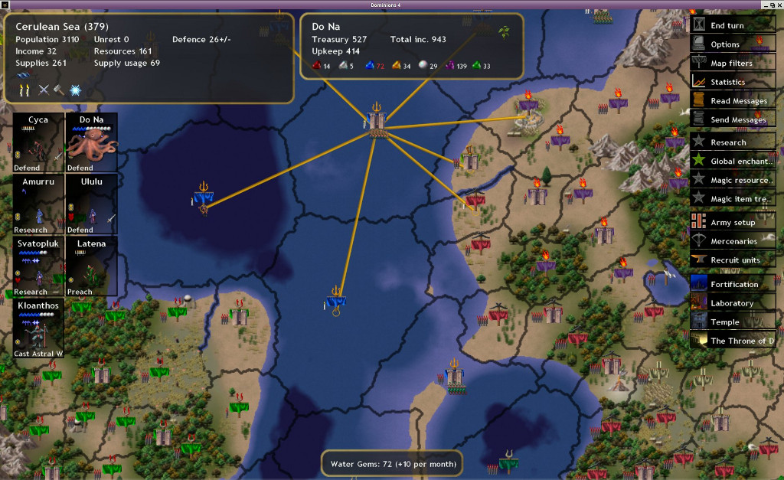
User Interface
Top down view of the world map
Lots of mouse driven menus with few hotkeys
Buttons are ugly and do a poor job of communicating function

Slide 8
The Good
Amazing Variability every game
Procedural Generation
Dozens of factions, pretenders, and abilities
Balanced gameplay with a little bit of luck
Defeating other players is mostly due to skill, but even a worse player can get lucky with the RNG and come out on top
Play the game you want to play
Finding your own strategies and synergies is very satisfying

Slide 9
The Bad
Poor Presentation
Sound/music and graphics lessen the experience
Confusing User Interface
Poor UI controls and visuals make the game frustrating to traverse through
Late game management
Due to poor UI and few in game tools the end of a game came be very difficult to manage all of the different units you have

Slide 10
Compared to other games in the genre (Civilization 5)
Why is it Better?
More customizability and choices in a genre famous for its meaningful choices
More strategy involved in battles
Why is it Worse?
Very poor Interface
Poor and confusing visuals
Bad sounds/music
Poor late game management

Slide 11
Is this game worth buying?
Intended Audience
Hardcore Grand Strategy Game Fans
Not an introduction game
$40 is still a little much wait for a sale

Slide 12
Improvements
Improve Visuals
Keep a consistent art style and clearer images
More Efficient User Interface
New names and visuals for buttons
More hotkeys to navigate through menus
More Management Tools
Automation or better group selections and actions

