Slide 1
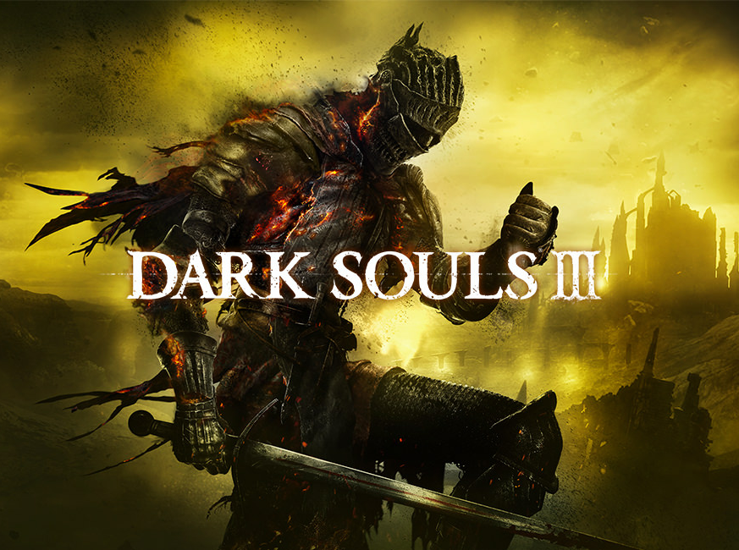
Game Evaluation
By Griffin McCormick

Slide 2
Basic Information
Dark Souls III
Bandai Namco Entertainment
FromSoftware
RPG/Action-Adventure
$59.99

Slide 3
System Requirements
MINIMUM:
Processor: Intel Core i3-2100 / AMD® FX-6300
Memory: 4 GB RAM
Graphics: NVIDIA® GeForce GTX 750 Ti / ATI Radeon HD 7950
RECOMMENDED:
Processor: Intel Core i7-3770 / AMD® FX-8350
Memory: 8 GB RAM
Graphics: NVIDIA® GeForce GTX 970 / ATI Radeon R9 series
OS: Windows 7 SP1 64bit, Windows 8.1 64bit Windows 10 64bit
DirectX: Version 11
Network: Broadband Internet connection
Storage: 25 GB available space
Sound Card: DirectX 11 sound device

Slide 4
Installation
17 GB
Approximately 4 hours
Must finish before launch

Slide 5
Quick Overview
Dark-Fantasy
Extreme Difficulty
RPG Elements
PvE and PvP
Lore-based Story

Slide 6
Story Line
Difficult to Determine
Cut Scenes
Item Descriptions
Passing Dialogue

Slide 7
Player Role
Ashen One
Defeat Bosses
Decide (temporary) State of Universe

Slide 8
User Interface
Fitting Theme
Very Informative
Natural Navigation
Confusing at times

Slide 9
Example

Slide 10
Game Play
Consistency is Key
Various Playstyles
Avoid Enemy Attacks and Counter Attack (PvE)
Upgrade and Level Up
Bonfires
Mind Games (PvP)
No notable bugs/glitches

Slide 11
Artwork, Sound, and Music
Game Audio and Video are stunning
Perfect Representation of Game Universe
Immersion
Music never without purpose
Emotional Response

Slide 12
Game Review
Very in depth character customization
Extreme Difficulty
Can feel slightly repetitive
Rewarding
Unique PvP

Slide 13
Similar Games
Demon Souls
Dark Souls
Dark Souls II
Bloodborne
Lords of the Fallen
Dragon’s Dogma

Slide 14
Personal Ranking
Dark Souls III
Dark Souls II
Bloodborne
Demon Souls
Dark Souls
Dragon’s Dogma
Lords of the Fallen

Slide 15
Ranking Reasoning
More immersive
Better and more responsive gameplay
PvP vastly superior
More viable and unique playstyles
Pace of gameplay
Replay value

Slide 16
Audience
Rated M (17 years or older)
Personally been playing the series since 15
More serious than casual gamers
Seeking a challenge

Slide 17
Design Mistakes
Balancing issues
Glitches (almost no effect on gameplay)
patched
Server issues upon release

Slide 18
Summary
Absolutely worth buying
Beyond Rewarding
Extreme Difficulty
Little to do after story and side mission completion
De-leveling System
Group PvP Battles
Difficulty settings

Slide 19
Sources
Steam
https://en.wikipedia.org/wiki/Dark_Souls_III

