Slide 1
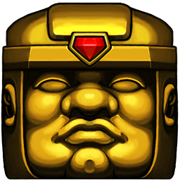
Spelunky A Game Review
Brandon manni
Cis 487 | September 21, 2016

Slide 2
Basic Information
Game Title: Spelunky
Company: Mossmouth
Designer: Derek Yu (Original and HD) & Andy Hull (HD)
Genre: Roguelite Platformer
Price: $15
Minimum Requirements:
CPU: Intel Core 2 Duo 2.8GHz
Memory: 2 GB
GPU: 3D Graphics Card
DirectX: v9.0c
Storage: 200 MB
Actual Requirements:
CPU: Any
Memory: 2 GB
GPU: Integrated
DirectX: v9.0c
Storage: 200 MB

Slide 3
Game Summary
Installation: The game is only sold through Steam or GOG.com. Steam’s installation is automated, and GOG’s is a single exe.
Manual: The game starts with a short intro that only teaches you the controls. Learning the game world is all up to you. Every time you kill a monster or obtain an item, it’s added to your journal for more info. There is also a very detailed Wiki for each object and monster.
User Interface: The user interface is the worst part of the game. Navigating menus is very annoying. Switching characters takes long. The game has a startup animation before getting to the main menu. If you skip that animation, then you skip the main menu.
Bugs: One game breaking bug is when a shopkeeper takes damage off screen and then freezes. His character is idle, so he doesn’t move or attack you.

Slide 4
Game Summary
Overview: Platformer with perma-death roguelite elements. Procedurally generated levels. Inspired by classic platformers like Mario and DuckTales.
Storyline: Get to the last level and defeat Olmec. Yama if you do the Hell run sequence correctly. Save the damsel and get a kiss.
Role: You play a character inspired by Indiana Jones, a spelunker. You explore caves and see cool art history.
Game Play: The game involves extremely smooth platforming. The fights involve complex mechanics where the bosses aren’t just bullet sponges. RNG can play a role, but daily runs give everyone the same seed, which keeps the game competitive and fair.

Slide 5
Game Summary
Scoring: The game keeps track of score by treasures collected. You can spend money in shops, which will lower your score (unless you rob a shop, well then everything is free).
Artwork: The sprites are very bright and clear. You always know what you’re seeing. Monsters are always differentiable (Blue Frogs do not explode, Orange Frogs do). Objects are clear with what they do. The artwork is very appealing in general and they look nice.
Sound & Music: The sound design in this game is very well designed. Stereo sound is used, so you can position events happening around you. Every event has a distinguishable sound. Monster dies on spikes? You hear a splat sound. Damsel exits the level? You hear a bell ring. Many confirmation sounds throughout the game. Music is pretty good, but you can disable it if you want.

Slide 6
Game Review
What is fun about Spelunky? The game has very smooth and satisfying platforming. The controls are very responsive and playing the game is just satisfying in general. Super Meat Boy for example, is a very slippery platformer. Getting precision jumps in that game is not easy. The mechanics are all unscripted. You can do whatever you want with the items in game. For example, you can whip arrow traps if you time it correctly. You can toss live bombs. The game always feel fair, even when you die. You never feel cheated, it’s almost always your fault that you died. There are a ton of secret levels and bosses.
What is not fun about Spelunky? The game has a high skill ceiling, so new players are sometimes discouraged from continuing, especially complaining about the Ghost on the Steam forums.

Slide 7
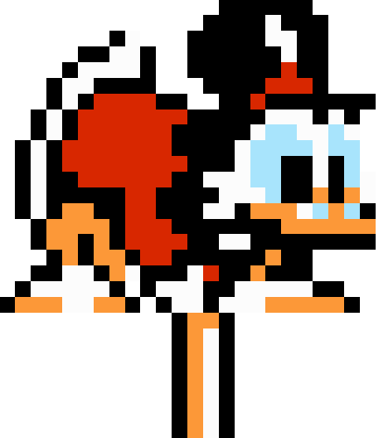
Game Review
How does the game compare with others? Spelunky was inspired by old school platformers like Mario. Mario is not procedurally generated though, but both games provide smooth platforming. The game is pretty similar to other roguelites. It has perma death, you die, you start at Level 1 with nothing. Procedural generation. Secret levels, monsters, and items.
Is it better or worse than others in the genre? Spelunky is procedurally generated which allows you to play new levels all the time, so instead of relying on memorization, you must rely on game mechanics to beat the game, learning how things work to make the most of each run. I think this makes Spelunky a better platformer. I also think it’s better at being a roguelite than Binding of Isaac. The items you pick up in Spelunky are clear in what they do, and they don’t just give passive buffs, they give you new abilities.

Slide 8
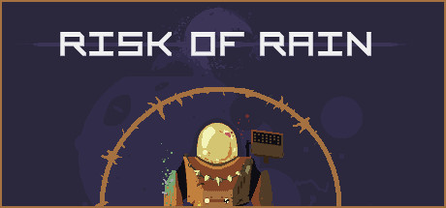
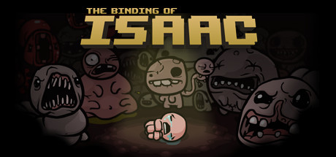
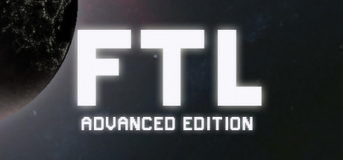
Game Review
Appropriate Audience? The game can be very difficult at times. The Hell run has a very complex sequence that you must do in order. I wouldn’t say that kids would enjoy this game unless they like platforming aimlessly. It’s perma death, so if you die, you better have multiple controllers in case you break one. People who like roguelites or platformers would love this though. It takes roguelite elements and puts them into a very smooth platformer. People who want a challenge, or even want a 2D Dark Souls type of game. People who like metroidvania games might enjoy finding secrets.
Design Mistakes? Some people complain about the Ghost. It is a soft timer that makes you rush to exit the level. It will kill you on collision, but it has a high payoff to balance it. Gems that touch the Ghost become diamonds, which are worth a lot more. I don’t see a design problem since it’s balanced, but people complain about it. The game wasn’t designed for multiplayer. Co-op mode is good, but the Deathmatch Arena is pointless.

Slide 9
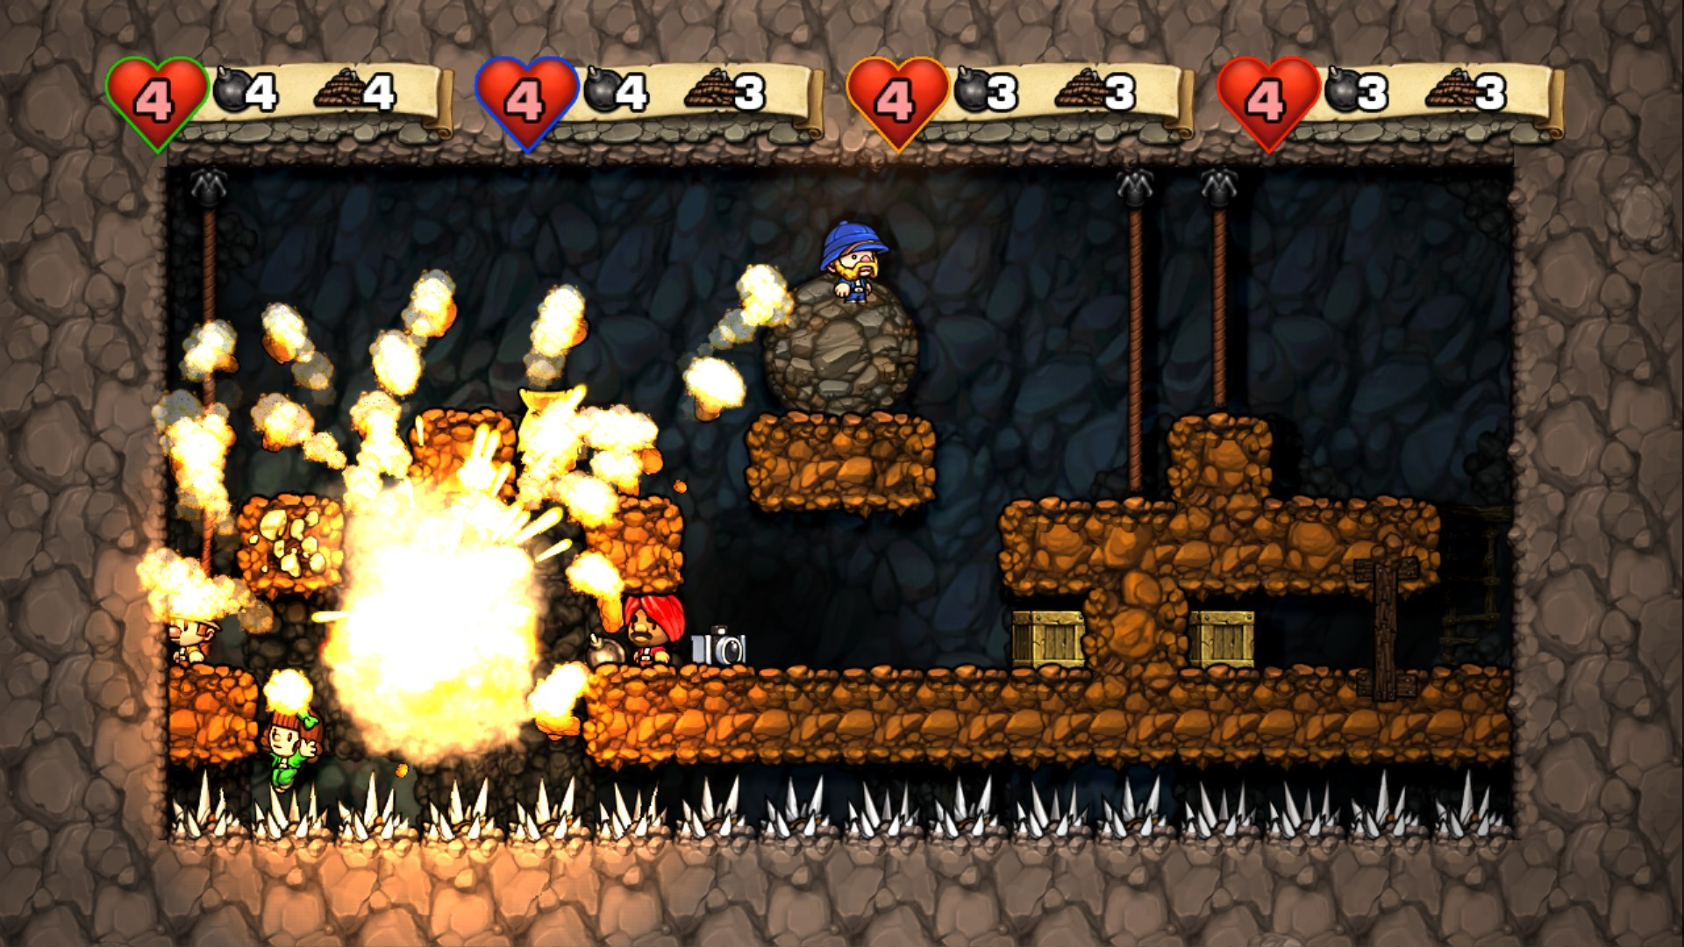

Slide 10
Summary
Overall Strengths: The procedural generation is well done. You can always beat a level without bombs, there is always a path. You can beat the game without a single item, you can die in one hit with every item in the game. The items give you actual benefits and not boring stat buffs. Monsters are not bullet sponges. Secret runs and good bosses.
Overall Weaknesses: The menus are annoying to navigate. RNG plays a negative role in the competitive scene, unless you’re playing Daily Runs. No real tutorial other than for the controls. You have to discover everything on your own. Low mod support.
Improvement: It could be improved with a better GUI. More mod support. You cannot change core mechanics, you’re limited to textures, music, and level editors.

Slide 11
Final Verdict
The game is absolutely worth purchasing. For $15, you’re getting a game with a ton of content, secrets, great procedural generation, beautiful artwork, satisfying platforming. The game is very balanced and extremely polished.
You can also get hand-crafted campaigns that people have made with fan made level editors.
There are no microtransactions or DLCs, so you buy the game once and you get the everything that it has to offer.
10/10

Slide 12
Demo

Slide 13
Level Sections
Mines, jungle, ice caves, temple, Olmec’s lair
Bonus: hell, Yama’s throne

Slide 14
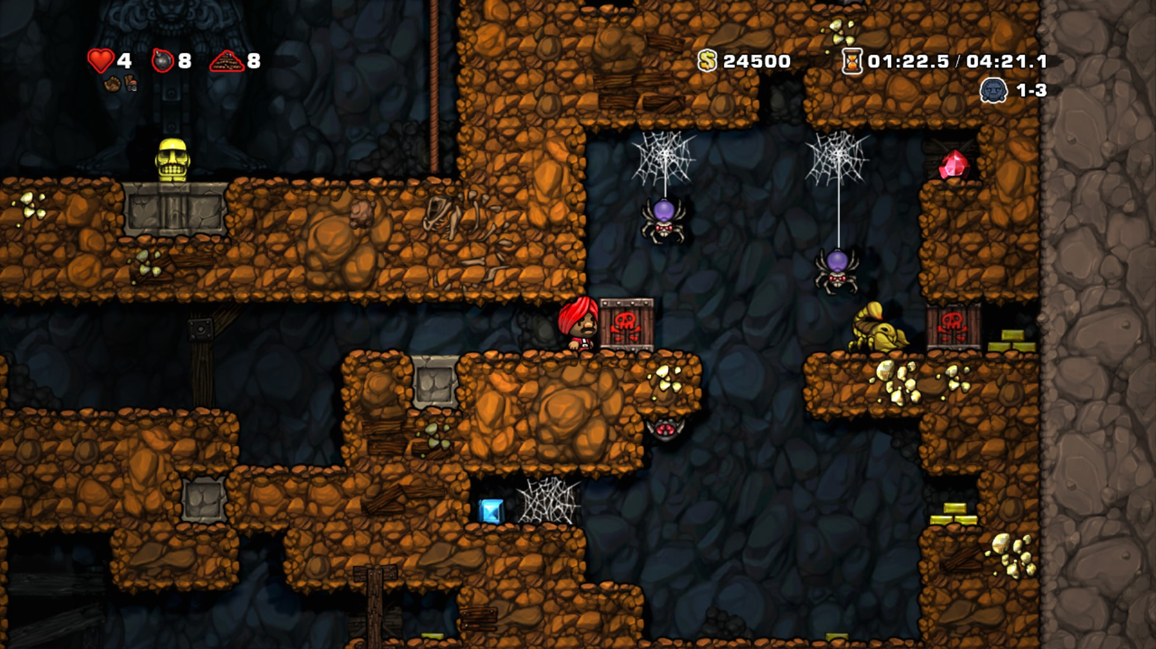

Slide 15
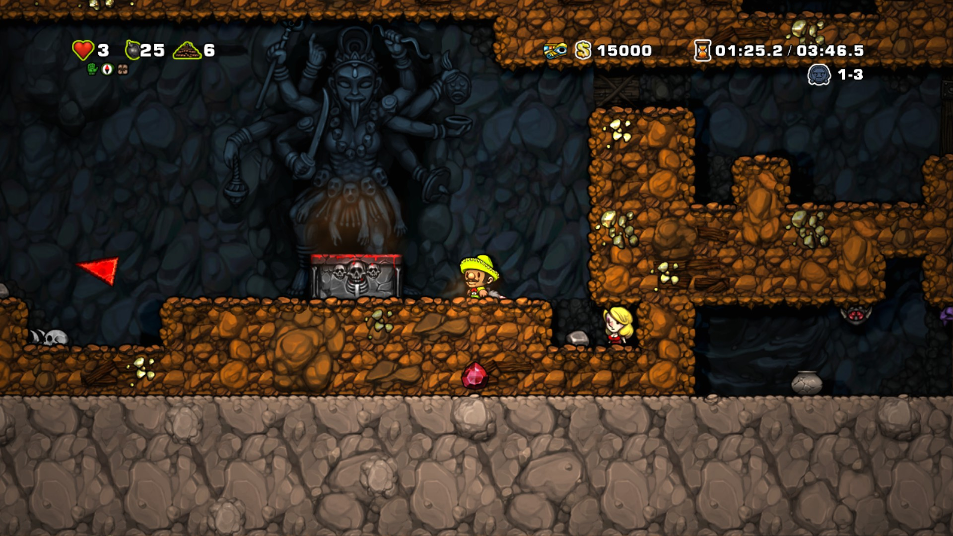

Slide 16
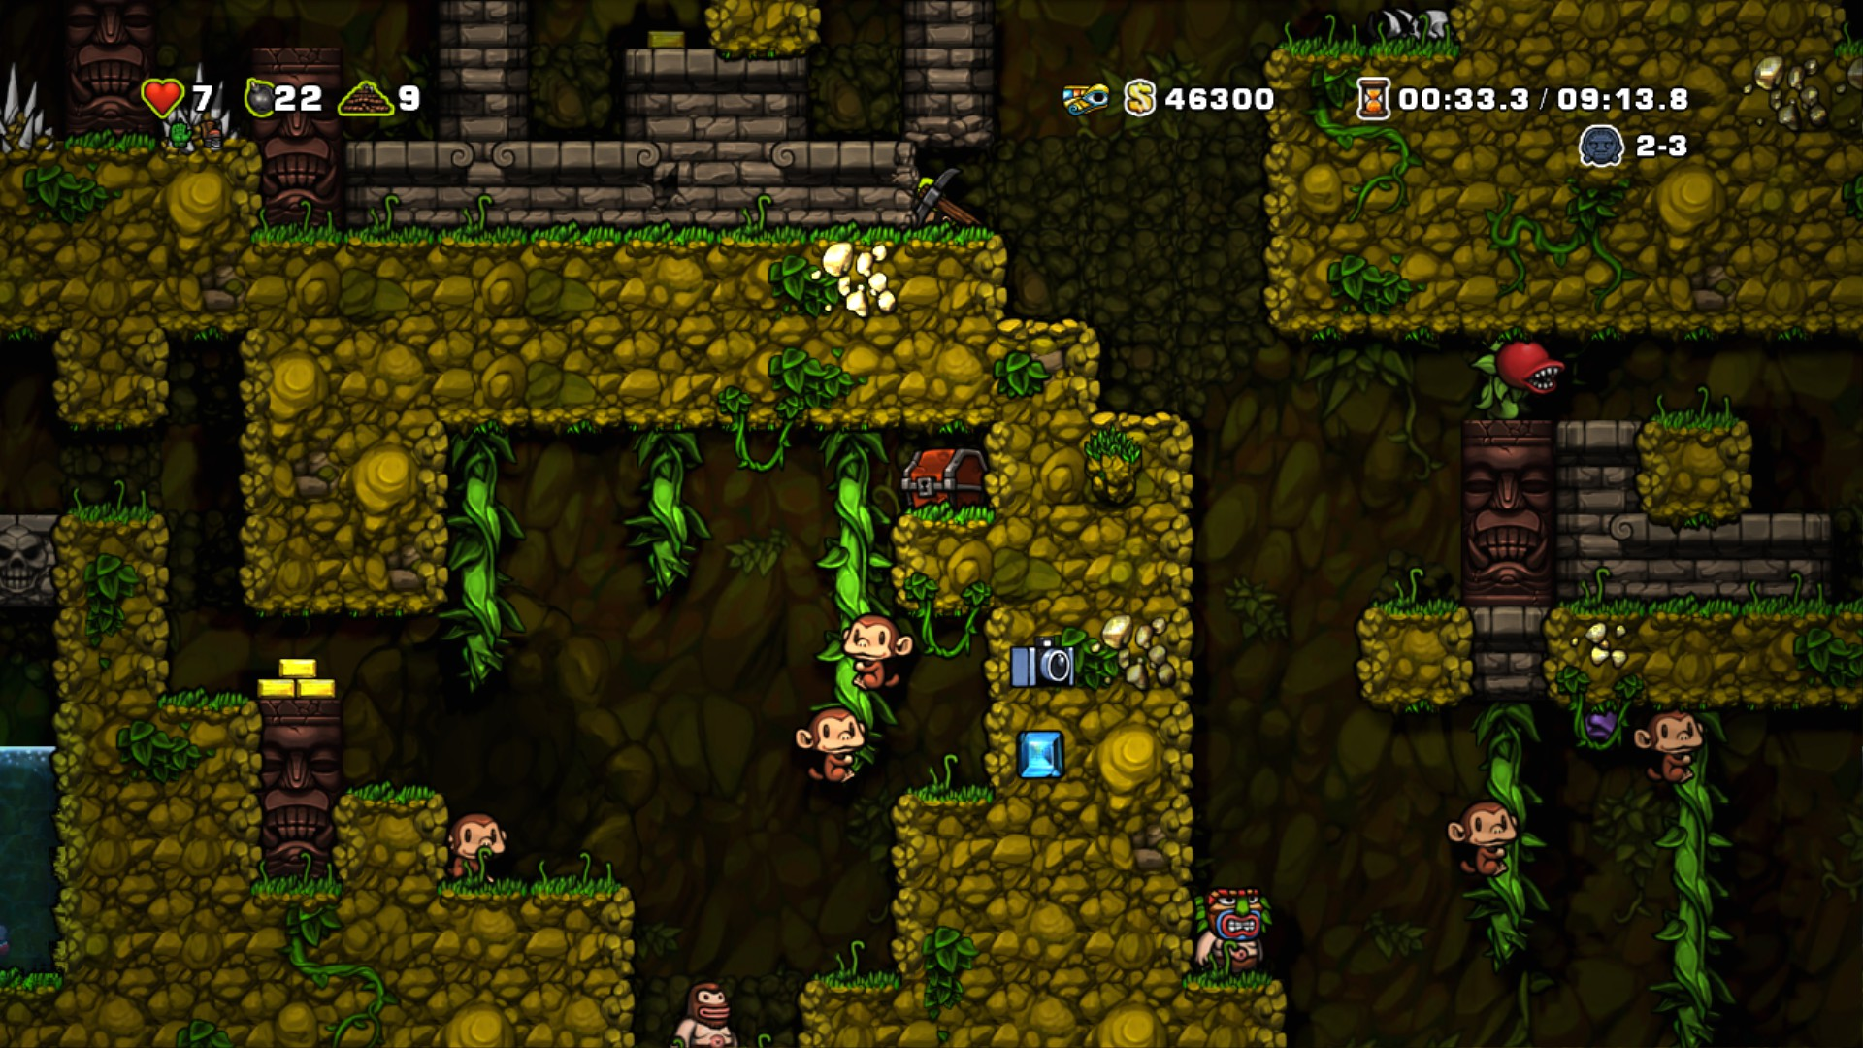

Slide 17
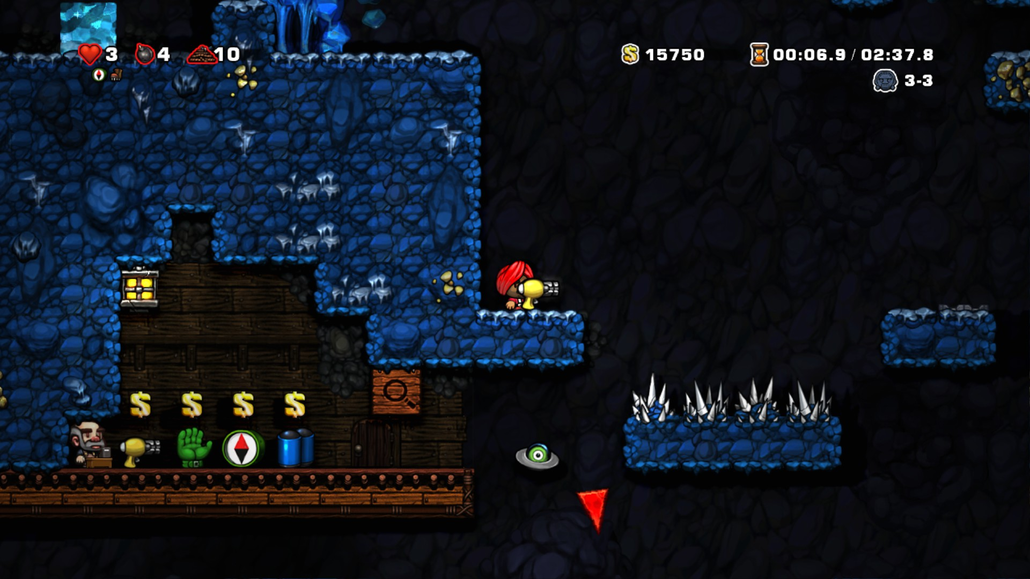

Slide 18
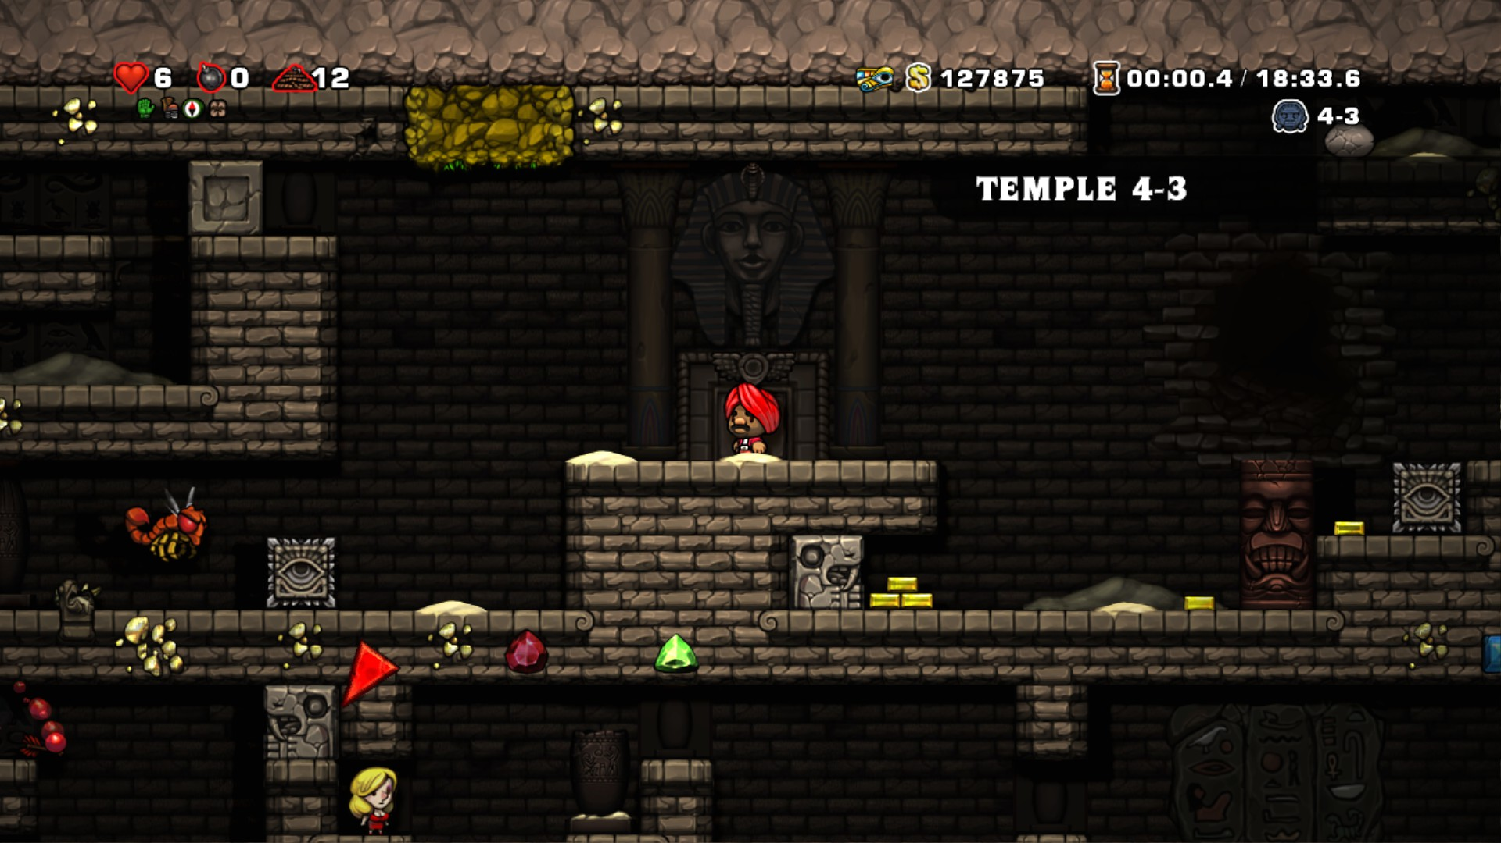

Slide 19
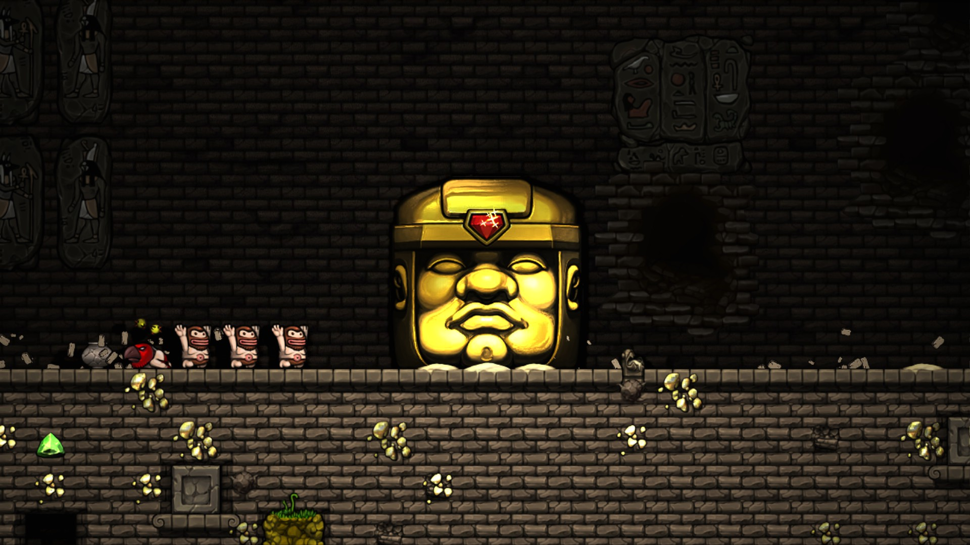

Slide 20
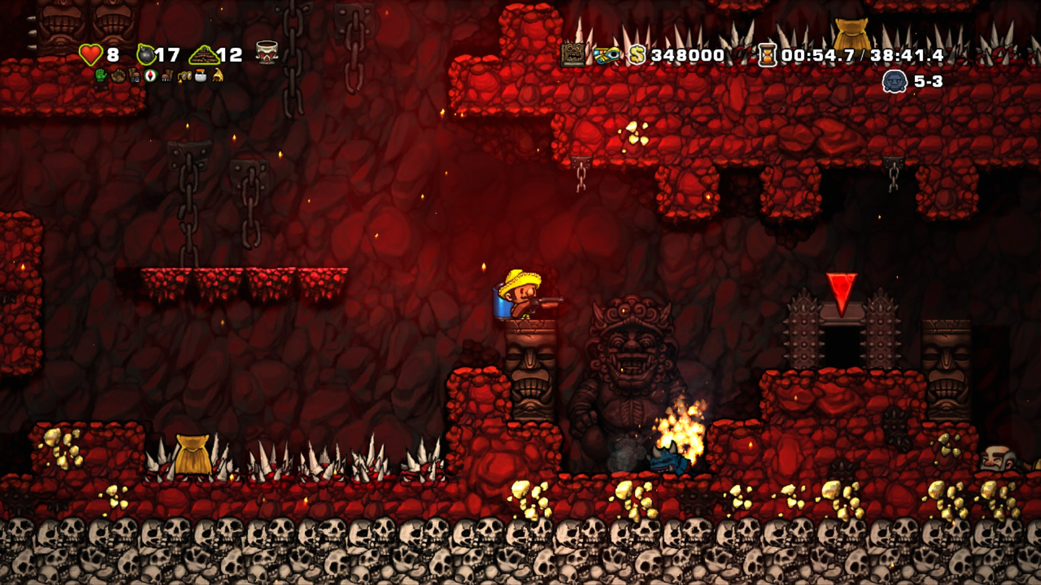

Slide 21
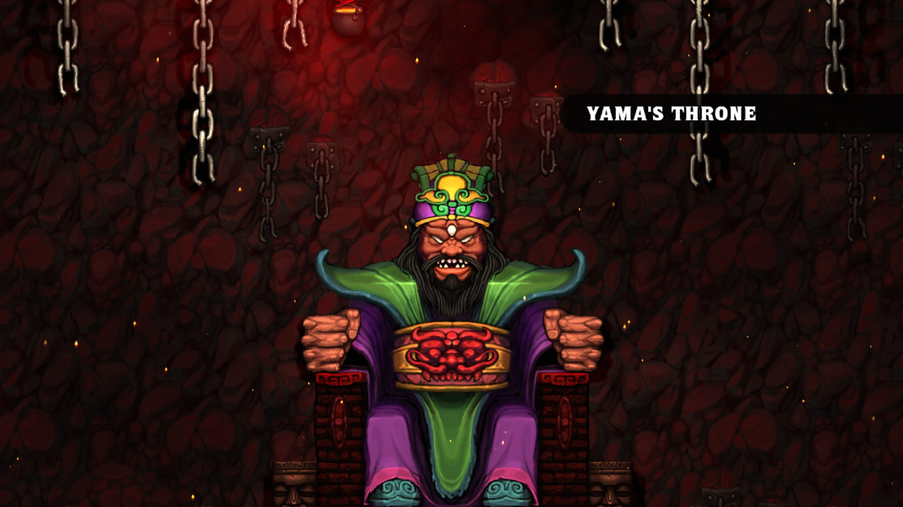

Slide 22
Level Feelings
Rare level changes that challenge the player and give bonuses

Slide 23
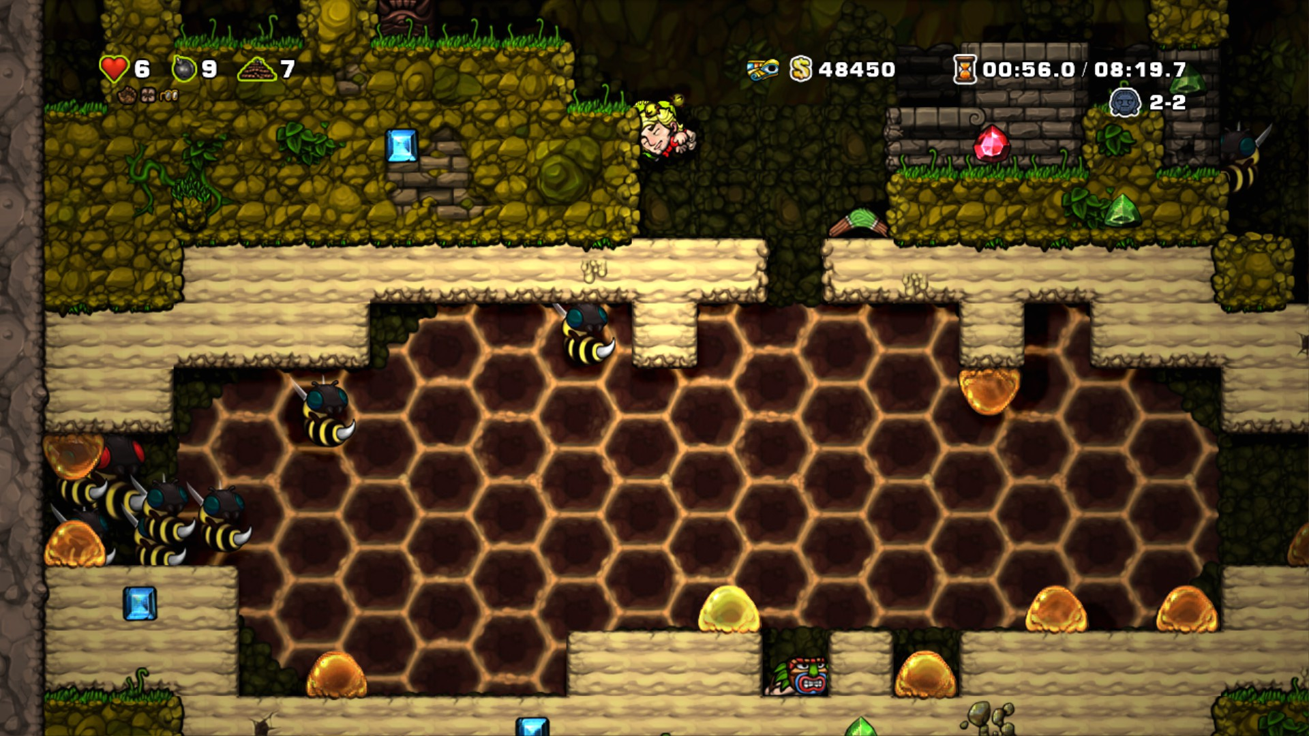

Slide 24
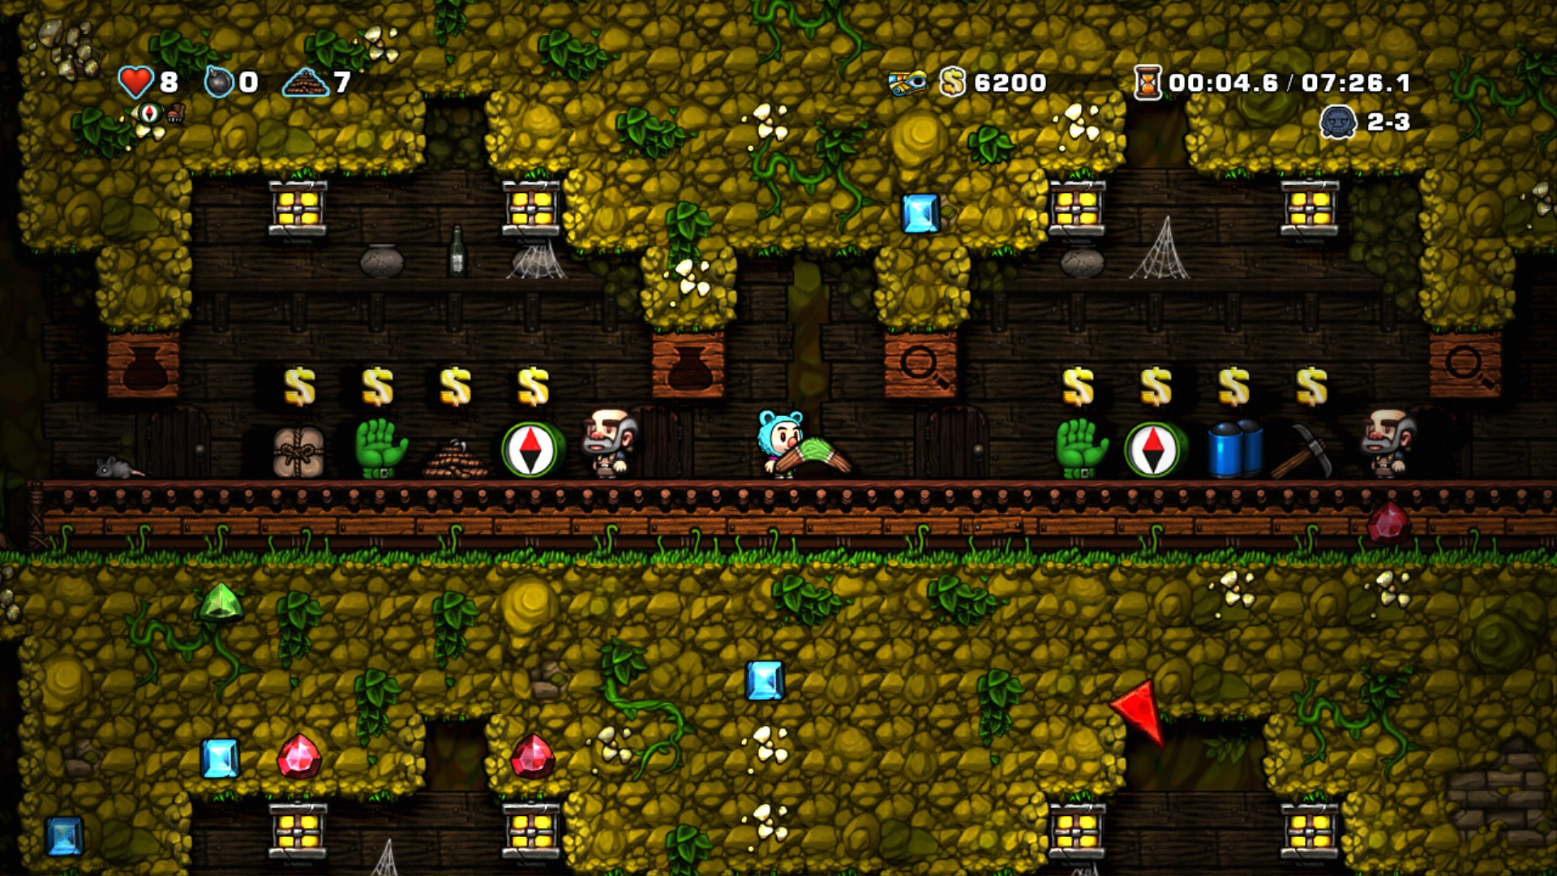

Slide 25
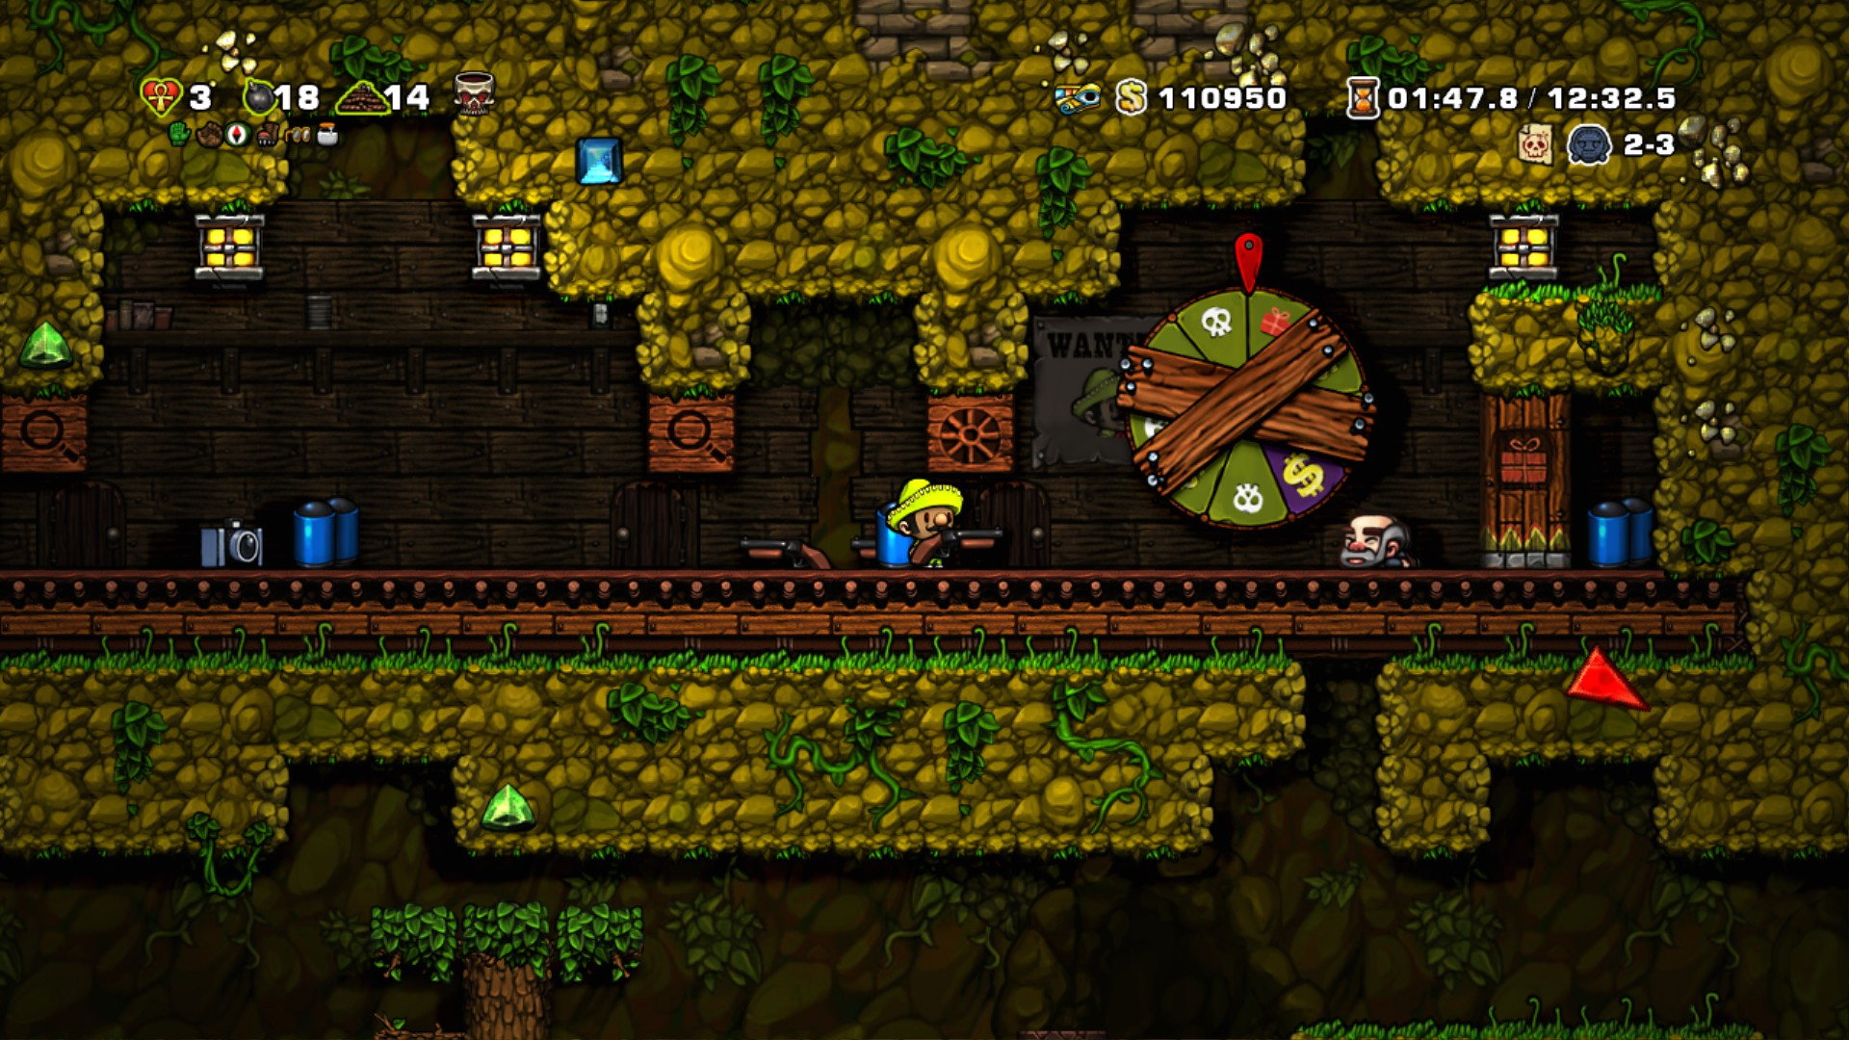

Slide 26
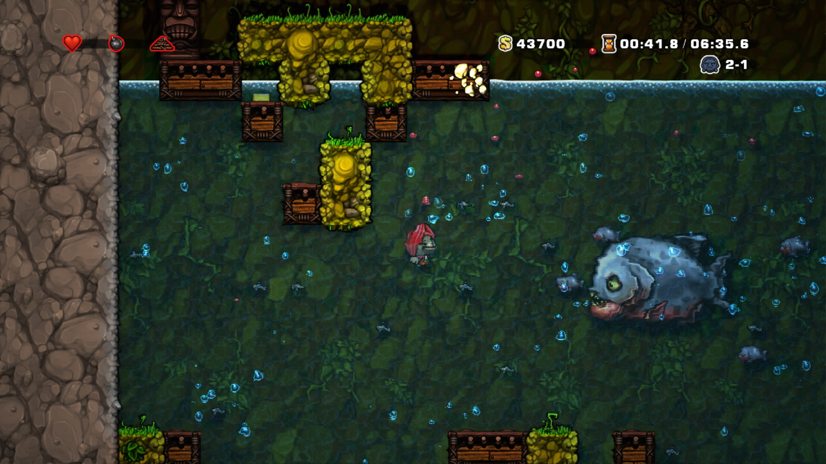

Slide 27
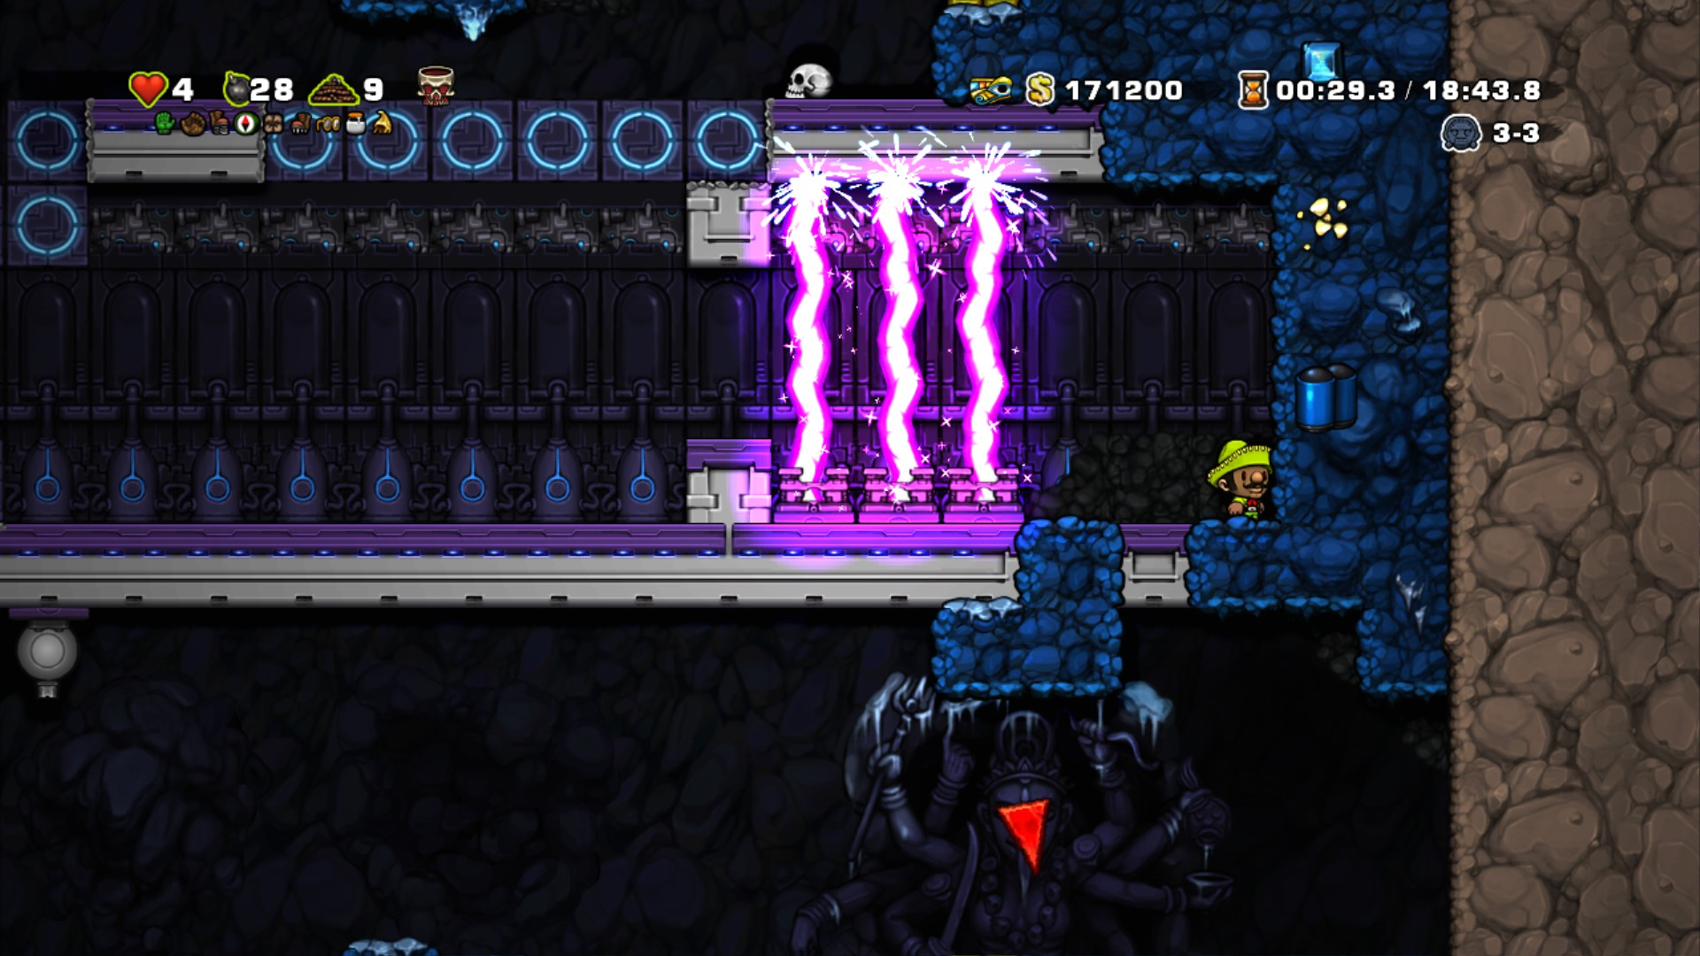

Slide 28
