Slide 1
Jubeat
By Ruoyu Li
CIS-487 Game Evaluation
2016 Fall

Slide 2
Basic Info
Issuing Company: Konami Entertainment (Japan)
Pronunciation: Yubeat
Game Type: Music Video Game
Two Editions: Arcade and tablet
Price: 100JPY/3Tunes for arcade
Free download, 500JPY/Music Pack for tablet
Hardware Requirement: iOS 9.0 or higher on Apple devices, or a Sony/Amazon tablet for Android
Jubeat Plus – JP Store
Jukebeat - Other

Slide 3
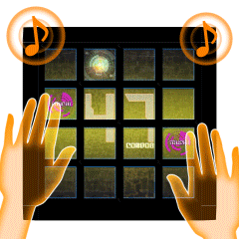
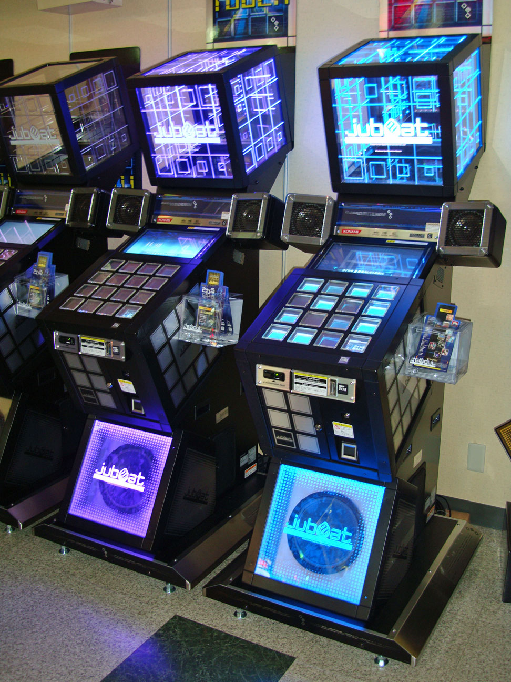
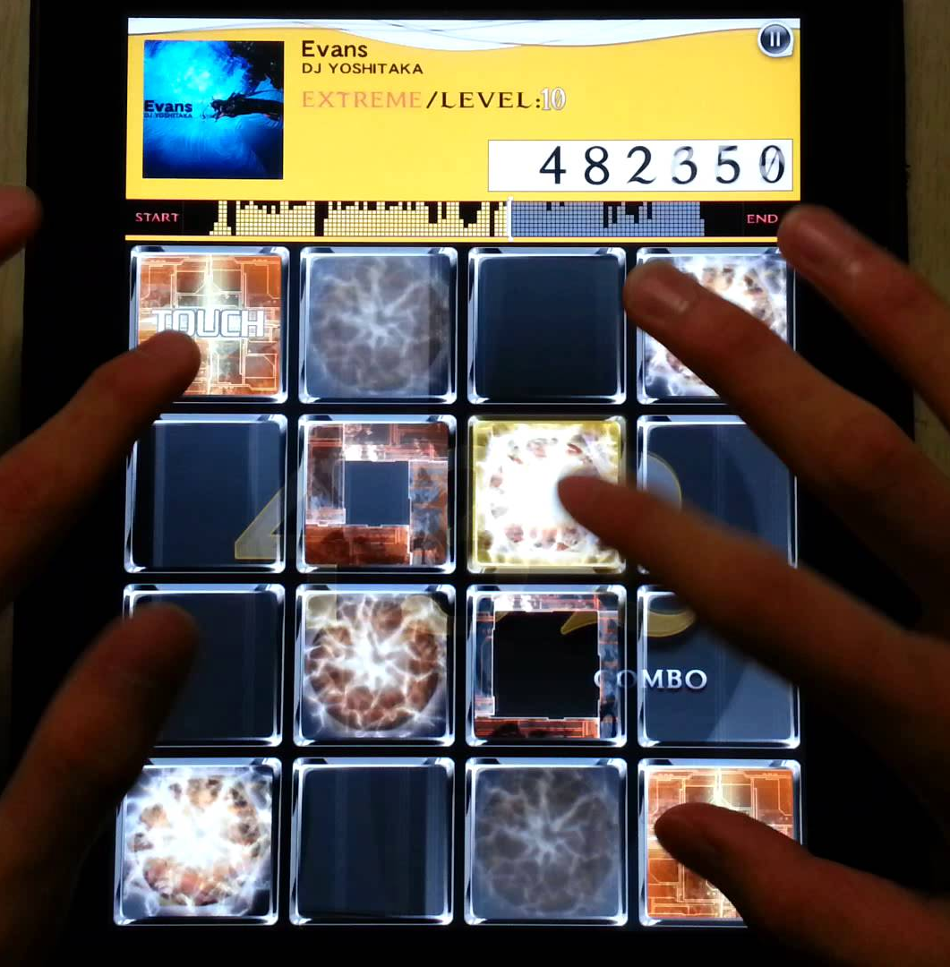
Gameplay
16 Keys, 4x4
Scoring: Perfect, Great, Good, Bad, Miss timings for each note, 1,000,000 Maximum for total
Ratings: EXC(1000k), SSS(980k), SS(950k), S(900k), A(850k), B(800k), C(700k), D, E
Levels: 1 to 10(Highest), 3 difficulties for every tune
Markers: Customizable
Music & Rhythm: Soul for this and any music games
Original Tunes – By DJs and singers of Konami, mostly electronic in style
License Tunes – By 3rd party musicians
Gameplay
Arcade
Tablet
Markers

Slide 4
Attractions
Following the rhythm of the music
Reaction training
Hit songs and tunes – original ones really appealing, license songs are mostly popular Japanese songs
Different types of notes: normal and hold
Short for every single gameplay
Portable for tablets and good for short breaks during work
Hold Note
Sense of Accomplishment
Practice and progress: timing skills, ways of pressing different combinations
Better visual effects for better timings: Timings.mp4
Combos: Combo counts Special effect for ‘Full Combo’:
Full Combo.mp4
Excellent Special Effect:
EXC.mp4
Work hard for higher ratings in hard games

Slide 5
Unique of its kind
Other music games have totally different gameplays (Excluding copycats)
Issued by the inventor of music games (Konami)
Videos
Some of the hardest songs
Arcade (Hold): https://youtu.be/lT0Ldda1vu0
Tablet: https://youtu.be/3PFlfzK5qyo

Slide 6
Cons
Long acclimating time for newcomers
Some tunes are too difficult to get high scores
Slow in releasing new songs to play
Relatively small player society
No express ways
Arcade edition available mainly in Japan and Korea
Few aspects for future innovation

Slide 7
Aimed Audience
Mainly young people (reaction speed)
More appealing for Japanese ACG lovers
ACG: Animations, Comics & Games

Slide 8
Summary
Worth a try – 4 Free initial songs for tablets
Pros and Cons:
Good music
Good for small time pieces
Time-consuming for perfection
Limited future innovation in gameplay
Expectation: more songs, of course!

