Slide 1
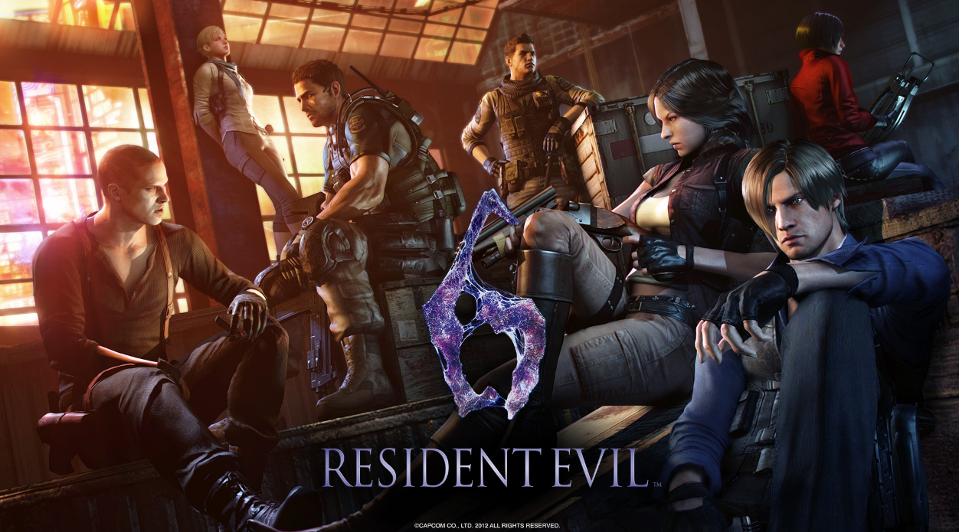
Ada Lam
CIS 487 – 001
09/12/2016

Slide 2
Basic Information
Company & Author: Capcom
Game Type: Horror/Survival/Action Adventure Third Person Shooter
Price: $10 - $20
Platforms:
PlayStation 3
PlayStation 4
Xbox 360
Xbox One
Microsoft Windows

Slide 3
Game Summary
Overview:
A new bio-weapon, known as the C-Virus has been unleashed, causing many people to become infected and turn into a zombie-like being. Some heroes, old and new, are tasked with stopping the spread of the virus. To do so, they must extract the one person they know, whose blood contains the antidote.
Storyline:
Jake Muller and Sherry Birkin – Sherry’s task is to find Jake and escape with him due to his blood containing the anti-bodies to fight against the C-Virus.
Chris Redfield and Piers Nivans – Fight off the rebels in Edonia and help extract Jake and Sherry from the country
Leon S. Kennedy and Helena Harper – Find the man responsible for infecting the President with the C-Virus
Ada Wong – Mislead Chris and Piers? Or help Leon and Sherry?

Slide 4
Game Summary (cont.)
Player Roles:
Since the game is played from a third-person perspective, you control them from over-the-shoulder.
All players can cycle through their weapons and roam around to pick up items as they find them. If they happen to find herbs, depending on the type, herbs can be combined to make a more effective healing herb
Players can jump, run, slide, walk, punch and communicate with each other using quick phrases
Depending on the story line, each can be faced with puzzles or mazes they must navigate through in order to get to the next location or to avoid being spotted by enemies.
Installation:
The game can be bought as a CD, or a downloadable copy can be bought and installed to the PlayStation, Xbox, or PC.

Slide 5
Game Summary – (cont.)
User Interface
In the middle of the screen, there is an aim assist that players can use to help allow them shoot with better accuracy
The bottom right shows the player stats for their health, stamina, ammo, and weapon.
Players can cycle through their items/guns to select what item/gun they want to use

Slide 6
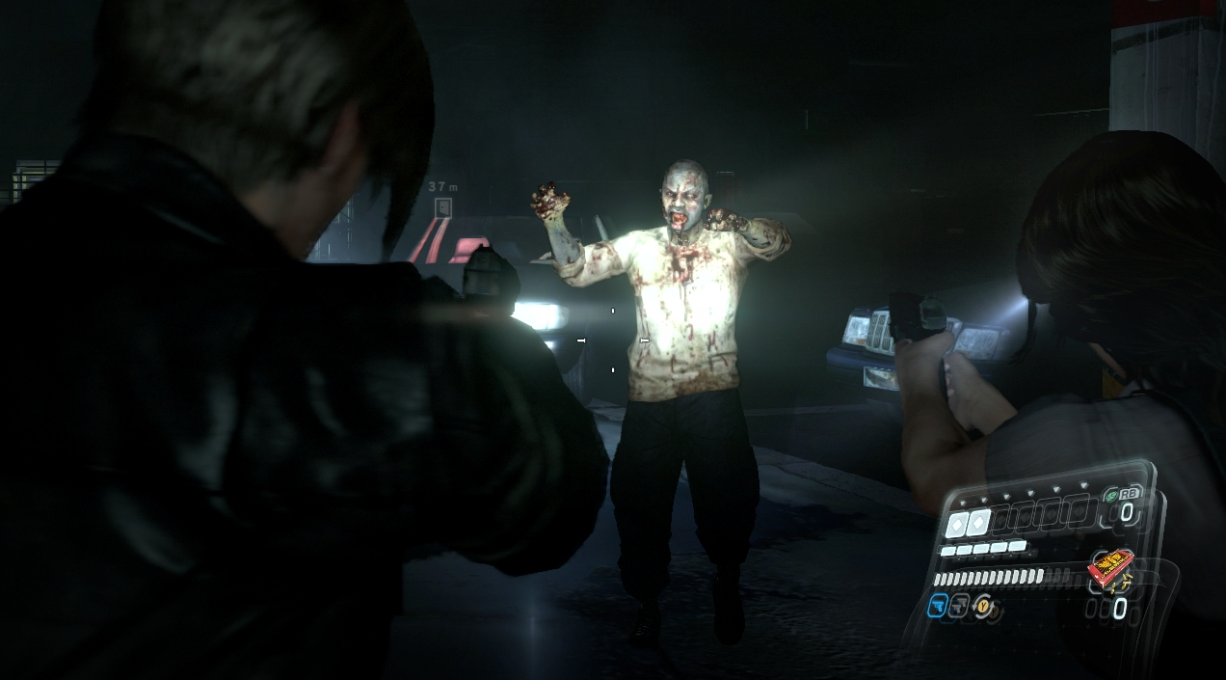
Game Summary – User Interface

Slide 7
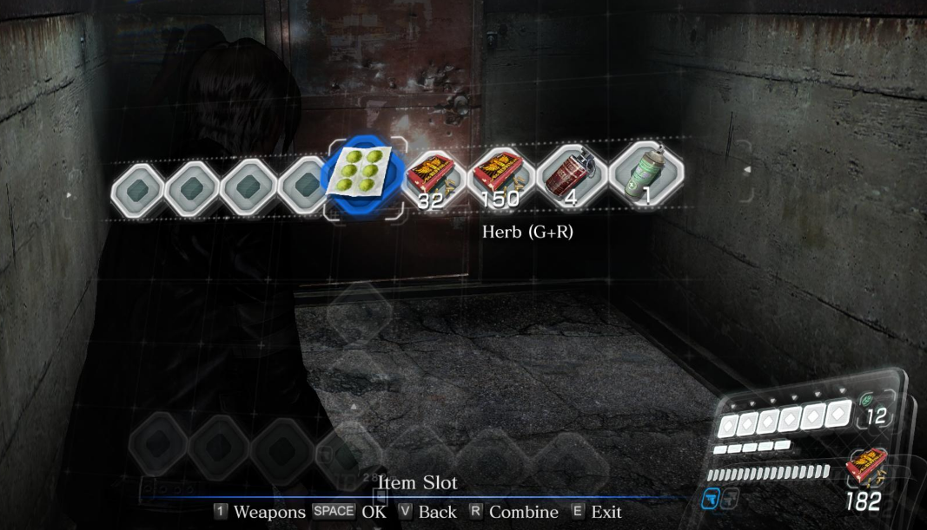
Game Summary – User Interface

Slide 8
Game Summary – (cont.)
Game Play
Main Storyline – To stay alive and fight off as many of the infected as possible. Use weapons, melee attacks, or map items.
Mercenaries – Survive as many hordes of the enemies as possible
Agent Hunt – Plays can take control of random enemies in other people’s online sessions
The main storyline and mercenaries can be played by yourself, couch co-op, or with an online partner. (Except for Ada’s storyline in the main storyline)
Scoring
Each chapter gives a status update that shows accuracy, how many deaths, and how many kills. No actual scoring recorded.

Slide 9
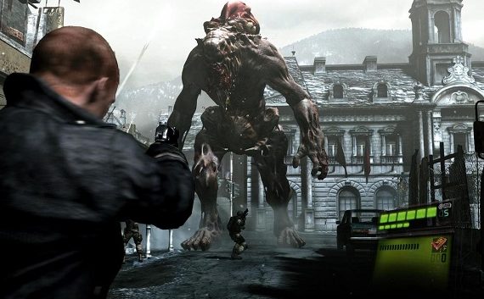
Game Summary - Artwork

Slide 10
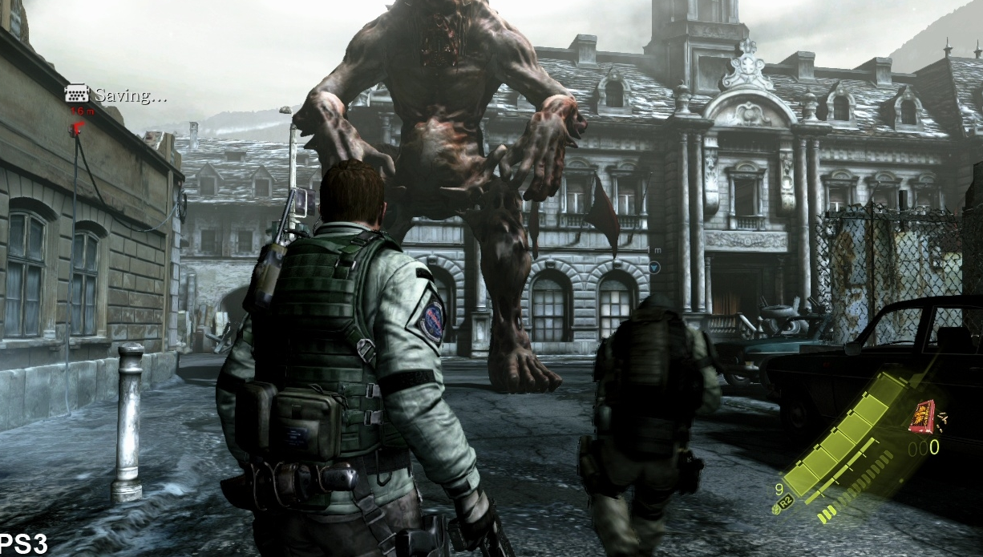
Game Summary - Artwork

Slide 11
Game Summary – (cont.)
Sound & Music
Music changes depending on the location and action sequence. It gets more dramatic when an action sequence comes up or a big boss battle starts. Changes to a more eerie feel if navigating through a “scary” area.
Special Features
Some modes are only unlocked after you beat a certain amount of campaigns
Infinite ammo can be unlocked

Slide 12
Game Summary (cont.)
Manual
A manual may come with the game that shows player controls.
Bugs
Mission Failed Bug – randomly says mission failed in the middle of a cut scene (I believe for PC only)
Not a bug but an annoyance – can’t re-invite a friend into your campaign if they disconnect. Must go back to main menu and invite them, then start again.

Slide 13
Good Aspects of the Game
Action packed and exciting
Offers many different difficulties
Has 4 different engaging story lines
Variety of weapons and skins for the player to choose
Different modes and unlockables

Slide 14
Bad Aspects of the Game
Controls aren’t as intuitive
Bad cover system
Camera angles
Too similar to every other Resident Evil game

Slide 15
Comparison and Audience
Due to the amount of violence in the game, the target audience is meant for ages 17+
Doesn’t really have an evolving story line. It still has the same feel as the other Resident Evil games, where a bio-weapon is released and the protagonists have to escape/stop the culprit behind the release
Didn’t receive as great of a review as it’s predecessors. Seemed to be trying to overcompensate by using the 4 different story lines as a way to engage players

Slide 16
Design Mistakes
Controls aren’t as intuitive as the previous games. The need to cycle through more in order to reach weapons or items
Inability to roll if items are too close to your character. This causes you to simply pick up the item when attempting to dodge an enemy
Chapter 4 on the PC – Randomly declares your character dead in the middle of a cut scene

Slide 17
Strengths and Weaknesses
Strengths
Multiple story lines to choose from
Different modes available
Good graphics
Optional co-op or online partner
Unlockables
Weaknesses
Controls not aren’t as easy to use
Computer partner doesn’t do as much as I would like
Doesn’t stand out from any other RE game

Slide 18
Improvements and Worthiness
Improvements:
Instead of having so many different story lines, it’d be better to have one strong story line
Make the controls and UI a little easier to understand. Some of the functions, in terms of switching between weapons and items seemed more complex than need be. Also a bit too cluttered.
Worth buying?
At the original price of $50-$60, probably not. But now that it’s dropped down to about $10-$15, I’d say it’s a good buy if you want to just play a game for fun.

