Slide 1
CIS 487 Game Evaluation: Dishonored
By Michael Krcmarik

Slide 2
Title: Dishonored (2012) Produced by: Bethesda Softworks Developed by: Arkane Studios Original Price (PC): $59.99 Current Price (PC): $9.99
Background Information
“Set in the fictional, plague-ridden industrial city of Dunwall, Dishonored follows the story of Corvo Attano, bodyguard to the Empress of the Isles. He is framed for her murder and forced to become an assassin, seeking revenge on those who conspired against him.” – Wikipedia¹
http://66.media.tumblr.com/4535dcf2d968128f4256cf7e596b6867/tumblr_mws5ts821t1t3np44o3_r1_1280.jpg

Slide 3
System Requirements
Minimum hardware²
Recommended hardware²
Actual hardware
OS: Windows Vista / Windows 7
Processor: 3.0 GHz dual core or better
Memory: 3 GB system RAM
Hard Disk Space: 9 GB
Video Card: DirectX 9 compatible with 512 MB video RAM or better (NVIDIA GeForce GTX 460 / ATI Radeon HD 5850)
Sound: Windows compatible sound card
OS: Windows Vista / Windows 7 (enhanced for 64-bit OS)
Processor: 2.4 GHz quad core or better (enhanced for multi-core processors)
Memory: 4 GB system RAM
Hard Disk Space: 9 GB
Video Card: DirectX 9 compatible with 768 MB video RAM or better (NVIDIA GeForce GTX 460 / ATI Radeon HD 5850)
Sound: Windows compatible sound card
OS: Windows 10 64-bit
Processor: Intel i5 4670k @ 4.0 GHz
Memory: 8 GB system RAM
Hard Disk Space: 200 GB+
Video Card: Geforce GTX 770 2GB
Sound: Headphones into built-in soundcard.

Slide 4
Game Summary
You play as an bodyguard-turned assassin named Corvo who is framed as the murderer of the empress of Dunwall he was sworn to protect.
Corvo gets framed as a murderer, then after a perceived death joins a resistance force called the Loyalists fighting the corrupt group that framed him with an ultimate end goal to topple their regime.
The players role is to play as Corvo and use his skills along with some supernaturally enhanced equipment to accomplish various objectives for the resistance group.

Slide 5
Game Summary (continued)
The main objectives throughout the game center on eliminating key members of the corrupt regime but also include side missions to help out residents of Dunwall or to affect certain aspects of the city by eliminating rat problems or searching for missing items
There is a plague outbreak spread in the city by rats and many citizens have taken on a zombie-like state or have deceased.
There is a steam-punk like atmosphere which has elements of London with old century styling but some futuristic technology.

Slide 6
Installation / Manual
I installed the game with no issue through the Steam client. It takes up 6.1gb of hard drive space.
There was a digital manual available on the Steam store.
There are also console versions available for Xbox 360, PS3, etc.

Slide 7
User Interface
Pros:
The user interface is clear, easy to see for the most part.
The style is consistent with the art style of the world.
Can quickly glance and see health and magic as most important items
Cons:
The numbers are pretty small and difficult to read at a quick glance when trying to determine the quantity of one of the players items.
http://image.jeuxvideo.com/images/pc/d/i/dishonored-pc-1349450723-122.jpg

Slide 8
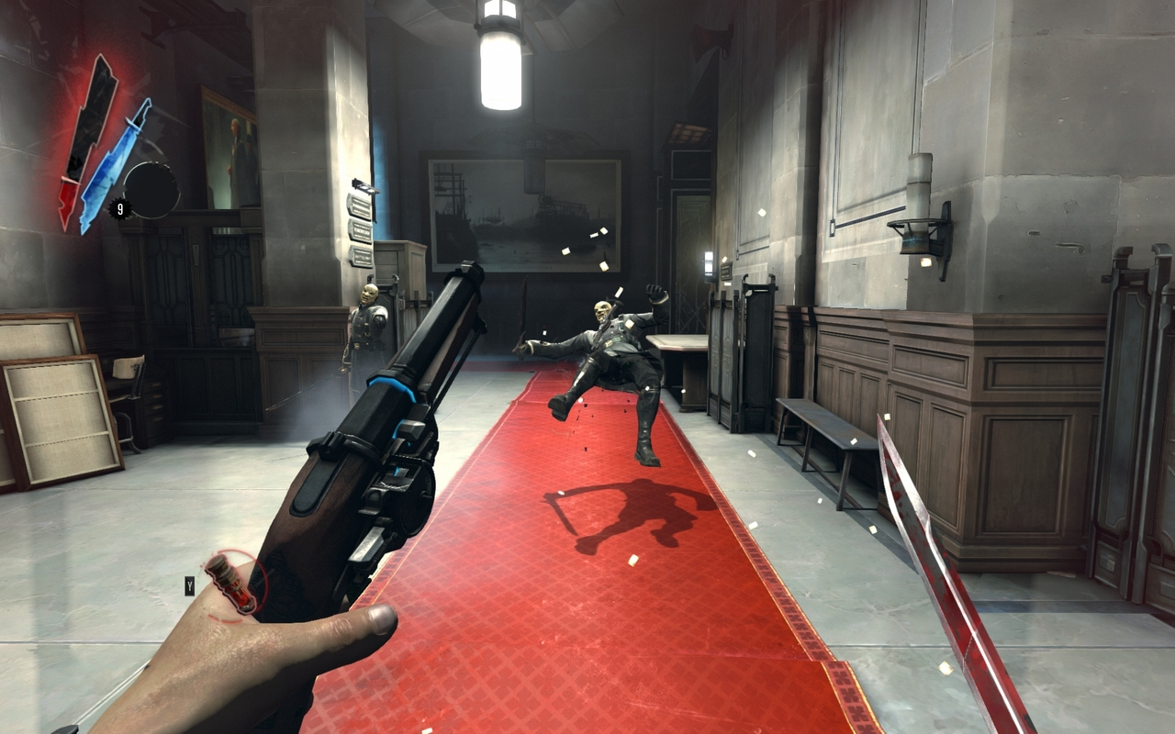

Slide 9
Gameplay
Have a sword, pistol, crossbow, grenades, and other various weapons and gadgets for physical combat.
Have a list of supernatural abilities you can use to gain an edge such as slowing down time, seeing enemy movement through walls, a “teleport” type power as well as many others.
Items and powers have different levels and can be upgraded as you unlock points and collect items throughout the world.
Can chain together use of weapons and powers interchangeably with the right timing for deadly combinations.

Slide 10
More gameplay
You use the resistance area that includes your bed to save/rest along with the bar where many missions start from. This acts as a safe area where you can buy items.
Get assigned assassination missions then take a boat ride into the city when you are prepared.
Rewarded for completing objectives undetected and with minimal lethal use

Slide 11
Performance/Bugs
Runs on Unreal Engine 3.
Very easy to run, averaged 150+ fps on the system listed in slide #3 when v-sync was turned off.
No major slowdowns or bugs occurred to the best of my memory.
There was one moment where the objective marker started acting erratically because I used the jumping powers to skip around an objective and trigger the next scene.

Slide 12
Skilled Gameplay
https://www.youtube.com/watch?v=T5Ymh_wHjaQ

Slide 13
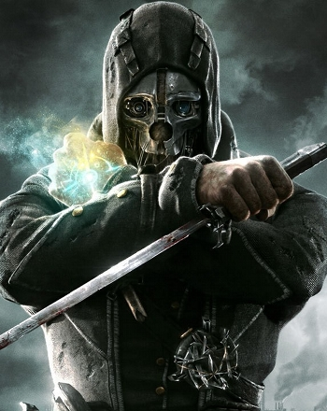
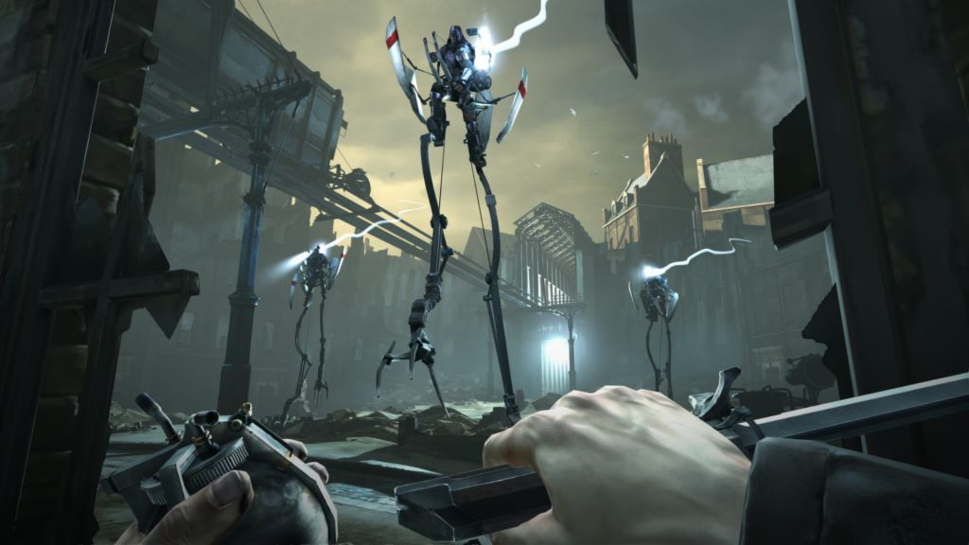
Artwork
https://images.g2a.com/m/1024x768/1x1x0/thumbnail/d/i/fb62c0c50d05_dishonored_6_.jpg
http://static.tvtropes.org/pmwiki/pub/images/tropes_dishonored_278.jpg

Slide 14
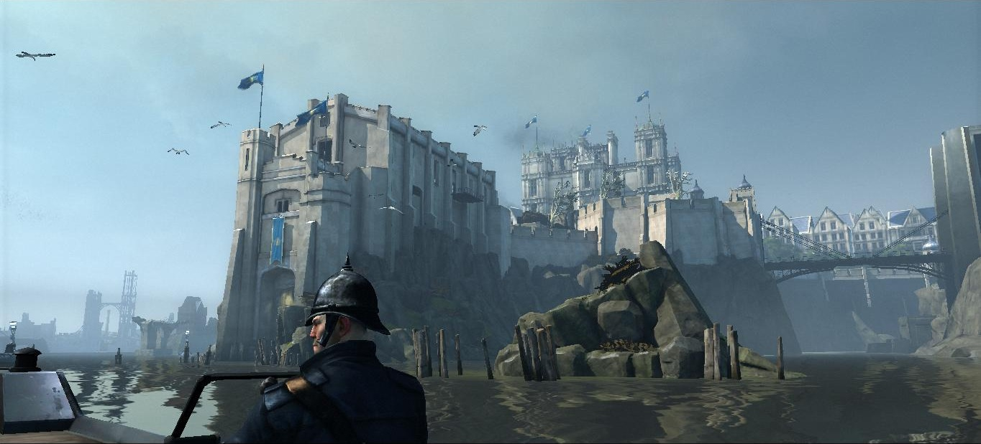
More artwork

Slide 15
Game review pt.1
The good
The bad
Solid controls
Can influence the world around you
Can play in multiple playstyles and have a rewarding experience
The game rewards skill by having a unsuspectingly deep combat system where you can chain combos using weapons and powers together.
A few parts are hard to see/figure out the next path to take while traversing through dark interior levels.
A few frustrating jumping challenges.
Could be greater variation of puzzles

Slide 16
Game review pt. 2
What games are similar?
Better or worse?
Sub-genre of action stealth
Includes Thief, Metal Gear Solid series, Hitman series, Splinter Cell series
Gameplay objective of being an assassin is closest to Hitman
Gameplay itself is closest to Thief, they are the most renowned full first person stealth games in recent time.
Better than most
Cohesive experience
Hand crafted world that is designed to take advantage of their puzzles and items they designed
Gameplay and story both flow naturally and don’t feel forced
Engaging first person experience

Slide 17
Game review pt. 3
Appropriate for who?
Design mistakes
No one under 13
Plenty of blood
Can dismemember enemies with sword
Actions are portrayed as “good” rather than playing a bad character
None to note

Slide 18
Final thoughts
Overall this was one of my favorite stealth experiences and game in general. I put 10 hours of time into it and completed the story.
The game’s overall strengths are solid controls and combat, engaging stealth experience, beautiful design and world. These outshine any notable downsides.
At the current price of $9.99 this game is highly worth it and will run on a wide variety of machines judging by the observed performance and requirement list.
I can’t think of many ways the game could be improved other than continuing to work on the sequel which is supposed to have improved fluidity of movement and combat.

Slide 19
Citations
https://en.wikipedia.org/wiki/Dishonored
http://store.steampowered.com/app/205100/

