Slide 1
CIS-487-001 – Fall 2016 – Dr. Bruce R. Maxim

Slide 2
BASIC INFORMATION
DEVELOPER
thatgamecompany
PUBLISHER
Sony Computer Entertainment
DIRECTOR
Jenova Chen
LEAD DESIGNER
Nicholas Clark
RELEASE DATE
March 13, 2012
GENRE
Adventure
PRICE
$14.99
MINIMUM SYSTEM REQUIREMENTS
PlayStation 3
OPERATING SYSTEM
System Software 4.10
PROCESSOR
Cell Broadband Engine at 3.2 GHz
MEMORY
256 MB XDR DRAM at 3.2 GHz
STORAGE
589 MB for installation, 72 KB for save data
GRAPHICS
NVIDIA RSX Reality Synthesizer with 256 MB GDDR3 VRAM at 700 MHz
SOUND
Dolby 5.1 capable Cell-based processor
* The minimum system requirements are the actual system requirements.

Slide 3
Mechanics
INSTALLATION
Purchased and downloaded through the PlayStation Store.
MANUAL
No manual is provided or available.
Basic mechanics taught during gameplay.
BUGS AND GLITCHES
Unusual flying physics tricks.
Glitch entrances to backstage areas.
Glitches purposefully remain through updates.

Slide 4
Story
The story of Journey is told completely in-game through images and pictographs.

Slide 5
Gameplay
Walking
Walking is a large part of gameplay.
Chirping
Can produce a sound and floating symbol.
Limited Flying
Amount of upward motion limited to length of character’s scarf, and the charge the scarf contains.
Scarf Recharging
Interaction with cloth entities or other player will recharge scarf.
Cooperative Multiplayer
One other player will appear if in same area and not otherwise partnered.
Cloth Switches
Chirping near some cloth entities cause changes in the world.
Sand Dune Sliding
While walking down a sandy incline.
Forced Sand Sliding
Walking and Flying have constant downslope force.
Hostile Entities
Large creatures patrol and will permanently shorten scarf upon contact.
Free Fly Zones
Areas where the character’s scarf remains fully charged at all times.
Charge Stealing Snow
Frosty areas slowly steal charge from scarf.

Slide 6
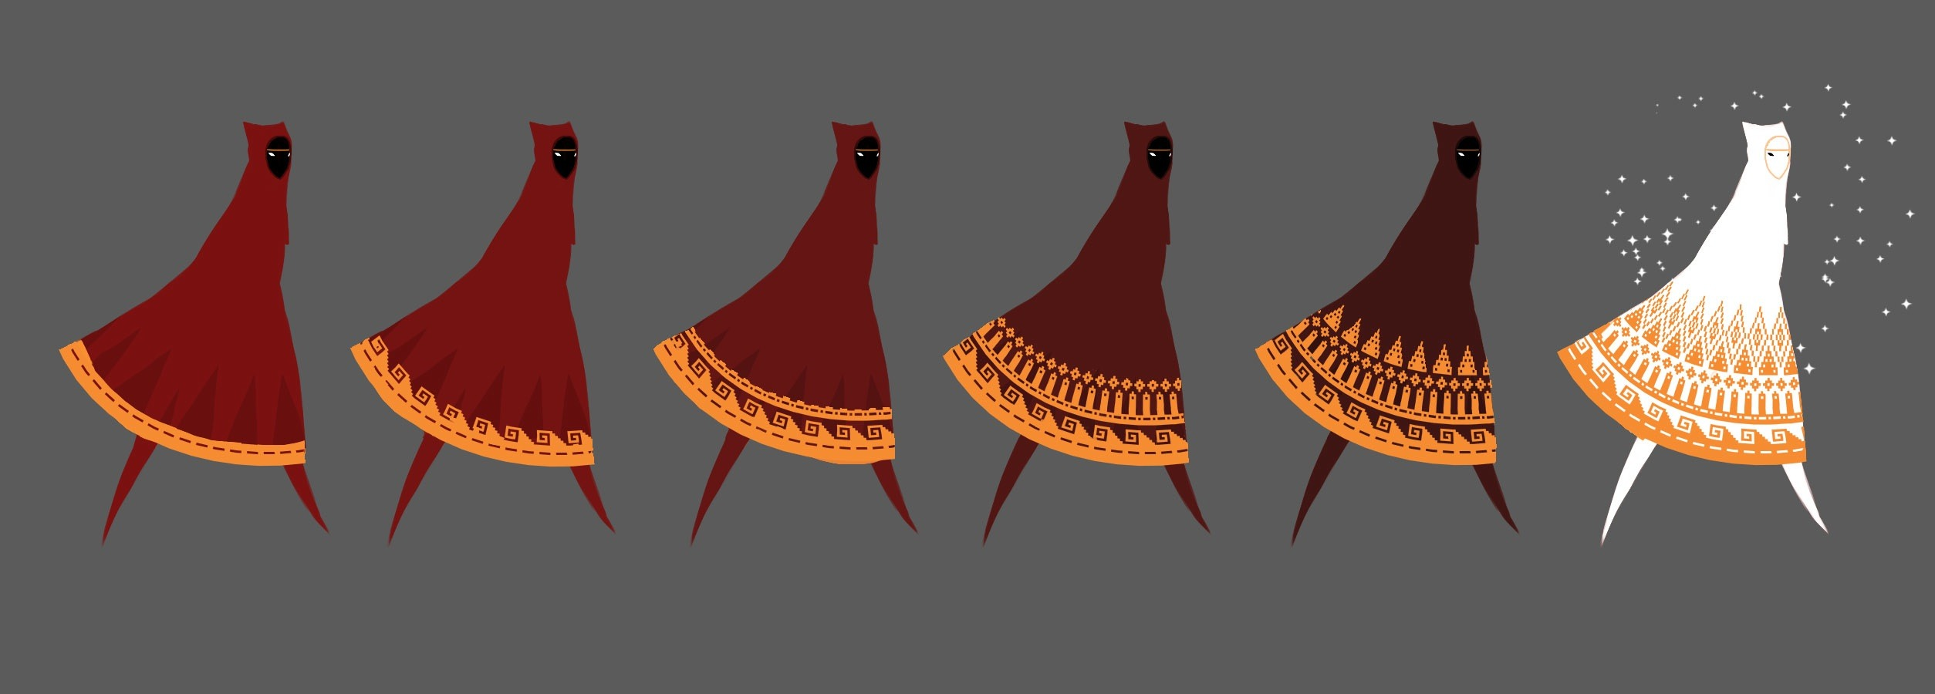
Scoring
No numerical scoring mechanic is provided in the game, but there are ways to measure your progress.
A limited number of power-ups exist throughout the levels. Upon picking up these power-ups, the length of the character’s scarf is increased; giving them a greater ability to jump or fly. Obtaining all of the available power-ups gives the player the ability to change their character’s cloak to white. A white cloak allows the scarf to automatically recharge while walking.
The cloak the character has decorative trim around the hem. The decorative trim becomes more elaborate after finishing the game. Each successive completion continues to increase the elaborateness of the cloak’s trim until the game has been finished three or more times. The trim on the character’s cloak gives other players a sense of the experience level of the player controlling the character.

Slide 7
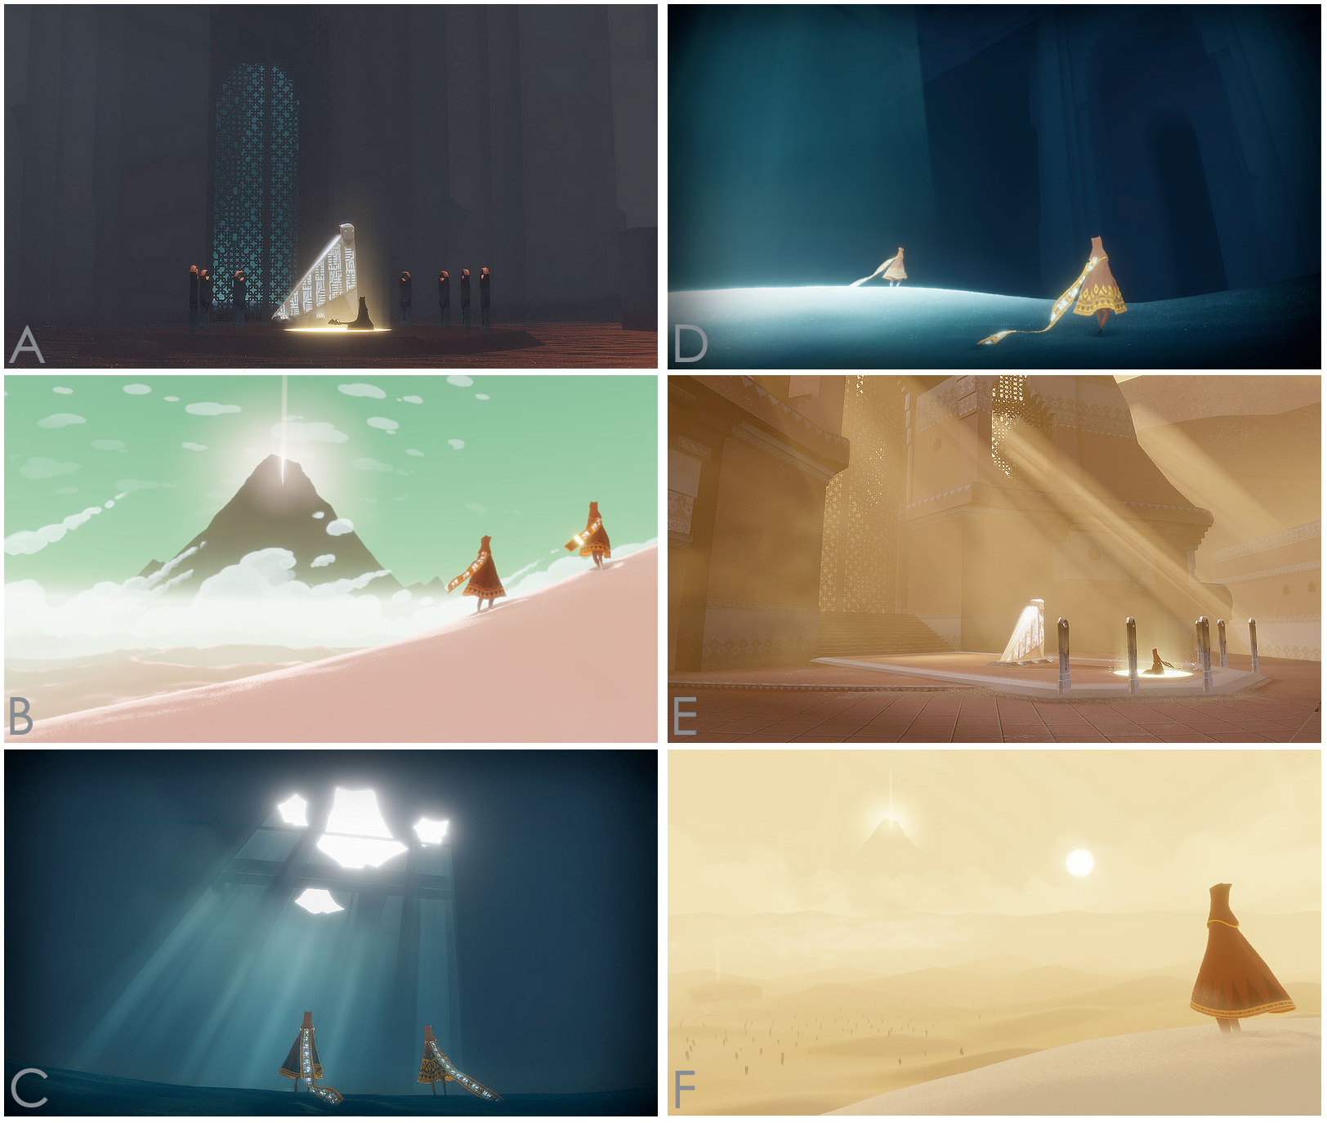
Artwork

Slide 8
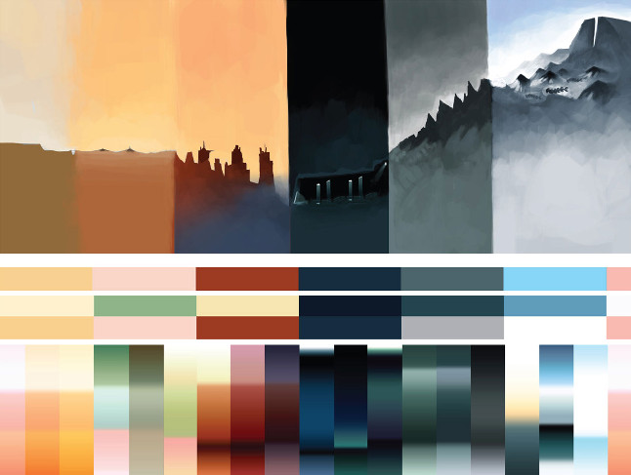
Artwork

Slide 9
Sound and Music
SOUND
Environments and weather
Character actions
Cloth creatures
MUSIC
Composed by Austin Wintory
Nominated for Grammy Award in 2013
Changes dynamically based on progress and events

Slide 10
Positives
WHAT’S FUN
Communication with other players only through chirping
Ability to set your own pace
HOW DOES IT COMPARE
Puzzles straightforward and not tedious on replays
WHY IS IT BETTER?
Partner-play makes game more enjoyable and meaningful
Negatives
WHAT’S BAD?
Forced camera movement
Key component relies on strangers
HOW IS IT WORSE?
Slower gameplay could give negative impression

Slide 11
Summary
AUDIENCE
A person of any age capable of manipulating controller.
Rare encounters with enemies could be startling, or scary to young children.
STRENGTHS
Completely safe online interactions.
High replayability
WEAKNESSES
Puzzles could be too simple for puzzle fans.
Platforming could be too simple for platforming fans.
WORTH THE PURCHASE
If 3-4 hours of entertainment is worth $15 then it is worth the price.
Dozens or hundreds of hours could hypothetically be spent playing.
IMPROVEMENTS
Lengthier journey (but not too long)
Harder puzzles
Challenging platforming

Slide 13
Credits
Title page: http://matou31.deviantart.com/art/Tribute-to-Journey-353756783 Matou31
Journey Font: http://www.dafont.com/font-comment.php?file=journey Greg O'Malley
Last page: http://cargocollective.com/SLiD3/Le-Journey SLiD3
All other multimedia created by thatgamecompany.

