Slide 1
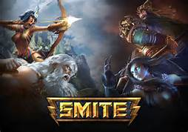
GAME EVALUATION
Luis Gonzalez-Prendes
September 21, 2016
CIS 487

Slide 2
The Basics
Developed by Hi-Rez Studios
3rd Person MOBA
Free To Play
Minimum Requirements
CPU: Core 2 Duo 2.5 GHz or Althon 64 X2 2.7 GHz
RAM: 2 GB (XP), 3 GB(Vista, Win7)
OS: Windows XP SP2, Windows Vista, or Windows 7
Video Card: ATI or Nvidia graphics card with 512 MB video ram or better and Shader Model 3.0+ support.
Sound Card: Yes
Free Disk Space: 10 GB
Also runs on XBOX One & PS4

Slide 3
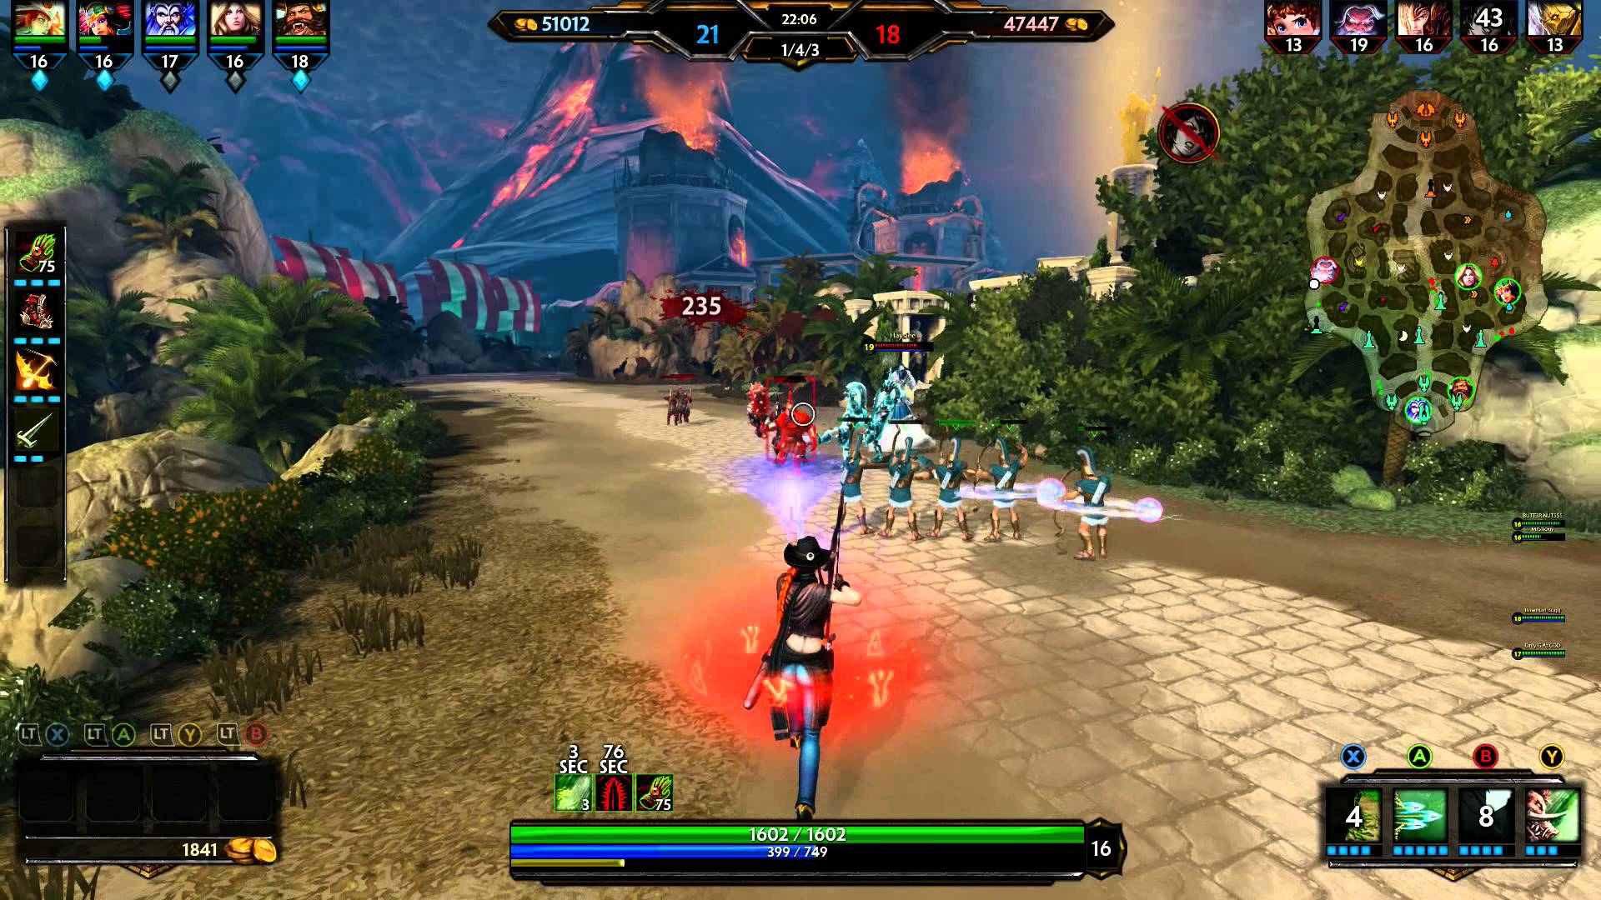
Game Summary
7 Casual Game Modes: Conquest, Assault, Siege, Joust, Clash, Arena, XING TIAN’s Mountain
3 Ranked Game Modes: Conquest, Joust, Duel
Control a God in combat using abilities and team tactics vs enemy Gods/minions

Slide 4
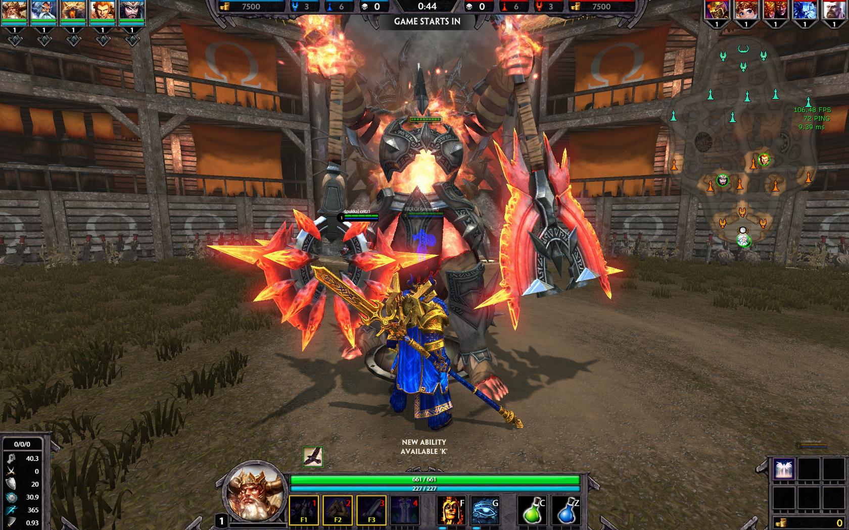
Game Overview Continued
Scoring: Wide Range of Scoring
Bugs: Character Selection/Queue
Manual: Tutorials/Training/Button Layout
Special Features

Slide 5
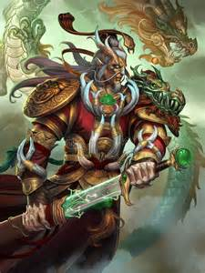
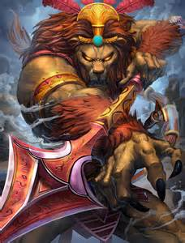
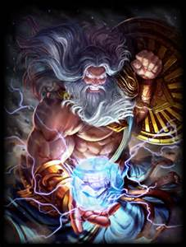
Music/Artwork
Original music done by Chris Rickwood
Artwork Examples

Slide 6
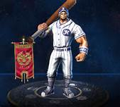
Fun/Not Fun
Team Based Game/Strategy
Rewards skillful play
Aesthetics
Long Queues
MOBAS = TOXIC
Matchmaking

Slide 7
Game Review Continued
Similarities
Similar (if not same) game modes as other MOBAS
Similar roles, game language, gameplay, etc.
Differences
3RD Person
Available on Consoles
Audience
Design Mistakes

Slide 8
Summary
Strengths
MOBA for non PC users
Strategy/teamwork
Quick Games
Weaknesses
Questionable Servers
Too many game modes
Common MOBA problems
Improvements
Eliminate Game Modes
Worth the purchase?

