Slide 1
CIS 479 Game Evaluation
By: Steven Gassner

Slide 3
Basic Information
Title: Sonic Generations
Platforms: Xbox 360, Playstation 3, Nintendo 3DS, PC
Developer: Sonic Team (PC port by Devil’s Details)
Publisher: SEGA
Genre: Action/Platformer
Price: $16-$20, depending on platform. A free demo is available on all platforms as well.

Slide 4
Hardware Requirements (PC)
Photo Credit: http://store.steampowered.com/app/71340/

Slide 5
Game Summary - Overview, Storyline, and Player’s Role
Overview: Sonic Generations was released in 2011 as a celebration of Sonic’s 20th anniversary. As such, it brings back several stages and boss fights from previous Sonic titles with new level designs and mechanics.
Story Line: While Sonic and his friends are celebrating Sonic’s birthday, a strange creature appears, kidnaps all of Sonic’s friends, and leaves Sonic in a white void, where he encounters many locations explored in past adventures. Sonic rescues his best friend Tails, teams up with his past self, and sets off to rescue his friends and restore time.
Player’s Role: The player controls either Classic Sonic or Modern Sonic through a variety of nostalgic stages and boss fights, rescuing Sonic’s friends as the player completes each stage.

Slide 6
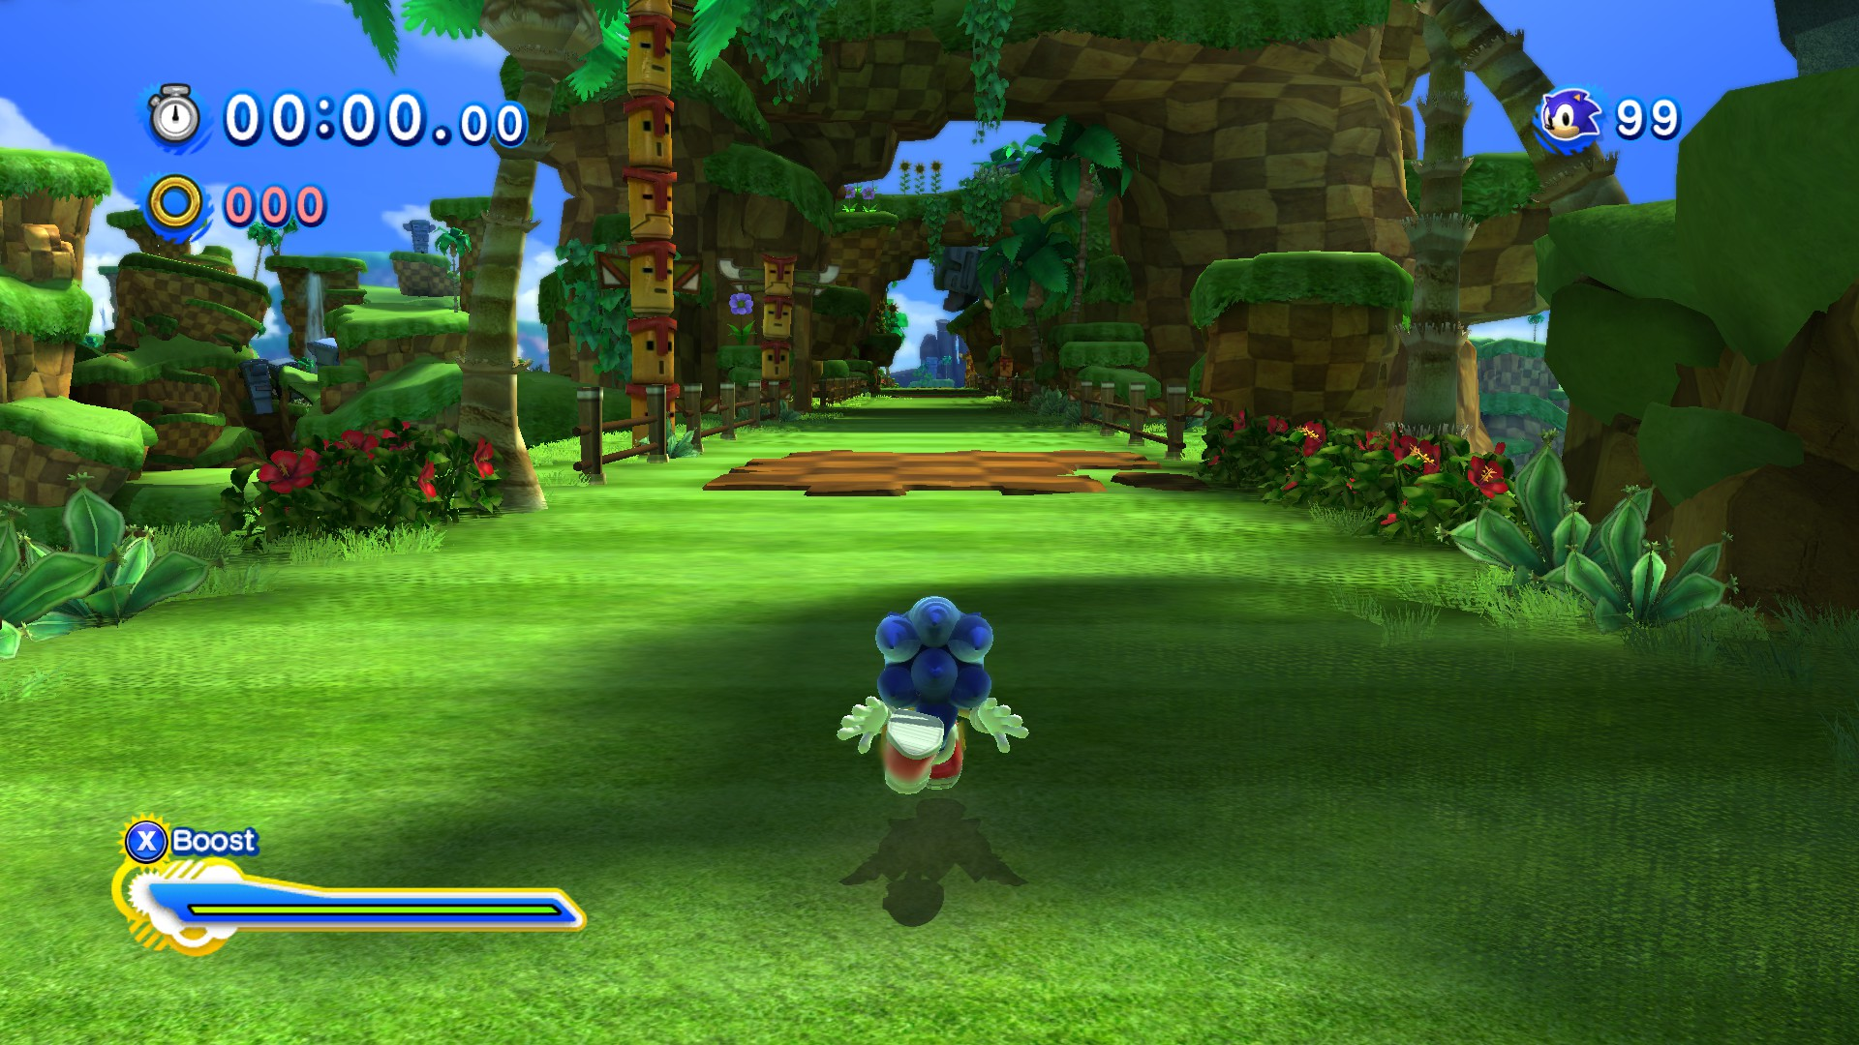
Game Play
Classic Sonic’s gameplay consists of 2D stages. He can jump and use the spin dash, just like he can in the Genesis days.
Modern Sonic’s stages mix 2D and 3D sections. Instead of spin dashing, Modern Sonic can boost to achieve high speeds. He can also use the homing attack to defeat enemies.

Slide 7
User Interface
On the main menu players can choose to start a new game, continue their previous game, upload their best times in the stages to worldwide leader boards, view the options menu shown to the right, or quit the game.
There are a variety of options that can be tweaked in the options menu.
Control tutorial will show button prompts on-screen when the player can perform certain actions.
Omochao hints will give the player vocal instructions on how to perform each ability as they appear during gameplay.

Slide 8
Scoring, Artwork, and Sound Design
Scoring: After completing each stage, the player is scored based on how quickly the stage was completed and how many rings were collected. Once the score is totaled, a rank (D, C, B, A, S) is given based on the player’s score. The ranking is saved, so the player is encouraged to achieve the highest rank on each stage.
Artwork: The artwork of each stage is inspired by the game it originally appeared in, but it has been updated to a more modern look. The game looks great when in motion, as it should for a game this fast paced, but there are many artistic details that can be seen if the player decides to take it slow.
Sound and Music: The music for each stage is remixed from the game it originally appeared in. There are distinct styles between music in Classic and Modern Sonic’s stages. The entire soundtrack is still memorable even when not playing the game, which is great.

Slide 9
Special Features, Manual, Bugs, and Installation
Special Features: In each stage there are five red star rings to collect. Each ring collected unlocks either a piece of concept art or a music piece from a previous Sonic title.
Manual: The PC version does not come with a manual (other versions of the game may include one), but the controls can be viewed from the in-game options menu at any time.
Bugs: Modern Sonic has the ability to jump off of certain walls in his stages to reach new areas. In the PC version, he will stick to walls, which will sometimes hinder this ability. In the console versions, he will slide off of the wall if the player does not jump, which is the intended behavior.
Installation: After purchasing the game from the Steam store, it will appear in the user’s library and installation can be initiated as soon as the user wishes. After installing, there is a first time setup, but it is straightforward.

Slide 10
Game Review – The Good and the bad
The Good
Even though the objective of each stage is to reach either a sign post or a goal ring at the end, there are several different paths to reach the end for the most part. What may appear to be a background or cosmetic element is actually a part of the stage to be explored.
The use of stages from previous Sonic titles may be unoriginal, but each stage brings something new that makes it feel different from its original incarnation.
The Bad
The last two stages suffer from a pretty large difficulty spike and drag on for too long.
The final boss fight is confusing during the first play through and is not very interesting once the player knows what to do.
The game could use more 3D sections since classic Sonic’s stages are entirely 2D and Modern Sonic stages are a mix between 2D and 3D.

Slide 11
Comparison to Similar Games
This game may seem like just another platformer, but it is fast paced and open ended just like many Sonic games before it.
To compare it to a different platformer series, Super Mario Bros, this game is more fast paced and there is always more than one way to reach the goal.
Stages in a Mario game are quite linear and have only one route to the goal.
In Sonic Generations, stages are more open and have multiple routes to the goal.

Slide 12
Appropriate Audience and Design Mistakes
Sonic Generations is intended for fans who have played Sonic games since the Sega Genesis era, because the game is built entirely on Sonic’s previous adventures, and the classic sonic of the Genesis era is playable. It can also appeal to those who are new to Sonic games, since the gameplay style of the most recent Sonic games to this point is present.
Design Mistakes: There are a few moments where the camera does not like to cooperate in 3D sections of gameplay, which can be problematic.

Slide 13
Summary
Strengths: The gameplay is fun, there are plenty of easter eggs and references that Sonic fans will enjoy, and the soundtrack is amazing.
Weaknesses: The last two stages and the final boss fight are the weakest aspect of the game, and will definitely feel like a bit of a letdown.
The game is definitely worth purchasing, since it is high in replay-ability.
Improvements: The last two stages and the final boss fight could have been designed better, and there could have been a better balance between 2D and 3D gameplay.

Slide 14
Works Cited
http://store.steampowered.com/app/71340/
https://www.amazon.com/s/ref=nb_sb_noss_2?url=search-alias%3Daps&field-keywords=sonic+generations
Screenshots of gameplay were taken directly by me, they were not taken from online sources.

