Slide 1
Evaluation of: Dishonored
Omar Elshaikh
CIS 487

Slide 2
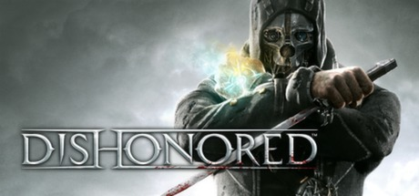
Developed by Arkane Studios
Published by Bethesda Softworks (Developers of Skyrim and Fallout)
Released in October 2012
Genre: First Person Stealth Action (Similar to Assassin’s Creed + Bioshock)
Price: 10$ on Steam (60$ at Release)

Slide 4
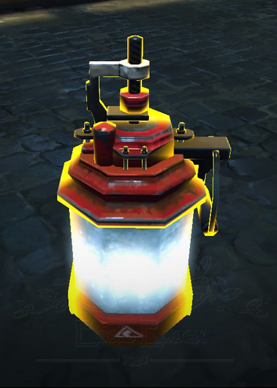
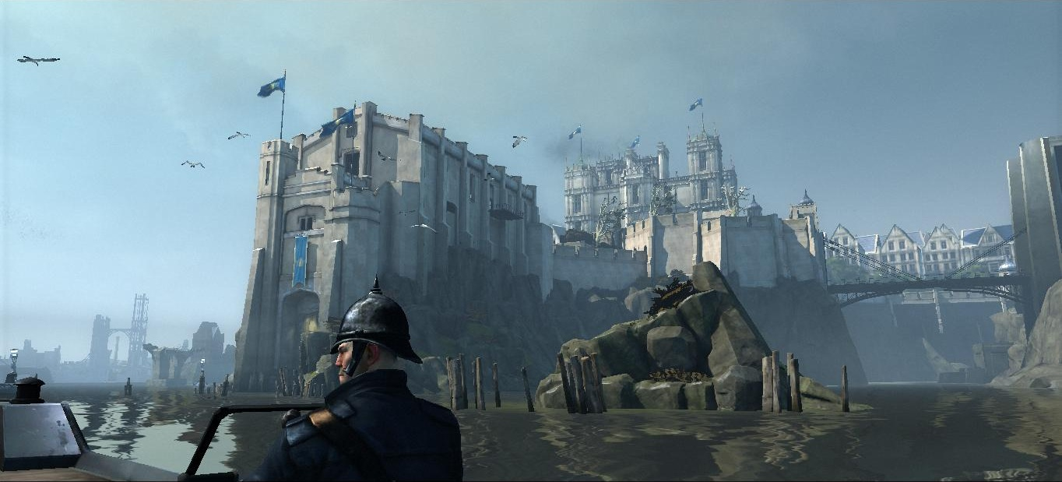
Game Summary
The game is set in the port city of Dunwall
Elements of 17th Century England combined with steampunk – only instead of steam, everything is powered by whale oil
You start the game as a royal bodyguard of the Empress

Slide 5
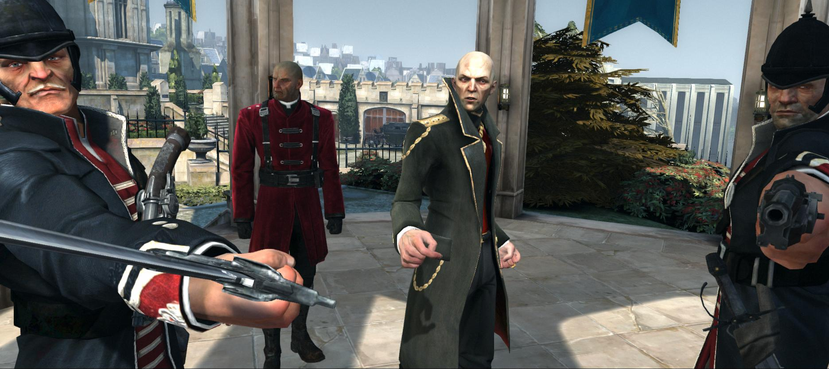
Game Summary continued
At the beginning of the game the empress is murdered and her daughter is kidnapped by a group of officials who seek power of the region
You are immediately framed for her murder and sentenced to execution after a period in prison

Slide 6
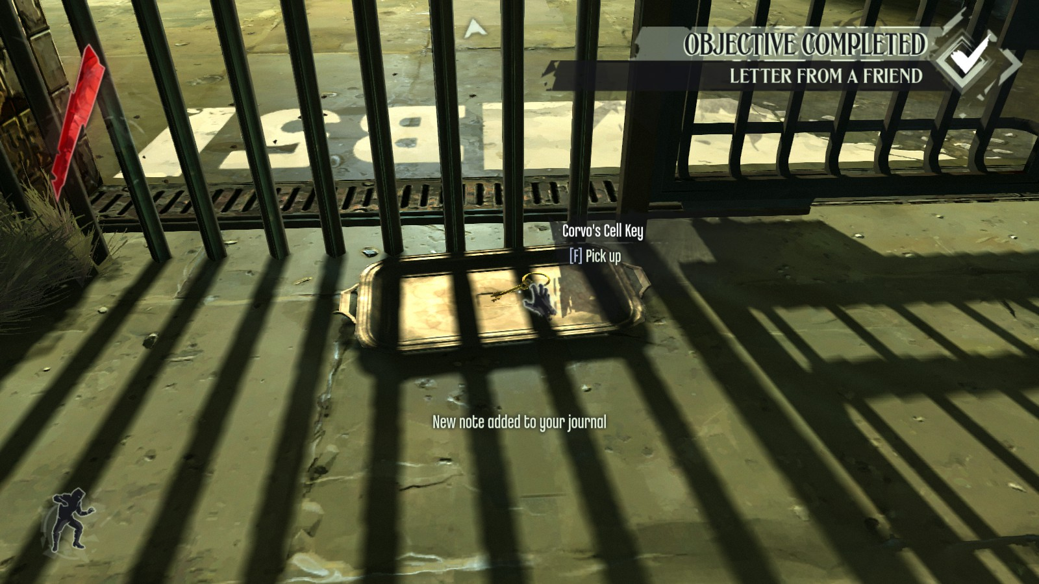
Game Summary continued
While in prison you receive a note and key from a group of loyalists that wish to overthrow the corrupt regime
They believe you were framed and want to employ your help in order to bring those involved in the conspiracy to justice

Slide 7
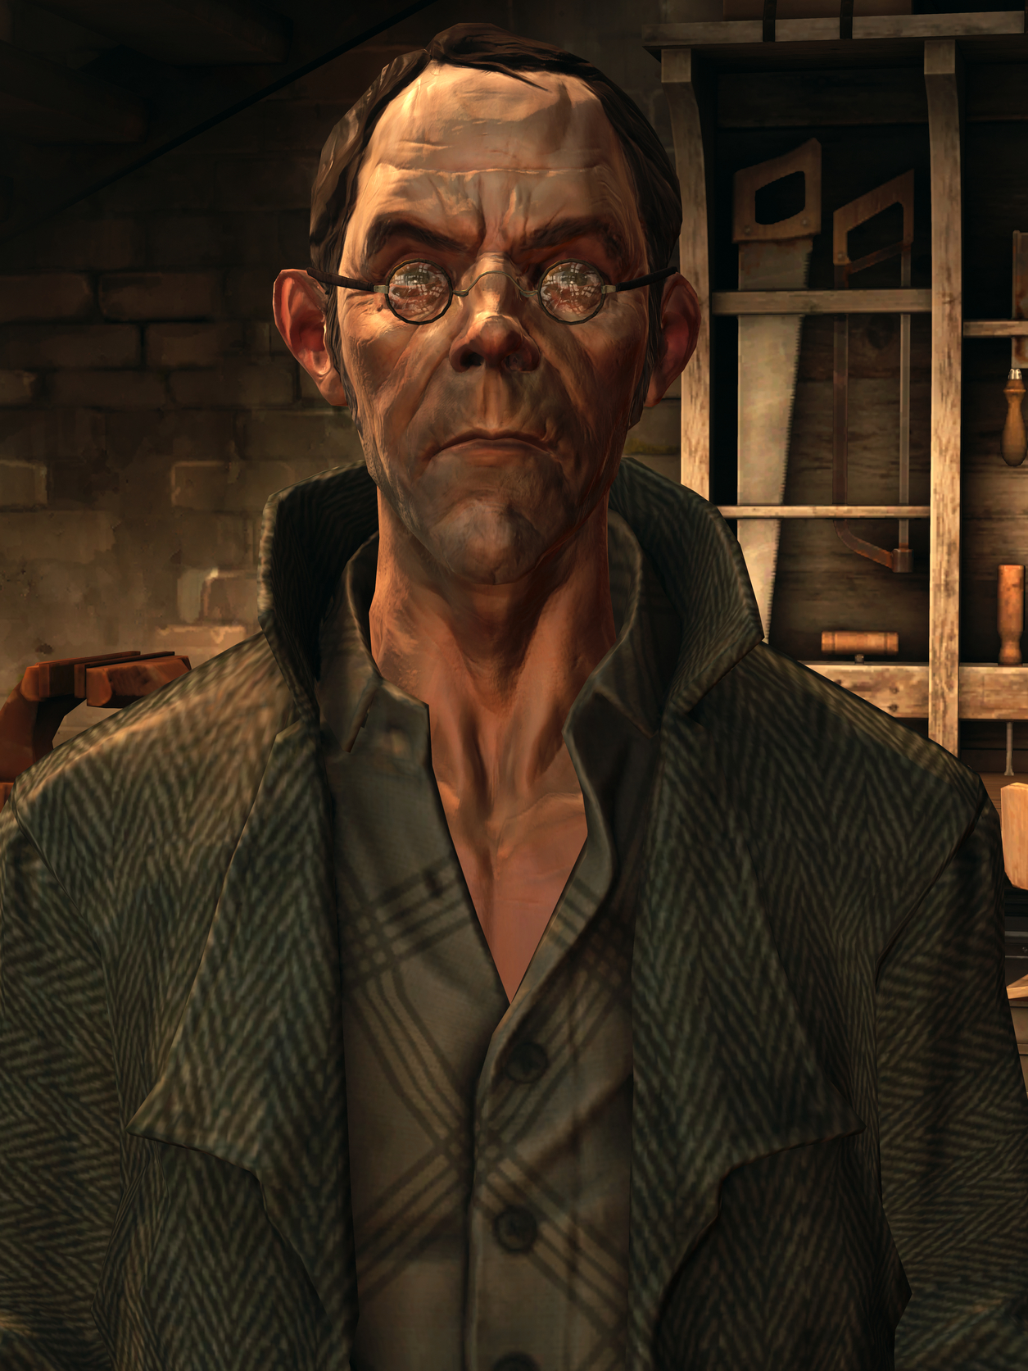
Gameplay
After becoming an assassin in order to neutralize targets within the regime, you build you arsenal of skills and weapons
A member of the loyalists that saved you provides you with gadgets, weapons, and upgrades
You also find gadgets randomly across the map
You always wield a sword in your right hand and your left hand is free to switch between weapons, gadgets and abilities.

Slide 8
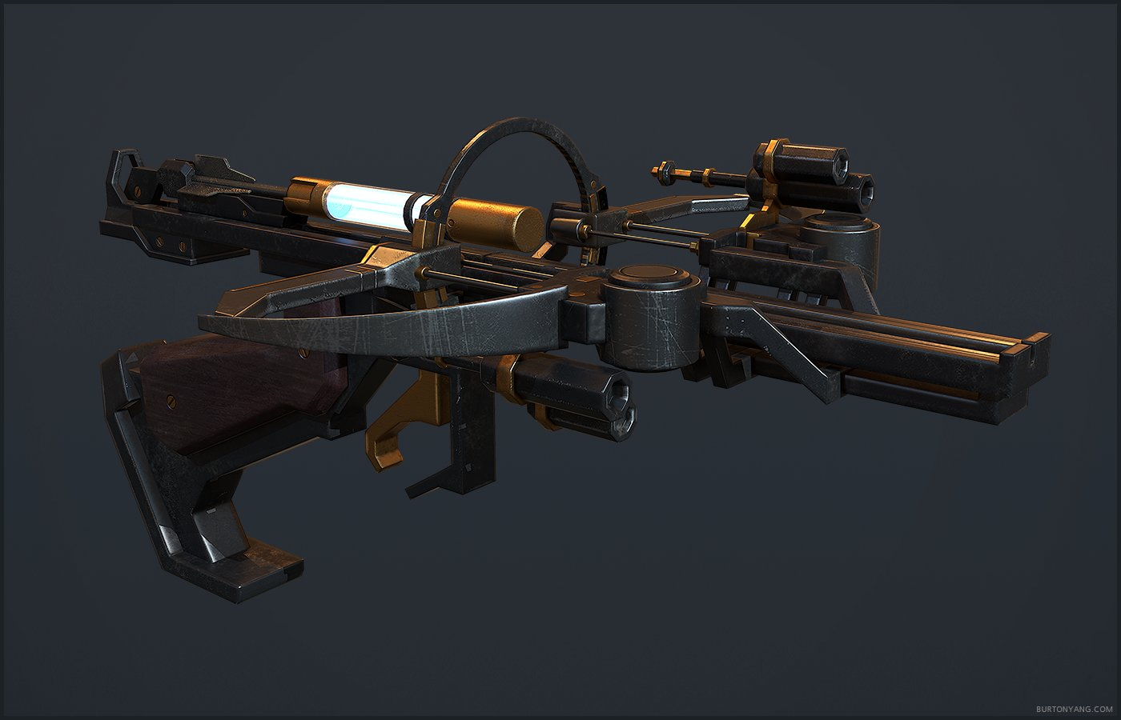
Gameplay continued
Some of the weapons and gadgets you acquire as you advance through the game include:
A Pistol
A Crossbow
Regular grenades
Sticky grenades
Stun mines
Weapons such as the crossbow and pistol also offer upgrades in terms of damage, accuracy and ammo type

Slide 9
Gameplay continued
You gain supernatural abilities bestowed upon you from a mysterious character known as the outsider
Abilities include the likes of:
Blink - Allows you to blink forward a distance
Dark Vision - Allows you to see enemies through walls and which direction they are looking
Devouring Swarm - Summons rats to eat enemies and eliminate corpses
Agility - Passive ability which grants extra movement speed and jump height
Abilities cost mana and can be upgraded through the outsider

Slide 10
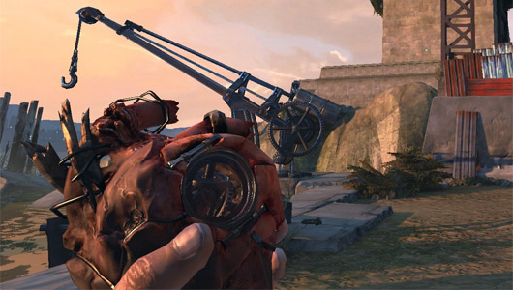
Gameplay continued
You can find runes throughout the map which allow you to upgrade your abilities
Bone charms are artifacts found throughout the map which grant passive bonuses such as:
Faster climbing
Potions grant 10% more health
Faster mana regeneration
Enemy grenades take longer to explode
The outsider provides you a heart which you can equip to help find bone charms and runes

Slide 11
Review
The beauty of Dishonored is that it grants freedom to the player to advance through the levels in a variety of ways
Fight, Flight, or Out of Sight
You can confront enemies head on and use your combat skills, weapon upgrades, and the ability to parry guard attacks and cause as much bloodshed as possible
You can traverse a level while constantly being pursued by the slower guards thanks to you agility and blink abilities
The entire game can be completed without killing any enemies (including assassination targets)
You can combine any of the 3 fundamental strategies

Slide 12
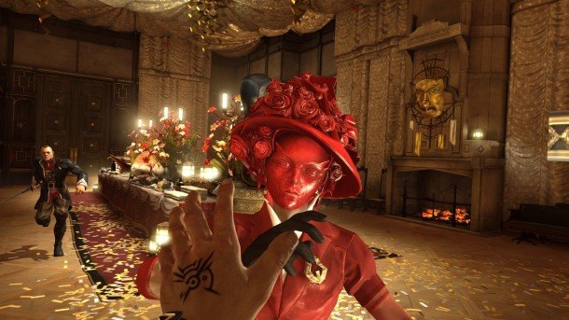
Artwork, Sound, and Music
Music changes if you’re revealed to guards or being pursued
You can eavesdrop guards talking for clues on how to pass level or reveal how infamous you are becoming
You often hear city-watch announcements which helps immersion
The artwork is beautiful full of colors and contrast

Slide 13
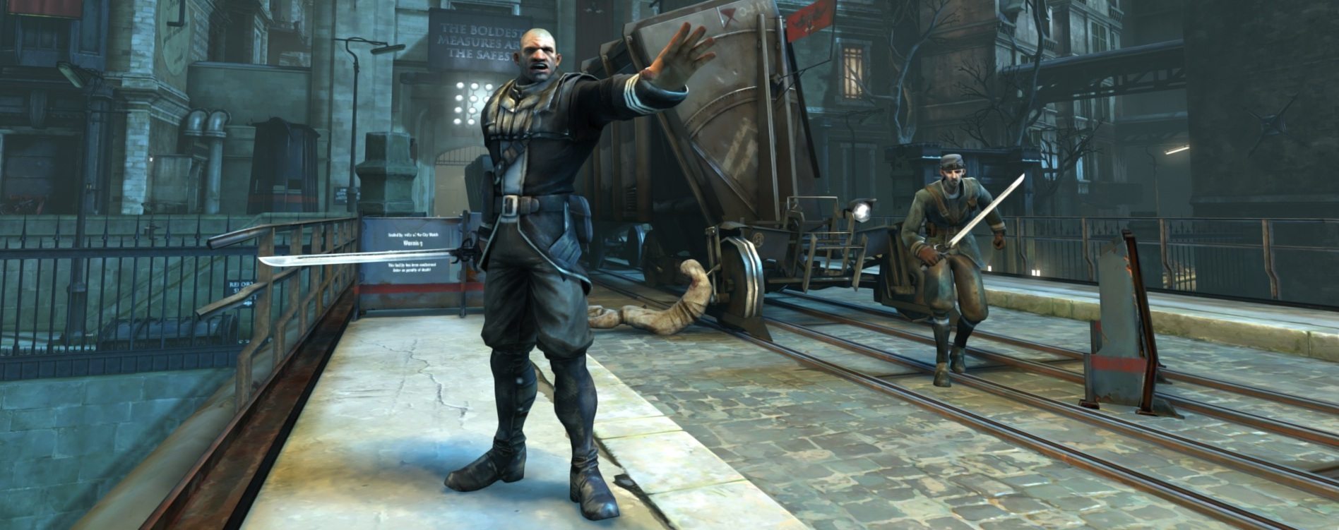
Compared to Other Games
Less repetitive than something like Assassin's Creed
More options and freedom when compared to Bioshock
Same immersion as Half-Life 2
Almost in a genre of its own

Slide 14
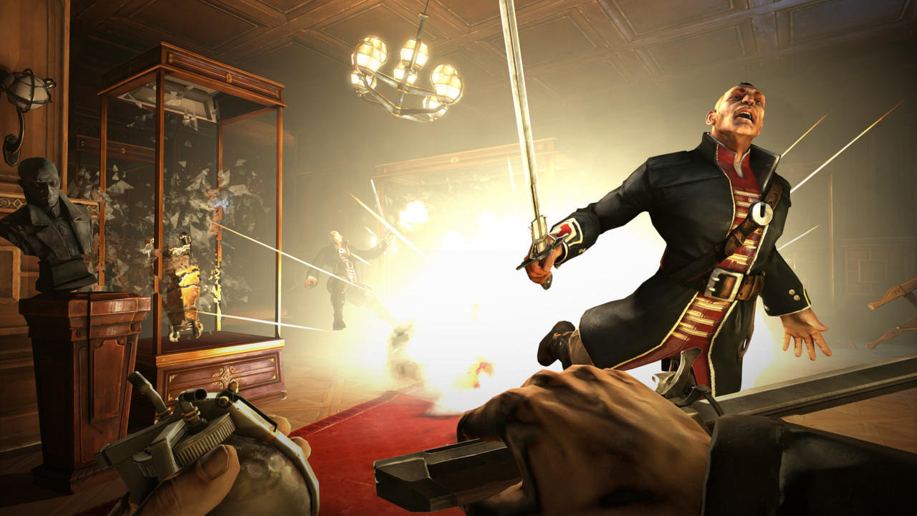
What’s not Great
The game can sometimes feel too easy since you are a skilled assassin with supernatural powers fighting poorly equipped guards
The story ending seems unsatisfying after all of the build up and ambiguity

Slide 15
Would I recommend it?
Definitely, especially at only $10 on Steam
Dishonored 2 is scheduled to come out soon (November 2016)

