Slide 1
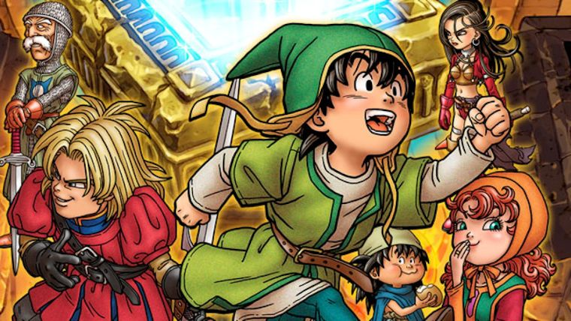
Dragon Warrior VII Game Evaluation
By: Abdullah El-Haik

Slide 2
Basic Info
Developed by Japanese game developers Heartbeat & ArtePiazza
Published by Enix
Turn based RPG game for the PS1
Released:
August 26, 2000 in JP
October 31, 2001 in NA
Original price $50
Current price varies greatly by condition
$20-$50 for a used copy
$90-$150 for a sealed complete copy
https://www.pricecharting.com/game/playstation/dragon-warrior-7

Slide 3
Quick Overview
First 3D game in the Dragon Quest/Warrior Series
Single player
One of the longest games in the series with 100+ hours of gameplay not including side quests and extras
Best seller in Japan with 4.12 million units sold
Released for PS1 the year the PS2 console was released

Slide 4
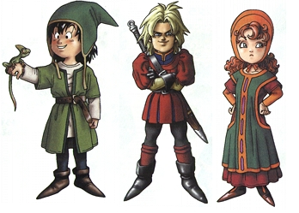
Story
Play as the son of a fisherman on Estard Island.
Estard Island is the only landmass in the world. Making it’s inhabitants the only humans on the planet.
However, local legends and a mysterious temple hint at a mysterious calamity fracturing the world in the distant past.
Uncover the mystery of the world with your friends Kiefer and Maribel.

Slide 5
Art and Music
Art design by Akira Toriyama
Low polygon 3d models
Large number of orchestral music tracks
Simplistic in-engine cut scenes with a couple of pre-rendered cinematics
Few animations (however each attack has a unique though simple animation)
Sound affects for damage taken, critical hits, spells casting, etc.

Slide 6
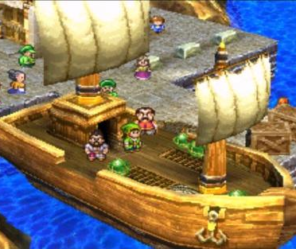
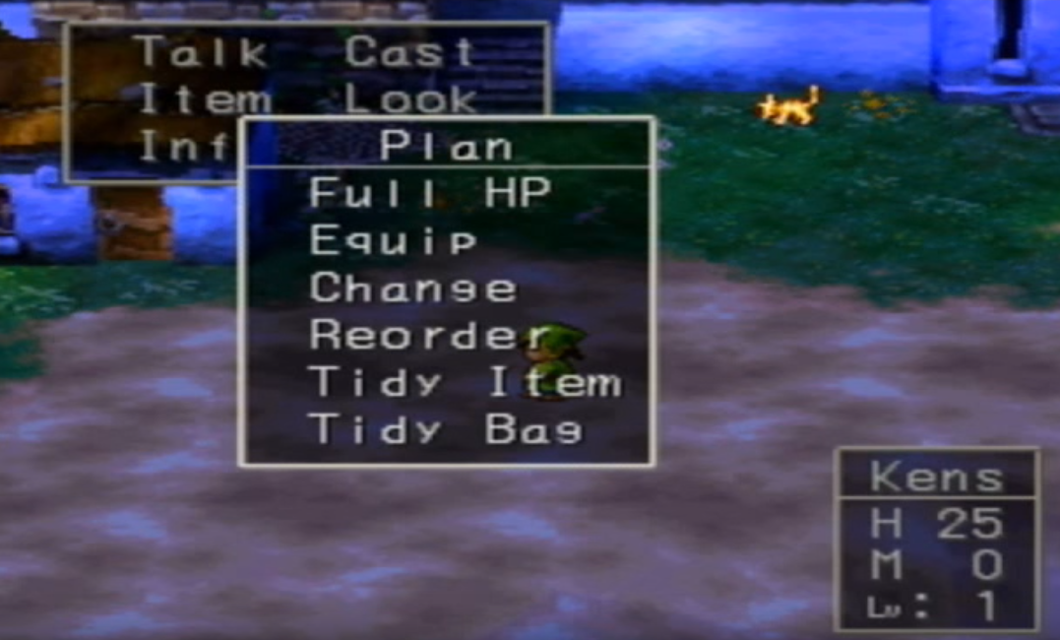
User Interface Overworld and Dungeons
Menus, menus, menus
Pressing start brings up a menu with each option leading to more menus
In addition to the party inventory each party member has an individual inventory
Inventory is represented as a list with no graphical representation
No visible HUD while exploring

Slide 7
Combat User Interface and Gameplay
Traditional turn based strategy
Can only see enemies, party is represented by a table
Menus within menus
Game varies combat by introducing physical, magical, and support skills with different attributes and effects
All party commands are input at the beginning of each round. Turn order is based on speed stats and if an attack has a “first strike” modifier
Can fully control companions or automate AI behavior
Ex. Heal when health < 50% otherwise use a normal attack

Slide 8
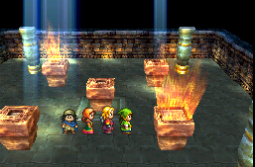
Unique Gameplay Feature: Map Shards
Map shards can be found and used in the temple to allow time travel to other islands.
The player must then stop the events that lead to the island’s disappearance.
Recovered islands can be visited in the present.
Leads the player to become intimately familiar with each island’s layout and history
Makes exploration and seeing the results of your actions exciting

Slide 9
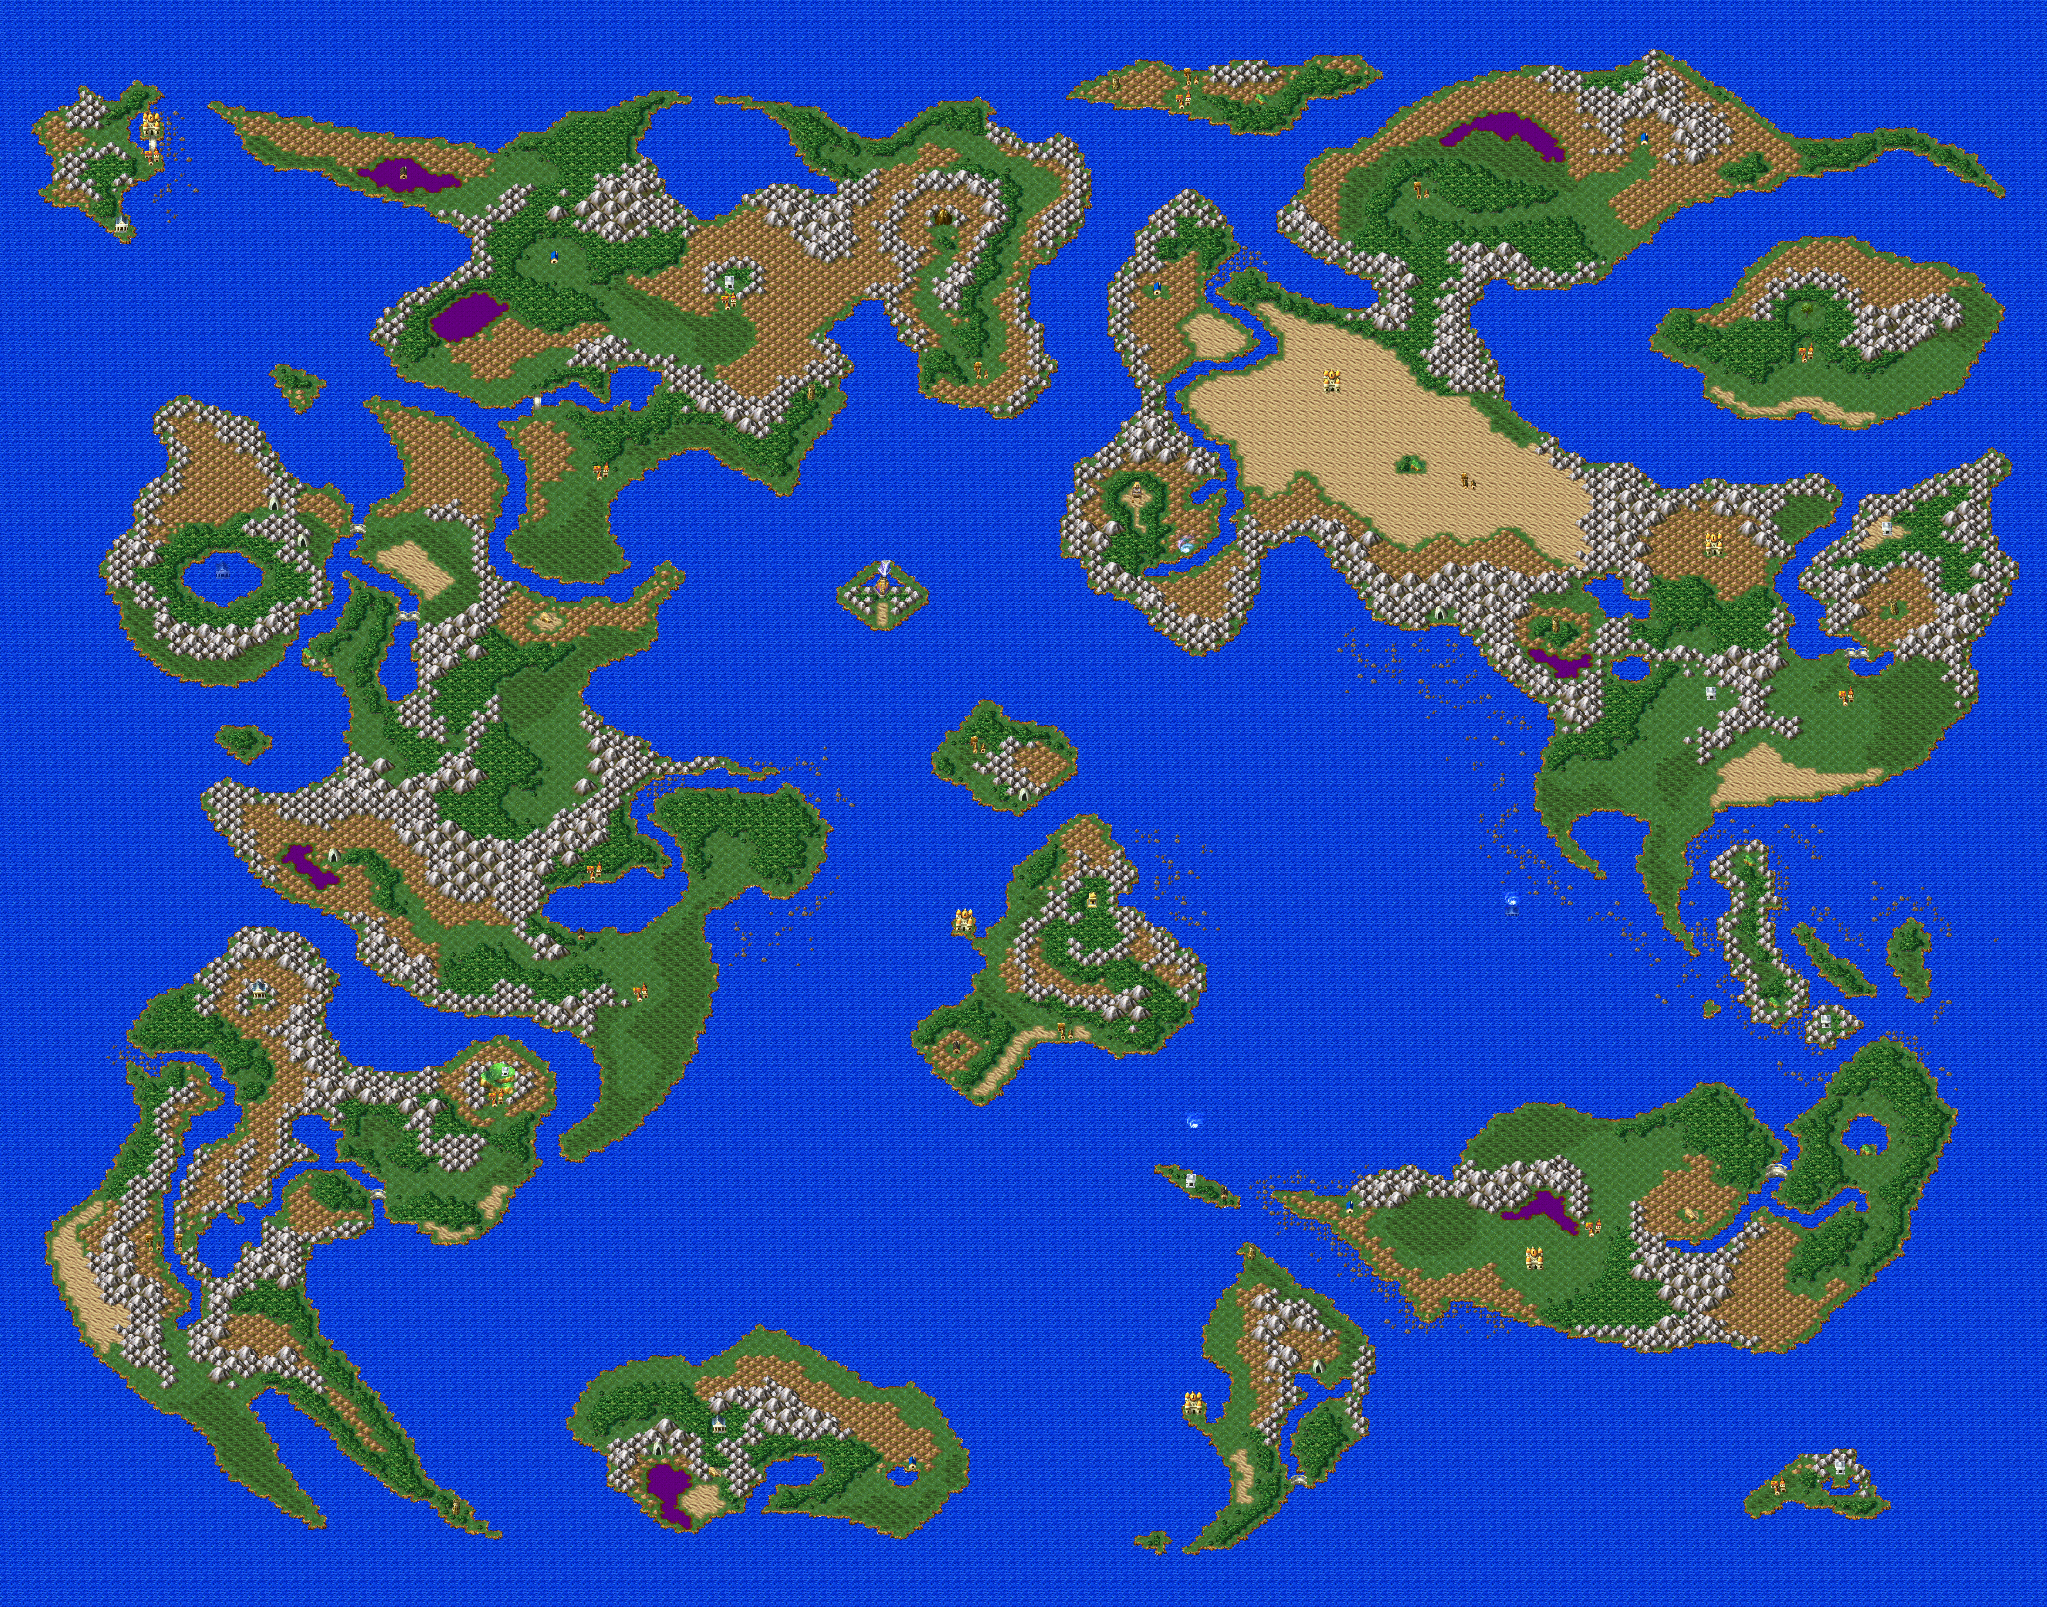

Slide 10
Unique Gameplay Feature: Custom Town
5 Variations of the custom town to build based on what kinds of villagers you recruit.
Each town has unique items that can only be obtained in that variation, including hidden shards.
Gives you a reason to stop into nearby towns and inns to recruit

Slide 11
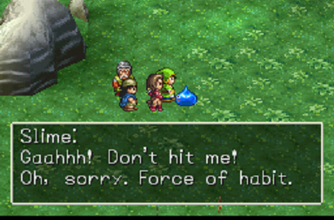
Unique Gameplay Feature: Monster Park
Monsters you fight in the wild have a chance of being recruited to the park.
Collect blue prints to build unique locations in the park
Gives you a goal while grinding

Slide 12
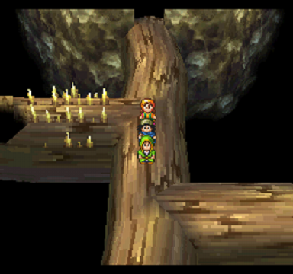
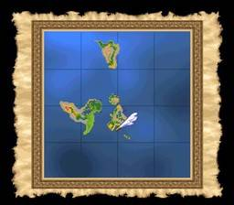
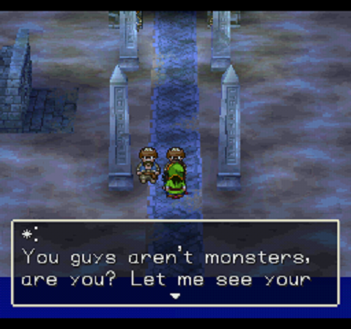
What is good about the game?
Excellent story
The gradual introduction of new islands is a great way to keep the player informed and interested in the world
Flipping between past and present makes back tracking fun
Large variation in dungeon theme and design
Bonus hidden islands
Lots of extra side quests, activities, and collectibles
Change classes and unlock advanced classes
Quick travel spell
No bugs

Slide 13
What is bad about the game?
Low monster recruitment chance
Random recruit able villager spawn
Re-use monster and npc sprites
Inventory management is a pain
Lots of grind
Difficulty spikes
No mini-map in dungeons

Slide 14
Comparison and Summary
Dragon Warrior 7 is a good old school JRPG aimed at teenagers and older. Despite its bright colors and cartoony graphics, it was difficult and deep.
Overall graphical quality was low despite it stylized art style. This is apparent in low quality textures, jagged edges, and rough monster/villager sprites.
It also suffered from a poor interface and awful inventory system compared to other games such as Final Fantasy.
However, I think the game’s excellent story and music place it among the best rpgs.
It also had more content than any of it’s competitors at the time by far.
The weaknesses of the game were addressed in the newly released remake for the 3ds.

Slide 15
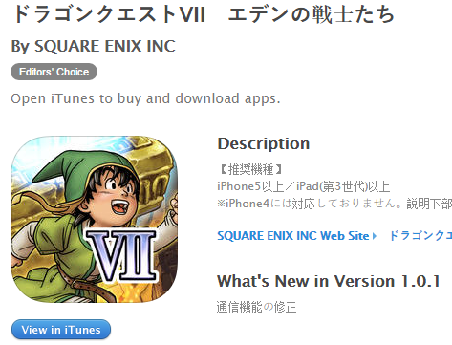
Remakes
Android, iOS
JP: September 17, 2015
NA: Not Announced
Nintendo 3DS
JP: February 7, 2013
NA: September 16, 2016
Price $39.99
The 3DS port is worth the price. Grind was reduced, graphical quality improved, and the interface was overhauled.

