Slide 1
William Do
CIS 487

Slide 2
Basic information
Company: Capcom
Created by Shu Takumi
Released 2001 for GBA, rereleased 2005 for DS
Type: Adventure
MSRP: $29.99
Hardware Requirements: GBA/DS

Slide 3
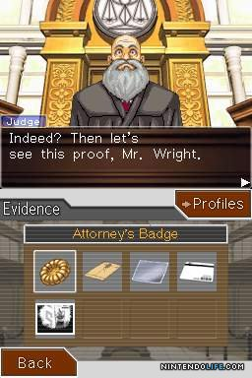
Summary
Play as defense attorney
UI consists of characters, text, backgrounds on top screen, inventory, navigation, etc. below
Gameplay: Two primary modes, investigation and courtroom

Slide 4
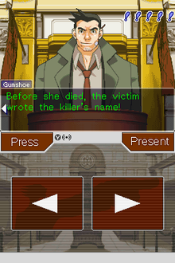
Summary (continued)
Artwork - all 2d, character portraits slightly animated
Sound - Characters not voiced aside from interjections in court
Special features - DS rerelease featured bonus case
Bugs

Slide 5
Review
Good
Game does well at producing emotional response
Bad
Very linear
Light on actual “gameplay”

Slide 6
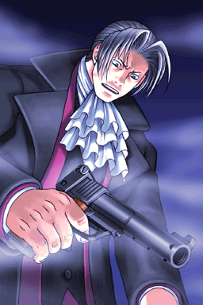
Review (continued)
Investigation portions of game most similar to other adventure games, but set apart by courtroom portions
Writing and soundtrack are both excellent
ESRB rating of Teen

Slide 7
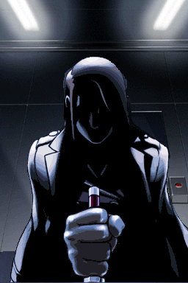
Summary
Strengths
Writing and soundtrack are excellent
Gameplay is satisfying, if light
Weaknesses
Linearity of game can be frustrating at times
Worth purchasing - Depends
Improvements - certain investigation portions could be clearer

