Slide 1
CIS 487
Game Evaluation
By: Ali Dashti

Slide 2
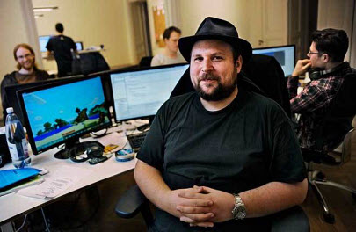
About
Genre: Sandbox Survival
Developers:
Markus Parsson
Mojang
Microsoft Studios
4J Studios
Copies Sold: 100+ Million Copies
Platforms:
Microsoft Windows | Windows Phone
OS X | iOS
Linux | Android
PS 3 | PS 4 | Xbox 360 | More…!

Slide 3
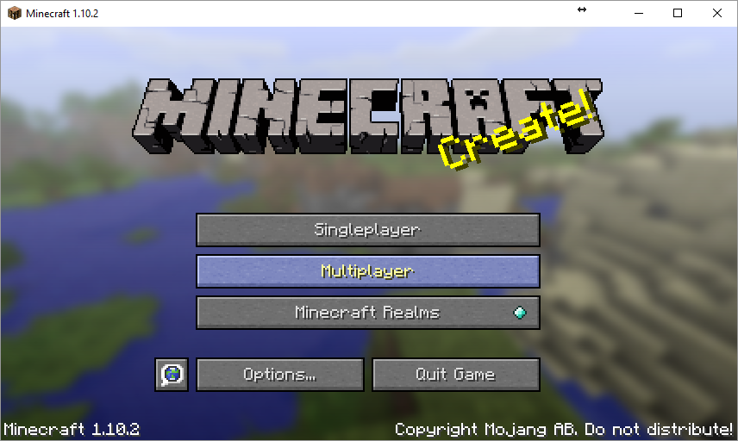
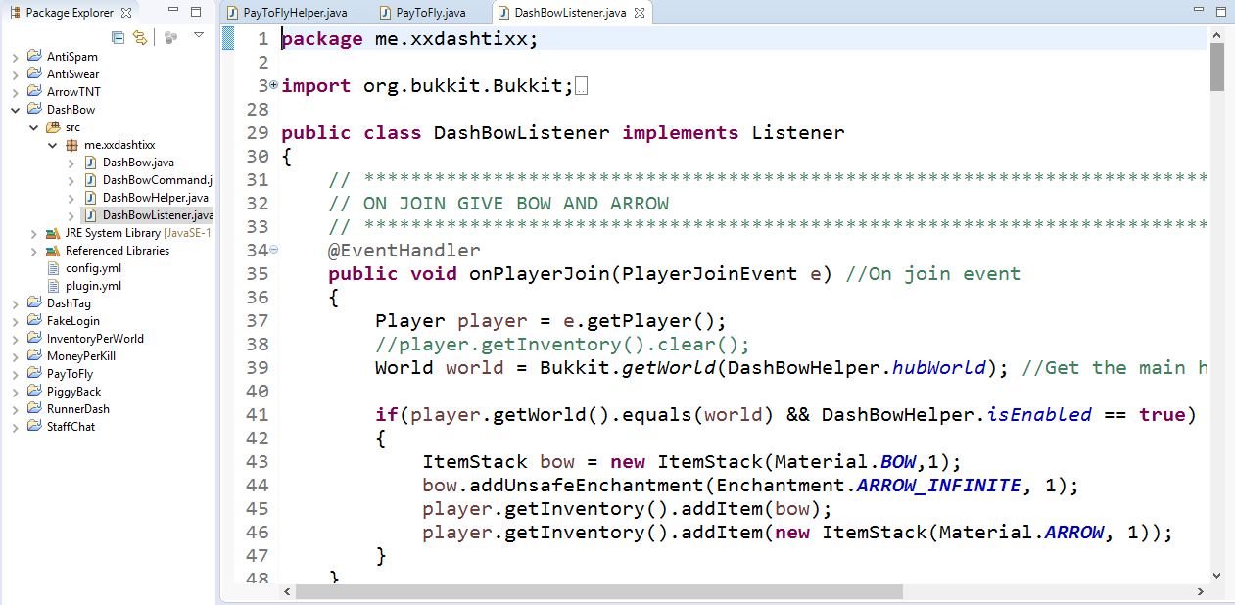
Why minecraft?
Genre
Simplicity
SFX: https://www.youtube.com/watch?v=NOI5XV7I_yA
Multiplayer
Audience
Modifications
Link: https://dev.bukkit.org/

Slide 4
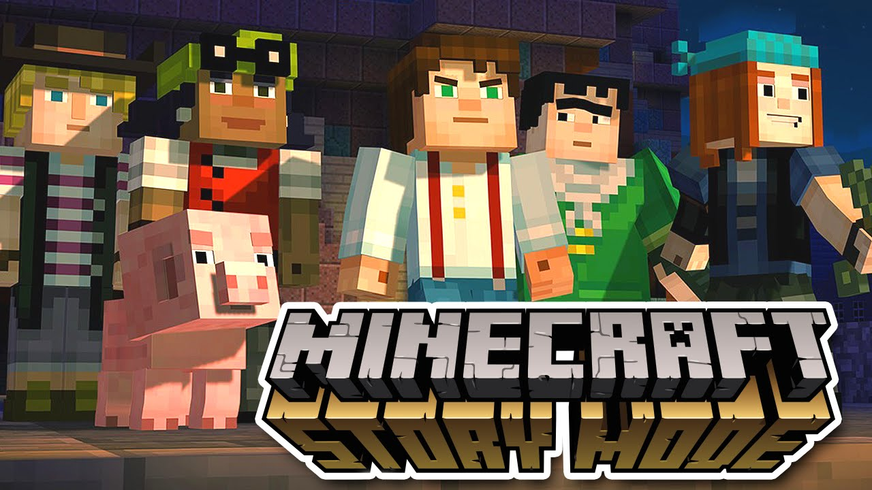
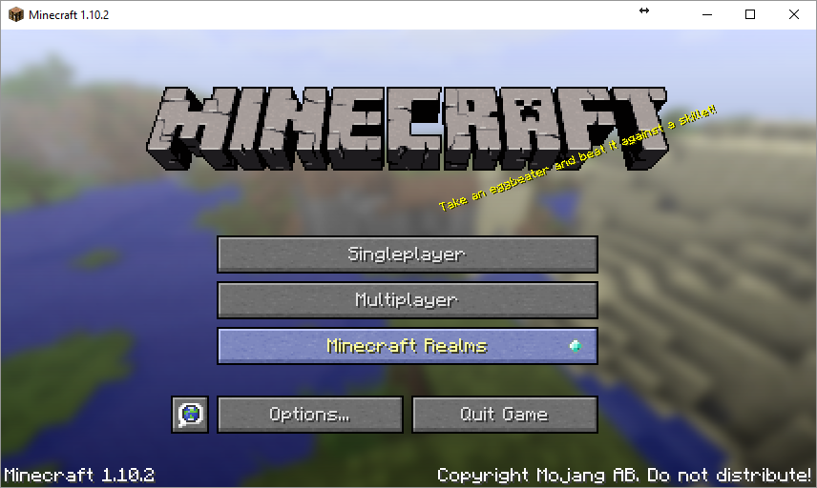
What needs improvement
Official Servers
Story (Plot)
Ref: https://help.mojang.com/customer/en/portal/articles/1018151-minecraft-realms

Slide 5
THANK YOU!
Questions?

