Slide 1
GAME EVALUATION
CIS-487
SEAN CROSKEY
FALL 2016

Slide 2
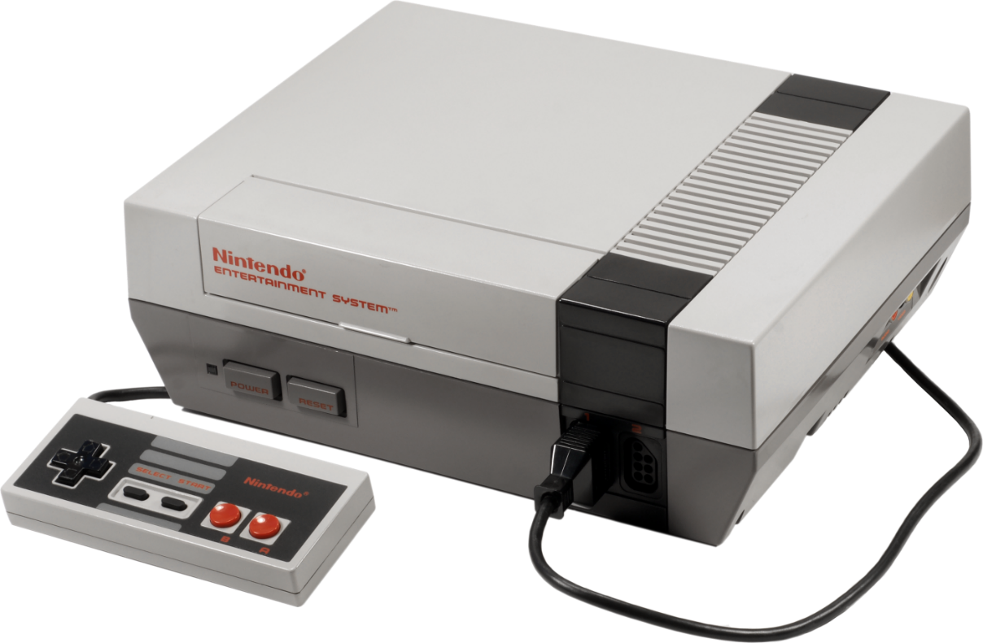
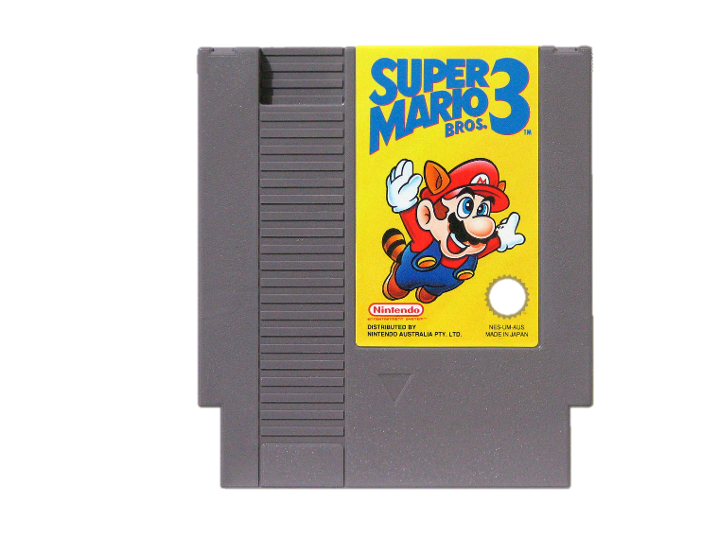
BASIC INFORMATION
Game Title: Super Mario Bros. 3 (SMB3)
Developer/Publisher: Nintendo
Release Date: February 9, 1990 (NA)
Game Type: Platformer
Price: $50 (~$92 today)
Hardware Requirements:
Nintendo Entertainment System (NES)
One NES controller (two for multiplayer)
No installation required (just insert cartridge)
Minimum/Actual hardware requirements are identical

Slide 3
GAME SUMMARY

Slide 4
QUICK OVERVIEW AND STORY LINE
The game world consists of eight kingdoms (or worlds), each of which have their own set of levels
Mario is a plumber that rescues Princess Peach from danger
Mario must recover the magic wands from Bowser’s children in each world
Bowser kidnaps Princess Peach towards the end of the game
Page 4 from the game manual
Mario
Princess Peach
Bowser

Slide 5
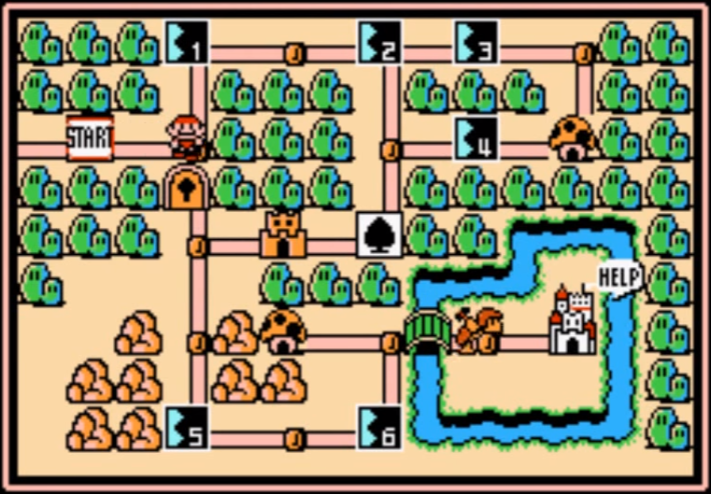
PLAYER’S ROLE AND GAME PLAY
The player controls Mario through each of the eight kingdoms
Mario is able to jump in the air, stomp on enemies, swim, fly, and much more
The end goal is to save Peach and defeat Bowser
The goal in each level is to overcome all of the enemies and make it to the end within a time limit
If Mario gets hit by an enemy (while small), falls in a pit, or lets time run out, a life is lost
World 1 Map Screen

Slide 6
USER INTERFACE AND SCORING
World Number
Power Meter
Number of Coins
Number of Lives
Score
Time Left
Card Slots
Score is almost meaningless
Main goal is to beat the game – so lives are important
100 coins gives you an extra life
Cards are awarded upon beating a level
Getting three of a kind of card nets multiple bonus lives

Slide 7
ARTWORK, SOUND, AND MUSIC
SMB3 is a very colorful game
Graphics stutter in some areas, though
26 songs in the game
Any in-game sound (hitting a coin block) overrides the background song
Full soundtrack
Abundance of different sounds in the game

Slide 8
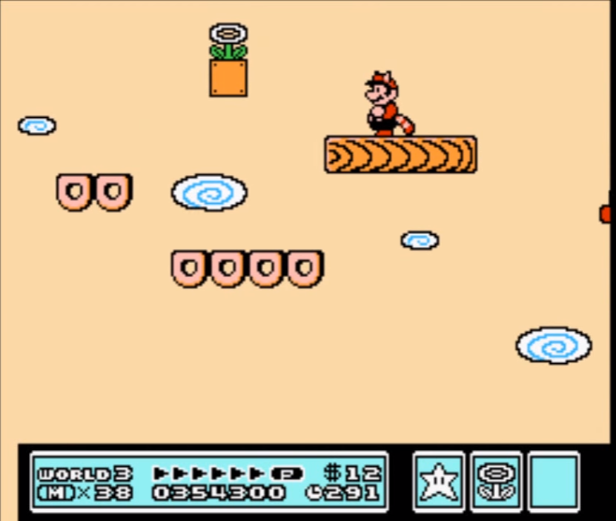
SPECIAL FEATURES
The Super Mario Bros. 3 game cartridge used a special chip (memory management controller) which:
Provided extra RAM for diagonal scrolling in game
Allowed for the screen to be split into two segments: one for the persistent user interface and the other for the actual game.
Segment 1
Segment 2

Slide 9
BUGS
Very few bugs – game was well tested and polished
Once a NES game was released, there was no “patching” it
There are certain walls that you can clip through if you jump a specific way
If the player crouches when they jump in this area, they get to skip part of the level by traveling through the wall.

Slide 10
GAME REVIEW

Slide 11
THE GOOD
Great difficulty incline/curve as game progresses
Each level and each world feels unique
Many unique items and enemies
Plenty of content (game takes ~5 hours to beat)
Most bosses are difficult, but not unfair
Map screen allows player to bypass some difficult levels
Many mini-games and secrets
Almost every single level in the game has some sort of secret

Slide 12
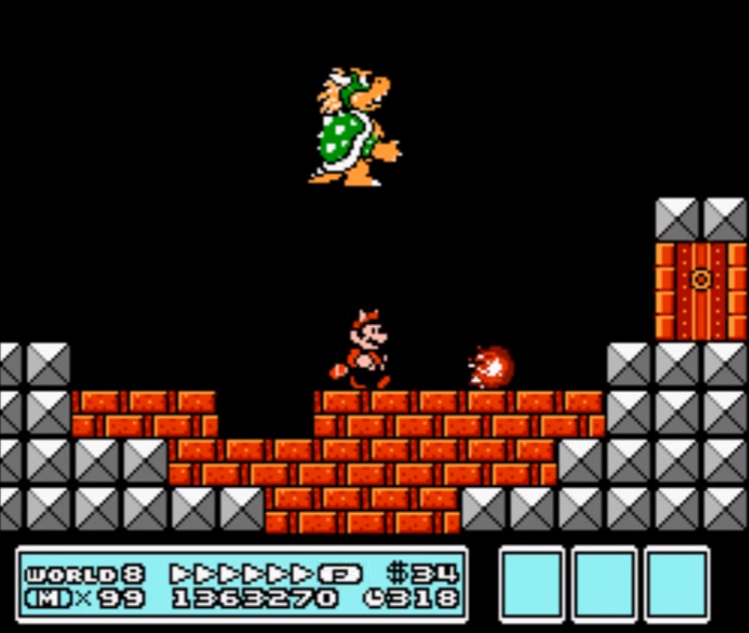
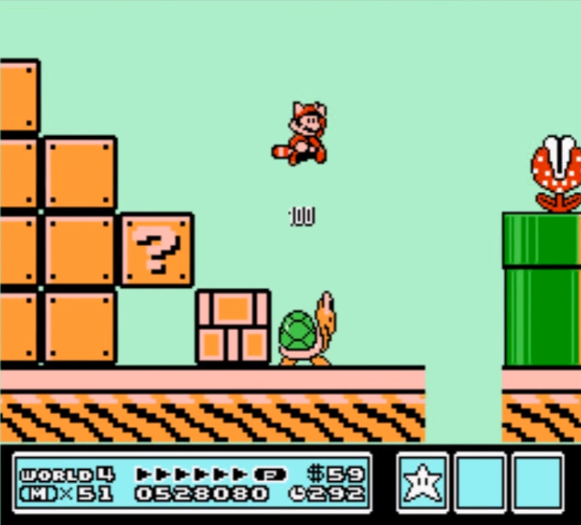
COOL AREAS IN GAME
To defeat Bowser, you must make him destroy the blocks beneath you so that he falls down.
World 4 is the Giant World. Almost all of the enemies in this world are gigantic.

Slide 13
BYPASS DIFFICULT LEVELS
Level 4 is considered one of the harder levels in World 1
You can get through the world without having to play this level

Slide 14
THE BAD
Some areas in levels are poorly designed
A few bosses have annoying mechanics
Bosses that can stun you for three seconds
Once you start to lose lives on a level you lose momentum
Some levels are set up in such a way that they are very difficult to beat without starting off with an item (like the ability to fly)
No way to save progress
Playing the entire game through is a time commitment
If the console shuts off, you start back at World 1 – Level 1

Slide 15
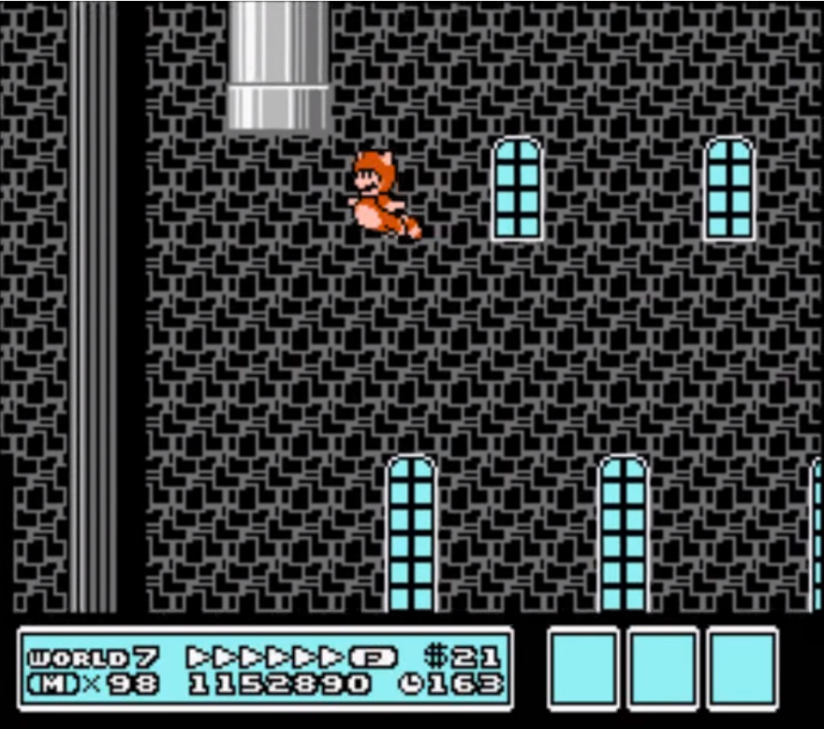
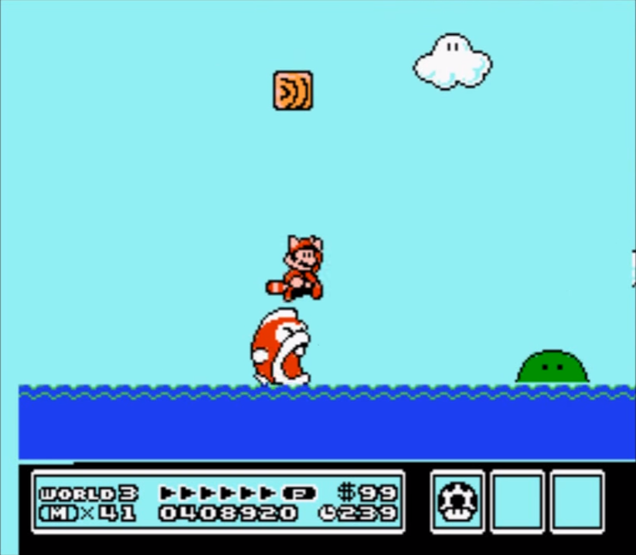
POOR LEVEL DESIGN (MISTAKES)
Solution to this “puzzle” is to fly to the top of the level and enter the pipe.
This level gets completely submerged every five seconds. The big fish tries to eat you.

Slide 16
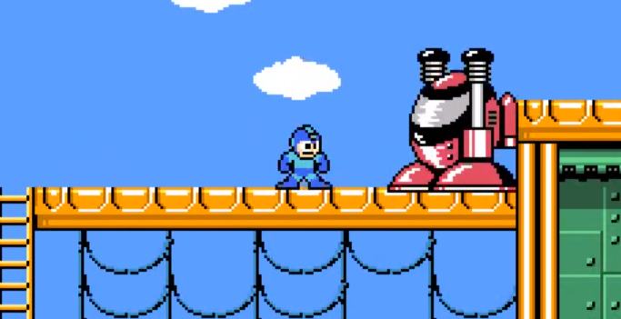
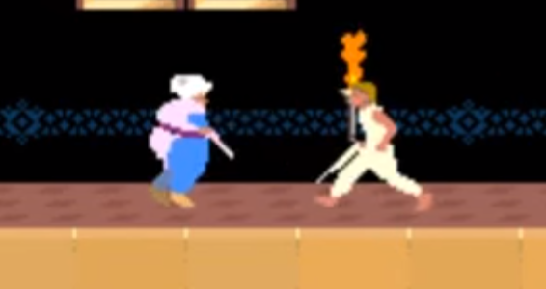
COMPARISON TO SIMILAR GAMES
Mega Man 3
Action-Platform game released on September 28, 1990 for the NES
~4 hours of game play
A lot of action and gun combat
Prince of Persia (1989)
Cinematic Platformer game released on October 3, 1989 for the Apple II
~2 hours of game play
Many unique puzzles
Great animations and movement
Very good graphics for its time

Slide 17
HOW DOES SMB3 COMPARE?
In terms of puzzles, Prince of Persia is the clear winner
In some areas, pressure plates have to be timed to open doors
In SMB3, the puzzles consist of finding a hidden pipe or door
Mega Man 3 lacks the in-depth user interface that SMB3 provides
SMB3 also has an overworld which Mega Man 3 does not have
Instead, Mega Man 3 has a boss selection screen which leads to each stage
Very few games were released back in this time
Games were unique – comparing apples to oranges even in the same genre
Mario’s popularity comes with the fact that he’s generic (or simplistic)
He’s not a superhero
Mario games feel simple because Mario is not overcomplicated

Slide 18
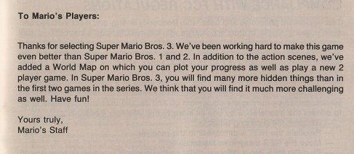
APPROPRIATE AUDIENCE
The game is appropriate for almost everyone by a rating standpoint
There is quite a bit of cartoon violence (Mario stomps on enemies)
The game could be quite difficult for a younger audience, though
Page 42 of the SMB3 Manual which is a letter from the developers to the players

Slide 19
SUMMARY

Slide 20
STRENGTHS AND WEAKNESSES
Strengths:
Unique feeling levels
Good difficulty curve
Many secret areas and items
Weaknesses
Bad puzzles
The worse you do, the harder the game becomes
No way to save progress

Slide 21
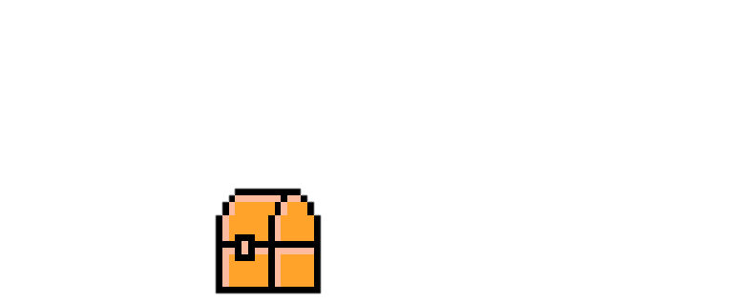
IS IT WORTH IT?
This game is definitely worth purchasing one way or another
Game has been re-released and ported to almost every Nintendo device
The game can be improved by:
Adding a save feature (newer versions have added this)
Reworking the bad puzzles/levels

Slide 22
SOURCES
SMB3 title page pic: http://orig14.deviantart.net/b352/f/2014/253/5/4/super_mario_bros_3_by_neo_musume-d7yr25q.jpg
Mario Font: http://fontstruct.com/fontstructions/show/1184080/super_mario_maker_extended
Inflation Calculator: http://data.bls.gov/cgi-bin/cpicalc.pl
NES SMB3 Cartridge: http://www.the-liberator.net/site-files/retro-games/games/nintendo-nes/nintendo-entertainment-system-nes-super-mario-bros-3.JPG
NES System: http://vignette2.wikia.nocookie.net/nintendo/images/8/8b/Nintendo_Entertainment_System_Model.png/revision/latest?cb=20120228011352&path-prefix=en
User Manual: http://www.digitpress.com/library/manuals/nes/Super%20Mario%20Bros%203.pdf
Some screenshots of in-game: https://www.youtube.com/watch?v=UlhahiPjua4

