Slide 1
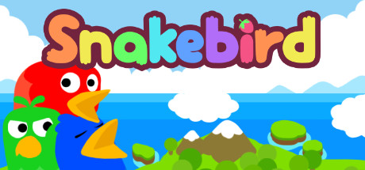
Kenneth Chen
CIS 587
September 21, 2016

Slide 2
Basic Information
Snakebird
By Noumenon Games
Puzzle Game
Price:
PC (Windows, Mac): $6.99
Mobile Device: Levels 1-9 free, All $3.99
Install via download from Steam

Slide 3
Minimum Hardware Requirements
Windows XP+
Processor: SSE2 instruction set support
Memory: 2 GB RAM
Graphics: Shader model 2 capable card
DirectX: Version 9.0c
Storage: 430 MB available space
Mac OS X 10.7+
Processor: SSE2 instruction set support
Memory: 2 GB RAM
Graphics: Shader model 2 capable card
Storage: 430 MB available space

Slide 4
Minimum Hardware Requirements, continued
Ubuntu 10.10+
Processor: SSE2 instruction set support
Memory: 2 GB RAM
Graphics: Shader model 2 capable card
Storage: 430 MB available space
Mobile Device
iOS 5.1.1 or later
iPhone
iPad
iPod touch

Slide 5
Overview
Snakebird is a puzzle game where your character is a snakebird. In order to beat each level you must maneuver your snakebird through various obstacles to reach a portal to the next level. If there are any fruit in the level you will have to eat all the fruit before entering the portal. Every time a fruit is consumed the snakebird grows in length by one link. The number of snakebirds and their length will vary on each level. The maximum number of snakebirds on a level is three.

Slide 6
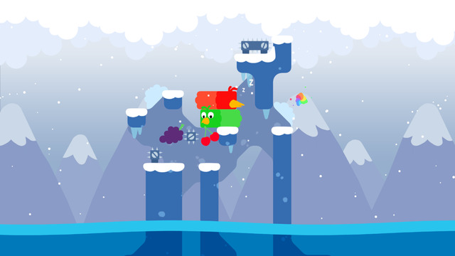
Sample Level

Slide 7
Game Details
Snakebird is a simple but challenging game. The way in which you use each of your snakebirds to maneuver through the scene matters since they are different lengths. The order in which the fruits are consumed matters. Snakebird is all about manipulating your snakebird’s body in the right shapes. Manipulative skills include pushing, lifting and teleporting. Recognizing the appropriate skill to use and when is key. In Snakebird nothing is hidden; if you wanted to you could solve each level on paper. You may undo moves or reset to the beginning of the level, if necessary, to figure out how to move to manipulate the snakebird.

Slide 8
Game Controls
PC Keyboard
Up: w or up-arrow
Down: s or down-arrow
Left: a or left-arrow
Right: d or right-arrow
Switch bird: space
Undo: q or Undo button on the top left
Reset level: r
Mobile Device
Select snakebird with touch
Swipe screen in desired direction to move the snakebird
Touch button at top of screen to Undo or Reset

Slide 9
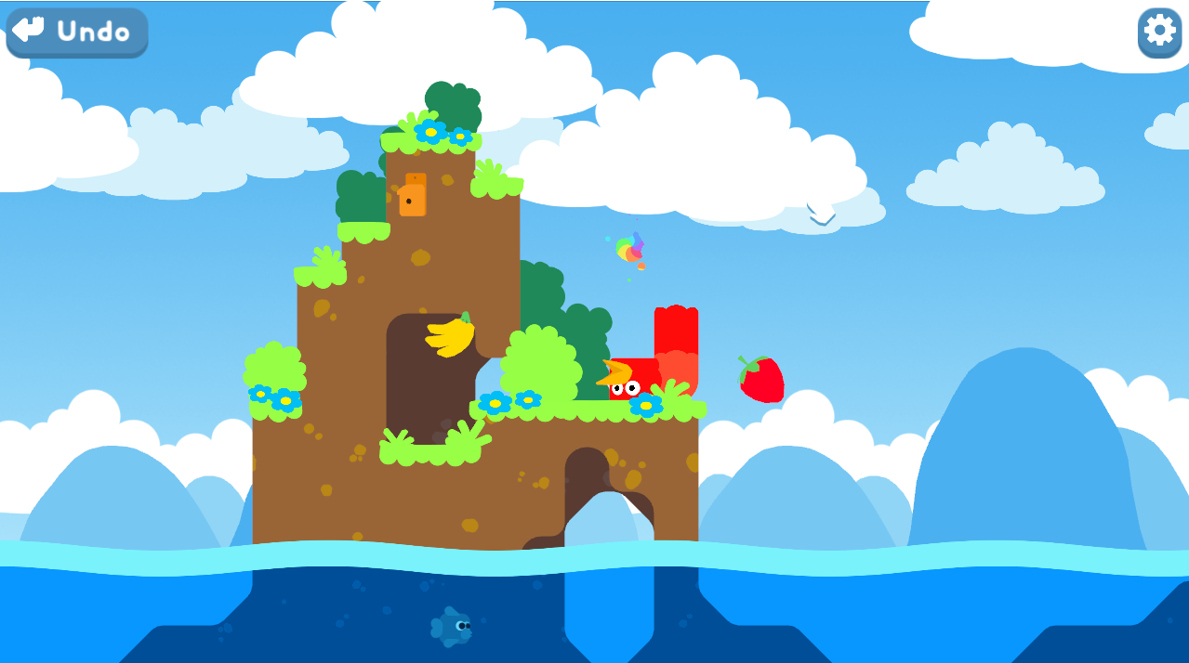
Game with Undo and Tool Buttons

Slide 10
Miscellaneous
No score, just moving up levels
No player manual
Learn tricks, moves from first levels
No bugs detected
Special Features
Over 50 levels
Non-linear world map
Several zones, each with unique themed puzzles

Slide 11
Artwork
Created with Unity 4.6.x
3D but made to look 2D
Scenes are simple and calming with soft colors
Only flat colors and sharp edges
No blending
Link to artwork details: http://noumenongames.com/the-art

Slide 12
Sound Track
Music by Carl Karjalainen
Song Titles:
Small World
Take a Stroll
Down Below
Sokosnake
Up Above
Snowman’s Land
Space Maze
The Void
All the Fruit in the World

Slide 13
Game Review
What is fun?
Logical challenge of
Manipulating snakebirds
Determining order of operations
Each level has new challenges
What wasn’t fun?
Nothing.
Comparison with other puzzles
More enjoyable
Appropriate audience
All ages 6 and above
Logic challenge
Design mistakes?
None found.

Slide 14
Summary
Strengths of this logical puzzle
Each level introduces different tactics to solve the problem
How to manipulate the body of the snakebird over, around an obstacle
How to manipulate multiple snakebirds to reach the portal
Its you and the puzzle, no team effort
Easy mechanics
Simple but challenging
Graphics are simple, cute and pleasant

Slide 15
Summary, continued
Weaknesses:
Can be too challenging to some
Could be marketed better to reach larger audience
It is definitely worth buying because of the challenges.
The design and implementation of the game is right on target.
Link to youtube demo: https://www.youtube.com/watch?v=7HVWUxKQmdU

