Slide 1
Game Evaluation
Michael Awada

Slide 2
Rocket League Publisher & Developer: Psyonix Designer Corey Davis
Platform and Price: Playstation PS4 $32.75
Microsoft XBOX1 $24.99
PC/Mac/Steam $19.99
Sequel to:
Supersonic Acrobatic
Rocket Powered
Battle Cars

Slide 3
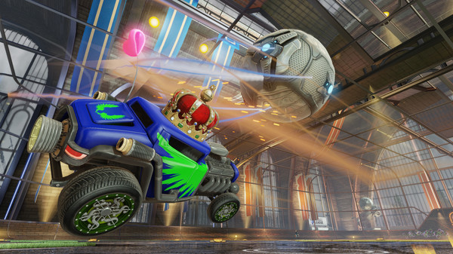
Gameplay “Soccer 101”
Single or Multi player
Online or Offline gameplay
Up to 8 players on a field
Assigned to a team if individual game player
Pushing or hitting the ball into the goal
Timed Match - Draws lead to a Sudden Death Match

Slide 4
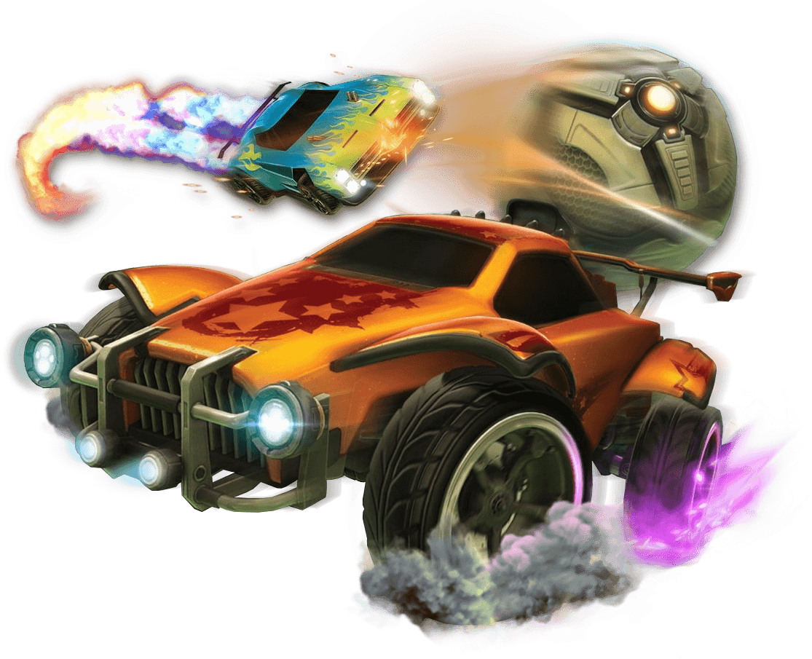
Game Summary
Player's Role
Quick Overview
Each player is equipped in a booster vehicle.
Control the vehicles and hit the ball in the goal
Able to flip, jump, and speed boost the vehicle to score
Soccer meets driving
Soccer combined with demolition derby -- Futuristic
Sports-Action Game
Matches are 5 mins each
Dome Arena – 2 teams
Rocket League Modes & Mutators
Season Mode - 4 vs 4 - 3 vs 3 - 2 vs 2 - 1 vs 1 -
Rumble Mode(random power ups) - Exhibition - Ice Hockey - Hoops -
and more

Slide 5
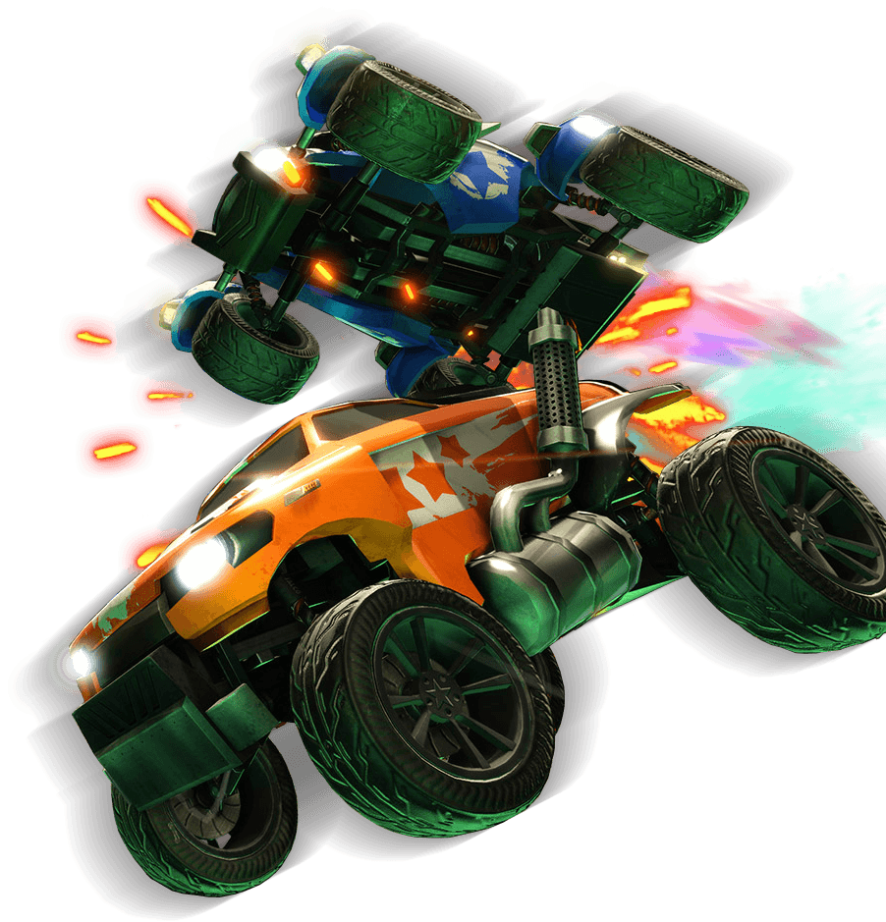
Cross-play and Users
One of the first games to start cross-play with networks
Released Microsoft Windows and PS4 in July 2015
PS4/ PC
XBOX1/PC
6 Million sales across all platforms
18 Million unique users after a year in its first year

Slide 6
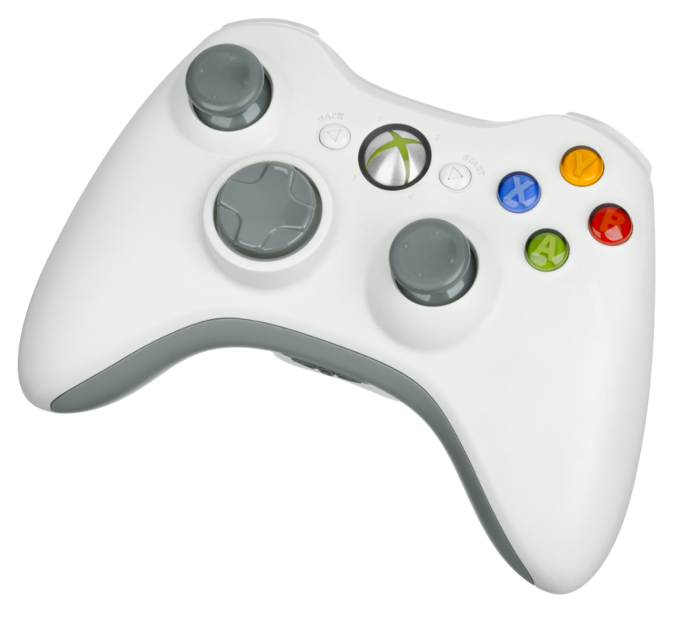
Requirements
Online Requirements
Broadband Internet Connection
Enables the online play with other players across the world.
Hardware Requirement
PS4 - Console and Game
XBOX1 - Console and Game
PC Windows - Windows 7 +
2GB RAM
Mac OS X - 10.8.5 +
8GB Ram
PC Processor: 2.4 GHz
Storage Space - 5GB
Optional Controller for Gameplay -- Recommended

Slide 7
Customizing “Express Yourself”
More than 10 billion combinations
Unlockable items and vehicles
(Rocket Trails, Toppers, Antennas, Decals, Car Bodies, and Wheels)

Slide 8
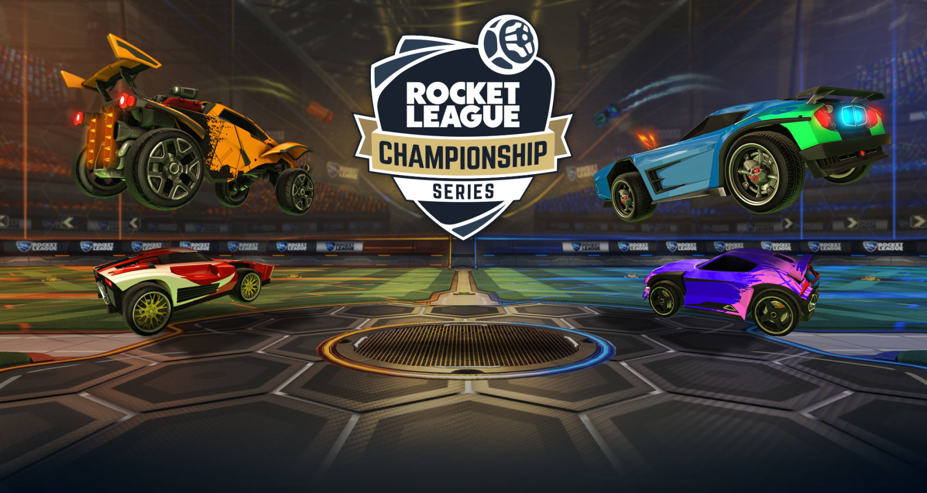
Professional Gameplay
Adopted as an eSport
Professional players through ESL and Major League Gaming
Prize pools estimated to $255,000 this year increase from $55,000 from 2015

Slide 9
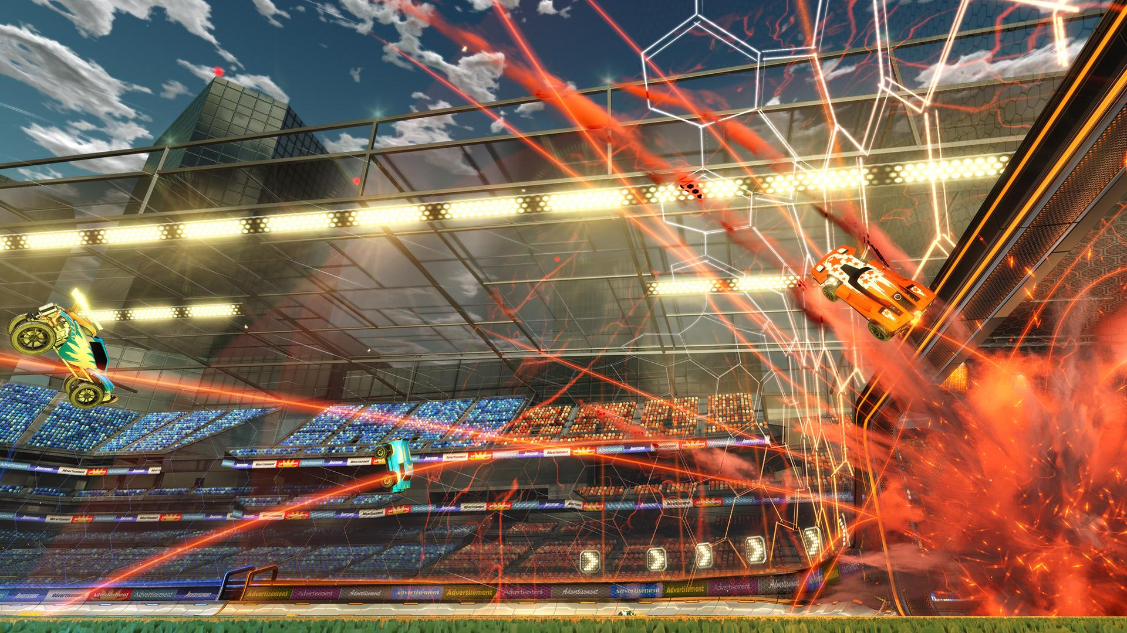
What is good(fun) about the Game?
Endless Options of Gameplay
New Maps
New Mutations
New Competition
Rankings – Sense of winning
Unlocking items, and
General
Demolition Derby and Soccer combined.
Twisted Metal with Soccer
Destroying or Exploding cars
Crazy Goals and Highlights

Slide 10
Ratings / Awards

Slide 11
Is it Worth it?
Review
Different from the norm
Pickup and play
Endless fun - Always new updates
Cheap

